Slide 1
Nineteenth Sunday after Pentecost
Year C
Jeremiah 31:27-34 and Psalm 119:97-104 • Genesis 32:22-31 and Psalm 121 • 2 Timothy 3:14-4:5 • Luke 18:1-8

Slide 2
… this is the covenant that I will make …says the LORD:
I will put my law within them, and I will write it on their hearts; and I will be their God, and they shall be my people.
Jeremiah 31:33ac

Slide 3
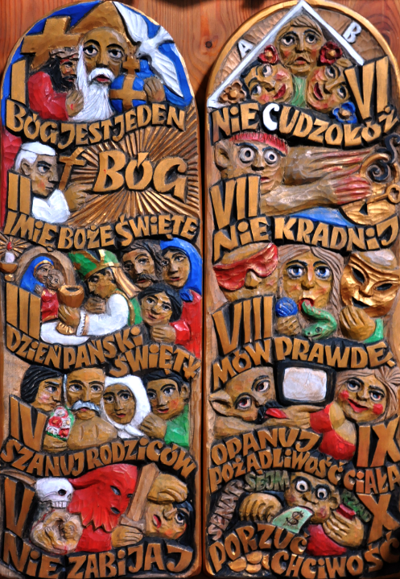
Ten Commandments
From a Catholic Church in
Paszyn, Poland

Slide 4
How sweet are your words to my taste, sweeter than honey to my mouth!
Through your precepts I get understanding; therefore I hate every false way.
Psalm 119:103-104

Slide 5
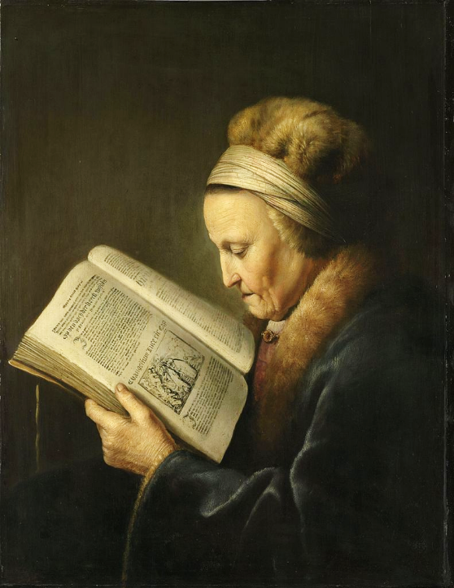
Old Woman Reading the Bible
Gerrit Dou
Rijksmuseum
Amsterdam, Netherlands

Slide 6
Jacob was left alone; and a man wrestled with him until daybreak.
Genesis 32:24

Slide 7
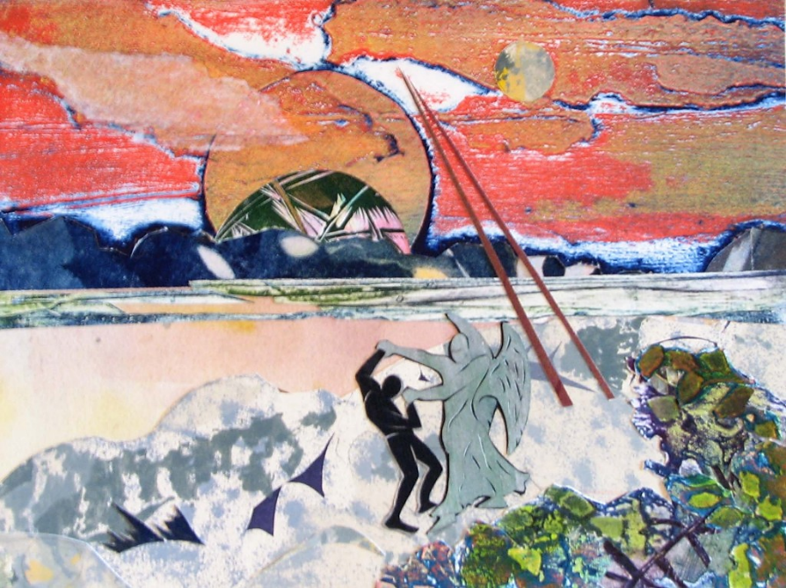
Jacob and the Angel -- Annette Gandy Fortt, Silver Spring, MD

Slide 8
When the man saw that he did not prevail against Jacob, he struck him on the hip socket; and Jacob's hip was put out of joint as he wrestled with him.
Genesis 32:25

Slide 9
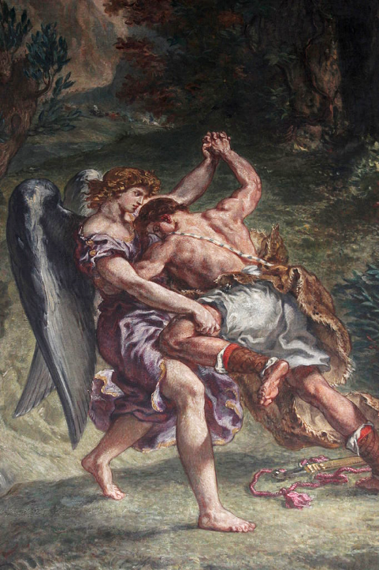
Jacob Wrestles with the Angel, detail
Church of Saint-Sulpice
Paris, France

Slide 10
Then the man said, "You shall no longer be called Jacob, but Israel, for you have striven with God and with humans, and have prevailed."
Genesis 32:28

Slide 11
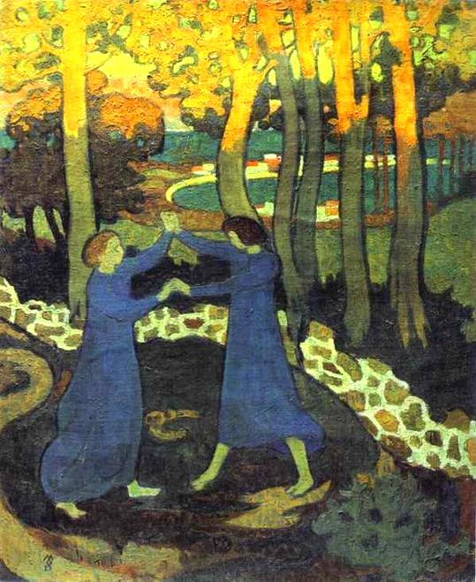
Jacob Wrestles the Angel
Maurice Denis
c. 1893

Slide 12
I lift up my eyes to the hills-- from where will my help come?
My help comes from the LORD, who made heaven and earth.
Psalm 121:1-2

Slide 13
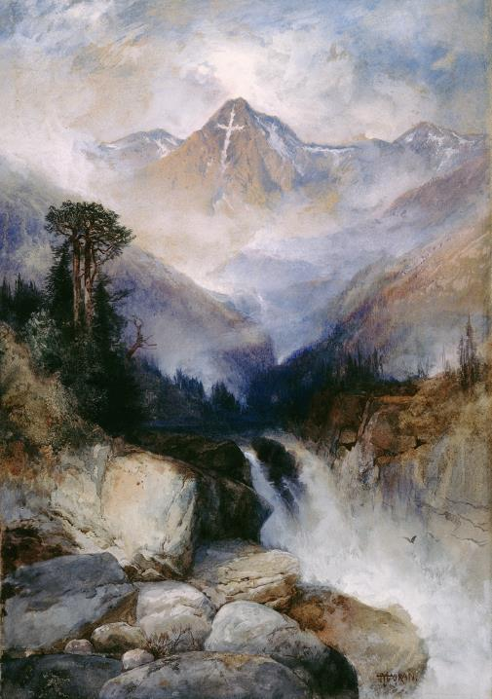
Mountain of the Holy Cross
Thomas Moran
National Gallery of Art
Washington, DC

Slide 14
He will not let your foot be moved; he who keeps you will not slumber.
He who keeps Israel will neither slumber nor sleep.
Psalm 121:3-4

Slide 15
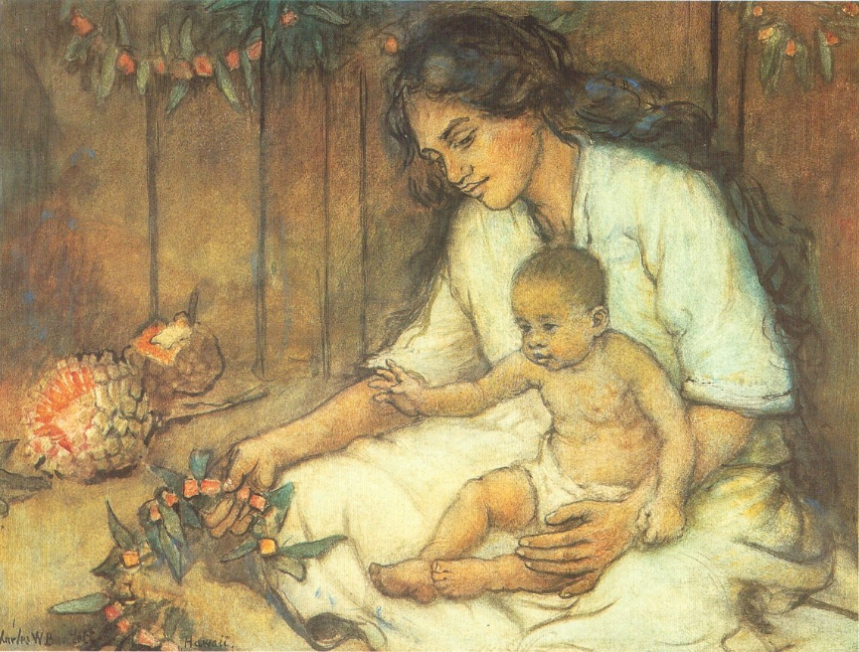
Hawaiian Mother and Child -- Charles Bartlett, c. 1920, watercolor

Slide 16
The LORD is your keeper; the LORD is your shade at your right hand.
The sun shall not strike you by day, nor the moon by night.
Psalm 121:5-6

Slide 17
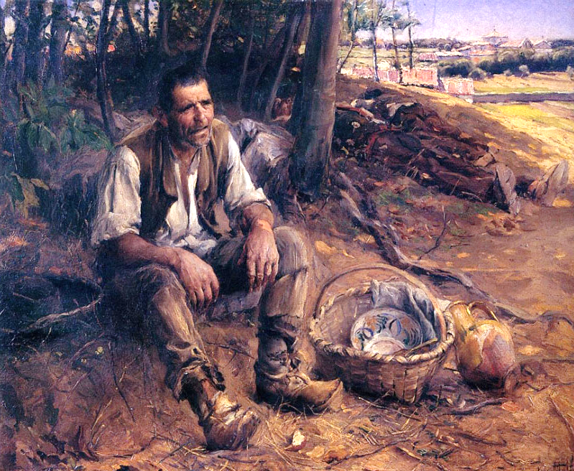
The Siesta -- Jose Malhoa, Museu Nacional de Belas Artes, Rio de Janiero, Brazil

Slide 18
The LORD will keep you from all evil; he will keep your life.
The LORD will keep your going out and your coming in from this time on and forevermore.
Psalm 121:7-8

Slide 19
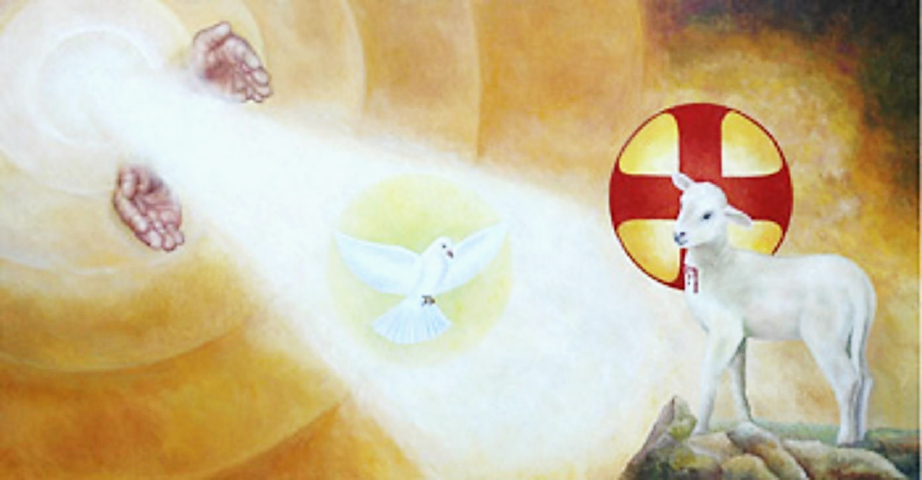
Hands of God, the Holy Spirit, and Lamb of Christ -- Church of the Holy Trinity, Caaupe, Paraguay

Slide 20
All scripture … is useful for teaching … and for training in righteousness, so that everyone who belongs to God may be proficient, equipped for every good work.
2 Timothy 3:16ac, 17

Slide 21
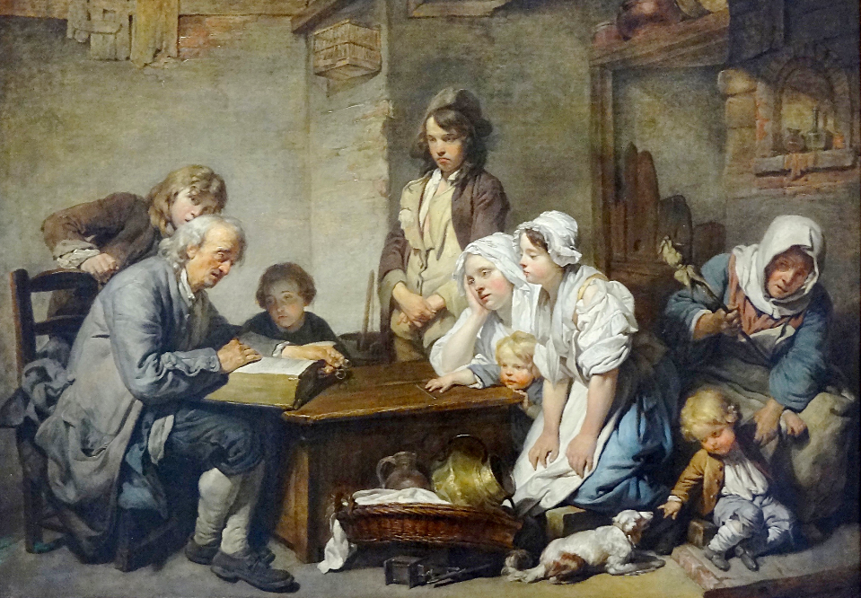
Reading the Bible -- Jean-Baptiste Greuze, Louvre Museum, Paris, France

Slide 22
"… there was a judge who neither feared God nor had respect for people … there was a widow who kept coming to him and saying, 'Grant me justice against my opponent.'
Luke 18:2b, 3b

Slide 23
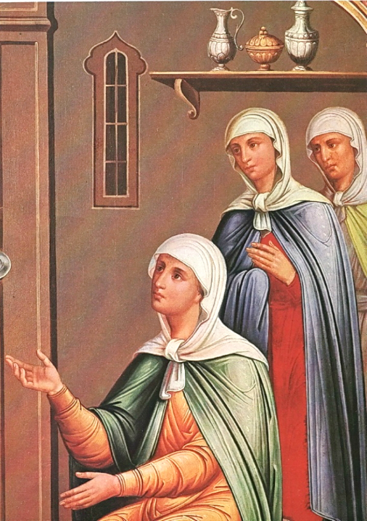
Parable of the Widow and the Unjust Judge, detail
The Kremlin Moscow, Russia

Slide 24
For a while he refused; but later he said to himself, 'Though I have no fear of God and no respect for anyone, yet because this widow keeps bothering me, I will grant her justice … '"
Luke 18:4, 5a

Slide 25
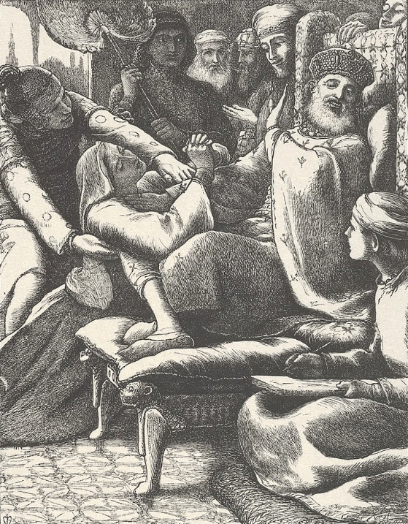
The Unjust Judge and the Importunate Widow
John Everett Millais
Metropolitan Museum of Art
New York, NY

Slide 26
And will not God grant justice to his chosen ones who cry to him day and night? I tell you, he will quickly grant justice to them."
Luke 18:7a, 8a

Slide 27
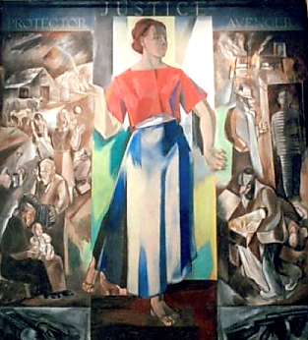
Justice as Protector
S. Hirsch, C. Simmons
Federal Courthouse
Aiken, SC

Slide 28
Credits
New Revised Standard Version Bible, copyright 1989, Division of Christian Education of the National Council of the Churches of Christ in the United States of America. Used by permission. All rights reserved.
http://www.flickr.com/photos/feargal/5096148585/
https://commons.wikimedia.org/wiki/File:Gerard_Dou_005.jpg
annettefortt.com
https://commons.wikimedia.org/wiki/File:Delacroix_Jacob_02.JPG
https://commons.wikimedia.org/wiki/File:Jacob_Wrestling_with_the_Angel_by_Maurice_Denis.jpg
https://commons.wikimedia.org/wiki/File:Thomas_Moran,_Mountain_of_the_Holy_Cross,_1890._Watercolor,_National_Gallery_of_Art,_Washington,.jpg
https://commons.wikimedia.org/wiki/File:Charles_W._Bartlett_-_%27Hawaiian_Mother_and_Child%27,_watercolor_and_pastel_on_art_board,_c._1920.jpg
https://commons.wikimedia.org/wiki/File:Jos%C3%A9_Malhoa_-_A_sesta,_1909.JPG
https://commons.wikimedia.org/wiki/File:Berazategui-Caacupe-Poliptico-Trinidad.jpg
https://www.flickr.com/photos/125149010@N07/38719333905 - Grégory Lejeune
https://commons.wikimedia.org/wiki/File:Parable_of_the_Unjust_Judge_(Granovitaya_palata,_1881-2)_4.jpg – Brothers Belusov
https://commons.wikimedia.org/wiki/File:The_Unjust_Judge_and_the_Importunate_Widow_(The_Parables_of_Our_Lord_and_Saviour_Jesus_Christ)_MET_DP835791.jpg – Dalziel Brothers
https://commons.wikimedia.org/wiki/File:JusticeAsProtectorAndAvenger.png
Additional descriptions can be found at the Art in the Christian Tradition image library, a service of the Vanderbilt Divinity Library, http://diglib.library.vanderbilt.edu/. All images available via Creative Commons 3.0 License.

