Slide 1
Seventeenth Sunday after Pentecost
Year C
Lamentations 1:1-6 and Lamentations 3:19-26 or Psalm 137 Habakkuk 1:1-4; 2:1-4 and Psalm 37:1-9 • 2 Timothy 1:1-14 Luke 17:5-10

Slide 2
How lonely sits the city that once was full of people! … She that was a princess … has become a vassal. She weeps bitterly in the night, with tears on her cheeks;
Lamentations 1:1ac, 2a

Slide 3
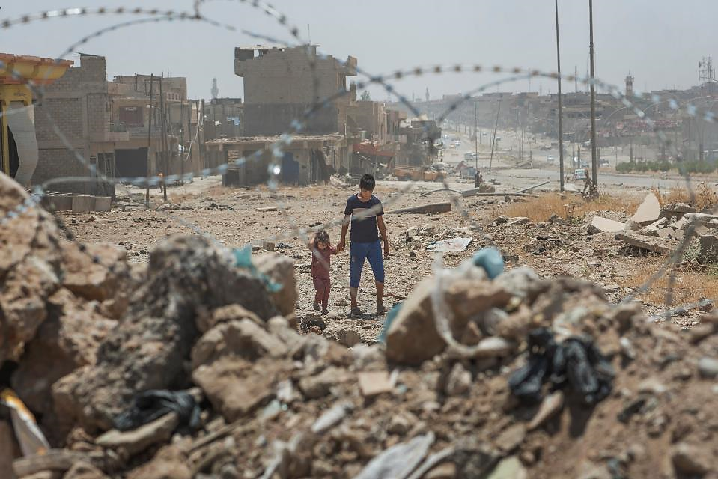
Brother and Sister Walk in War-torn Mosul, Iraq -- EU Civil Protection Service, 2017

Slide 4
By the rivers of Babylon-- there we sat down and there we wept when we remembered Zion.
Psalm 137:1

Slide 5
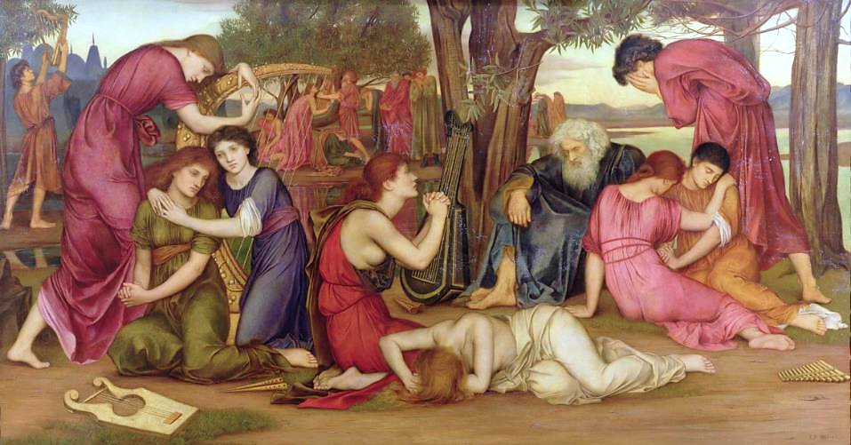
"By the Waters of Babylon", Psalm 137 -- Evelyn de Morgan, De Morgan Foundation, UK

Slide 6
Look at the proud! Their spirit is not right in them, but the righteous live by their faith.
Habakkuk 2:4

Slide 7
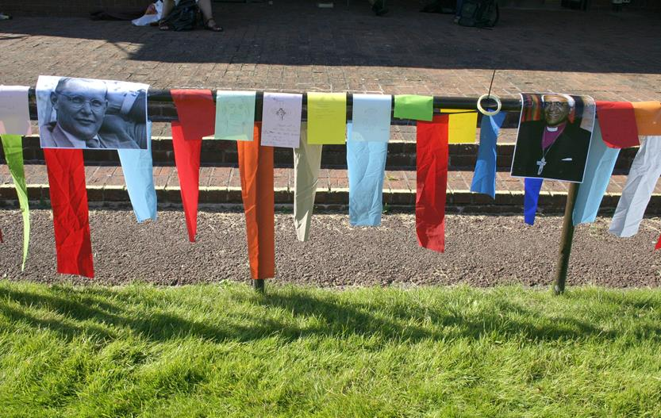
"Placing yourself in god's story, among the heroes of the faith (Niebhur, Tutu…)
Emerging Church Festival, Cheltenham, England

Slide 8
Be still before the LORD, and wait patiently for him; do not fret over those who prosper in their way, over those who carry out evil devices.
Psalm 37:7

Slide 9
Fruit of the Spirit: Patience -- Nutmeg Designs and Susan Halstead

Slide 10
I am reminded of your sincere faith, a faith that lived first in your grandmother Lois and your mother Eunice and now, I am sure, lives in you.
2 Timothy 1:5

Slide 11
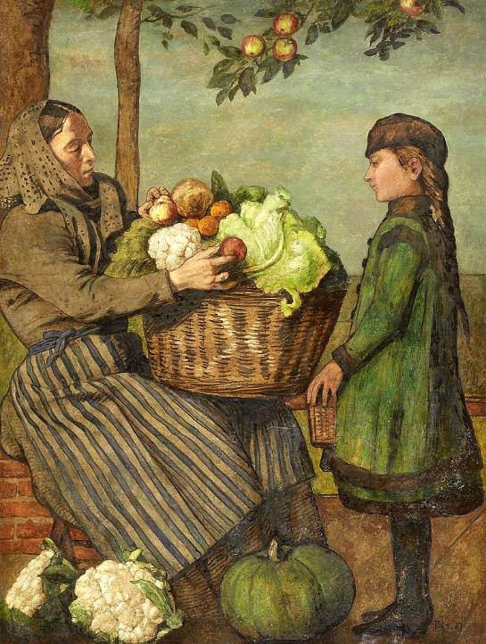
Grandmother and Granddaughter with a Vegetable Basket
Hans Thoma
Van Ham Gallery

Slide 12
… God did not give us a spirit of cowardice, but rather a spirit of power and of love and of self-discipline.
2 Timothy 1:7

Slide 13
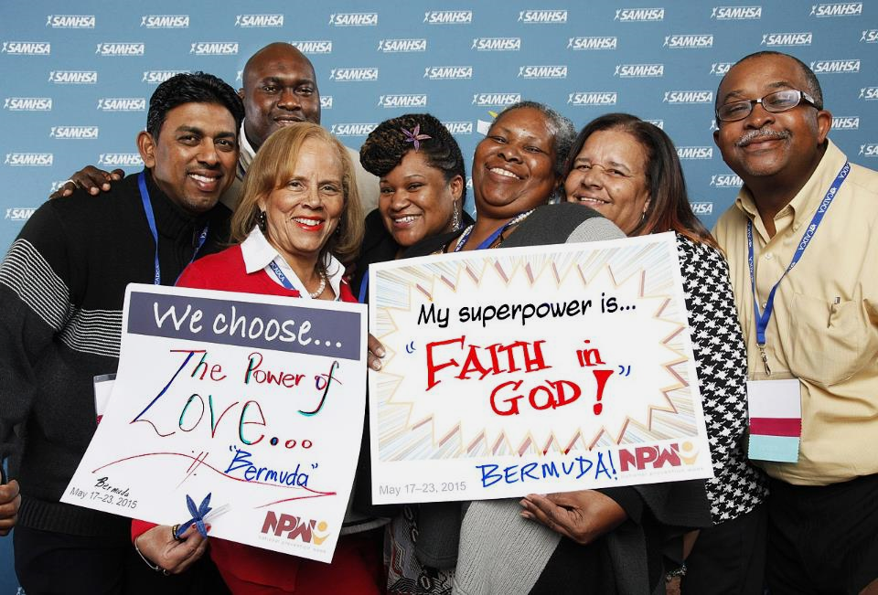
The Power of Love -- SAMSHA, Rockville, MD

Slide 14
The apostles said to the Lord, "Increase our faith!"
Luke 17:5

Slide 15
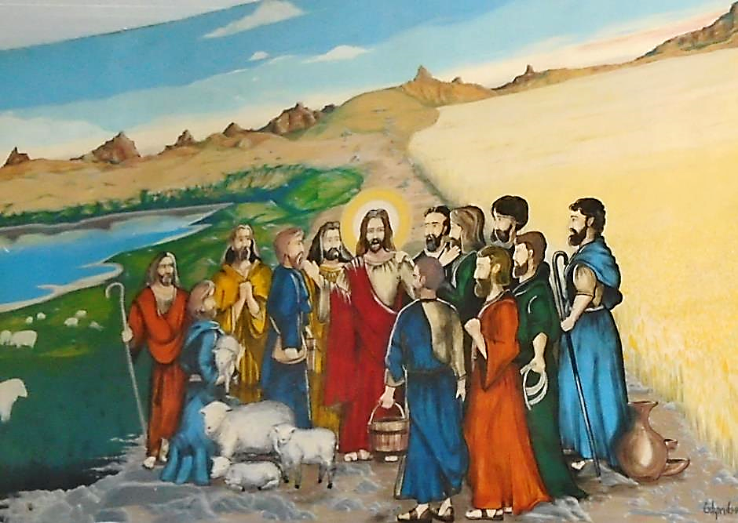
Christ with the Apostles -- Mural, Catedral São Francisco Xavier (Joinville, Brasil)

Slide 16
The Lord replied, "If you had faith the size of a mustard seed, you could say to this mulberry tree, 'Be uprooted and planted in the sea,' and it would obey you.
Luke 17:6

Slide 17
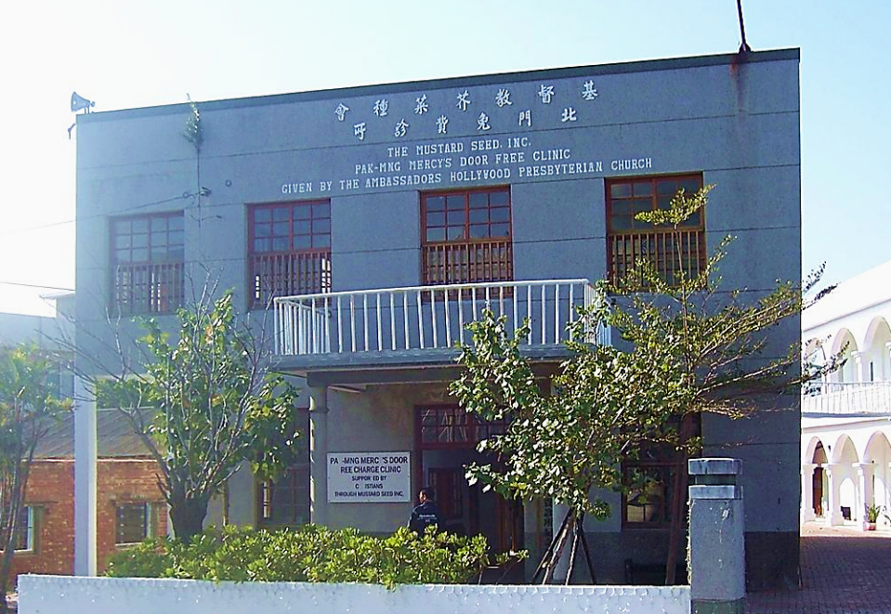
"Mustard Seed" Free Clinic -- Beimen, Taiwan

Slide 18
"Who among you would say to your slave who has just come in from plowing or tending sheep … 'Come here at once and take your place at the table'?
Luke 17:7ac

Slide 19
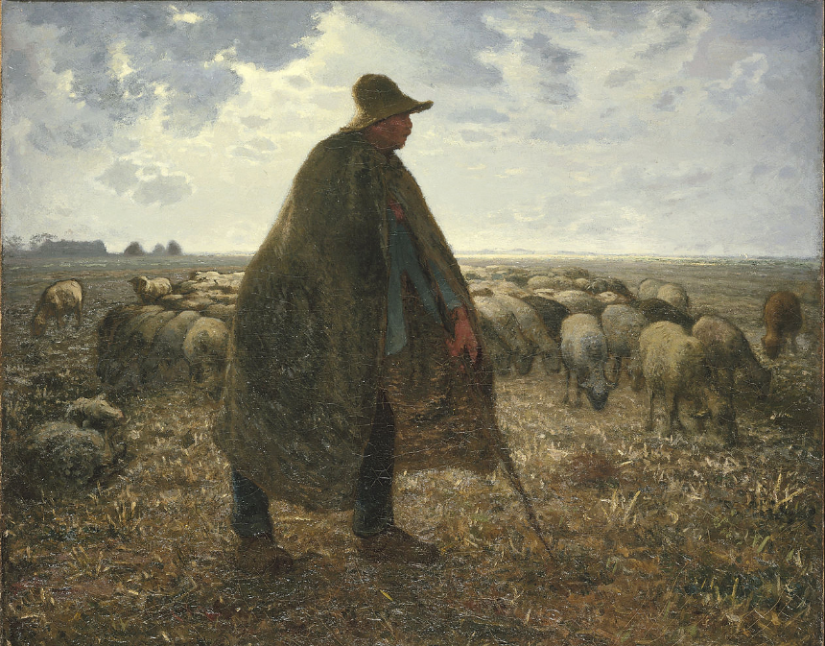
Shepherd Tending His Flock -- Jean-François Millet, Brooklyn Museum, New York, NY

Slide 20
Would you not rather say to him, 'Prepare supper for me, put on your apron and serve me while I eat and drink; later you may eat and drink'?
Luke 17:8

Slide 21
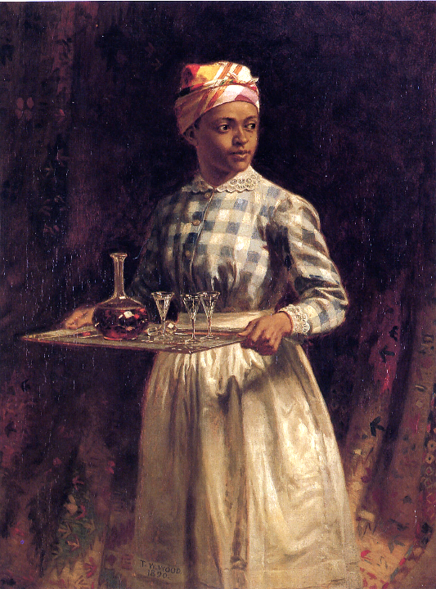
Sherry, Sir?
Thomas Waterman Wood Detroit Institute of the Arts
Detroit, MI

Slide 22
Do you thank the slave for doing what was commanded?"
Luke 17:9

Slide 23
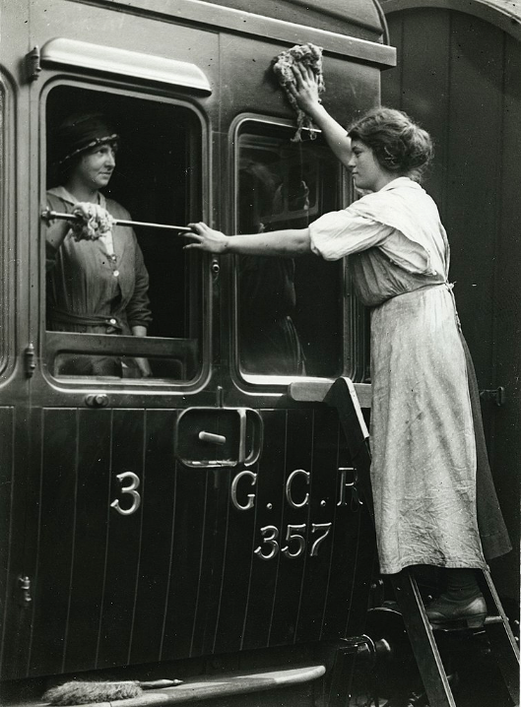
Railway Car Cleaners, World War I
University of British Columbia Library
Vancouver, Canada

Slide 24
Credits
New Revised Standard Version Bible, copyright 1989, Division of Christian Education of the National Council of the Churches of Christ in the United States of America. Used by permission. All rights reserved.
https://www.flickr.com/photos/eu_echo/35269738911/
https://commons.wikimedia.org/wiki/File:By_the_Waters_of_Babylon_(1882-1883).jpg
http://www.flickr.com/photos/smallritual/1280581974/
https://www.flickr.com/photos/nutmegdesigns/6209238865
https://commons.wikimedia.org/wiki/File:Hans_Thoma_Gro%C3%9Fmutter_und_Enkelin_mit_einem_Gem%C3%BCsekorb.jpg
https://commons.wikimedia.org/wiki/File:We_choose...the_Power_of_Love..._%22Bermuda%22_My_superpower_is...%22Faith_in_God!%22_(18135909606).jpg
https://commons.wikimedia.org/wiki/File:Catedral_S%C3%A3o_Francisco_Xavier_(Joinville,_Brasil)_38.JPG
https://commons.wikimedia.org/wiki/File:The_Mustard_Seed._Inc._Pak-mng_Free_Clinic.jpg
https://commons.wikimedia.org/wiki/File:Jean-Fran%C3%A7ois_Millet_-_Shepherd_Tending_His_Flock_-_Google_Art_Project.jpg
http://www.flickr.com/photos/freeparking/2224821427/
https://commons.wikimedia.org/wiki/File:Railway_workers_cleaning_carriages_(15379867136).jpg
Additional descriptions can be found at the Art in the Christian Tradition image library, a service of the Vanderbilt Divinity Library, http://diglib.library.vanderbilt.edu/. All images available via Creative Commons 3.0 License.

