Slide 1
Fifteenth Sunday after Pentecost
Year C
Jeremiah 8:18-9:1 and Psalm 79:1-9 • Amos 8:4-7 and Psalm 113 • 1 Timothy 2:1-7 • Luke 16:1-13

Slide 2
Is there no balm in Gilead? Is there no physician there? Why then has the health of my poor people not been restored?
Jeremiah 8:22

Slide 3
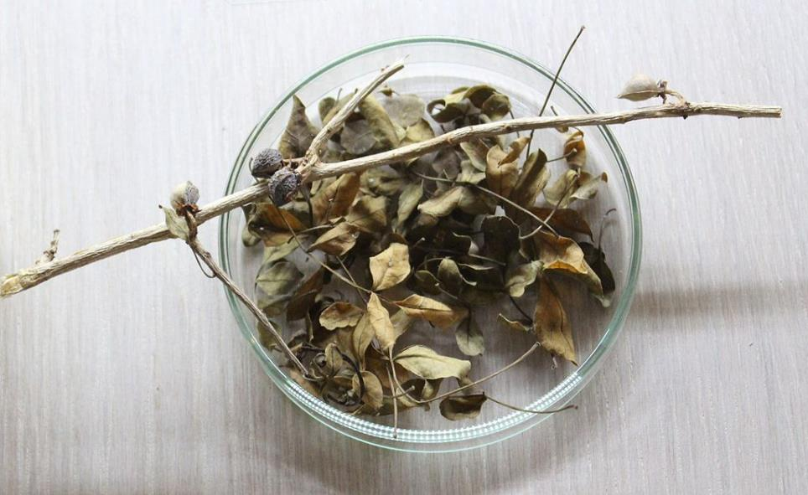
The herb "Balm of Gilead" -- from "Jerusalem: A Medical Diagnosis Exhibition", Israel

Slide 4
Help us, O God of our salvation, for the glory of your name; deliver us, and forgive our sins, for your name's sake.
Psalm 79:9

Slide 5
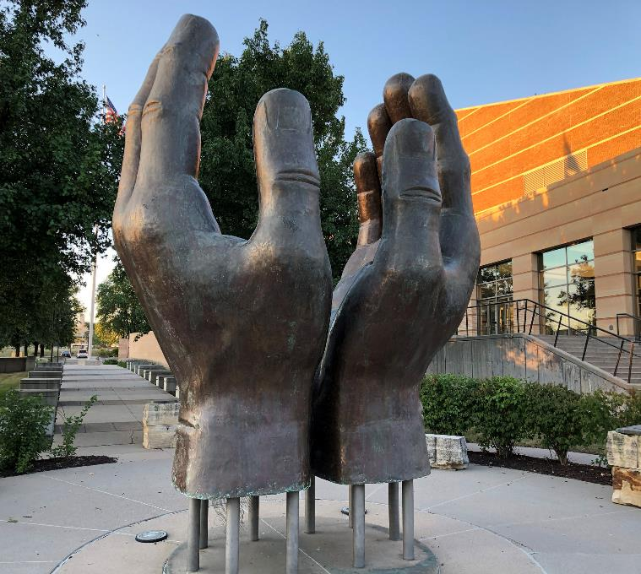
Veteran's Prayer for Eternal Peace
Des Moines,
Iowa

Slide 6
Hear this, you that trample on the needy … buying the poor for silver and the needy for a pair of sandals …"
Amos 8:4a, 6a

Slide 7
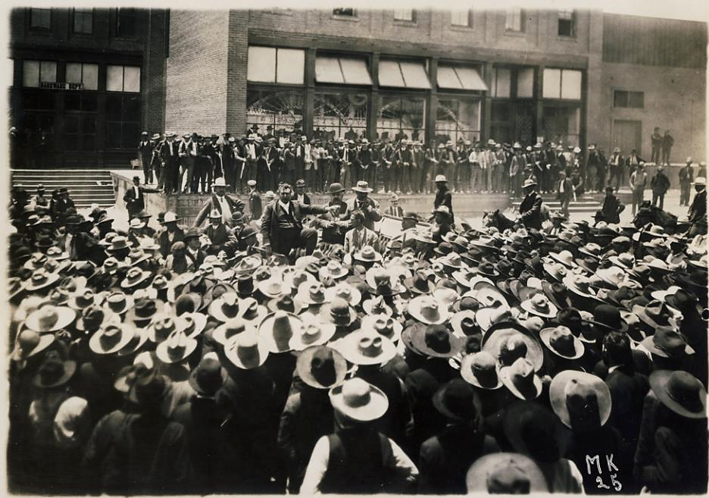
Mexican Workers During Miners' Strike, 1906, Cananea, Mexico

Slide 8
Praise the LORD! … He raises the poor from the dust, and lifts the needy from the ash heap …
Psalm 113:1a, 7

Slide 9
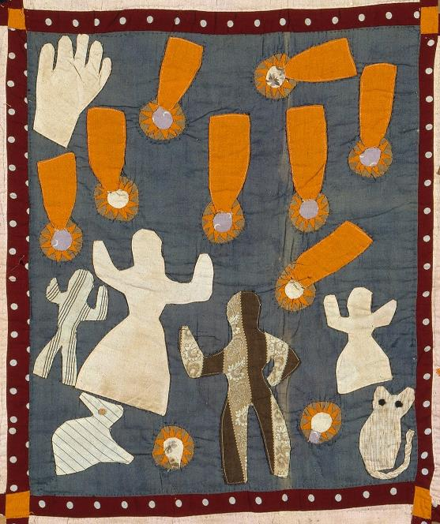
Praise the Lord – Manna from Heaven
Harriet Powers
Pictorial Quilt, section
c. 1895
Museum of Fine Arts
Boston, MA

Slide 10
… I urge that supplications, prayers, intercessions, and thanksgivings be made for … all who are in high positions, so that we may lead a quiet and peaceable life in all godliness and dignity.
1 Timothy 2:1a, 2

Slide 11
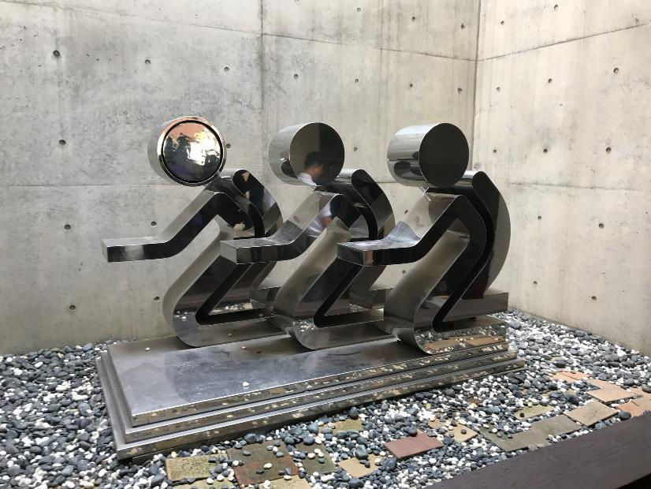
Prayer Sculpture, Kipun (Joyful) Methodist Church, Pyeongtaek, South Korea

Slide 12
Then Jesus said to the disciples, "There was a rich man who had a manager, and charges were brought to him that this man was squandering his property.
Luke 16:1

Slide 13
So he summoned him and said to him, 'What is this that I hear about you? Give me an accounting of your management …
Luke 16:2a

Slide 14
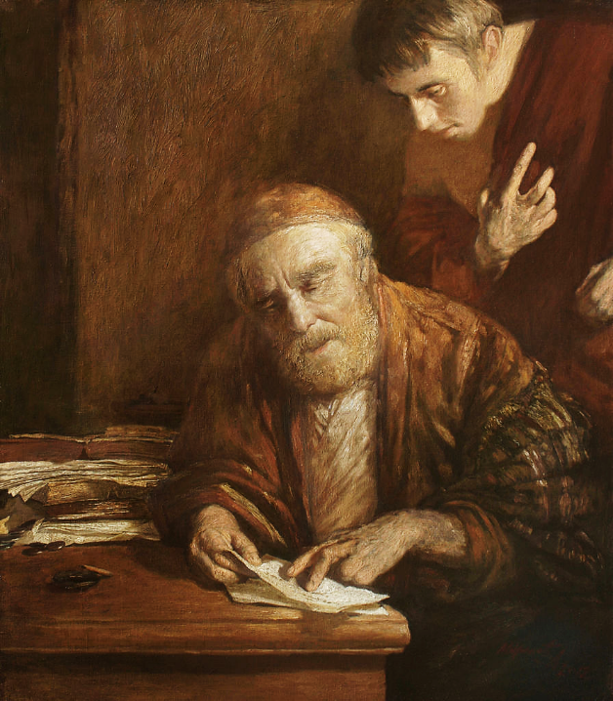
?
Parable of the Unjust Steward
Andrey Mironov
Oil painting, 2012

Slide 15
"Whoever is faithful in a very little is faithful also in much; and whoever is dishonest in a very little is dishonest also in much.
Luke 16:10

Slide 16
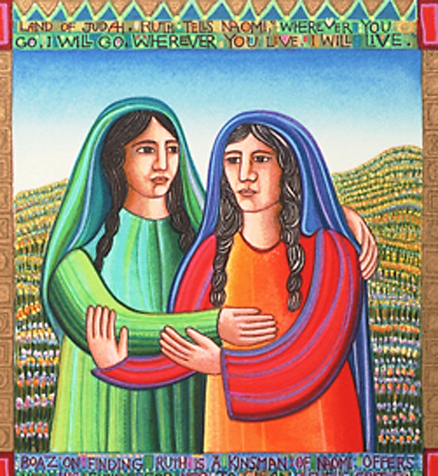
Ruth Stays with Naomi -- John August Swanson, serigraph, 1991

Slide 17
Always Faithful -- Mural, Oakland, CA

Slide 18
You cannot serve God and wealth."
Luke 16:13b

Slide 19
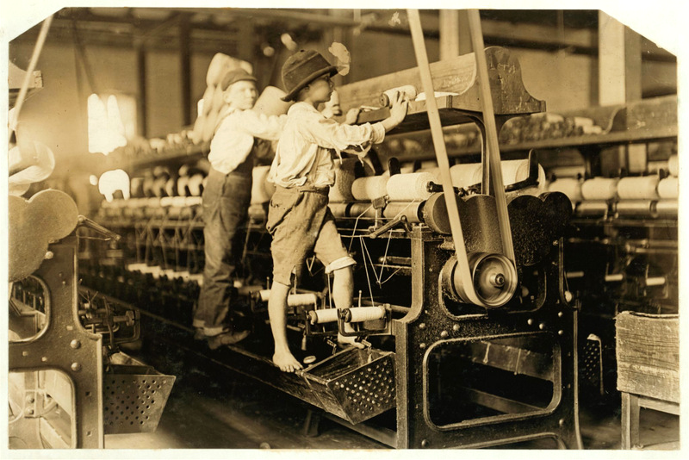
Mill Children in Macon, Georgia -- Lewis Hine, 1909, Library of Congress, Washington, DC

Slide 20
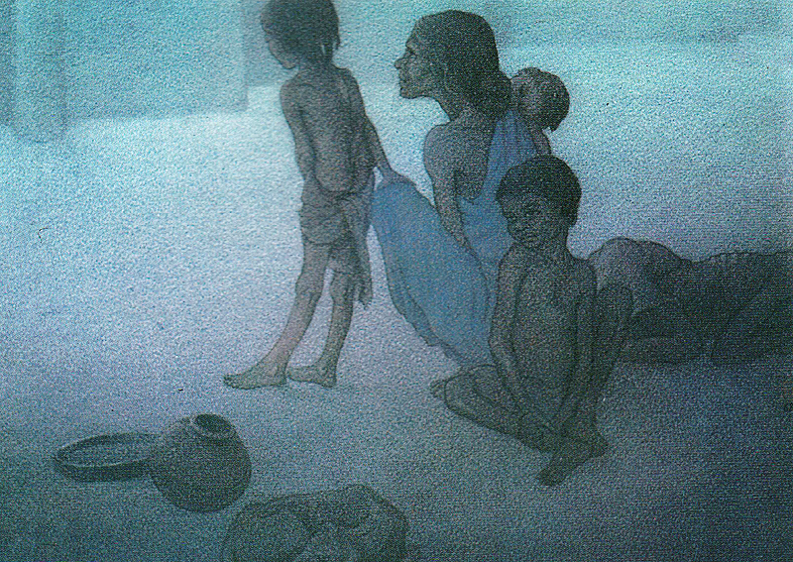
Did You Eat Today? -- Frank Wesley

Slide 21
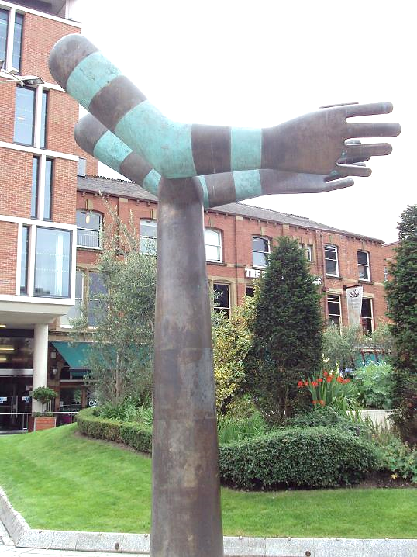
Helping Hands
Nelson Mandela Gardens
Leeds, England

Slide 22
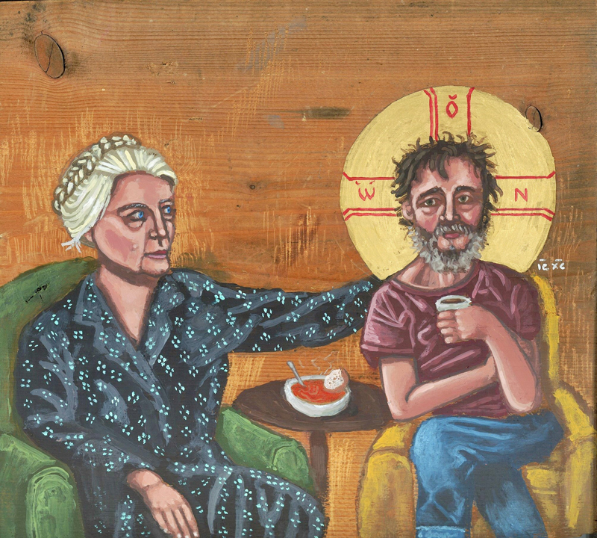
Dorothy Day and Homeless Christ
Kelly Latimore

Slide 23
Credits
New Revised Standard Version Bible, copyright 1989, Division of Christian Education of the National Council of the Churches of Christ in the United States of America. Used by permission. All rights reserved.
https://commons.wikimedia.org/wiki/File:Balm_of_Gilead_IMG_9781.JPG
https://www.flickr.com/photos/vanhoosear/44400574732 - Todd Van Hoosear
https://commons.wikimedia.org/wiki/File:Colonel_William_C._Greene_with_arm_outstretched_addressing_a_crowd_of_Mexican_workers_during_miners%27_strike,_1906,_Cananea,_Mexico_(4050919576).jpg
https://commons.wikimedia.org/wiki/File:Harriet_Powers_-_Pictorial_quilt_-_Google_Art_Project.jpg
https://www.flickr.com/photos/pbogs/36527854604/ - Bo Gordy-Stith
https://commons.wikimedia.org/wiki/File:%D0%9F%D1%80%D0%B8%D1%82%D1%87%D0%B0_%D0%BE_%D0%BD%D0%B5%D0%B2%D0%B5%D1%80%D0%BD%D0%BE%D0%BC_%D1%83%D0%BF%D1%80%D0%B0%D0%B2%D0%B8%D1%82%D0%B5%D0%BB%D0%B5._%D0%9A%D0%B0%D1%80%D1%82%D0%B8%D0%BD%D0%B0_XXI_%D0%B2%D0%B5%D0%BA%D0%B0..jpg
www.JohnAugustSwanson.com - copyright 1991 by John August Swanson
https://www.flickr.com/photos/phunk/4944470686 - Steve Rotman
http://commons.wikimedia.org/wiki/File:Mill_Children_in_Macon.jpg
Estate of Frank Wesley, http://www.frankwesleyart.com/main_page.htm
https://commons.wikimedia.org/wiki/File:Helping_Hands_sculpture,_Mandela_Gardens,_Leeds_-_DSC07711.JPG
Kelly Latimore Icons, https://kellylatimoreicons.com/
Additional descriptions can be found at the Art in the Christian Tradition image library, a service of the Vanderbilt Divinity Library, http://diglib.library.vanderbilt.edu/. All images available via Creative Commons 3.0 License.

