Slide 1
Fourteenth Sunday after Pentecost
Year C
Jeremiah 4:11-12, 22-28 and Psalm 14 • Exodus 32:7-14 and Psalm 51:1-10 • 1 Timothy 1:12-17 • Luke 15:1-10

Slide 2
For thus says the LORD: The whole land shall be a desolation; yet I will not make a full end.
Jeremiah 4:27

Slide 3
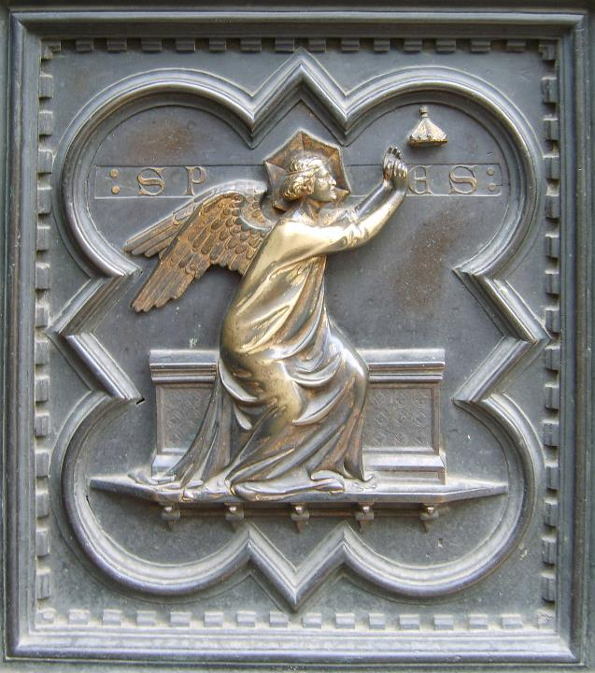
Hope
Andrea Pisano
South Doors of Florence Baptistery
Florence, Italy

Slide 4
Have they no knowledge, all the evildoers who eat up my people as they eat bread, and do not call upon the LORD?
Psalm 14:4

Slide 5
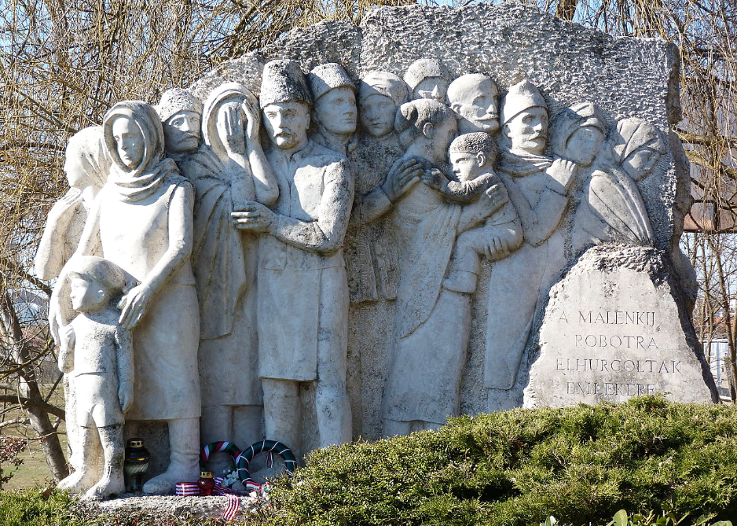
Memorial to Hungarian Forced Labor Captives after World War II -- Tomcsány Castle, Hungary

Slide 6
Your people … have been quick to turn aside from the way that I commanded them; they have cast for themselves an image of a calf, and have worshiped it …
Exodus 32:7b, 8a

Slide 7
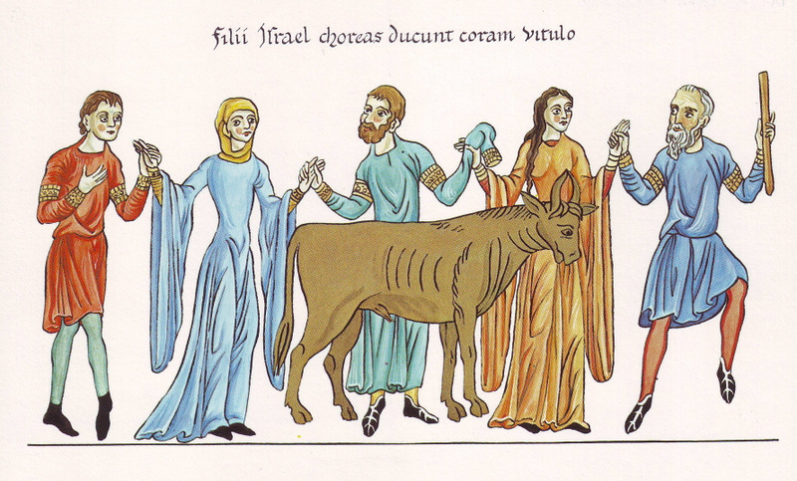
Children of Israel Dancing Around the Golden Calf -- Hortus Deliciarum, 1167

Slide 8
You desire truth in the inward being; therefore teach me wisdom in my secret heart.
Psalm 51:6

Slide 9
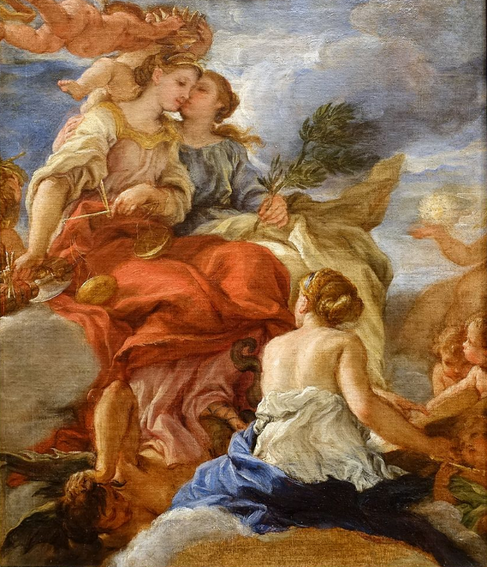
Study for Justice, Peace, and Truth
Baciccio
Blanton Museum of Art
Austin, TX

Slide 10
Create in me a clean heart, O God, and put a new and right spirit within me.
Psalm 51:10

Slide 11
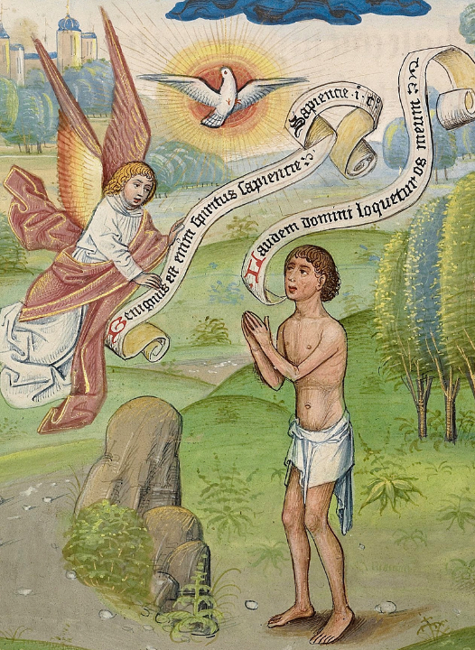
Praying to the Holy Spirit to Receive Wisdom
William Vrelant
Getty Museum
Los Angeles, CA

Slide 12
Christ Jesus came into the world to save sinners--of whom I am the foremost. But for that very reason I received mercy …
1 Timothy 1:15b, 16a

Slide 13
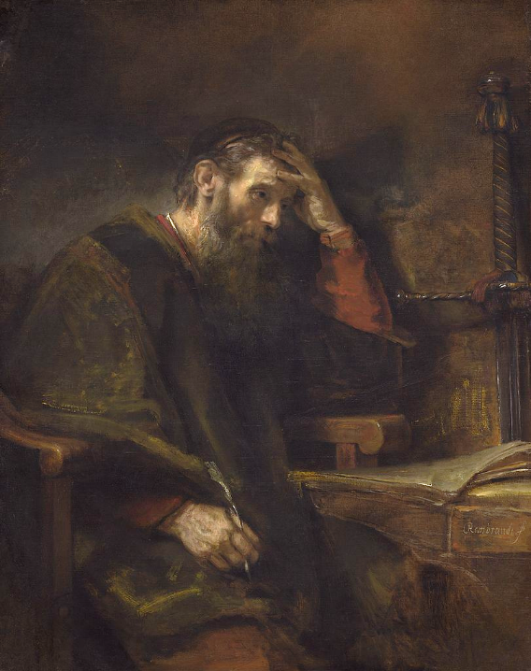
Apostle Paul
Rembrandt
National Gallery of Art
Washington, DC

Slide 14
… the Pharisees and the scribes were grumbling and saying, "This fellow welcomes sinners and eats with them." So he told them this parable:
Luke 15:2-3

Slide 15
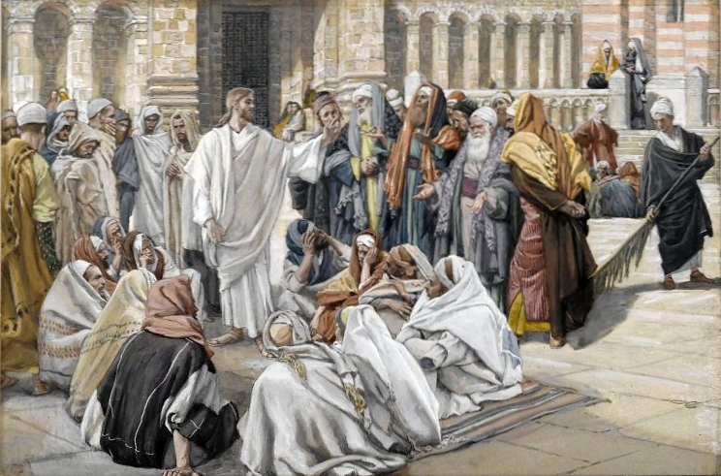
The Pharisees Question Jesus -- James Tissot, Brooklyn Museum, New York, NY

Slide 16
"Which one of you, having a hundred sheep and losing one of them, does not leave the ninety-nine in the wilderness and go after the one that is lost until he finds it?
Luke 15:4

Slide 17
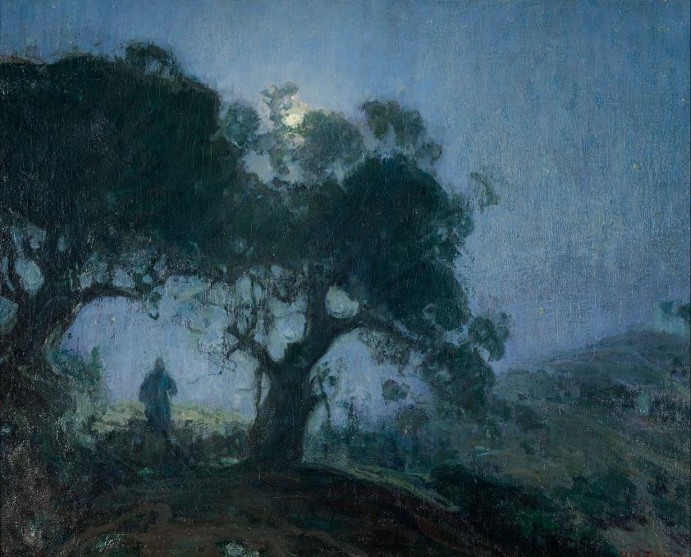
The Good Shepherd -- Henry O. Tanner, Zimmerli Art Museum, Rutgers, NY

Slide 18
When he has found it, he lays it on his shoulders and rejoices.
Luke 15:5

Slide 19
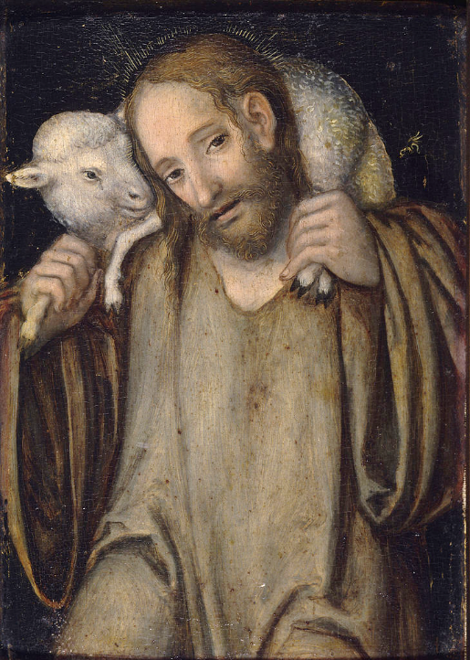
The Good Shepherd
Lucas Cranach
Anger Museum
Erfurt, Germany

Slide 20
And when he comes home, he calls together his friends and neighbors, saying to them, 'Rejoice with me, for I have found my sheep that was lost.'
Luke 15:6

Slide 21
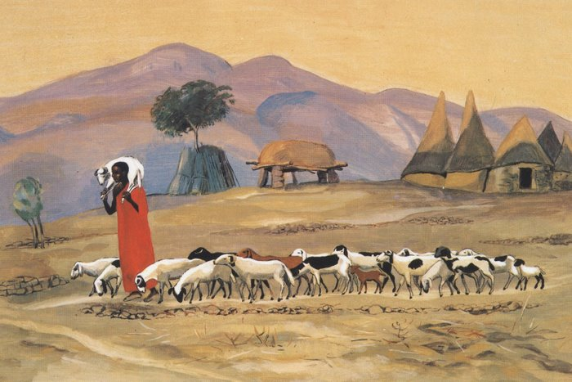
The Good Shepherd -- JESUS MAFA

Slide 22
Just so, I tell you, there will be more joy in heaven over one sinner who repents than over ninety-nine righteous persons who need no repentance.
Luke 15:7

Slide 23
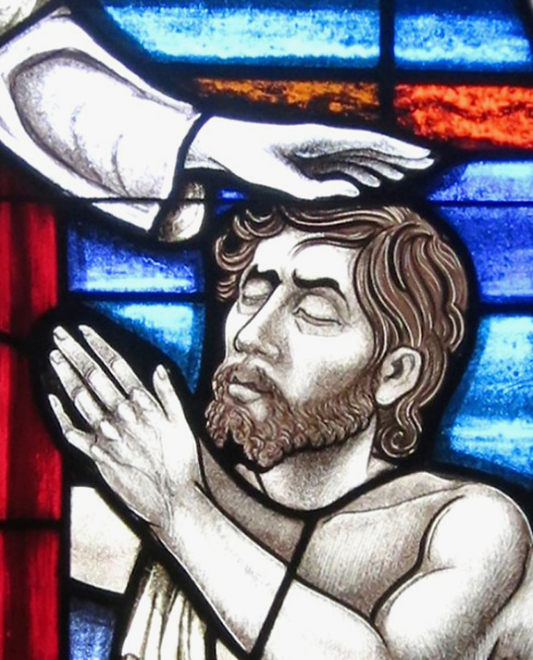
Christ, Forgive a Penitent
Church of St. Mary
Geneva, IN

Slide 24
"Or what woman having ten silver coins, if she loses one of them, does not light a lamp, sweep the house, and search carefully until she finds it?
Luke 15:8

Slide 25
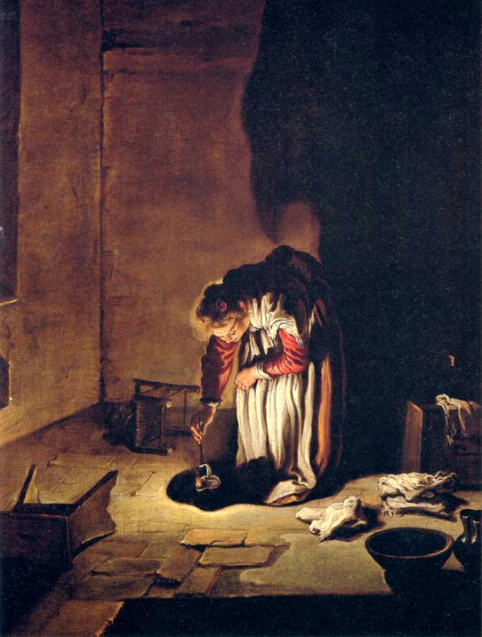
Parable of the Lost Drachma
Domenico Fetti
Old Masters Gallery
Dresden, Germany

Slide 26
When she has found it, she calls together her friends and neighbors, saying, 'Rejoice with me, for I have found the coin that I had lost.'
Luke 15:9

Slide 27
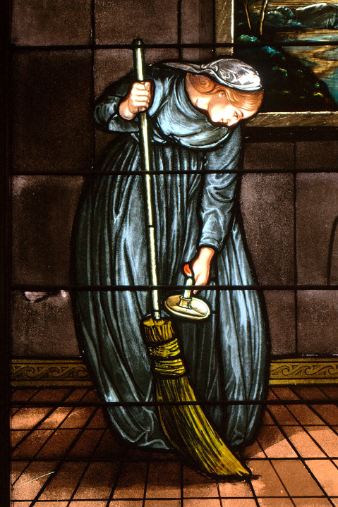
The Lost Coin is Found
Stained Glass

Slide 28
Just so, I tell you, there is joy in the presence of the angels of God over one sinner who repents."
Luke 15:10

Slide 29
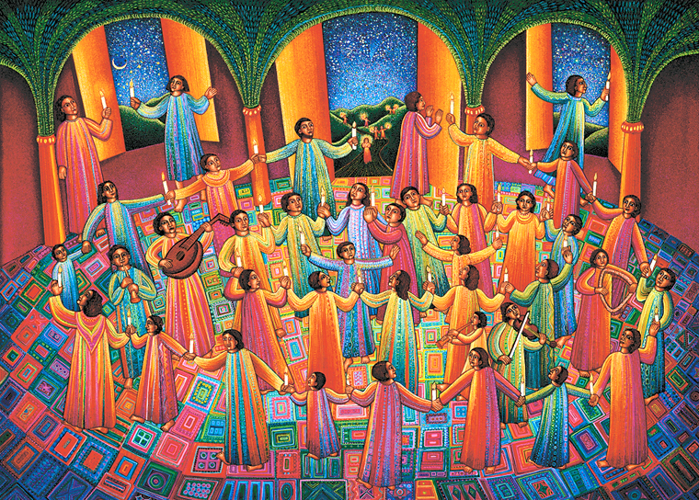
Celebration -- John August Swanson, serigraph, 1997

Slide 30
Credits
New Revised Standard Version Bible, copyright 1989, Division of Christian Education of the National Council of the Churches of Christ in the United States of America. Used by permission. All rights reserved.
https://commons.wikimedia.org/wiki/File:South_Doors_of_the_Florence_Baptistry_-_Detail_3.JPG
https://commons.wikimedia.org/wiki/File:V%C3%A1s%C3%A1rosnam%C3%A9ny_-_M%C3%A1lenkij_robotra_elhurcoltak_eml%C3%A9k%C3%A9re_2013.02.05_(59).JPG
http://commons.wikimedia.org/wiki/File:Hortus_Deliciarum,_Der_Tanz_um_das_goldene_Kalb.JPG
https://commons.wikimedia.org/wiki/File:Study_for_%27Justice,_Peace,_and_Truth%27_(Sant%27Agnese_in_Agone,_Rome)_by_Giovanni_Battista_Gaulli,_called_Baciccio,_c._1666-1672,_oil_on_canvas_-_Blanton_Museum_of_Art_-_Austin,_Texas_-_DSC08002.jpg – Daderot
https://commons.wikimedia.org/wiki/File:Willem_Vrelant_(Flemish,_died_1481,_active_1454_-_1481)_-_A_Man_Praying_to_the_Holy_Spirit_-_Google_Art_Project.jpg
https://commons.wikimedia.org/wiki/File:Saint_Paul,_Rembrandt_van_Rijn_(and_Workshop%3F),_c._1657.jpg
https://commons.wikimedia.org/wiki/File:Brooklyn_Museum_-_The_Pharisees_Question_Jesus_(Les_pharisiens_questionnent_J%C3%A9sus)_-_James_Tissot.jpg
https://commons.wikimedia.org/wiki/File:Henry_Ossawa_Tanner_-_The_Good_Shepherd_-_Google_Art_Project.jpg
https://commons.wikimedia.org/wiki/File:Lucas_Cranach_d.J._-_Christus_als_guter_Hirte_(Angermuseum).jpg
http://diglib.library.vanderbilt.edu/act-imagelink.pl?RC=48288
https://commons.wikimedia.org/wiki/File:Saint_Mary_of_the_Presentation_Catholic_Church_(Geneva,_Indiana)_-_stained_glass,_Christ_forgive_a_penitent.jpg
https://commons.wikimedia.org/wiki/File:Domenico_Fetti_-_Parable_of_the_Lost_Drachma_-_WGA07857.jpg
http://3.bp.blogspot.com/_-vNTK6_ARcE/Sdk3zixxN2I/AAAAAAAAUUw/doHrJs_lEvs/s1600/IMG_1895.jpg
www.JohnAugustSwanson.com - copyright 1997 by John August Swanson
Additional descriptions can be found at the Art in the Christian Tradition image library, a service of the Vanderbilt Divinity Library, http://diglib.library.vanderbilt.edu/. All images available via Creative Commons 3.0 License.

