Slide 1
Ninth Sunday after Pentecost
Year C
Isaiah 1:1, 10-20 and Psalm 50:1-8, 22-23 • Genesis 15:1-6 and Psalm 33:12-22 • Hebrews 11:1-3, 8-16
Luke 12:32-40

Slide 2
Learn to do good; seek justice, rescue the oppressed, defend the orphan, plead for the widow.
Isaiah 1:17

Slide 3
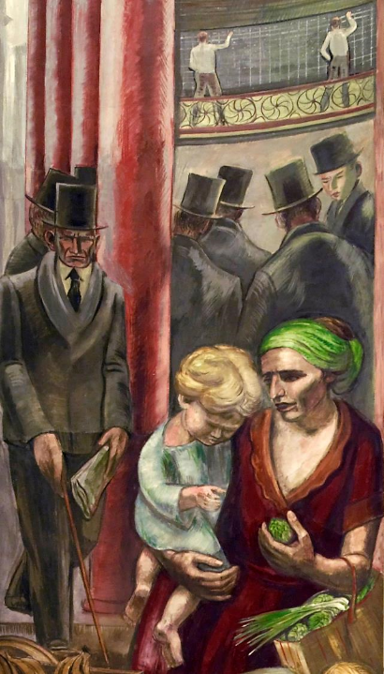
Business Men, Mother and Hungry Child
Department of Justice
Washington, DC

Slide 4
… God … speaks and summons the earth from the rising of the sun to its setting … the perfection of beauty, God shines forth.
Psalm 50:1b-2b

Slide 5
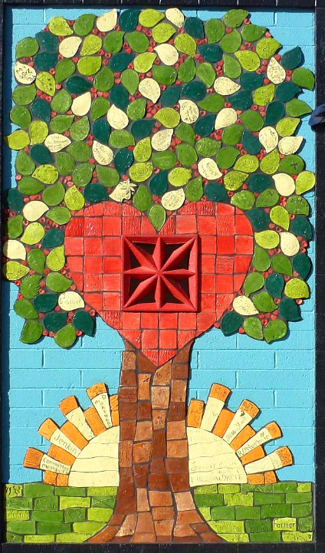
Shaw Butte School Mosaic
Phoenix, AZ

Slide 6
"Look toward heaven and count the stars, if you are able to count them … So shall your descendants be."
Genesis 15:5b

Slide 7
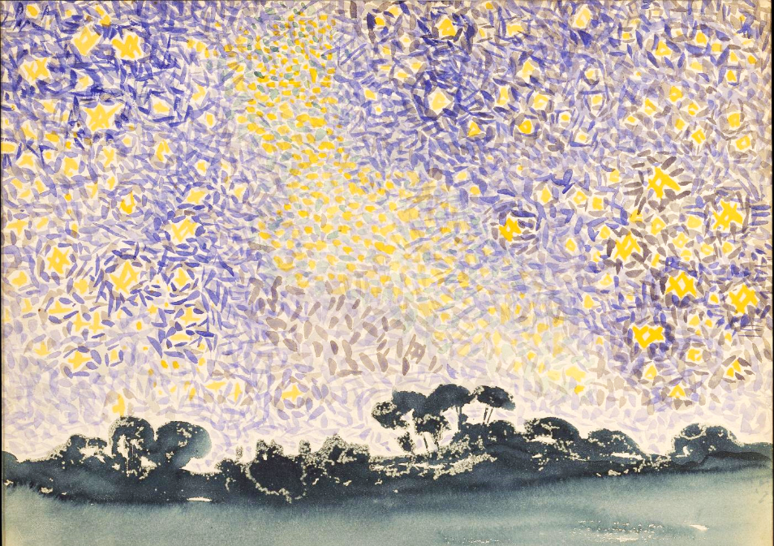
Landscape with Stars -- Henri-Edmond Cross, Metropolitan Museum of Art, New York, NY

Slide 8
Let your steadfast love, O LORD, be upon us, even as we hope in you.
Psalm 33:22

Slide 9
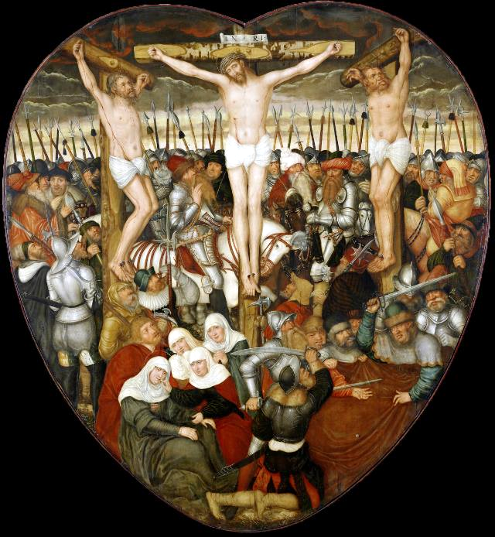
Heart-Shaped Altar, Crucifixion
Lucas Cranach
Nuremburg, Germany

Slide 10
Now faith is the assurance of things hoped for, the conviction of things not seen.
Hebrews 11:1

Slide 11
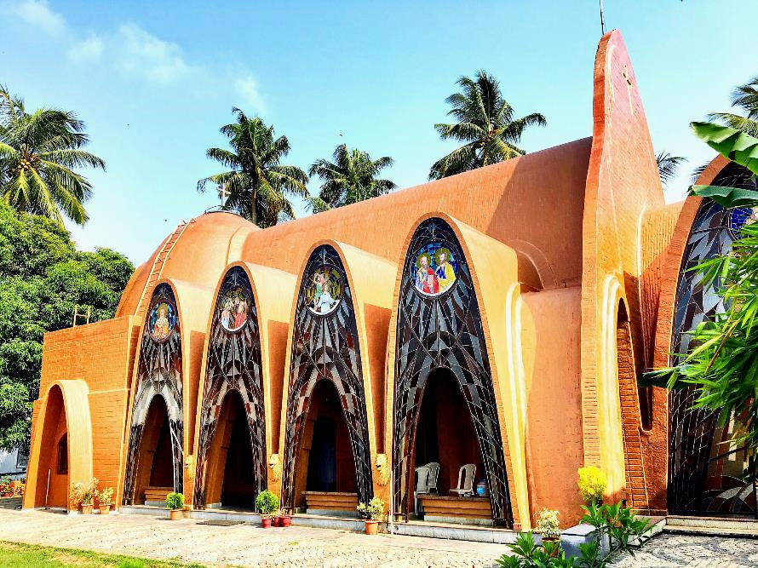
St George Orthodox Koonan Kurish Old Church -- Kerala, India (Mar Thoma, established AD 52)

Slide 12
"Do not be afraid, little flock, for it is your Father's good pleasure to give you the kingdom.
Luke 12:32

Slide 13
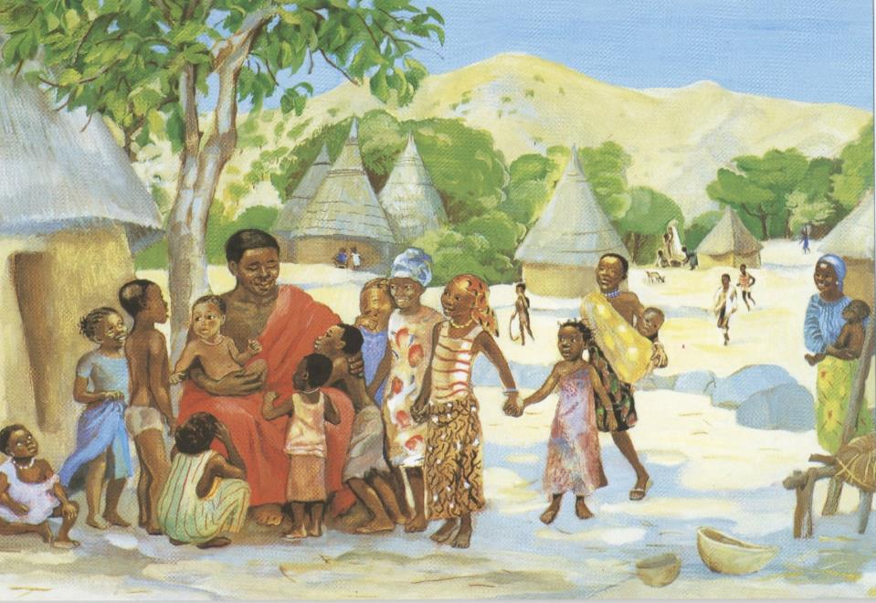
Jesus Welcomes the Children -- JESUS MAFA, Cameroon

Slide 14
Sell your possessions, and give alms … For where your treasure is, there your heart will be also..
Luke 12:33a, 34

Slide 15
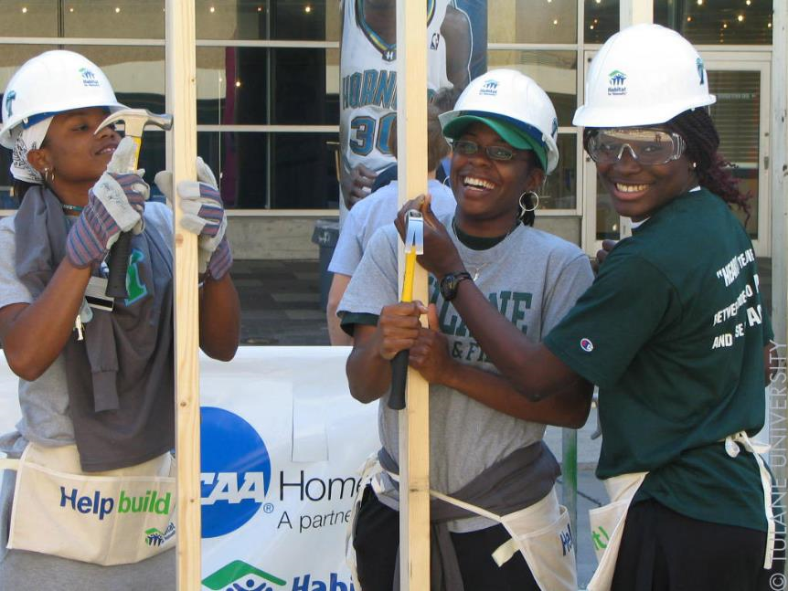
Tulane Students Helping to Build a Habitat for Humanity House

Slide 16
Be like those who are waiting for their master … so that they may open the door for him as soon as he comes and knocks.
Luke 12:36ac

Slide 17
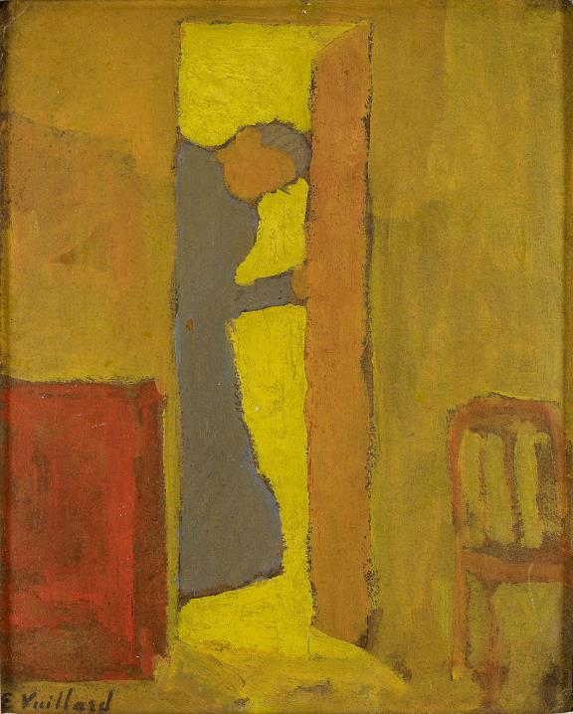
The Artist's Mother Opening the Door
Eduard Vuillard
Minneapolis Institute
Minneapolis, MN

Slide 18
Blessed are those … whom the master finds alert when he comes; … he will … have them sit down to eat, and he will come and serve them.
Luke 12:37ac

Slide 19
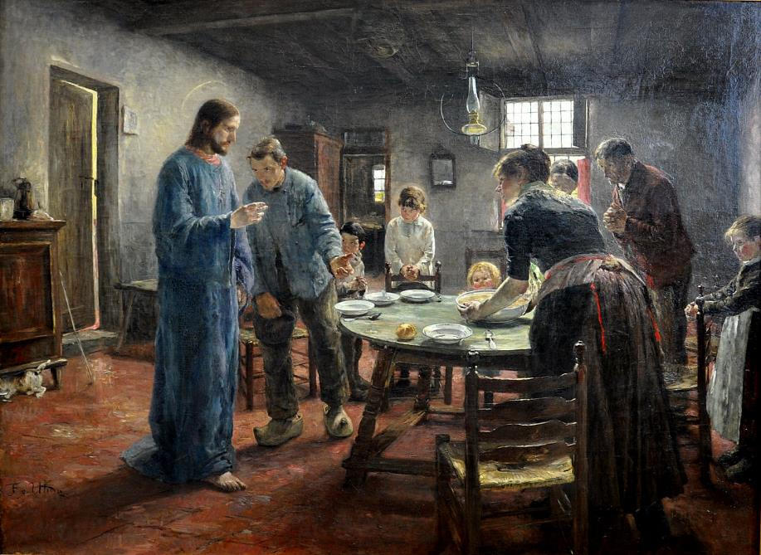
The Mealtime Prayer -- Fritz von Uhde, Alte Nationalgalerie, Berlin, Germany

Slide 20
You must also be ready, for the Son of Man is coming at an unexpected hour."
Luke 12:40

Slide 21
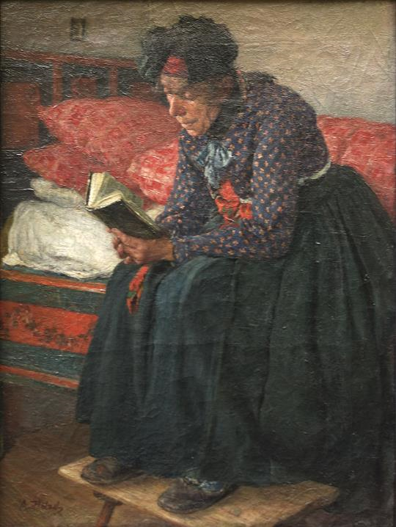
Personal Devotions
Adolf Holzel
Neue Pinakothek
Munich, Germany

Slide 22
Credits
New Revised Standard Version Bible, copyright 1989, Division of Christian Education of the National Council of the Churches of Christ in the United States of America. Used by permission. All rights reserved.
https://commons.wikimedia.org/wiki/File:Fresco_painting_above_room_5114_entrance,_Department_of_Justice,_Washington,_D.C_LCCN2010720252.tif
https://commons.wikimedia.org/wiki/File:Shaw_Butte_School_Mosaic,_2012_-_panoramio.jpg – Chris English
https://commons.wikimedia.org/wiki/File:Landscape_with_Stars_MET_DT736.jpg
https://commons.wikimedia.org/wiki/File:Lucas_Cranach,_Heart_shaped_altar,_Nuremberg.jpg
https://www.flickr.com/photos/mattancherry/33448167833/
http://diglib.library.vanderbilt.edu/act-imagelink.pl?RC=48395
https://commons.wikimedia.org/wiki/File:Habitat_for_Humanity_(3619985406).jpg
https://commons.wikimedia.org/wiki/File:Edouard_Vuillard_-_The_Artist%E2%80%99s_Mother_Opening_a_Door_-_Google_Art_Project.jpg
https://commons.wikimedia.org/wiki/File:The_Mealtime_Prayer_-_Fritz_von_Uhde_-_Google_Cultural_Institute.jpg
https://commons.wikimedia.org/wiki/File:Domestic_Devotions_Adolf_H%C3%B6lzel.jpg
Additional descriptions can be found at the Art in the Christian Tradition image library, a service of the Vanderbilt Divinity Library, http://diglib.library.vanderbilt.edu/. All images available via Creative Commons 3.0 License.

