Slide 1
Sixth Sunday after Pentecost
Year C
Amos 8:1-12 and Psalm 52 • Genesis 18:1-10a and Psalm 15 • Colossians 1:15-28 • Luke 10:38-42

Slide 2
"We will … practice deceit with false balances, buying the poor for silver and the needy for a pair of sandals …"
Amos 8:5cd, 6a

Slide 3
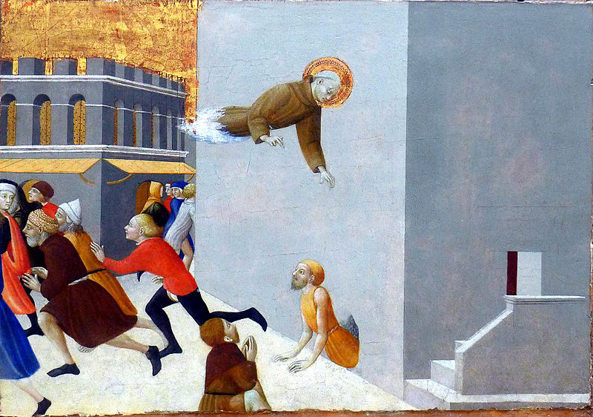
Saint Ranerius Frees the Poor From Prison -- Sassetta, Louvre Museum, Paris, France

Slide 4
But I am like a green olive tree in the house of God. I trust in the steadfast love of God forever and ever.
Psalm 52:8

Slide 5
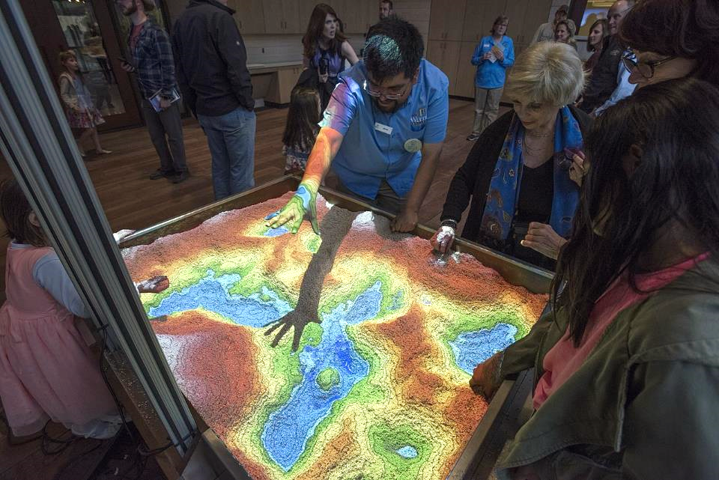
Land Stewardship Lab -- Witte Museum, San Antonio, TX

Slide 6
The LORD appeared to Abraham by the oaks of Mamre. He … saw three men … he ran … to meet them, and bowed down to the ground.
Genesis 18:1a, 2a,c

Slide 7
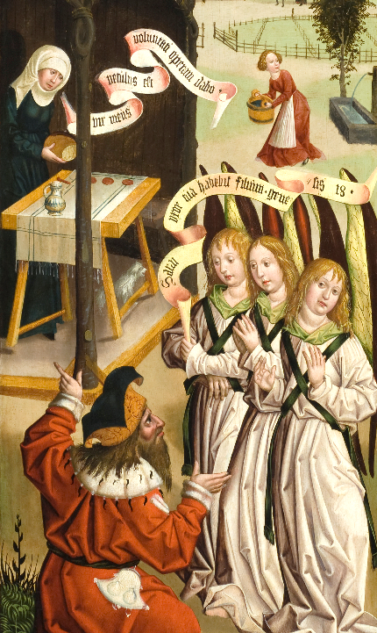
Abraham and the Three Angels
Jan Polack
Los Angeles County Museum of Art
Los Angeles, CA

Slide 8
Abraham hastened into the tent to Sarah, and said, "Make ready quickly three measures of choice flour, knead it, and make cakes."
Genesis 18:6

Slide 9
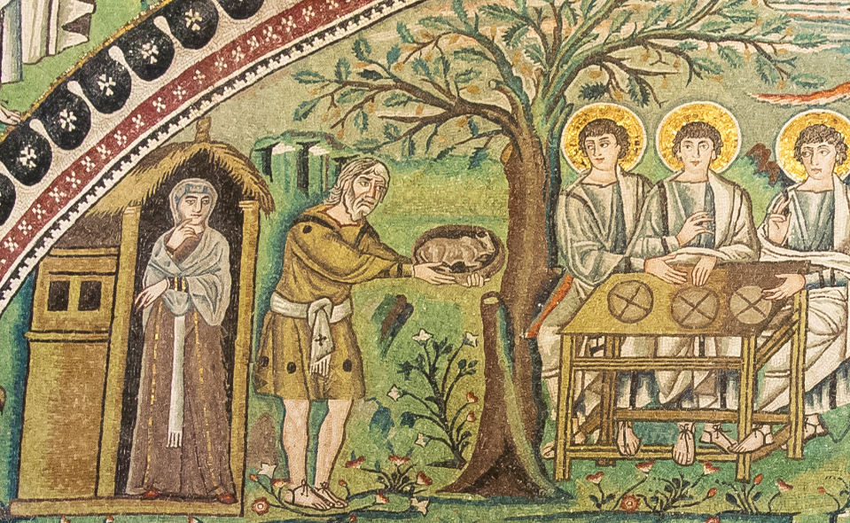
Sarah and Abraham Offer Hospitality to the Visitors -- Basilica of San Vitale, Ravenna, Italy

Slide 10
They said to him, "Where is your wife Sarah?" … Then one said, "I will surely return to you in due season, and your wife Sarah shall have a son."
Genesis 18:9a, 10a

Slide 11
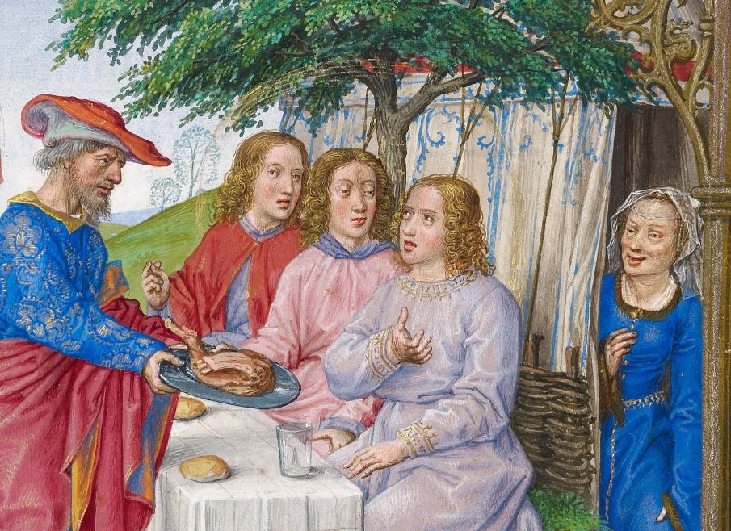
Sarah Hears the Visitor's Promise -- Master of James IV of Scotland, Getty Center, Los Angeles, CA

Slide 12
… God chose to make known how great … are the riches … of this mystery, which is Christ in you …
Colossians 1:27acd

Slide 13
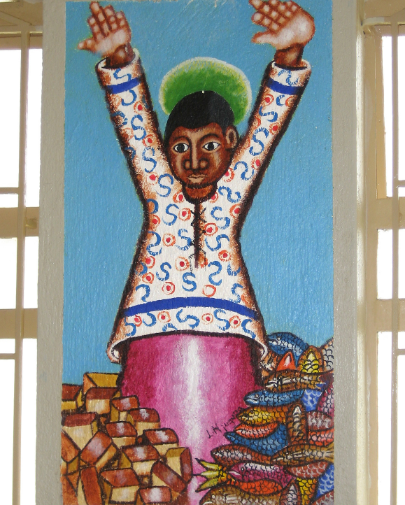
Jesus with Loaves and Fish
Church sanctuary
Kenya

Slide 14
Now as they went on their way, he entered a certain village, where a woman named Martha welcomed him into her home.
Luke 10:38

Slide 15
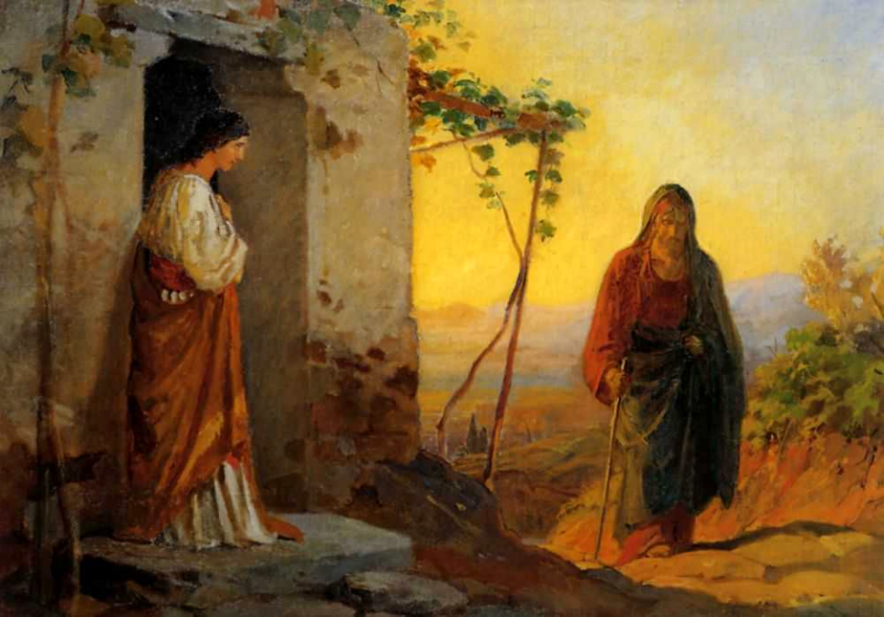
Mary, Sister of Lazarus, Welcomes Jesus Into Her Home -- Nikolai Ge

Slide 16
She had a sister named Mary, who sat at the Lord's feet and listened to what he was saying.
Luke 10:39

Slide 17
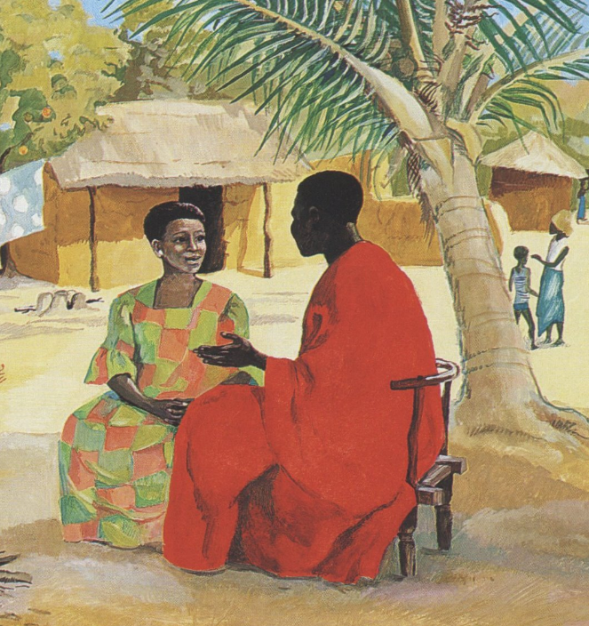
Jesus with Mary, detail of Jesus, Mary and Martha
JESUS MAFA, Cameroon

Slide 18
But Martha was distracted by her many tasks; so she came to him and asked,
Luke 10:40a

Slide 19
"Lord, do you not care that my sister has left me to do all the work by myself? Tell her then to help me."
Luke 10:40b

Slide 20
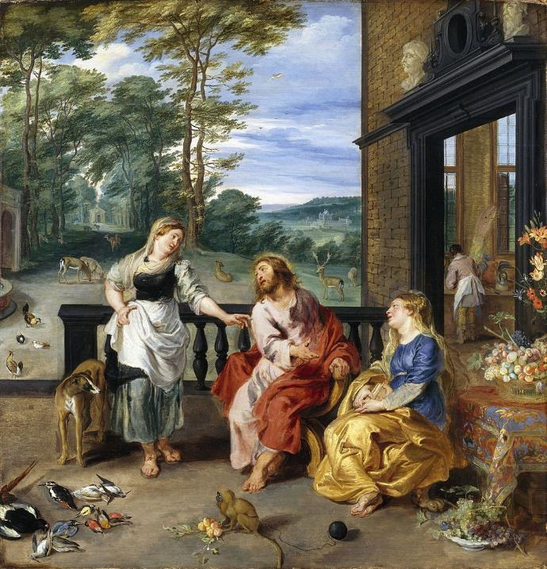
Christ at the House of Mary and Martha
Jan Brueghel the Younger and Peter Paul Rubens
National Gallery of Ireland
Dublin, Ireland

Slide 21
But the Lord answered her, "Martha, Martha, you are worried and distracted by many things;
Luke 10:41

Slide 22
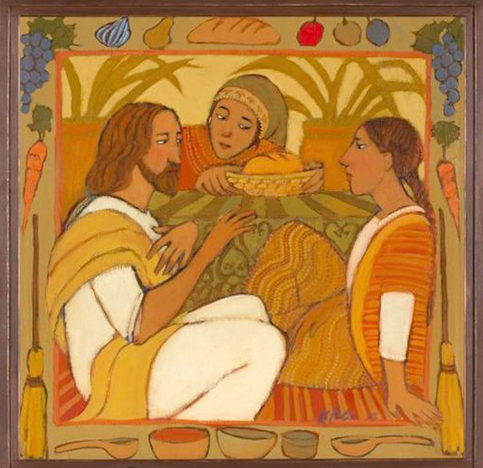
Mary and Martha
Kathleen Peterson Spring City, UT

Slide 23
there is need of only one thing. Mary has chosen the better part, which will not be taken away from her."
Luke 10:42

Slide 24
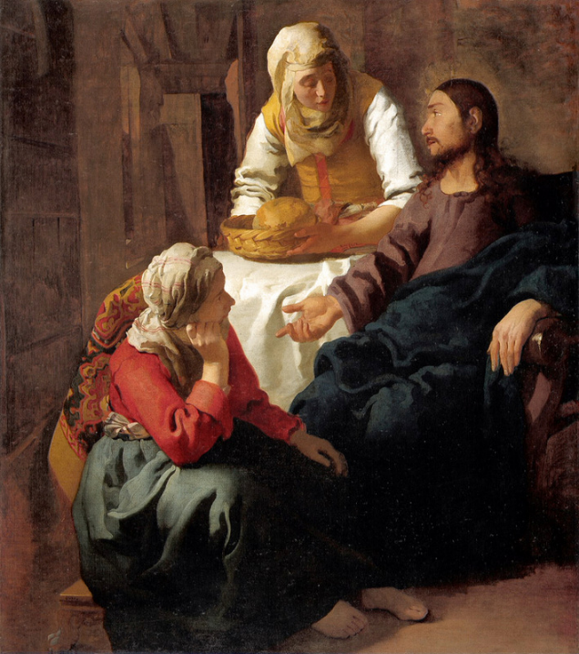
Christ in the House of Mary and Martha
Johannes Vermeer
Scottish National Gallery
Edinburgh, Scotland

Slide 25
Credits
New Revised Standard Version Bible, copyright 1989, Division of Christian Education of the National Council of the Churches of Christ in the United States of America. Used by permission. All rights reserved.
http://commons.wikimedia.org/wiki/File:P1080763_Louvre_Stefano_di_Giovanni_Bienheureux_Ranieri_RF1965-2_rwk.JPG
https://commons.wikimedia.org/wiki/File:Land_Stewardship_Lab.jpg
https://commons.wikimedia.org/wiki/File:Jan_Polack_-_Abraham_and_the_Three_Angels_(one_of_four_panels).jpg
https://commons.wikimedia.org/wiki/File:Ravenna_Basilica_of_San_Vitale_mosaic2.jpg
https://commons.wikimedia.org/wiki/File:Master_of_James_IV_of_Scotland_(Flemish,_before_1465_-_about_1541)_-_Abraham_and_the_Three_Angels_-_Google_Art_Project.jpg
https://www.flickr.com/photos/genvessel/537739978/ - klndonnelly
https://commons.wikimedia.org/wiki/File:Nikolay_Ge_015.jpeg
http://diglib.library.vanderbilt.edu/act-imagelink.pl?RC=48311
https://commons.wikimedia.org/wiki/File:Christ_in_the_House_of_Martha_and_Mary_1628_Jan_Bruegel2_and_Rubens.jpg
https://www.kathleenpetersonart.com
https://commons.wikimedia.org/wiki/File:Johannes_(Jan)_Vermeer_-_Christ_in_the_House_of_Martha_and_Mary_-_Google_Art_Project.jpg
Additional descriptions can be found at the Art in the Christian Tradition image library, a service of the Vanderbilt Divinity Library, http://diglib.library.vanderbilt.edu/. All images available via Creative Commons 3.0 License.

