Slide 1
Ninth Sunday after the Epiphany
Year C
1 Kings 8:22-23, 41-43 • Psalm 96:1-9
Galatians 1:1-12 • Luke 7:1-10

Slide 2
for they shall hear of your great name, your mighty hand, and your outstretched arm–when a foreigner comes and prays toward this house,
1 Kings 8:42

Slide 3
Unite
Washington DC, 2008

Slide 4
O sing to the LORD a new song; sing to the LORD, all the earth.
Psalm 96:1

Slide 5
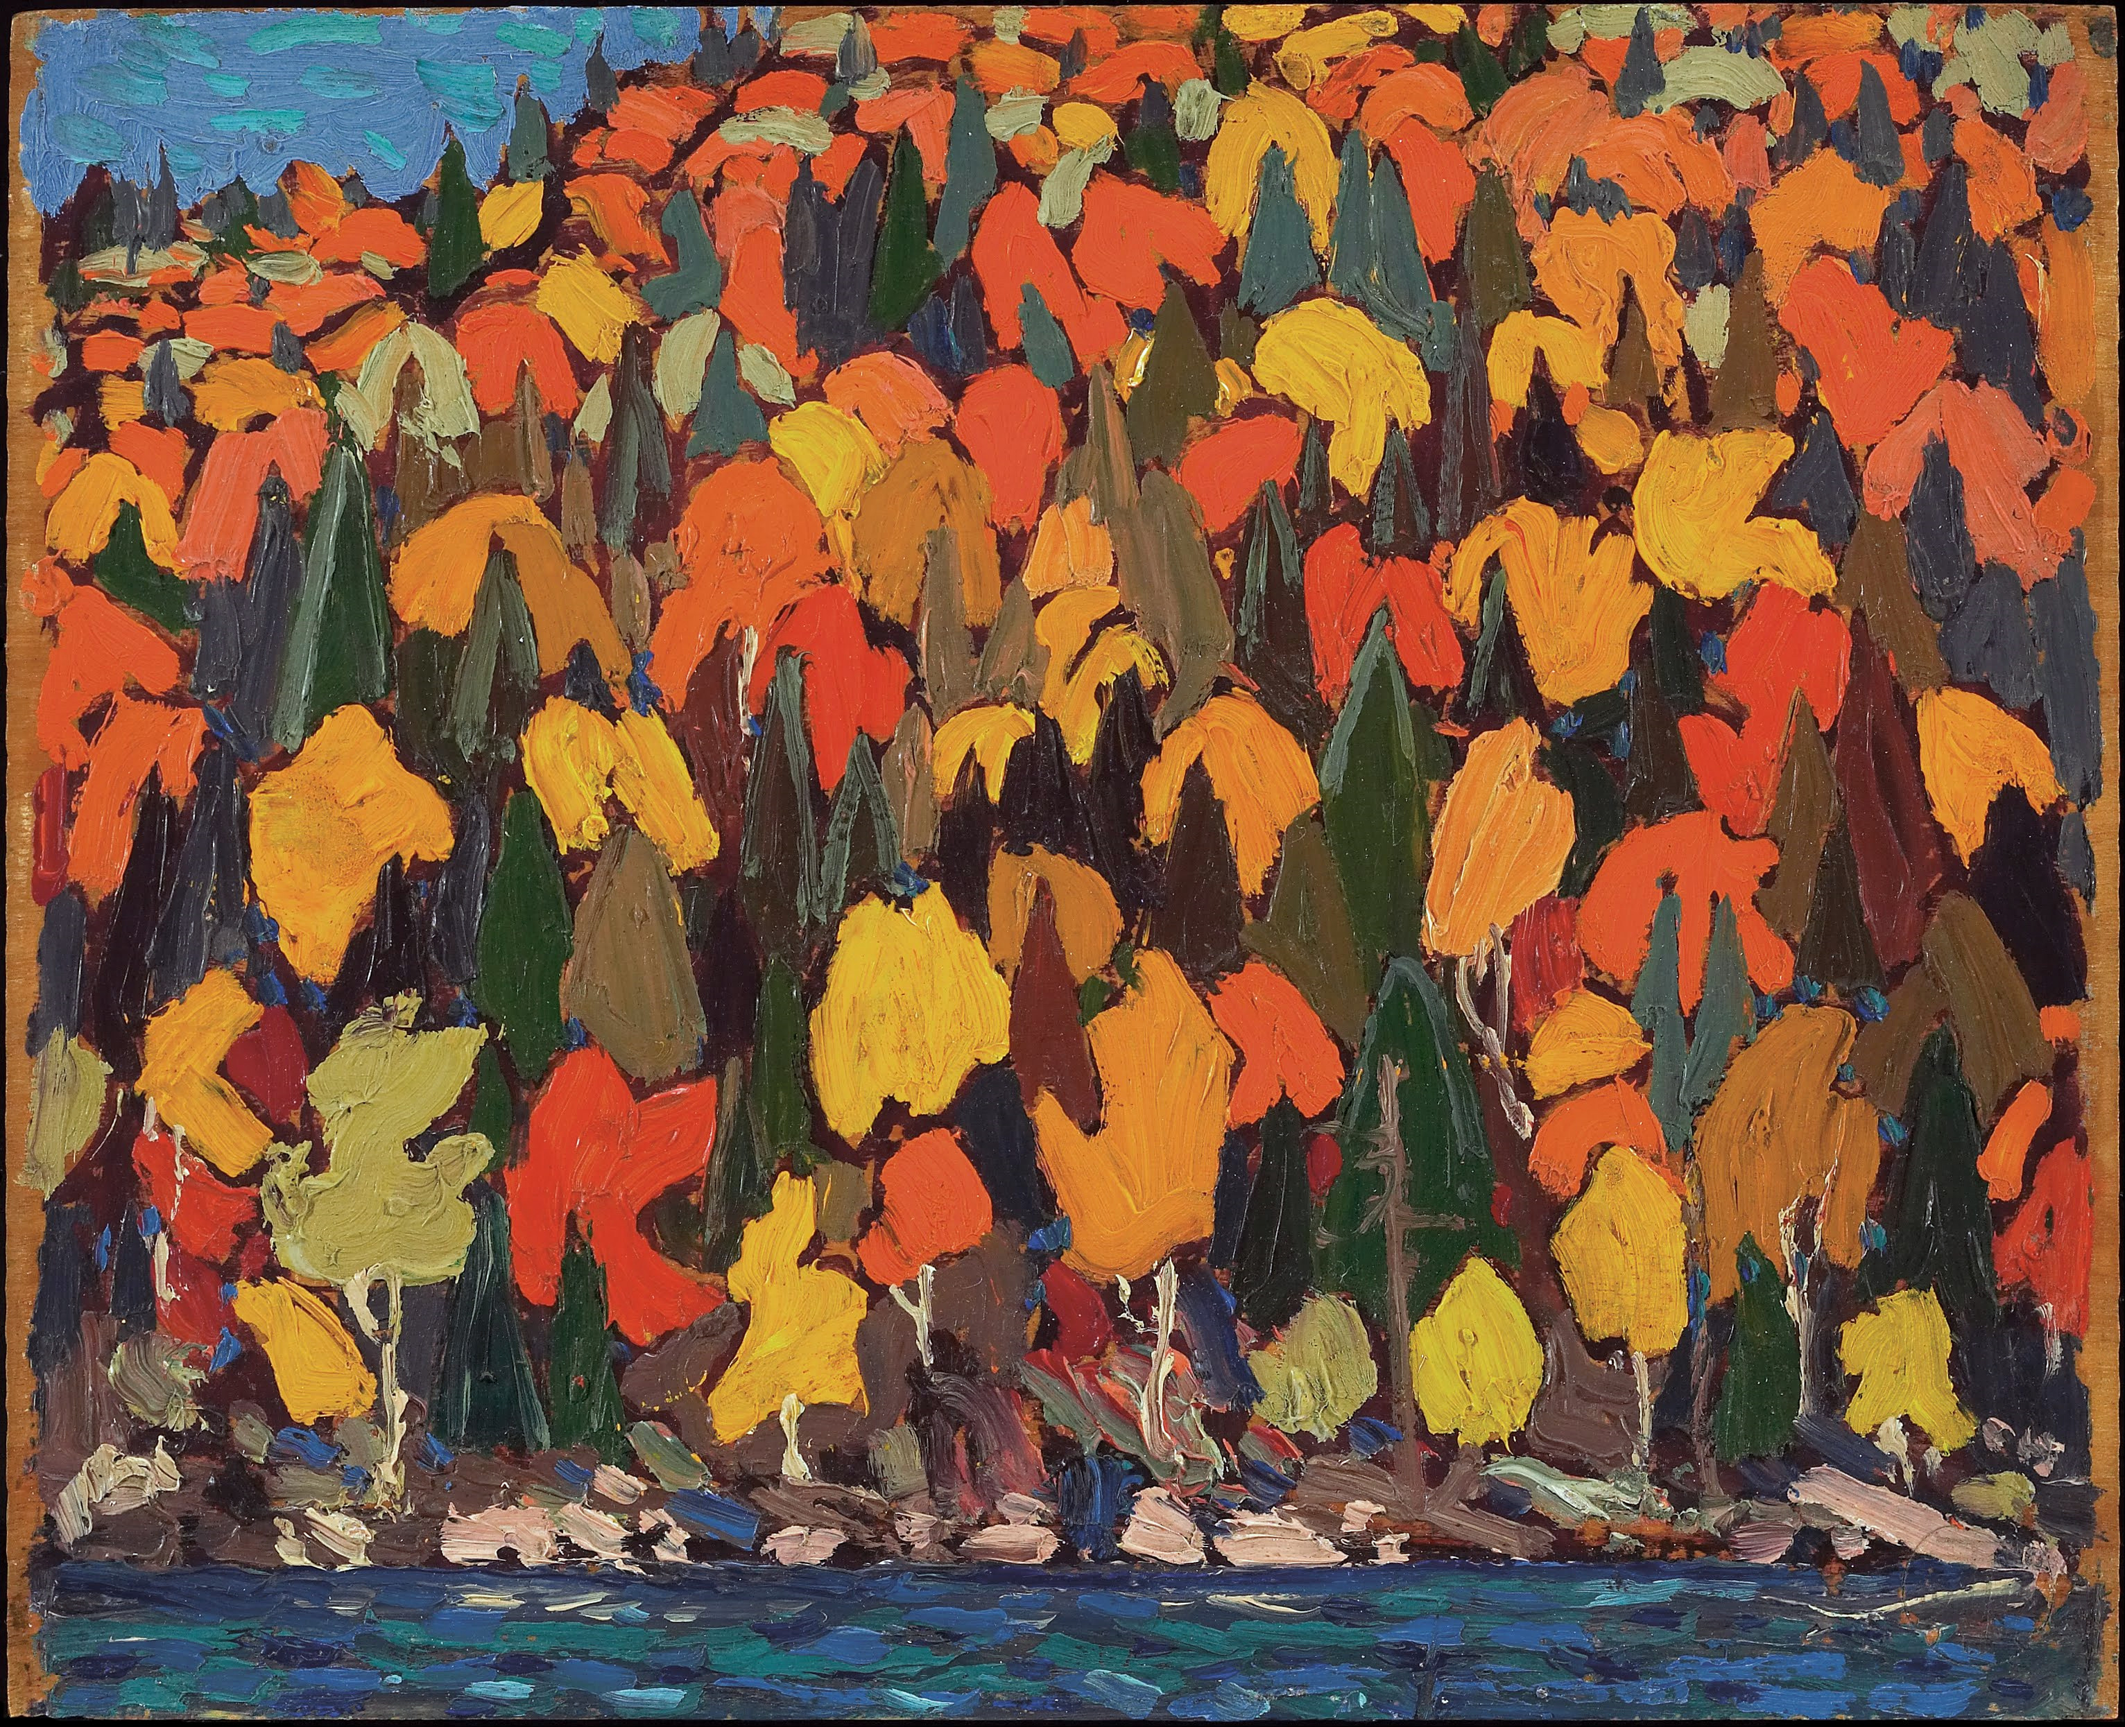
Autumn Foliage, Thomas John Thomson, 1915

Slide 6
Honor and majesty are before him; strength and beauty are in his sanctuary.
Psalm 96:6

Slide 7
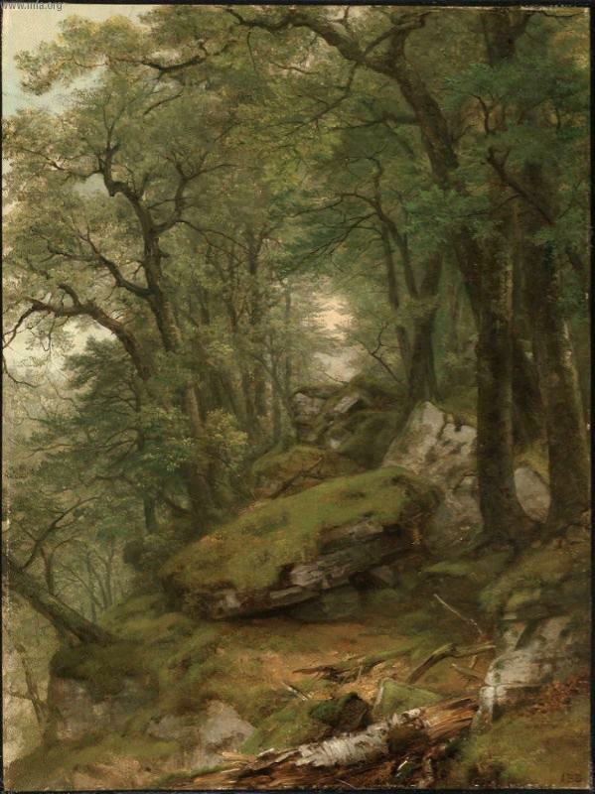
Woodland Interior
A.B. Durand, 1855

Slide 8
Worship the LORD in holy splendor; tremble before him, all the earth.
Psalm 96:9

Slide 9
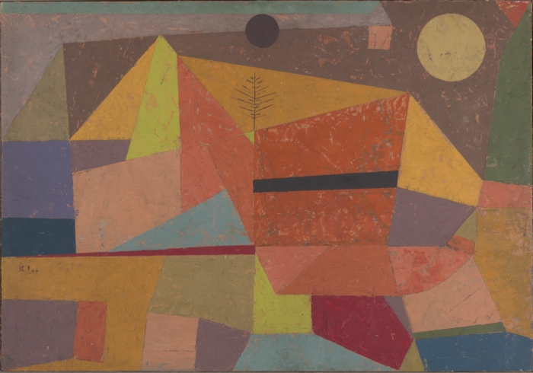
Joyful Mountain Landscape, Paul Klee, 1929

Slide 10
For I did not receive the gospel from a human source, nor was I taught it, but I received it through a revelation of Jesus Christ.
Galatians 1:12

Slide 11
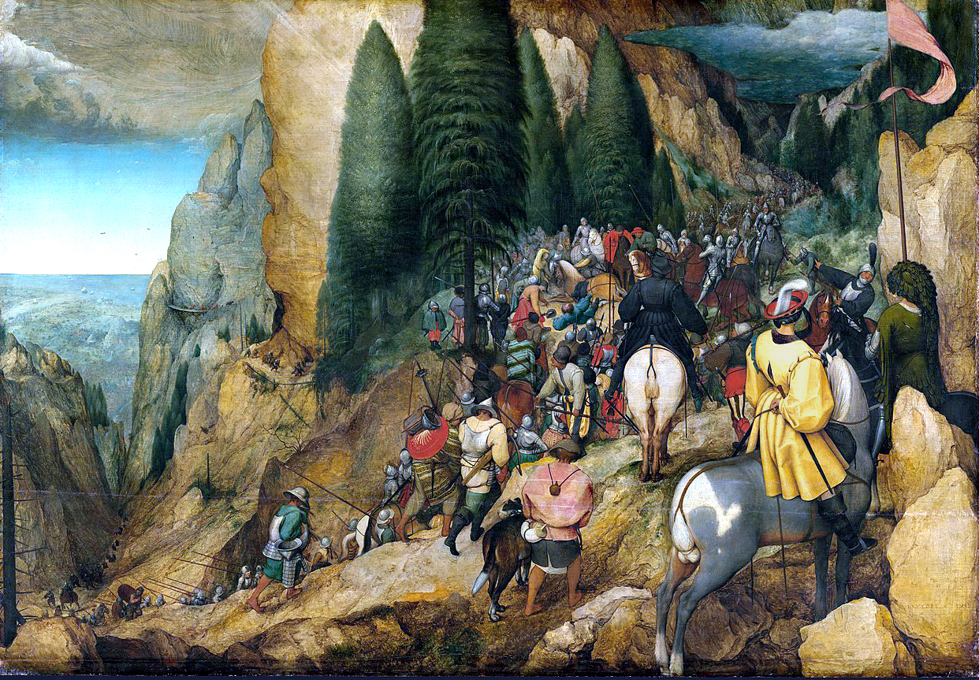
Conversion of Paul, Pieter Bruegel, 1567

Slide 12
A centurion there had a slave whom he valued highly, and who was ill and close to death.
Luke 7:1-10

Slide 13
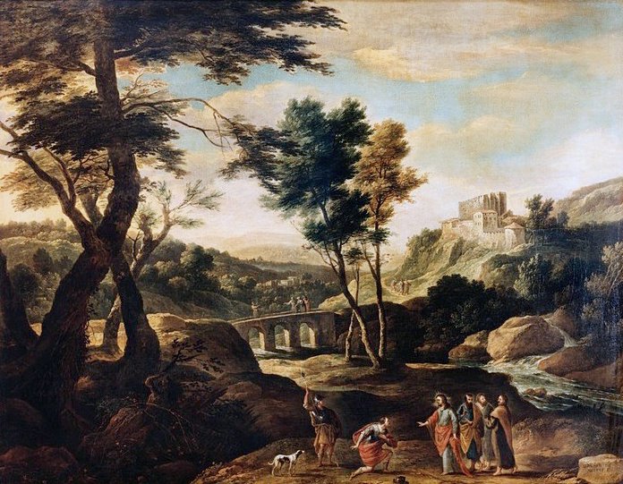
Jesus Heals the Centurion’s Servant

Slide 14
When he heard about Jesus, he sent some Jewish elders to him, asking him to come and heal his slave.
Luke 7:3

Slide 15
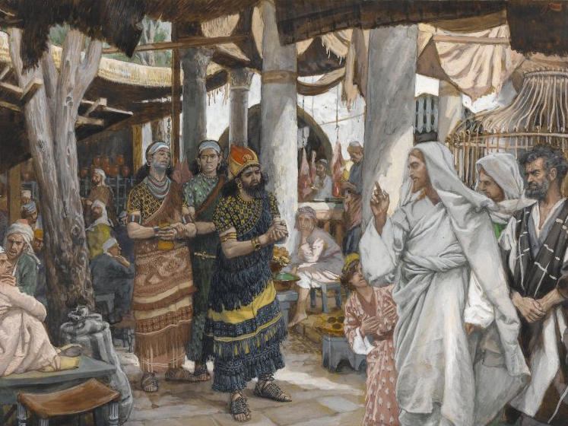
Jesus Heals the Centurion’s Servant, James Tissot, ca. 1886-1894

Slide 16
“therefore I did not presume to come to you. But only speak the word, and let my servant be healed.”
Luke 7:7

Slide 17
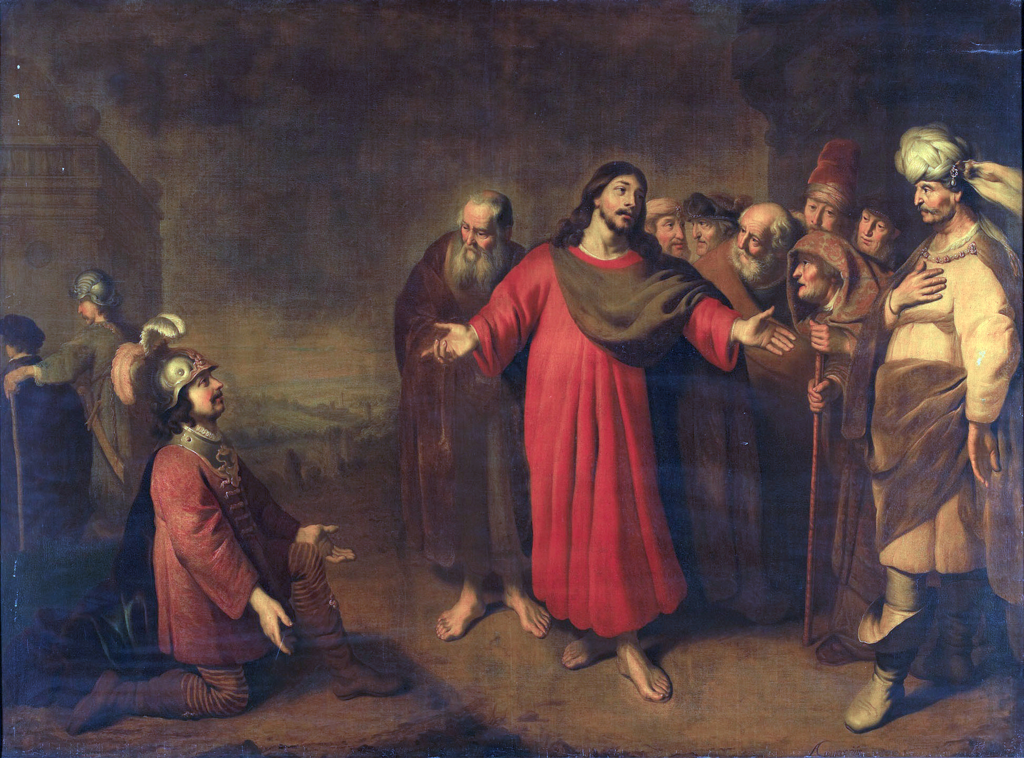
Jesus Heals the Centurion’s Servant, Adam Camerarius, ca. 1644-1665

Slide 18
When Jesus heard this he was amazed at him,
Luke 7:9a

Slide 19
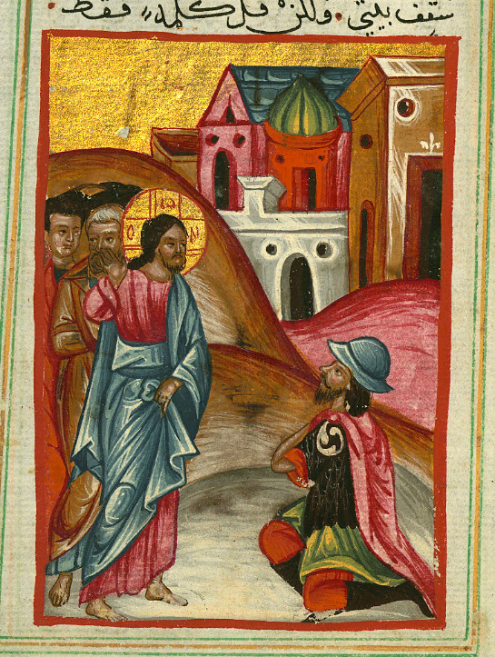
Jesus Heals the Centurion’s Servant
Ilyas Basim Khuri Bazzi Rahib,
1684

Slide 20
And turning to the crowd that followed him, he said, ”I tell you, not ever in Israel have I found such faith.”
Luke 7:9b

Slide 21
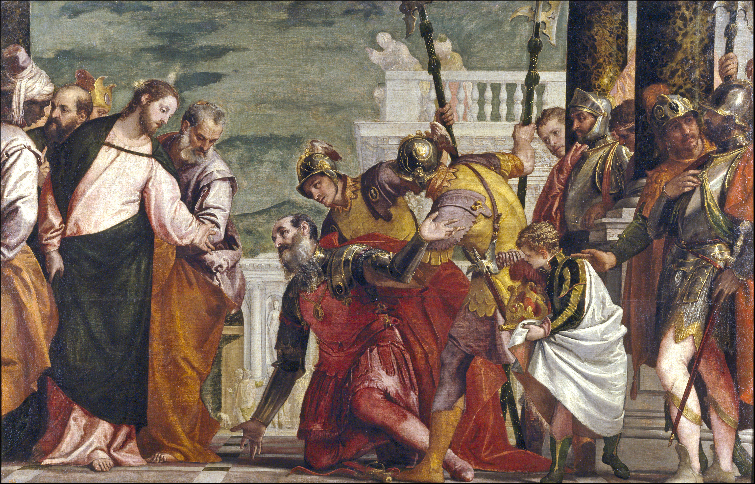
Jesus Heals the Centurion’s Servant, Veronese, ca. 1571

Slide 22
Credits
New Revised Standard Version Bible, copyright 1989, Division of Christian Education of the National Council of the Churches of Christ in the United States of America. Used by permission. All rights reserved.
J Ireland, Flickr Creative Commons
http://commons.wikimedia.org/wiki/File:Tom_Thomson_-_Autumn_Foliage_-_Google_Art_Project.jpg
https://commons.wikimedia.org/wiki/File:Asher_Brown_Durand_-_Woodland_Interior_-_63.269_-_Museum_of_Fine_Arts.jpg
http://commons.wikimedia.org/wiki/File:Heitere_Gebirgslandschaft_by_Paul_Klee_1929.jpeg
https://commons.wikimedia.org/wiki/File:Conversion_of_Paul_(Bruegel).jpg
https://commons.wikimedia.org/wiki/File:Gaspar_de_Witte_-_Jesus_heals_the_servant_of_the_centurion.jpg
https://commons.wikimedia.org/wiki/File:Brooklyn_Museum_-_The_Healing_of_the_Officer%27s_Son_(La_gu%C3%A9rison_du_fils_de_l%27officier)_-_James_Tissot.jpg
https://commons.wikimedia.org/wiki/File:Adam_Camerarius_001.jpg
https://www.flickr.com/photos/medmss/5184968294/
https://commons.wikimedia.org/wiki/File:Jes%C3%BAs_y_el_centuri%C3%B3n_(El_Veron%C3%A9s).jpg
Additional descriptions can be found at the Art in the Christian Tradition image library, a service of the Vanderbilt Divinity Library, http://diglib.library.vanderbilt.edu/. All images available via Creative Commons 3.0 License.

