Slide 1
FOURTH SUNDAY OF EASTER
Year C
Acts 9:36-43 • Psalm 23 • Revelation 7:9-17 • John 10:22-30

Slide 2
Even though I walk through the darkest valley, I fear no evil; for you are with me; your rod and your staff-- they comfort me.
Psalm 23:4

Slide 3
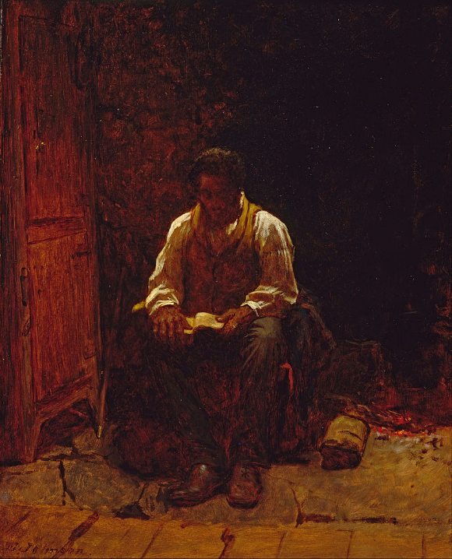
The Lord is My Shepherd
Eastman Johnson
Smithsonian Museum of American Art
Washington, DC

Slide 4
for the Lamb … will be their shepherd, and he will guide them to springs of the water of life and God will wipe away every tear from their eyes.
Revelation 7:17

Slide 5
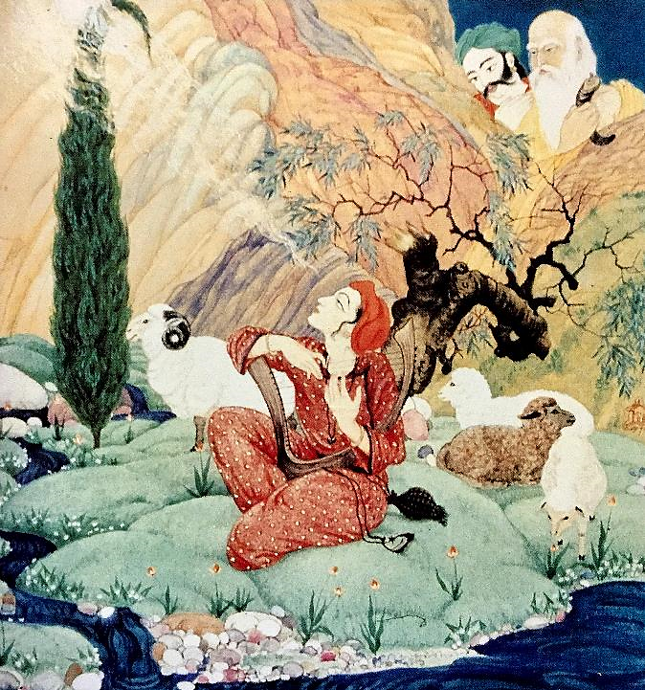
Twenty-Third Psalm
Frank Wesley

Slide 6
My sheep hear my voice. I know them … No one will snatch them out of my hand.
John 10:27a, 28b

Slide 7
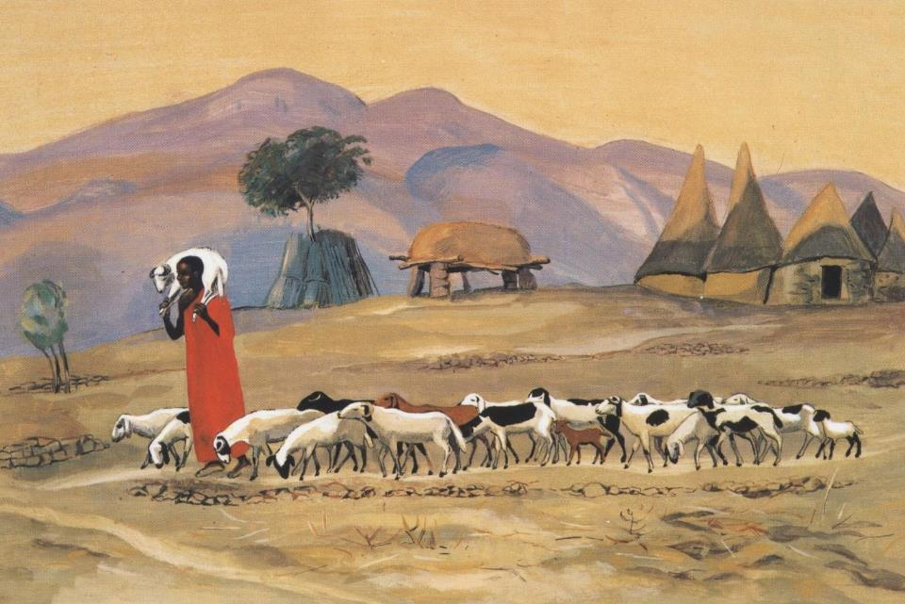
The Good Shepherd -- JESUS MAFA, Cameroon

Slide 8
Now in Joppa there was a disciple whose name was Tabitha, which in Greek is Dorcas.
Acts 9:36a

Slide 9
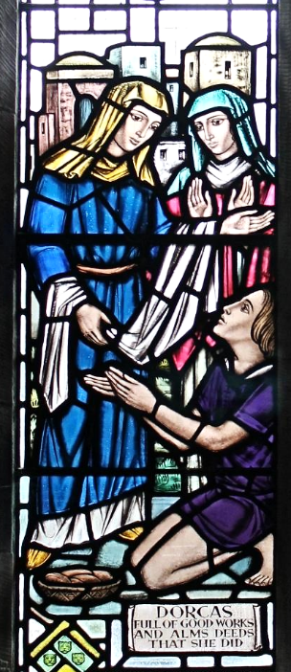
Dorcas
St. Twrog's Church
Maentwrog, Wales

Slide 10
She was devoted to good works and acts of charity.
Acts 9:36b

Slide 11
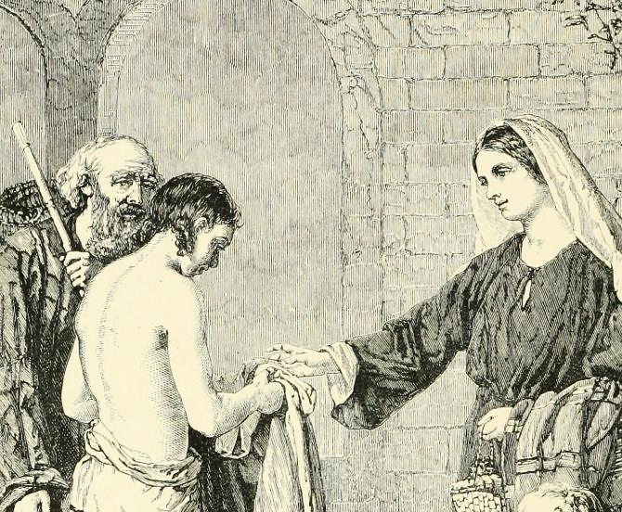
The Charity of Dorcas -- William Dobson, from British Painters, 1881

Slide 12
At that time she became ill and died. When they had washed her, they laid her in a room upstairs.
Acts 9:37

Slide 13
Peter … went with them; and when he arrived, they took him to the room upstairs.
Acts 9:38b, 39a

Slide 14
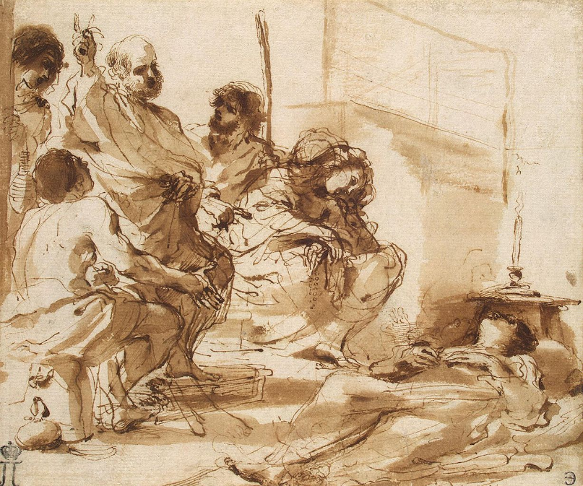
Raising of Tabitha -- Guercino, Hermitage, St. Petersburg, Russia

Slide 15
All the widows stood beside him, weeping and showing tunics and other clothing that Dorcas had made while she was with them.
Acts 9:39b

Slide 16
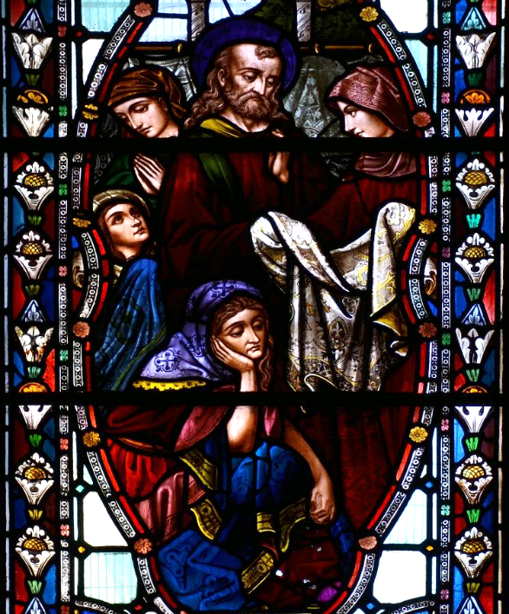
Mourning Tabitha
Southwark Cathedral
London, England

Slide 17
Peter put all of them outside, and then he knelt down and prayed. He turned to the body and said, "Tabitha, get up."
Acts 9:40a

Slide 18
Then she opened her eyes, and seeing Peter, she sat up.
Acts 9:40b

Slide 19
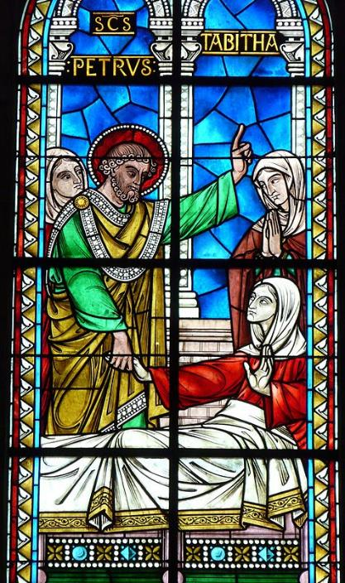
Raising of Tabitha
Cathedral of St. Front
Perigueux, France

Slide 20
He gave her his hand and helped her up. Then calling the saints and widows, he showed her to be alive.
Acts 9:41

Slide 21
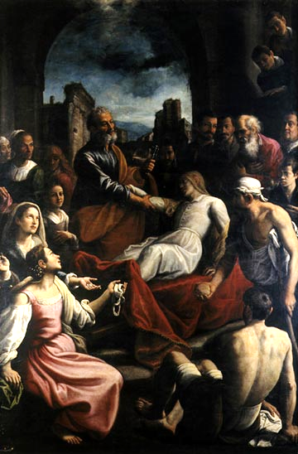
Raising of Tabitha
Fabrizio Santafede
Pio Monte della Misericordia
Naples, Italy

Slide 22
This became known throughout Joppa, and many believed in the Lord.
Acts 9:42

Slide 23
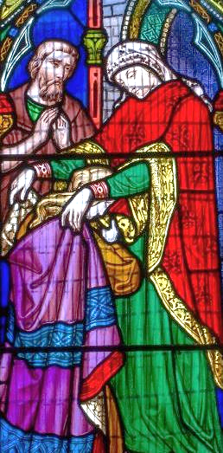
Dorcas (Tabitha)
Church of St. Nicholas Iford, England

Slide 24
Credits
New Revised Standard Version Bible, copyright 1989, Division of Christian Education of the National Council of the Churches of Christ in the United States of America. Used by permission. All rights reserved.
http://commons.wikimedia.org/wiki/File:Eastman_Johnson_-_The_Lord_Is_My_Shepherd_-_Google_Art_Project.jpg
https://diglib.library.vanderbilt.edu/act-imagelink.pl?RC=59161http://diglib.library.vanderbilt.edu/act-imagelink.pl?RC=48288
https://commons.wikimedia.org/wiki/File:Eglwys_Sant_Twrog,_Maentwrog_St_Twrog%27s_church,_Maentwrog,_Gwynedd,_Cymru,_Wales_27.JPG
https://commons.wikimedia.org/wiki/File:British_painters;_with_eighty_examples_of_their_work_engraved_on_wood_(1881)_(14781170651).jpg
https://commons.wikimedia.org/wiki/File:Raising-of-Tabitha-Sketch.jpg
https://commons.wikimedia.org/wiki/File:Southwark_Cathedral_stained_glass_windows_01082013_54.jpg – Vasil
https://commons.wikimedia.org/wiki/File:P%C3%A9rigueux_Saint-Front_vitrail_mur_nord_(2).JPG – Pere Igor
https://commons.wikimedia.org/wiki/File:Resurrezioneditabita.jpg
https://commons.wikimedia.org/wiki/File:Stained_glass_window,_St_Nicholas%27_church,_Iford,_E_Sussex_(17314377786).jpg – Jules and Jenny
Additional descriptions can be found at the Art in the Christian Tradition image library, a service of the Vanderbilt Divinity Library, http://diglib.library.vanderbilt.edu/. All images available via Creative Commons 3.0 License.

