Slide 1
FIRST SUNDAY AFTER CHRISTMAS DAY
Year C
1 Samuel 2:18-20, 26 • Psalm 148 Colossians 3:12-17 • Luke 2:41-52

Slide 2
Now the boy Samuel continued to grow both in stature and in favor with the LORD and with the people.
1 Samuel 2:26

Slide 3
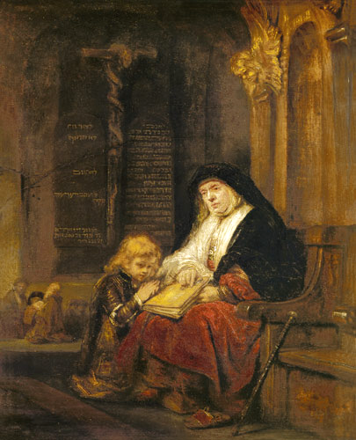
Samuel's Prayer Testing in the Temple
School of Rembrandt

Slide 4
Praise the LORD from the earth … Wild animals and all cattle, creeping things and flying birds!
Psalm 148:7a, 10

Slide 5
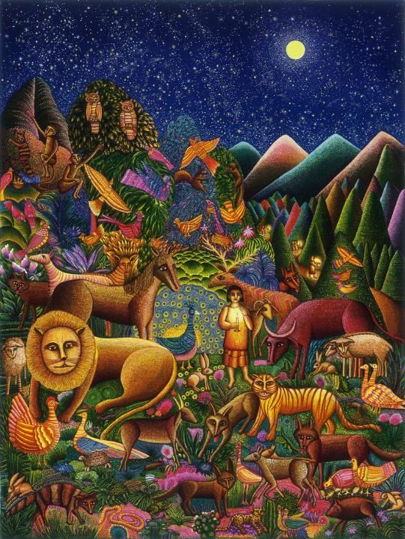
Peaceable Kingdom
John August Swanson
serigraph, 1994

Slide 6
Let the word of Christ dwell in you richly … and with gratitude in your hearts sing psalms, hymns, and spiritual songs to God.
Colossians 3:16ac

Slide 7
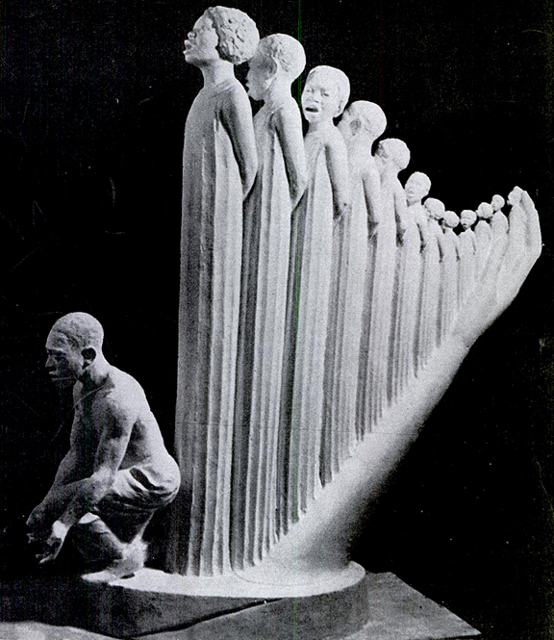
Lift Every Voice and Sing
Augusta Savage
Model for 1939 World's Fair

Slide 8
When the festival was ended and they started to return, the boy Jesus stayed behind in Jerusalem, but his parents did not know it.
Luke 2:43

Slide 9
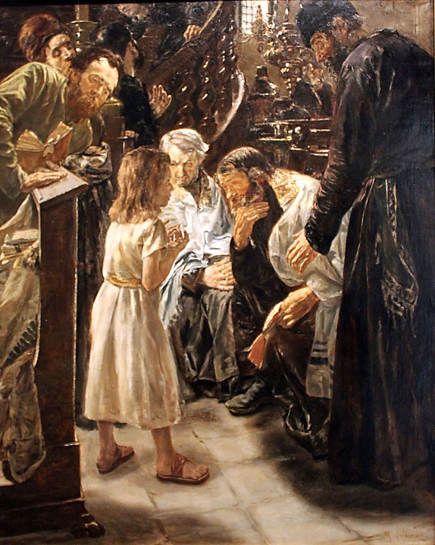
Jesus Among the Doctors
Max Liebermann
Kunsthalle Hamburg
Hamburg, Germany

Slide 10
After three days they found him in the temple, sitting among the teachers, listening to them and asking them questions.
Luke 2:46

Slide 11
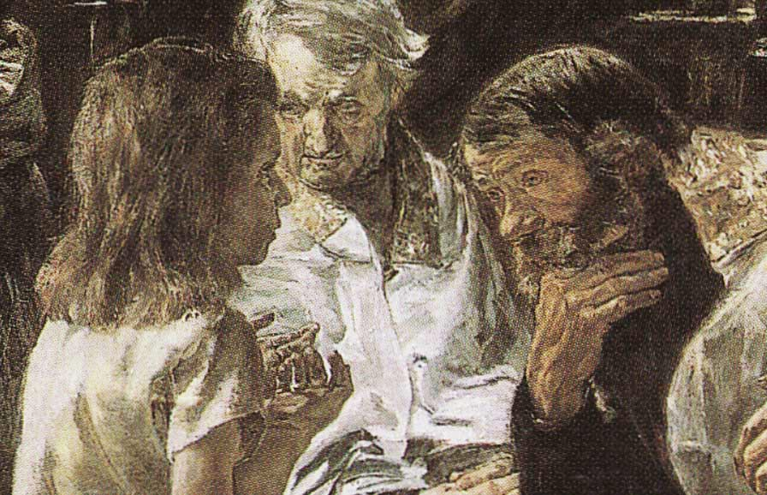
Jesus Among the Doctors, detail -- Max Liebermann, Kunsthalle Hamburg, Hamburg, Germany

Slide 12
And all who heard him were amazed at his understanding and his answers.
Luke 2:47

Slide 13
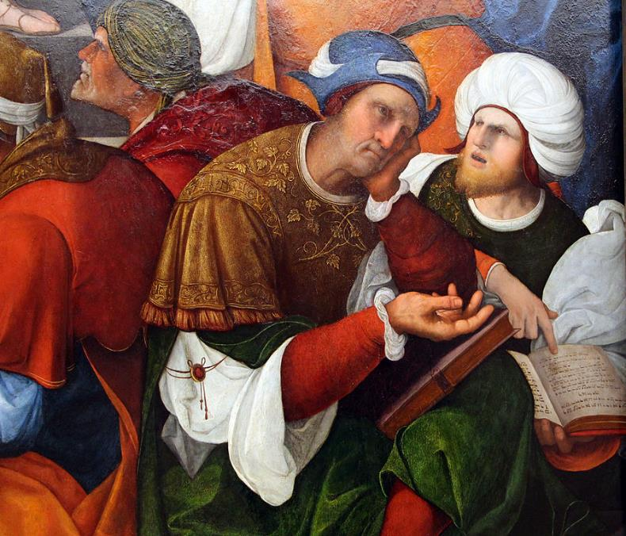
Christ Disputing with the Doctors, detail
Ludovico Mazzolino, Gemaldegalerie Berlin, Germany

Slide 14
When his parents saw him they were astonished; and his mother said to him,
Luke 2:48a

Slide 15
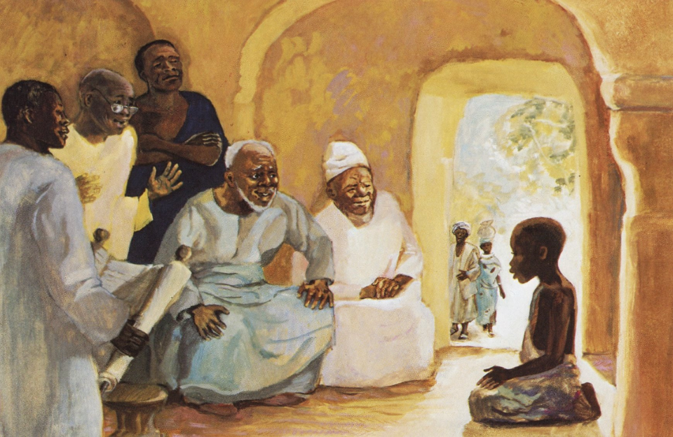
Jesus with the Elders -- JESUS MAFA, Cameroon

Slide 16
"Child, why have you treated us like this? Look, your father and I have been searching for you in great anxiety."
Luke 2:48b

Slide 17
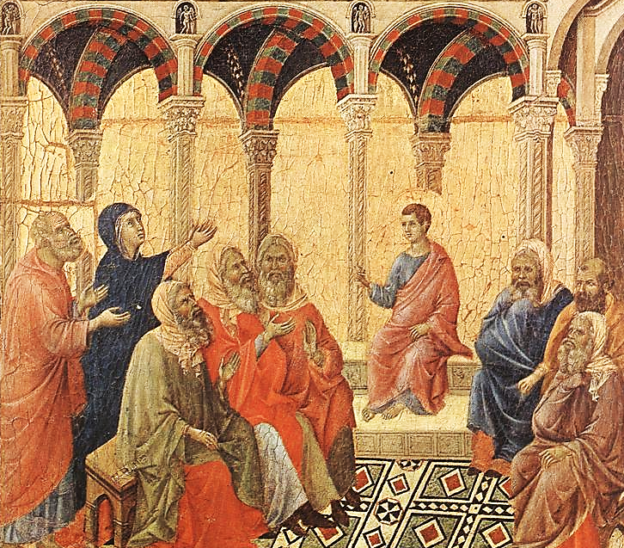
Christ with the Doctors in the Temple
Duccio
Museo dell'Opera del Duomo
Siena, Italy

Slide 18
He said to them, "Why were you searching for me? Did you not know that I must be in my Father's house?"
Luke 2:49

Slide 19
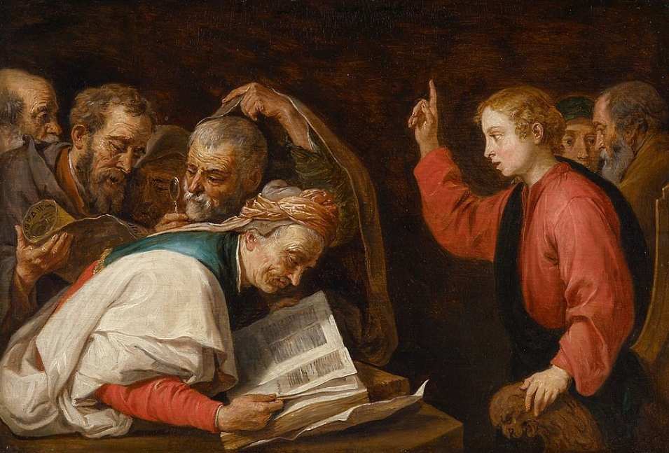
Jesus Among the Doctors -- David Teniers the Younger, Kunsthistorisches Museum, Vienna, Austria

Slide 20
Then he went down with them and came to Nazareth, and was obedient to them. His mother treasured all these things in her heart.
Luke 2:51

Slide 21
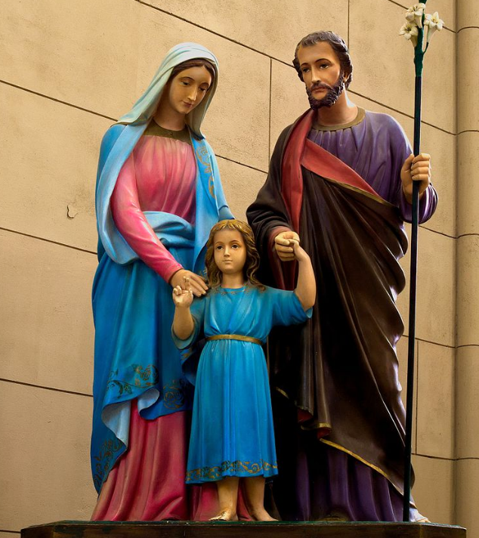
Mary, Joseph and Jesus
Basilica of Notre-Dame
Luhan, Argentina

Slide 22
And Jesus increased in wisdom and in years, and in divine and human favor.
Luke 2:52

Slide 23
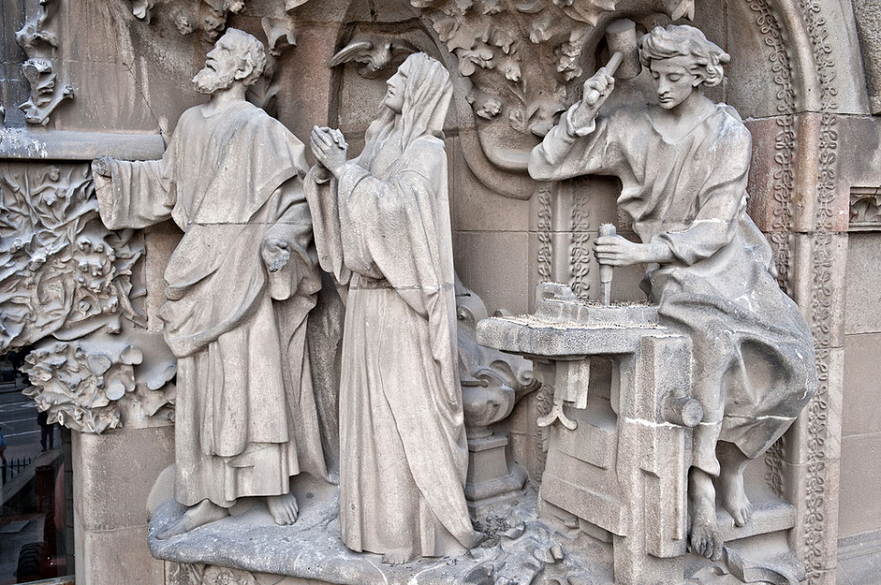
Joseph, Mary, and Jesus as a Carpenter -- Sagrada Familia, Barcelona, Spain

Slide 24
Credits
New Revised Standard Version Bible, copyright 1989, Division of Christian Education of the National Council of the Churches of Christ in the United States of America. Used by permission. All rights reserved.
https://commons.wikimedia.org/wiki/File:Hannah_in_the_temple,_Samuel%27s_prayer_testing.jpg
http://www.johnaugustswanson.com  1988 by John August Swanson
https://books.google.com/books?id=5VoEAAAAMBAJ&printsec=frontcover&dq=the+crisis+magazine+1939
https://commons.wikimedia.org/wiki/File:1879_Liebermann_Der_zw%C3%B6lfj%C3%A4hrige_Jesus_im_Tempel_anagoria.JPG
https://commons.wikimedia.org/wiki/File:Liebermann_Jesus_1879_det.jpg
https://commons.wikimedia.org/wiki/File:Ludovico_mazzolino,_cristo_tra_i_dottori_del_tempio,_1524,_15.JPG
http://www.librairie-emmanuel.fr (contact page: https://www.librairie-emmanuel.fr/contact)
https://commons.wikimedia.org/wiki/File:Duccio_di_Buoninsegna_-_Disputation_with_the_Doctors_-_WGA06768.jpg
https://commons.wikimedia.org/wiki/File:David_Teniers_after_Ribera_-_Jesus_among_the_Doctors_GG_9801.jpg
https://ga.wikipedia.org/wiki/%C3%8Dosa_Cr%C3%ADost
https://commons.wikimedia.org/wiki/File:Sagrada_Fam%C3%ADlia._Portal_de_la_Fe_(Jes%C3%BAs_treballant).jpg
Additional descriptions can be found at the Art in the Christian Tradition image library, a service of the Vanderbilt Divinity Library, http://diglib.library.vanderbilt.edu/. All images available via Creative Commons 3.0 License.

