Slide 1
FIFTH SUNDAY OF EASTER
Year C
Acts 11:1-18 • Psalm 148 • Revelation 21:1-6 • John 13:31-35

Slide 2
At that very moment three men … arrived at the house where we were. The Spirit told me to go with them and not to make a distinction between them and us.
Acts 11:11ac, 12a

Slide 3
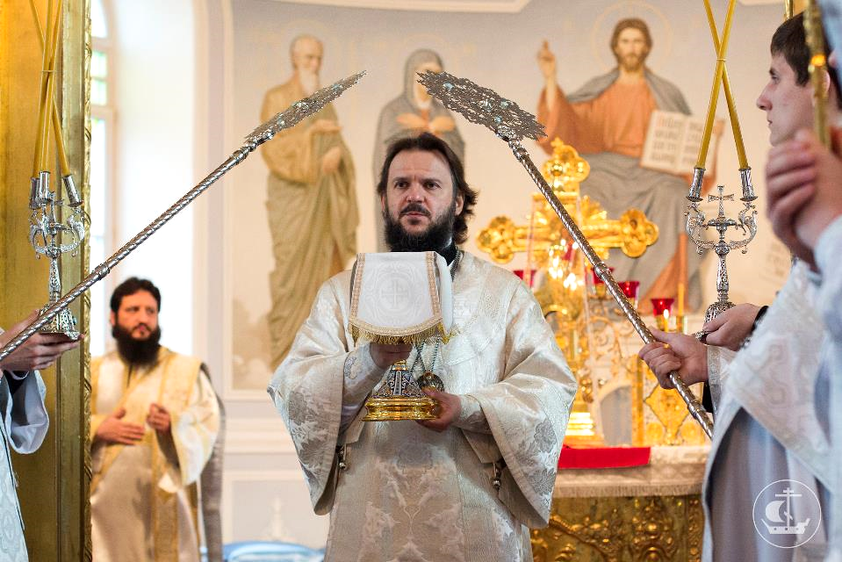
Holy Fathers of the First Ecumenical Council, St. Petersburg Theological Seminary, St. Petersburg, Russia

Slide 4
Praise the LORD!
Praise him, sun and moon;
praise him, all you shining stars!
Psalm 148:1a, 3

Slide 5
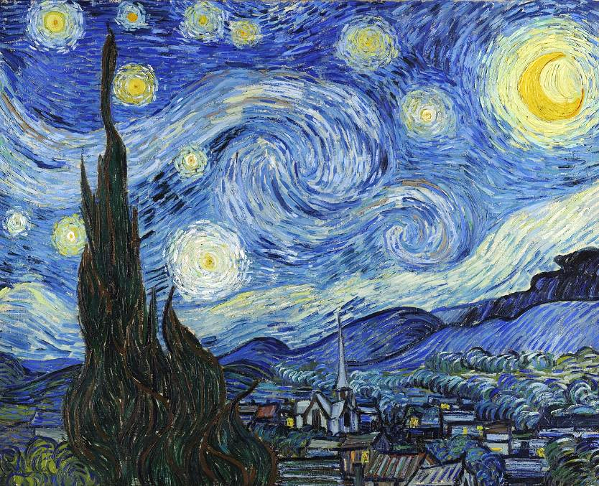
Starry Night -- Vincent van Gogh, Museum of Modern Art, New York, NY

Slide 6
Praise the LORD from the earth, you sea monsters and all deeps,
Psalm 148:7

Slide 7
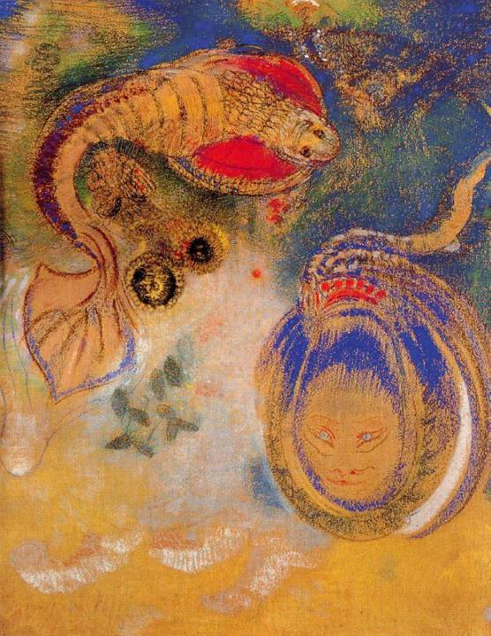
Animals at the Bottom of the Sea
Odilon Redon
1916

Slide 8
fire and hail, snow and frost, stormy wind fulfilling his command!
Psalm 148:8

Slide 9
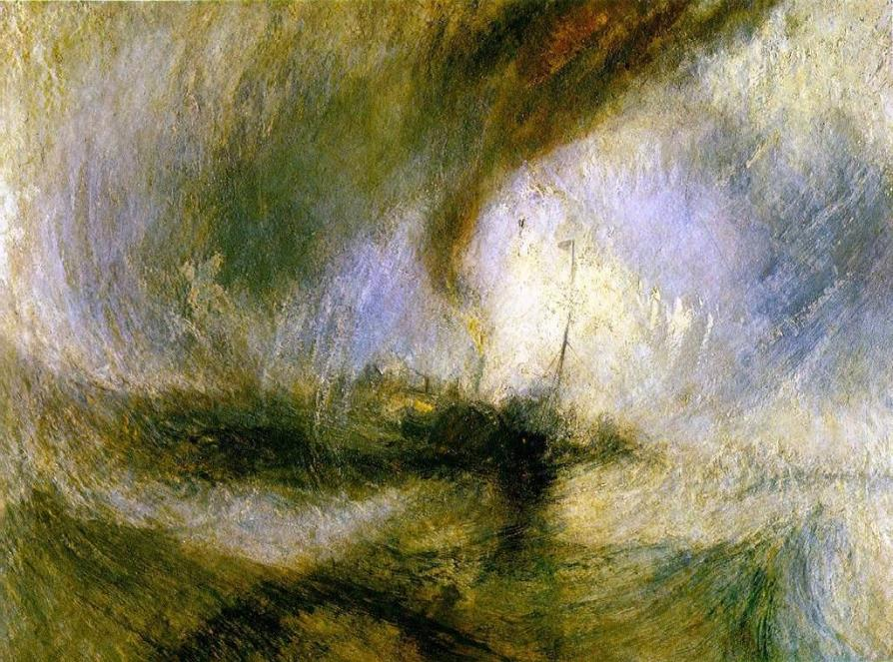
Snowstorm -- J. M. W. Turner, Tate Britain, London, England

Slide 10
Mountains and all hills, fruit trees and all cedars!
Psalm 148:9

Slide 11
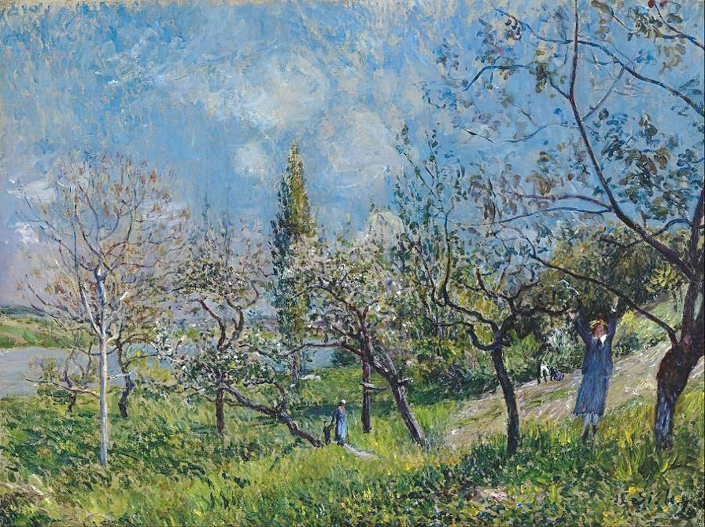
Orchard in Spring -- Alfred Sisley, Museum Boijmans Van Beuningen, Rotterdam, Netherlands

Slide 12
Wild animals and all cattle,
creeping things and flying birds!
Psalm 148:10

Slide 13
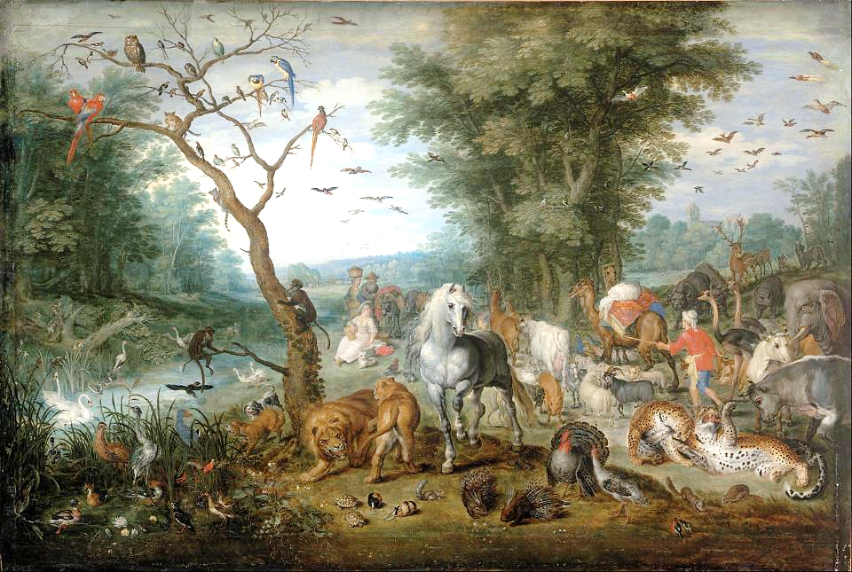
Paradise Landscape with Animals -- Jan Brueghel the Elder, Museum of Fine Arts, Budapest, Hungary

Slide 14
Kings of the earth and all peoples, princes and all rulers of the earth!
Psalm 148:11

Slide 15
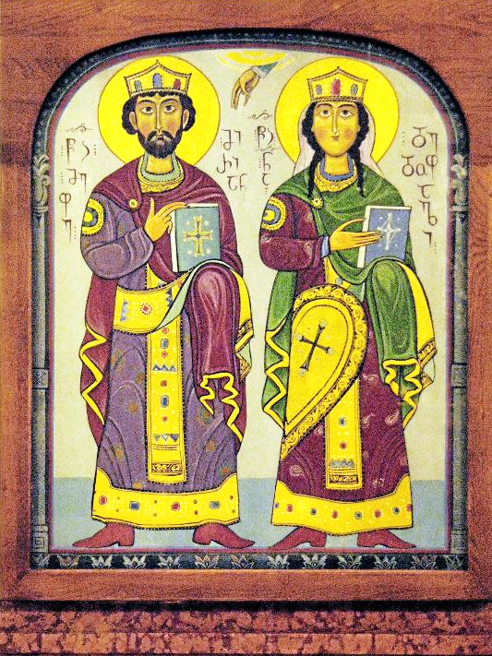
King and Queen Icon with Hand of God
Holy Trinity Cathedral
Tbilisi, Georgia

Slide 16
Young men and women alike,
old and young together!
Praise the LORD!
Psalm 148:12, 14b

Slide 17
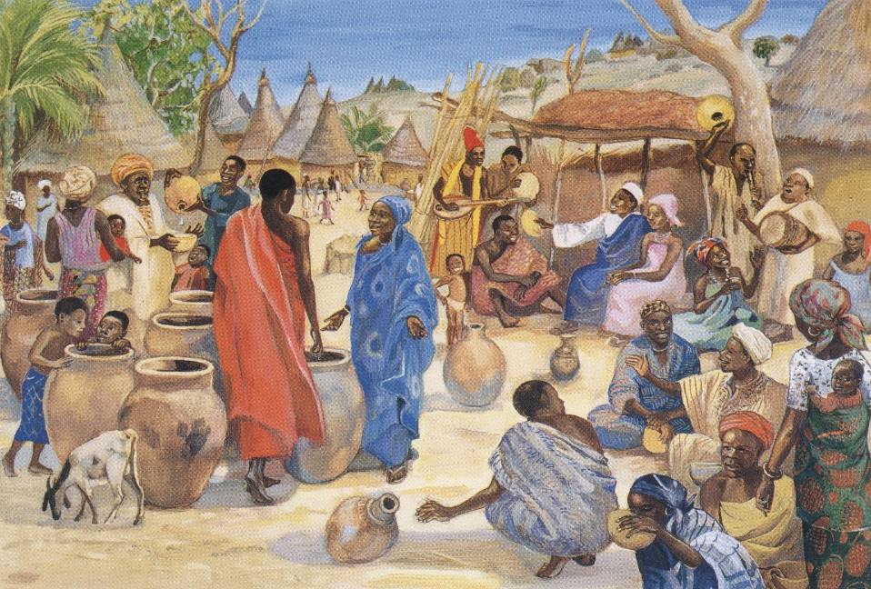
Wedding at Cana -- JESUS MAFA , Cameroon

Slide 18
… "the home of God is among mortals. He will dwell with them" …
Revelation 21:3b

Slide 19
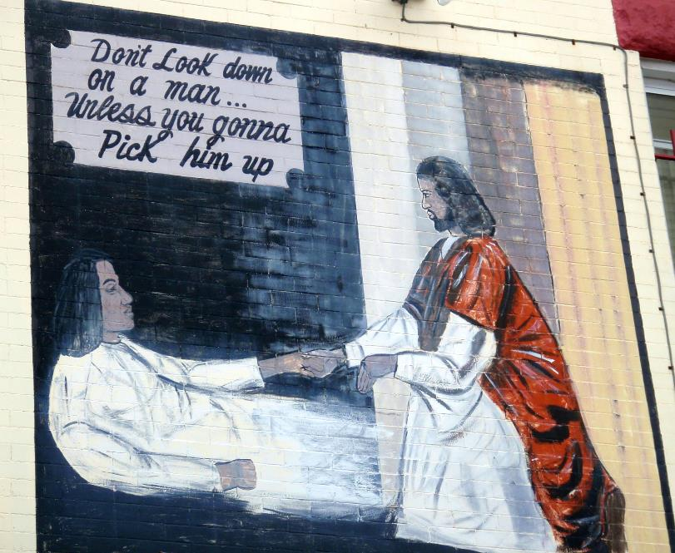
Jesus Christ Lends a Helping Hand -- Community mural, Washington, DC

Slide 20
"I give you a new commandment, that you love one another. Just as I have loved you, you also should love one another.
John 13:34

Slide 21
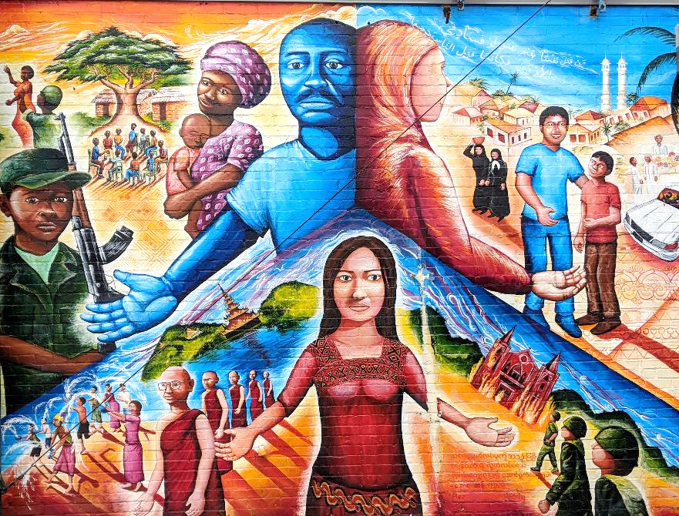
Global Refugee Mural -- Joel Bergner, Silver Spring, MD

Slide 22
By this everyone will know that you are my disciples, if you have love for one another."
John 13:35

Slide 23
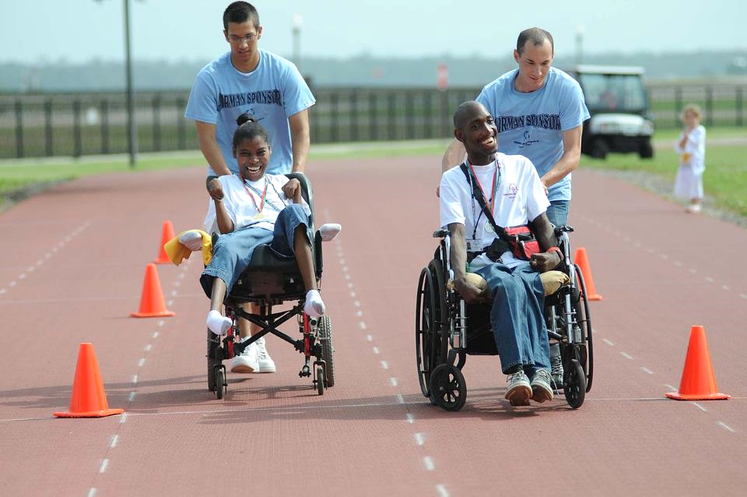
Mississippi Special Olympics Assisted Wheelchair Race, Keesler Air Force Base, MS

Slide 24
Credits
New Revised Standard Version Bible, copyright 1989, Division of Christian Education of the National Council of the Churches of Christ in the United States of America. Used by permission. All rights reserved.
https://www.flickr.com/photos/spbpda/14131553388
https://commons.wikimedia.org/wiki/File:Van_Gogh_-_Starry_Night_-_Google_Art_Project.jpg
https://commons.wikimedia.org/wiki/File:Odilon_Rendon_Animals-of-the-Bottom-of-the-Sea.jpg
https://commons.wikimedia.org/wiki/File:William_Turner_-_Snowstorm.JPG
https://commons.wikimedia.org/wiki/File:Alfred_Sisley_-_Orchard_in_Spring,_By_-_Google_Art_Project.jpg
https://commons.wikimedia.org/wiki/File:Jan_Breughel_Ii_-_Paradise_Landscape_with_Animals_-_Google_Art_Project.jpg
https://commons.wikimedia.org/wiki/File:An_icon_depicting_King_and_Queen_(of_Georgia)_at_Holy_Trinity_(Sameba)_Cathedral,_Tbilisi,_Georgia.jpg – Margot Kask
http://diglib.library.vanderbilt.edu/act-imagelink.pl?RC=48305
https://www.flickr.com/photos/daquellamanera/3994554964 - Daniel Lobo
Creative Commons Attribution ShareAlike - CC-BY-SA-3.0
https://commons.wikimedia.org/wiki/File:U.S._Air_Force_Airman_Basic_Tyler_Hewitt,_left,_pushes_Veronica_Nickelson_and_Airman_1st_Class_Adam_Trochesset_pushes_Roderick_Smith_while_competing_in_the_25-meter_assisted_wheelchair_race_at_the_2010_100515-F-BD983-009.jpg
Additional descriptions can be found at the Art in the Christian Tradition image library, a service of the Vanderbilt Divinity Library, http://diglib.library.vanderbilt.edu/. All images available via Creative Commons 3.0 License.

