Slide 1
Easter Vigil
Year C
Genesis 1:1-2:4a and Psalm 136:1-9, 23-26
Genesis 7:1-5, 11-18; 8:6-18; 9:8-13 and Psalm 46
Genesis 22:1-18 and Psalm 16
Exodus 14:10-31; 15:20-21 and Exodus 15:1b-13, 17-18
Isaiah 55:1-11 and Isaiah 12:2-6
Baruch 3:9-15, 3:32-4:4 or Proverbs 8:1-8, 19-21; 9:4b-6 and Psalm 19
Ezekiel 36:24-28 and Psalm 42, 43
Ezekiel 37:1-14 and Psalm 143
Zephaniah 3:14-20 and Psalm 98
Romans 6:3-11 and Psalm 114
Luke 24:1-12

Slide 2
God saw everything that he had made, and indeed, it was very good. And there was evening and there was morning, the sixth day.
Genesis 1:31

Slide 3
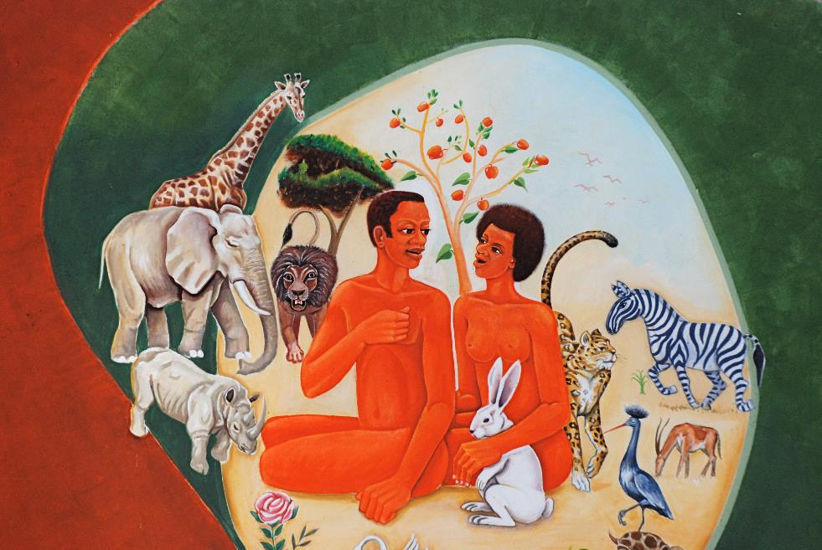
Creation -- Songea Cathedral, Tanzania

Slide 4
O give thanks to the LORD, for he is good … who spread out the earth on the waters, for his steadfast love endures forever;
Psalm 136:1a, 6

Slide 5
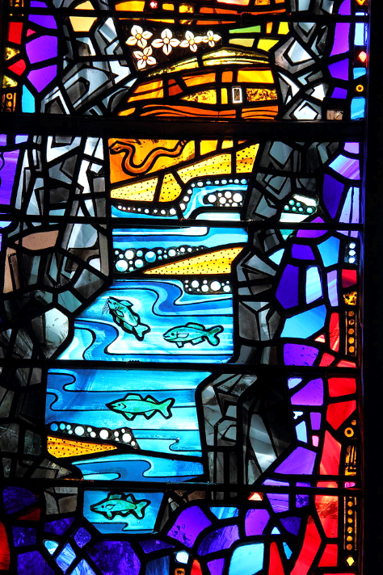
Creation - The Waters
Rowan and Irene LeCompte
National Cathedral
Washington, DC

Slide 6
“Bring out with you every living thing that is with you of all flesh--birds and animals and every creeping thing that creeps on the earth--so that they may abound on the earth, and be fruitful and multiply on the earth."
Genesis 8:17

Slide 7
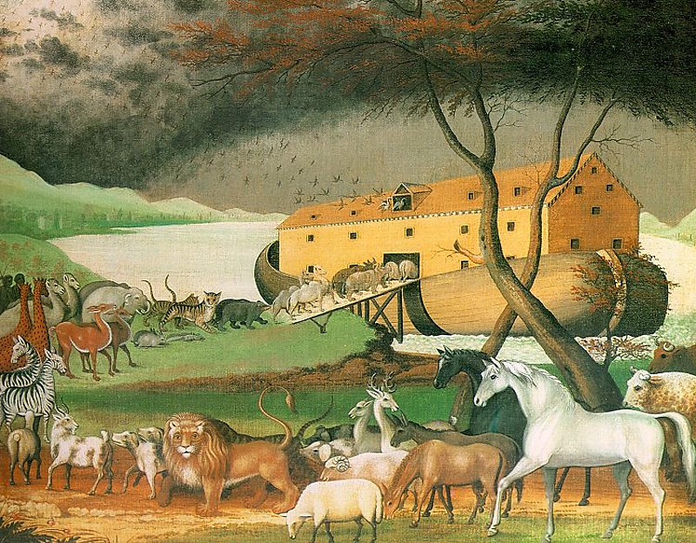
Noah’s Ark -- Edward Hicks, Philadelphia Museum of Art, Philadelphia, PA

Slide 8
I have set my bow in the clouds, and it shall be a sign of the covenant between me and the earth.
Genesis 9:13

Slide 9
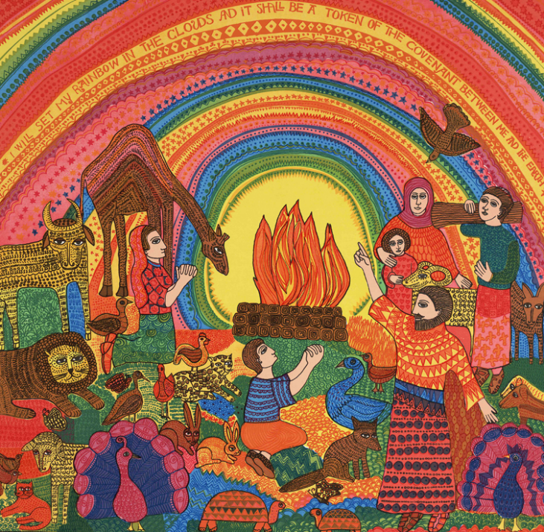
Rainbow
John August Swanson

Slide 10
"Take your son, your only son Isaac, whom you love, and go to the land of Moriah, and offer him there as a burnt offering on one of the mountains that I shall show you."
Genesis 22:2

Slide 11
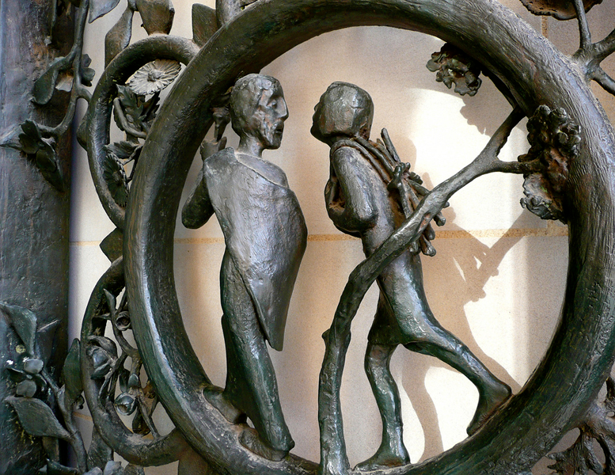
Sacrifice of Isaac -- Washington Cathedral, Washington, DC

Slide 12
When they came to the place that God had shown him, Abraham built an altar there and laid the wood in order. He bound his son Isaac, and laid him on the altar, on top of the wood.
Genesis 22:9

Slide 13
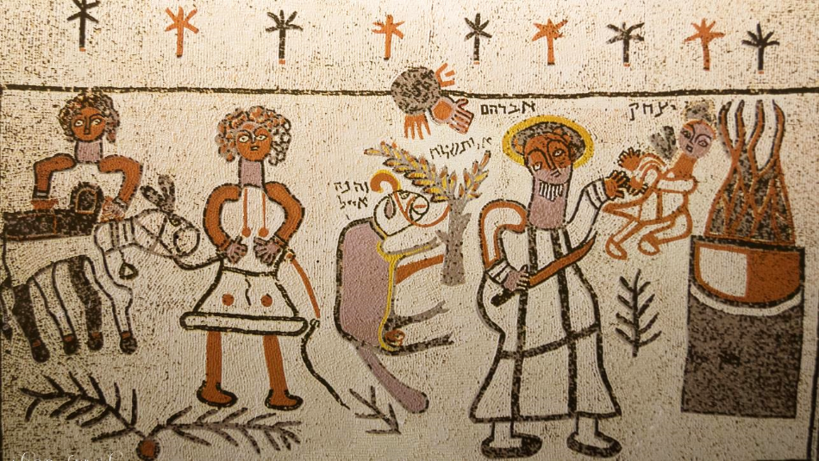
Bet Alfa Synagogue 5th century floor mosaic -- Bet Alfa, Israel

Slide 14
But the angel of the LORD called to him from heaven, and said …
"Do not lay your hand on the boy or do anything to him; for now I know that you fear God …"
Genesis 22:11a, 12a

Slide 15
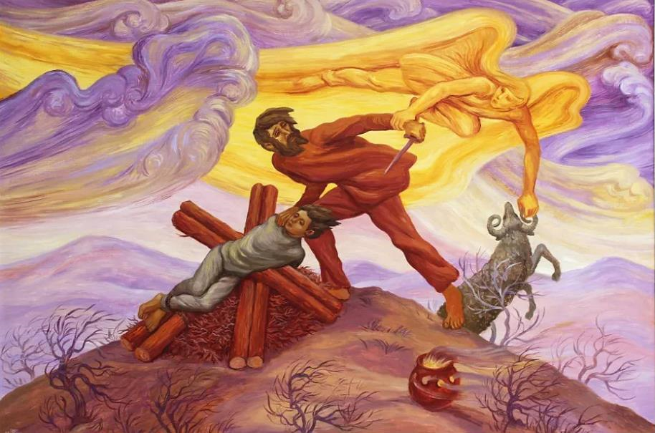
Abraham's Sacrifice – Peter Koenig

Slide 16
You show me the path of life. In your presence there is fullness of joy;
Psalm 16:11a

Slide 17
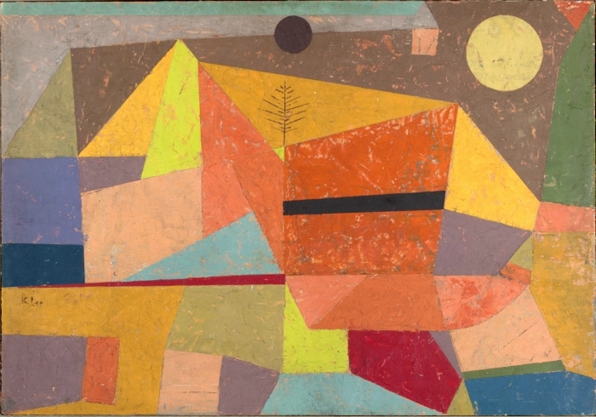
Joyful Mountain Landscape -- Paul Klee, Yale University Art Gallery, New Haven , CT

Slide 18
Then the LORD said to Moses, "Stretch out your hand over the sea, so that the water may come back upon the Egyptians, upon their chariots and chariot drivers."
Exodus 14:26

Slide 19
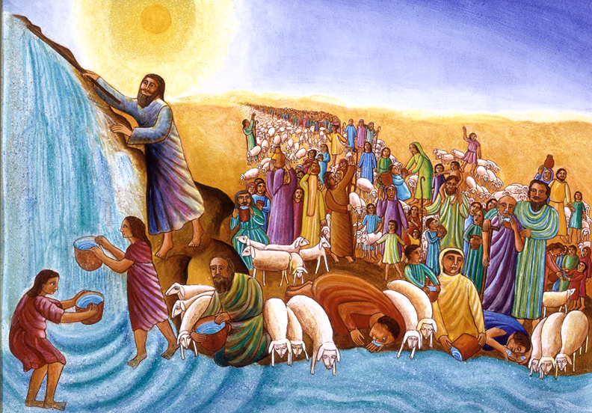
Crossing the Red Sea -- John August Swanson, serigraph, 1983

Slide 20
Then the prophet Miriam, Aaron's sister, took a tambourine in her hand; "Sing to the LORD, for he has triumphed gloriously; horse and rider he has thrown into the sea."
Exodus 15:20a, 21b

Slide 21
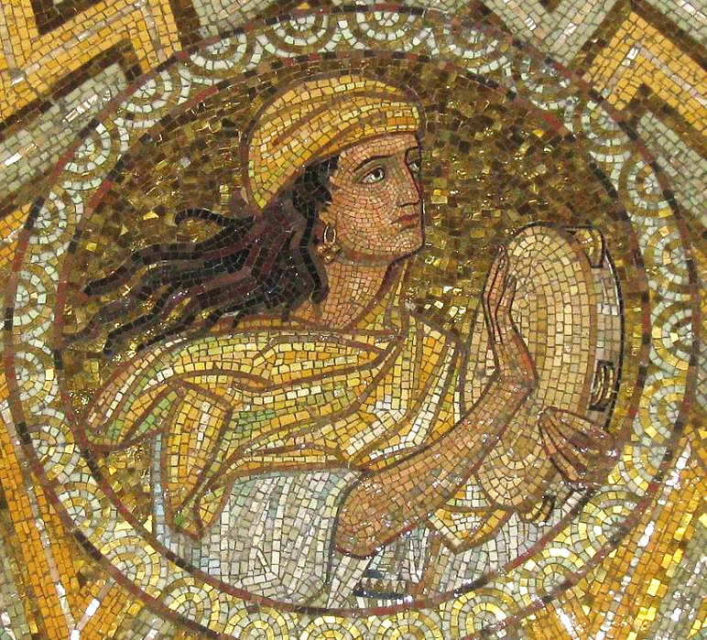
Miriam
Dormition Church
Mt. Zion, Jerusalem

Slide 22
In your steadfast love you led the people whom you redeemed; you guided them by your strength to your holy abode.
Exodus 15:13

Slide 23
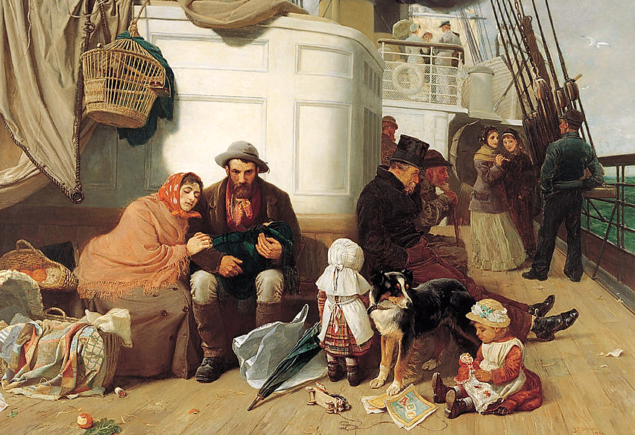
The Immigrant’s Ship -- John Dollman, Art Gallery of South Australia, Adelaide, Australia

Slide 24
The women were terrified … but the men said to them, "Why do you look for the living among the dead? He is not here, but has risen."
Luke 24:5ac

Slide 25
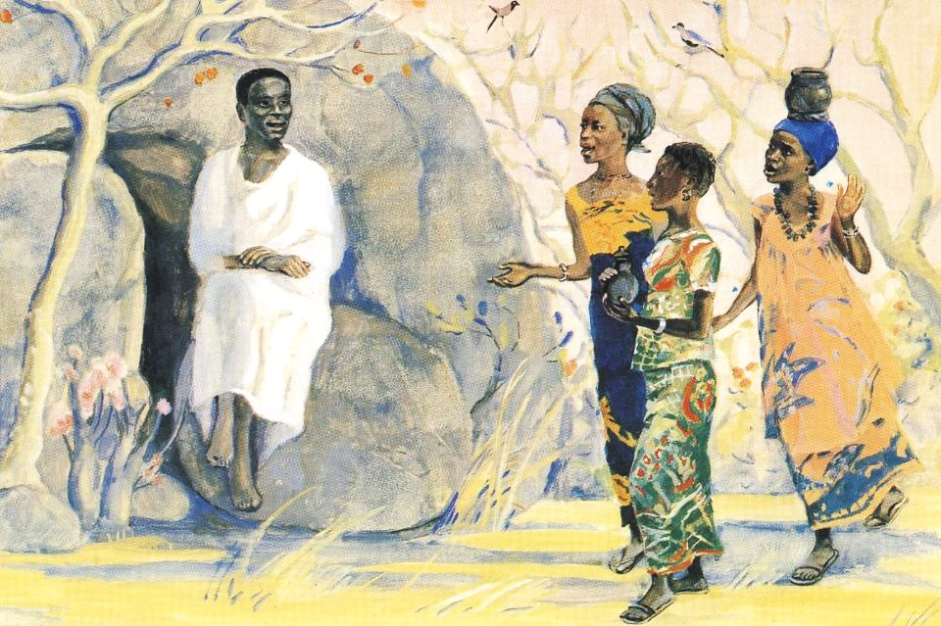
Empty Tomb -- JESUS MAFA, Cameroon

Slide 26
Credits
New Revised Standard Version Bible, copyright 1989, Division of Christian Education of the National Council of the Churches of Christ in the United States of America. Used by permission. All rights reserved.
flickr.com/photos/dominikkustra/4013203751
https://www.flickr.com/photos/dominikkustra/4013203751
https://commons.wikimedia.org/wiki/File:Stained_glass_window_Washington_National_Cathedral_2012_06.JPG
http://commons.wikimedia.org/wiki/File:Noahs_Ark.jpg
www.JohnAugustSwanson.com - copyright 1974 by John August Swanson
http://www.flickr.com/photos/sshb/2253871778/
https://www.flickr.com/photos/dnwinterburn/8587586562
https://www.pwkoenig.co.uk/
http://commons.wikimedia.org/wiki/File:Heitere_Gebirgslandschaft_by_Paul_Klee_1929.jpeg
www.JohnAugustSwanson.com - copyright 1983 by John August Swanson
https://commons.wikimedia.org/wiki/File:Miriam_IMG_28071.JPG
https://commons.wikimedia.org/wiki/File:John_C._Dollman_-_The_immigrants%27_ship_-_Google_Art_Project.jpg
http://diglib.library.vanderbilt.edu/act-imagelink.pl?RC=48301
Additional descriptions can be found at the Art in the Christian Tradition image library, a service of the Vanderbilt Divinity Library, http://diglib.library.vanderbilt.edu/. All images available via Creative Commons 3.0 License.

