Slide 1
DAY OF PENTECOST
Year C
Acts 2:1-21 or Genesis 11:1-9 • Psalm 104:24-34, 35b Romans 8:14-17 or Acts 2:1-21 • John 14:8-17, (25-27)

Slide 2
When the day of Pentecost had come, they were all together in one place.
Acts 2:1

Slide 3
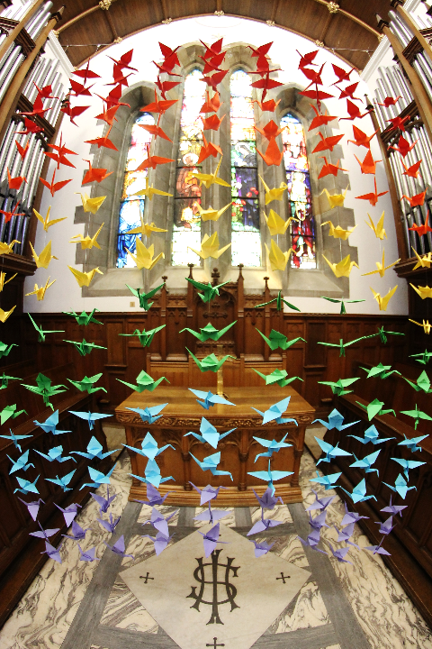
Pentecost
New Kilpatrick Parish Church Bearsden, Scotland

Slide 4
And suddenly from heaven there came a sound like the rush of a violent wind, and it filled the entire house where they were sitting.
Acts 2:2

Slide 5
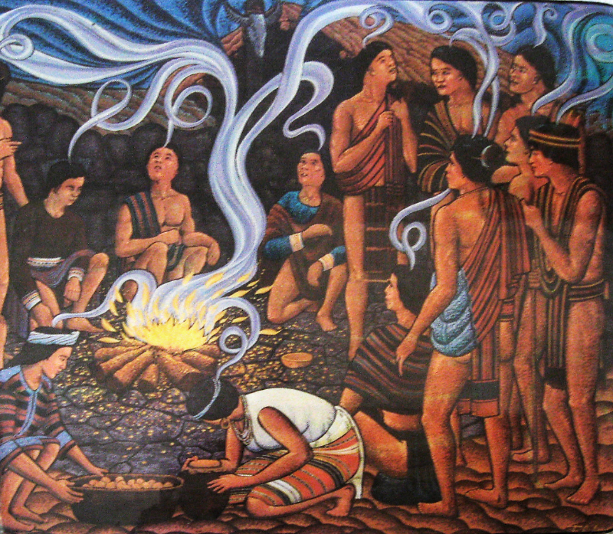
Pentecost
Bontoc Museum
Bontoc, Philippines

Slide 6
Divided tongues, as of fire, appeared among them, and a tongue rested on each of them.
Acts 2:3

Slide 7
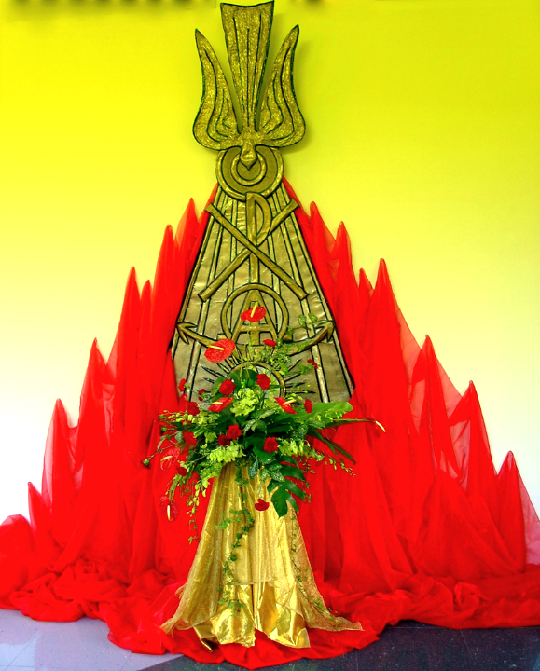
Pentecost
Church of the Holy Spirit Singapore

Slide 8
All of them were filled with the Holy Spirit and began to speak in other languages, as the Spirit gave them ability.
Acts 2:4

Slide 9
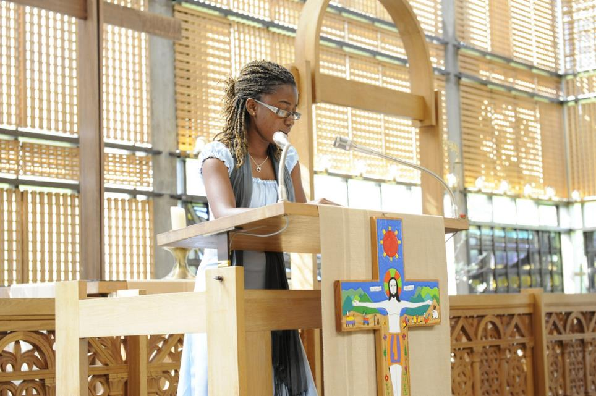
Acts 2, Pentecost, read by Surinamer Danielle Dokman, Lutheran World Federation, Geneva

Slide 10
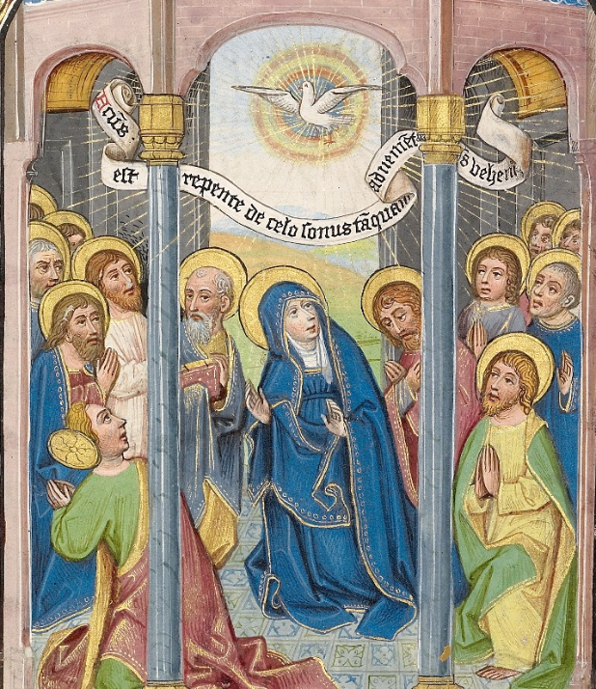
Pentecost
William Vrelant
Getty Center
Los Angeles, CA

Slide 11
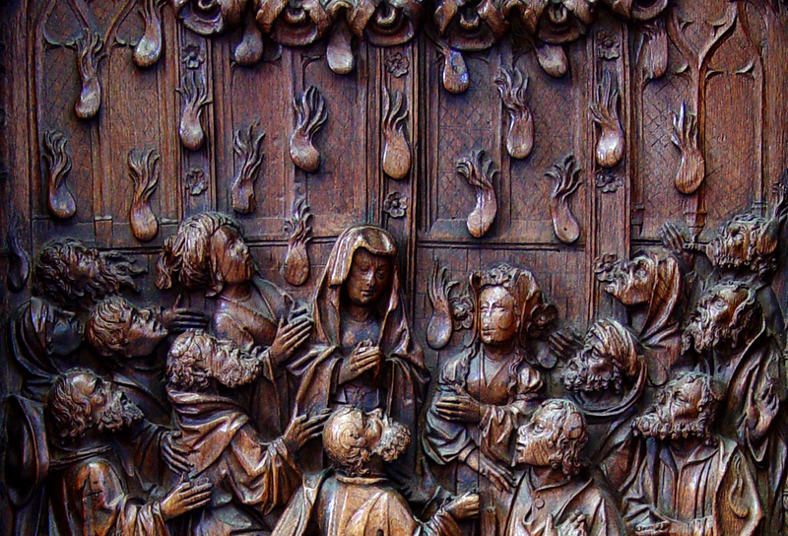
Pentecost -- Early 16th century Choirstall, Amiens Cathedral, Amiens, France

Slide 12
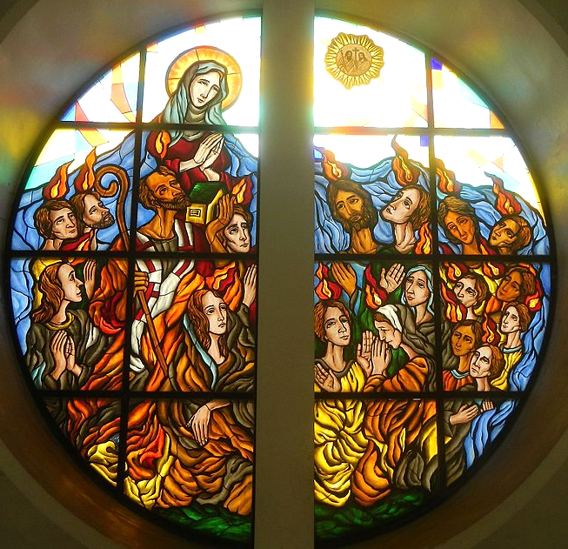
Pentecost
Our Lady of Pentecost Catholic Church Quezon City, Philippines

Slide 13
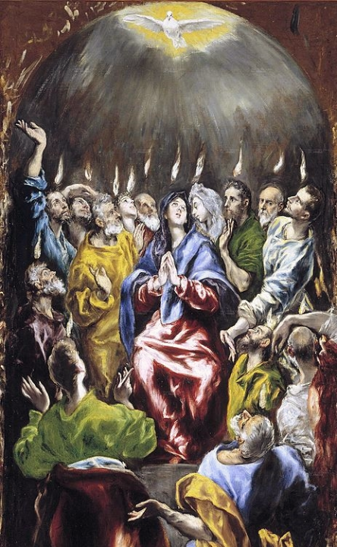
Pentecost
El Greco
Prado Museum
Madrid, Spain

Slide 14
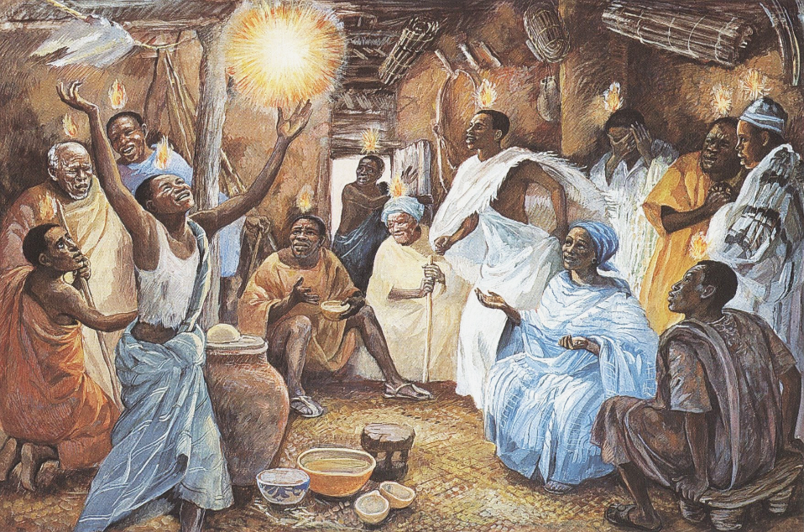
Pentecost -- JESUS MAFA, Cameroon

Slide 15
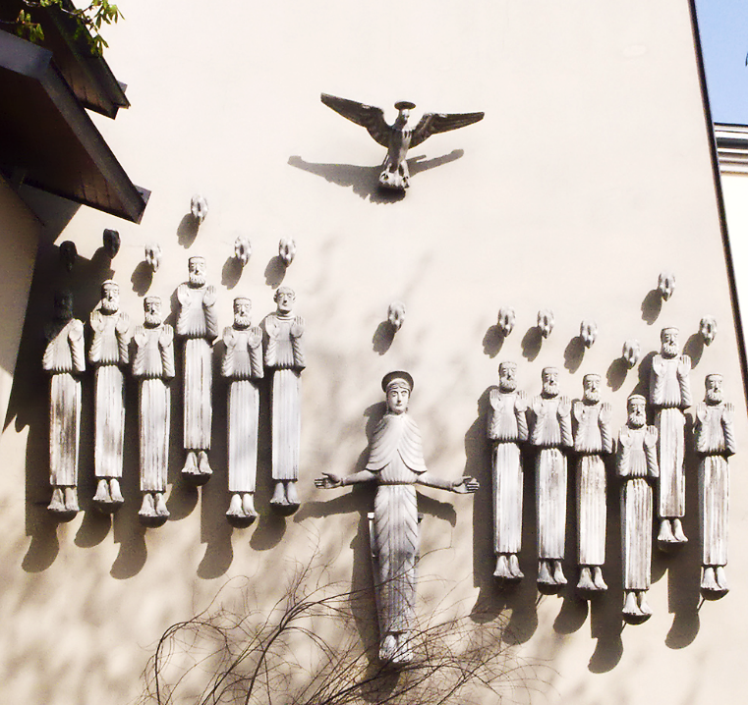
Pentecost
Church of Pallotihaus
Vienna, Austria

Slide 16
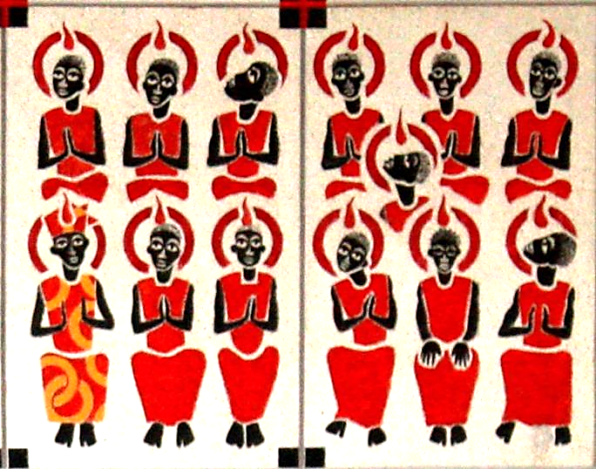
Pentecost -- Keur Moussa Abbey, Keur Moussa, Senegal

Slide 17
Therefore it was called Babel … and from there the LORD scattered them abroad over the face of all the earth.
Genesis 11:9ac

Slide 18
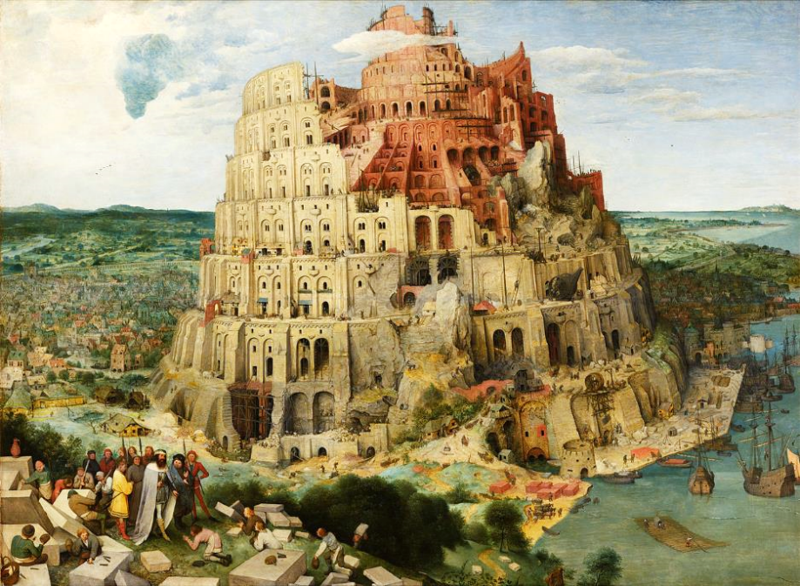
Tower of Babel -- Pieter Brueghel the Elder, Kunsthistorisches Museum, Vienna, Austria

Slide 19
O LORD, how manifold are your works! … When you send forth your spirit, they are created;
Psalm 104:24a, 30a

Slide 20
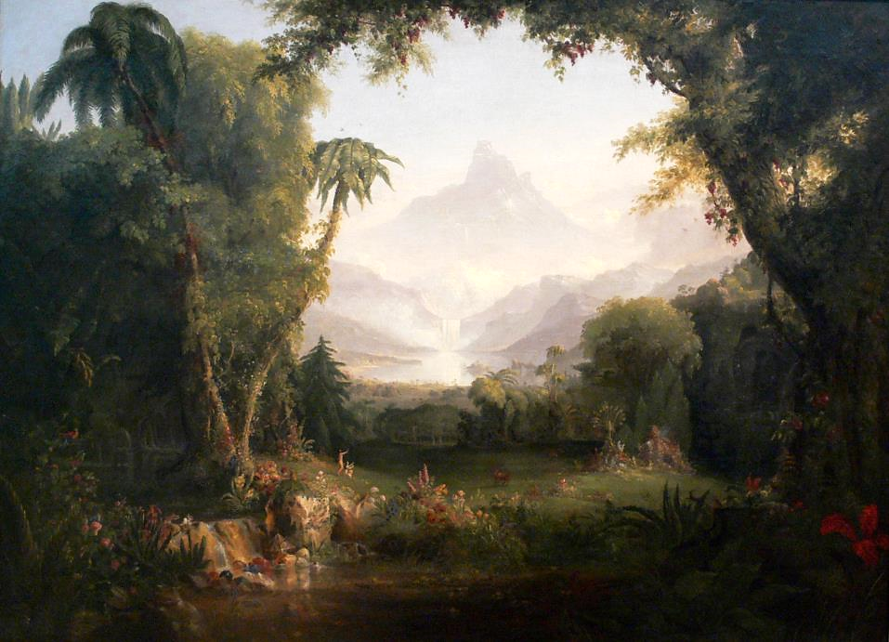
Garden of Eden -- Thomas Cole, Amon Carter Museum of Art, Fort Worth, TX

Slide 21
For all who are led by the Spirit of God are children of God.
Romans 8:14

Slide 22
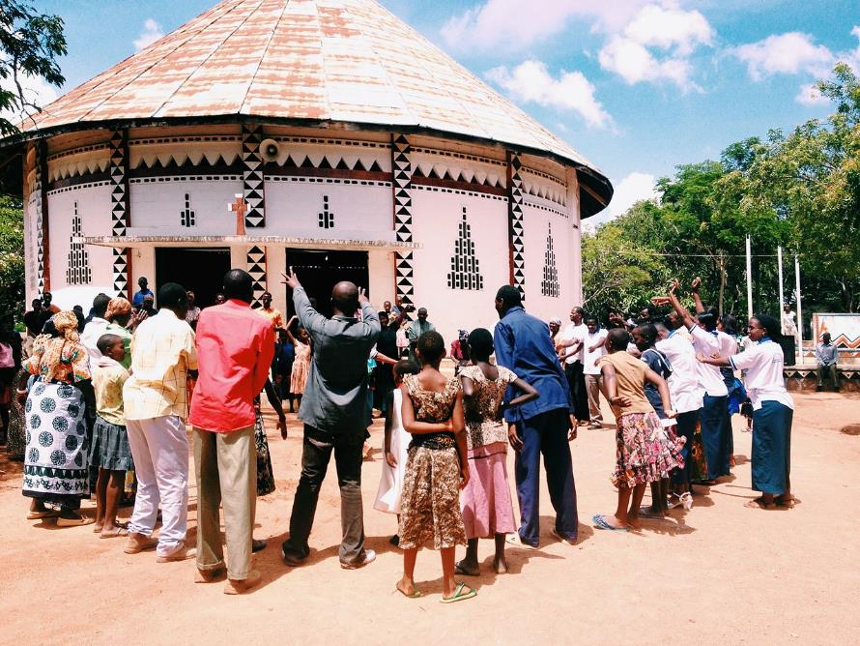
Celebration Day -- Bujora Catholic Church, Sukumaland, Tanzania

Slide 23
But the Advocate, the Holy Spirit, whom the Father will send in my name, will teach you everything, and remind you of all that I have said to you.
John 14:26

Slide 24
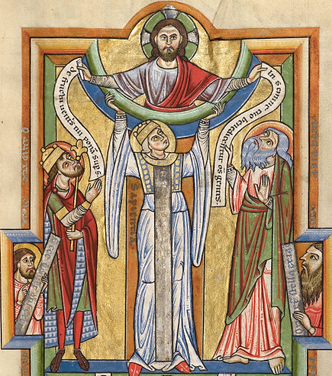
Wisdom as Holy Spirit
Manuscript, c. 1170
J. Paul Getty Museum
Los Angeles, CA

Slide 25
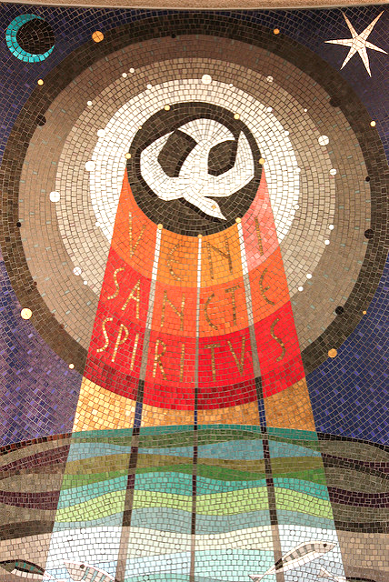
?
Veni Sancti Spiritus
St. Aloysius Somers Town
London, England

Slide 26
Credits
New Revised Standard Version Bible, copyright 1989, Division of Christian Education of the National Council of the Churches of Christ in the United States of America. Used by permission. All rights reserved.
https://www.flickr.com/photos/glasgowamateur/9370166215/ - Charles Clegg
https://www.flickr.com/photos/onbangladesh/4786279620
http://www.flickr.com/photos/eustaquio/3580213825/
https://www.flickr.com/photos/lwf_eleventh_assembly/5824745677 - Lutheran World Federation
https://commons.wikimedia.org/wiki/File:Willem_Vrelant_(Flemish,_died_1481,_active_1454_-_1481)_-_Pentecost_-_Google_Art_Project.jpg
http://diglib.library.vanderbilt.edu/act-imagelink.pl?RC=51555
https://commons.wikimedia.org/wiki/File:0329jfOur_Lady_of_Pentecost_Parish_Church_Quezon_City_Loyola_Heightsfvf_25.jpg
https://commons.wikimedia.org/wiki/File:Pentecost%C3%A9s_(El_Greco,_1597).jpg
http://diglib.library.vanderbilt.edu/act-imagelink.pl?RC=48388
https://commons.wikimedia.org/wiki/File:Pallottihaus_03.jpg
https://commons.wikimedia.org/wiki/File:KeurMoussaAutel.jpg
https://commons.wikimedia.org/wiki/File:Pieter_Bruegel_the_Elder_-_The_Tower_of_Babel_(Vienna)_-_Google_Art_Project_-_edited.jpg
https://commons.wikimedia.org/wiki/File:Thomas_Cole_The_Garden_of_Eden_Amon_Carter_Museum.jpg
https://commons.wikimedia.org/wiki/File:Holy_celebration.jpg -Patricia Gambula Larsen
http://commons.wikimedia.org/wiki/File:Wisdom_-_Google_Art_Project.jpg
https://www.flickr.com/photos/paullew/8750321716
Additional descriptions can be found at the Art in the Christian Tradition image library, a service of the Vanderbilt Divinity Library, http://diglib.library.vanderbilt.edu/. All images available via Creative Commons 3.0 License.

