Slide 1
Thanksgiving Day
Year B
Joel 2:21-27 and Psalm 126 • 1 Timothy 2:1-7
Matthew 6:25-33

Slide 2
Do not fear, you animals of the field, for the pastures of the wilderness are green;
Joel 2:22a

Slide 3
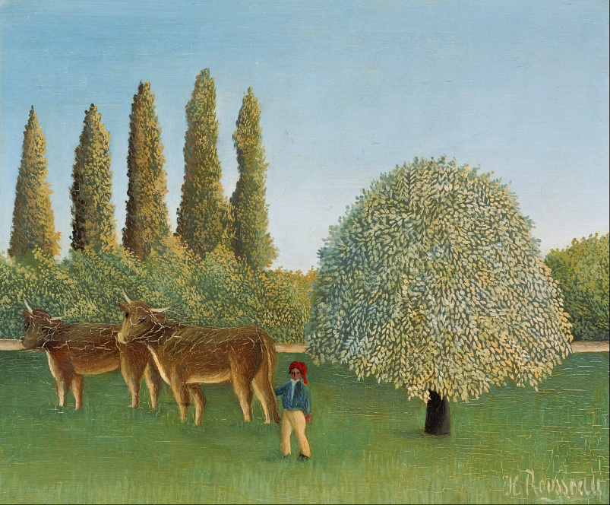
Meadowland -- Henri Rousseau, Bridgestone Museum of Art, Tokyo, Japan

Slide 4
the tree bears its fruit, the fig tree and vine give their full yield.
Joel 2:22b

Slide 5
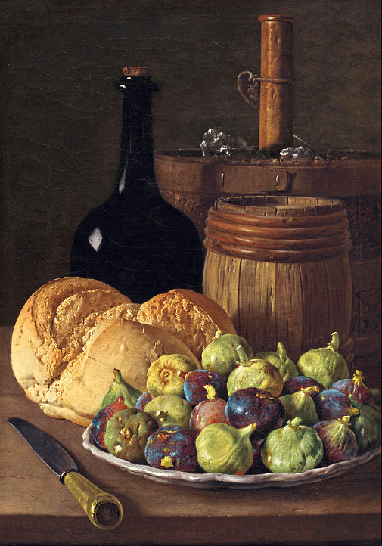
Still Life with Figs and Bread
Luis Melendez
National Gallery of Art
Washington, DC

Slide 6
You shall eat in plenty and be satisfied, and praise the name of the LORD your God, who has dealt wondrously with you.
Joel 2:26

Slide 7
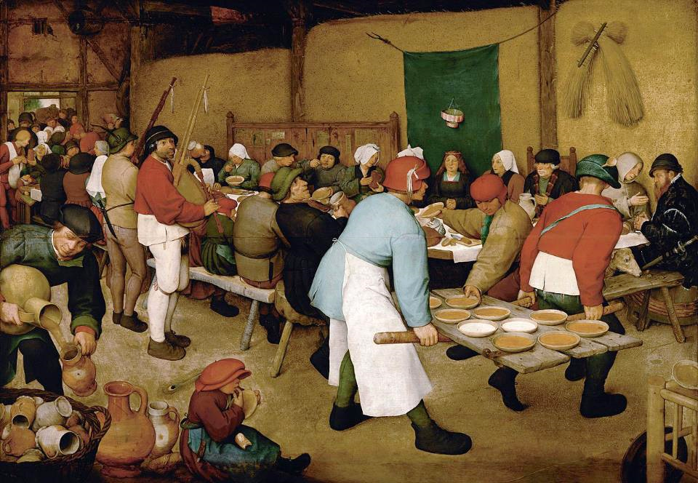
Peasant Wedding -- Pieter Brueghel, Kunsthistorisches Museum, Vienna, Austria

Slide 8
Those who go out weeping, bearing the seed for sowing, shall come home with shouts of joy, carrying their sheaves.
Psalm 126:6

Slide 9
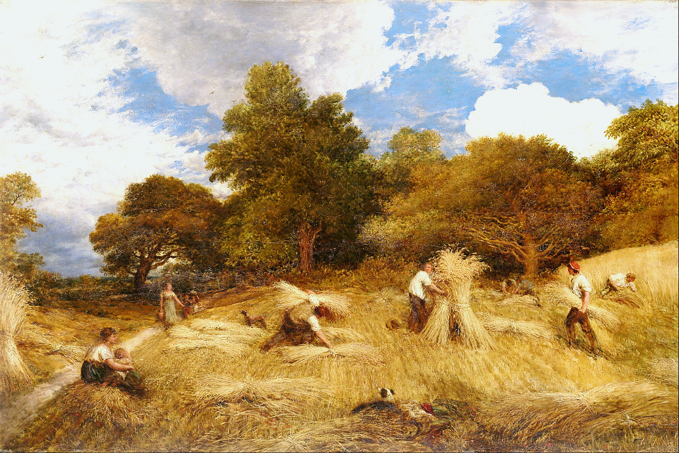
Wheat -- John Linnell, National Gallery of Victoria, Melbourne, Australia

Slide 10
First of all, then, I urge that supplications, prayers, intercessions, and thanksgivings be made for everyone,
1 Timothy 2:1

Slide 11
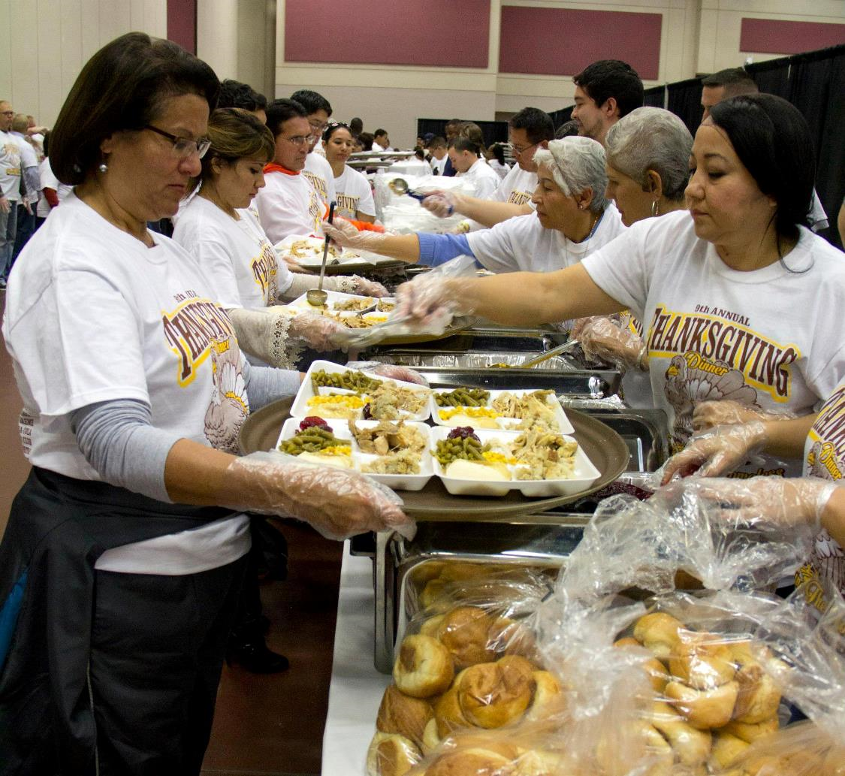
Preparing Thanksgiving for Homeless Community -- El Paso, TX

Slide 12
for kings and all who are in high positions, so that we may lead a quiet and peaceable life in all godliness and dignity.
1 Timothy 2:2

Slide 13
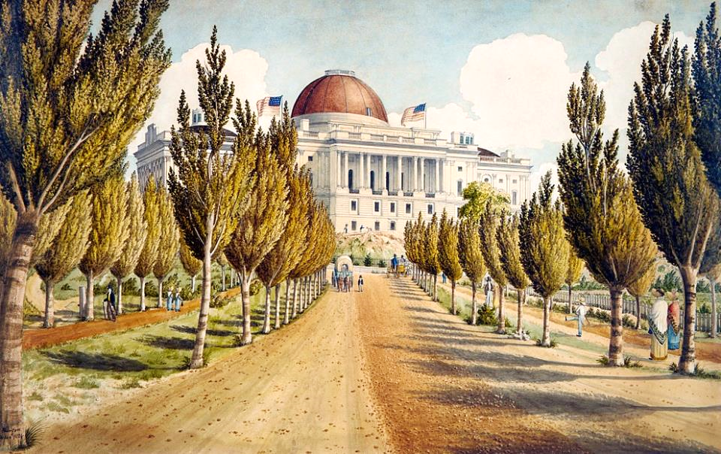
View of the United States Capitol -- watercolor, 1824, Metropolitan Museum of Art, New York, NY

Slide 14
"Therefore I tell you, do not worry about your life, what you will eat or what you will drink, or about your body, what you will wear.
Matthew6:25a

Slide 15
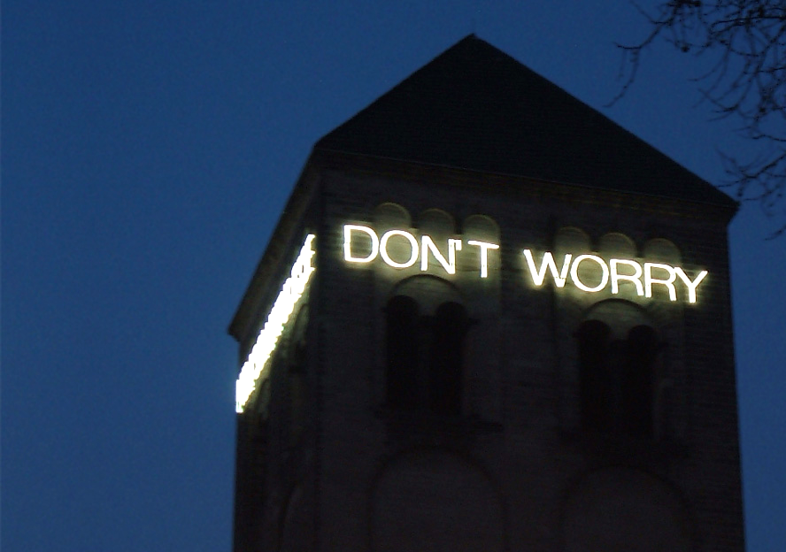
Don't Worry -- Martin Creed, permanent installation, St. Peter's Cathedral, Cologne, Germany

Slide 16
Is not life more than food, and the body more than clothing?
Matthew 6:25b

Slide 17
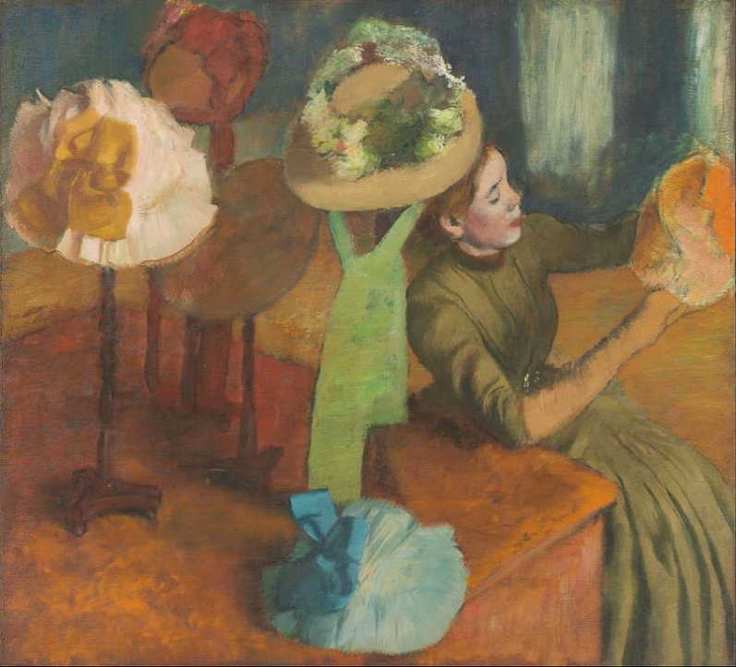
The Millinery Shop
Edgar Degas
Art Institute of Chicago
Chicago, IL

Slide 18
Look at the birds of the air; they neither sow nor reap nor gather into barns, and yet your heavenly Father feeds them.
Matthew 6:26

Slide 19
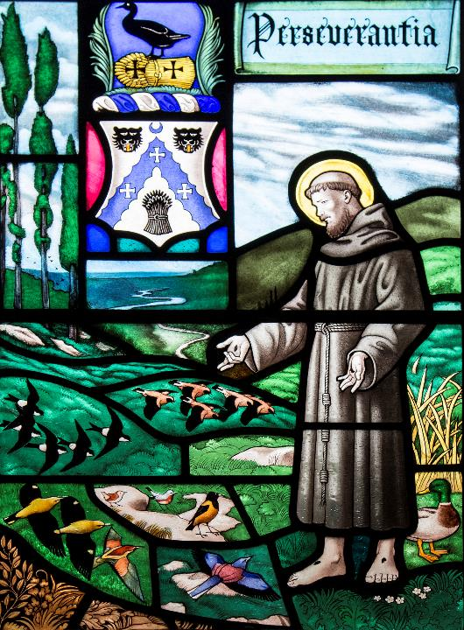
St. Francis and the Birds
Westminster Abbey
London, England

Slide 20
Consider the lilies of the field, how they grow; they neither toil nor spin, yet I tell you, even Solomon in all his glory was not clothed like one of these.
Matthew 6:28b, 29a

Slide 21
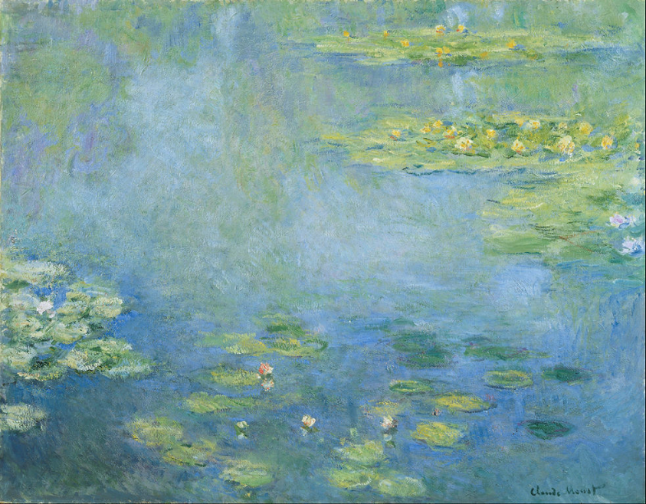
Waterlilies -- Claude Monet, Ohara Museum of Art, Kurashiki, Japan

Slide 22
Therefore do not worry, saying, 'What will we eat?' or 'What will we drink?' or 'What will we wear?'
Matthew 6:31

Slide 23
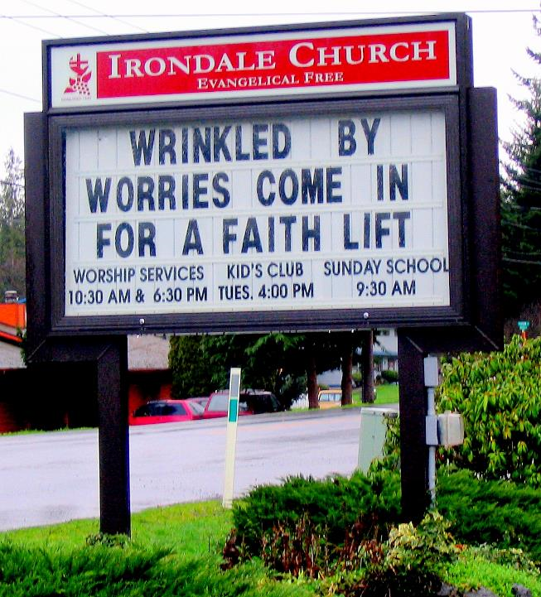
Wrinkled by Worries
Irondale Evangelical Free Church
Irondale, AL

Slide 24
But strive first for the kingdom of God and his righteousness, and all these things will be given to you as well."
Matthew 6:33

Slide 25
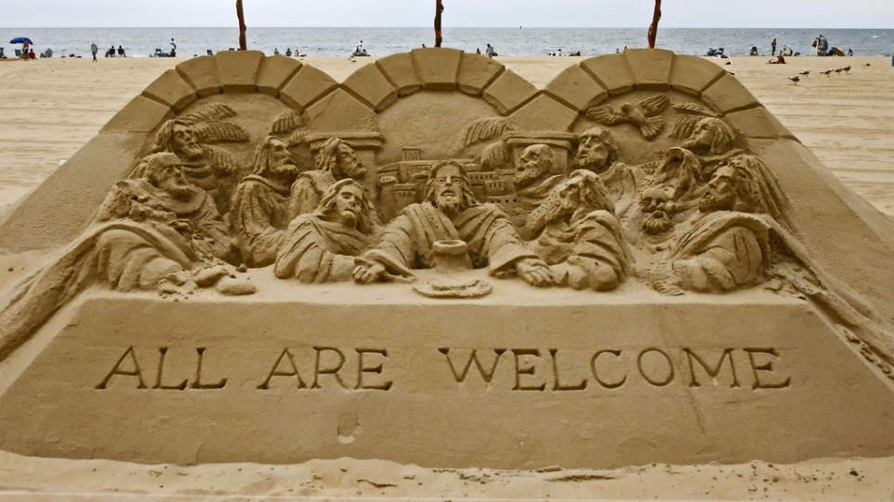
All Are Welcome in the Kingdom of God -- Sand sculpture, Ocean City, MD

Slide 26
Credits
New Revised Standard Version Bible, copyright 1989, Division of Christian Education of the National Council of the Churches of Christ in the United States of America. Used by permission. All rights reserved.
https://commons.wikimedia.org/wiki/File:Henri_Rousseau_-_Meadowland_-_Google_Art_Project.jpg
https://commons.wikimedia.org/wiki/File:Luis_Mel%C3%A9ndez_-_Still_Life_with_Figs_and_Bread_-_Google_Art_Project.jpg
https://commons.wikimedia.org/wiki/File:Pieter_Bruegel_the_Elder_-_Peasant_Wedding_-_Google_Art_Project_2.jpg
https://commons.wikimedia.org/wiki/File:John_Linnell_-_Wheat_-_Google_Art_Project.jpg
https://commons.wikimedia.org/wiki/File:Fort_Bliss_soldiers,_El_Paso_community_help_feed_homeless_families_on_Thanksgiving_131128-A-JV906-214.jpg
https://commons.wikimedia.org/wiki/File:View_of_the_Capitol_MET_APS2248.jpg – Charles W. Burton
https://commons.wikimedia.org/wiki/File:Don%27t_worry.jpg – Vincerama
https://commons.wikimedia.org/wiki/File:Edgar_Degas_-_The_Millinery_Shop_-_Google_Art_Project.jpg
https://www.flickr.com/photos/paullew/10081428036 - Fr Lawrence Lew, O.P.
https://commons.wikimedia.org/wiki/File:Claude_Monet_-_Waterlilies_-_Google_Art_Project.jpg
https://www.flickr.com/photos/jantik/4388441 - Jan Tik
https://www.flickr.com/photos/jillianaphotography/1236022574/ - Jillian
Additional descriptions can be found at the Art in the Christian Tradition image library, a service of the Vanderbilt Divinity Library, http://diglib.library.vanderbilt.edu/. All images available via Creative Commons 3.0 License.

