Slide 1
Sixth Sunday after the Epiphany
Year B
2 Kings 5:1-14 • Psalm 30
1 Corinthians 9:24-27 • Mark 1:40-45

Slide 2
So he went down and immersed himself seven times in the Jordan, according to the word of the man of God; his flesh was restored like the flesh of a young boy, and he was clean.
2 Kings 5:14

Slide 3
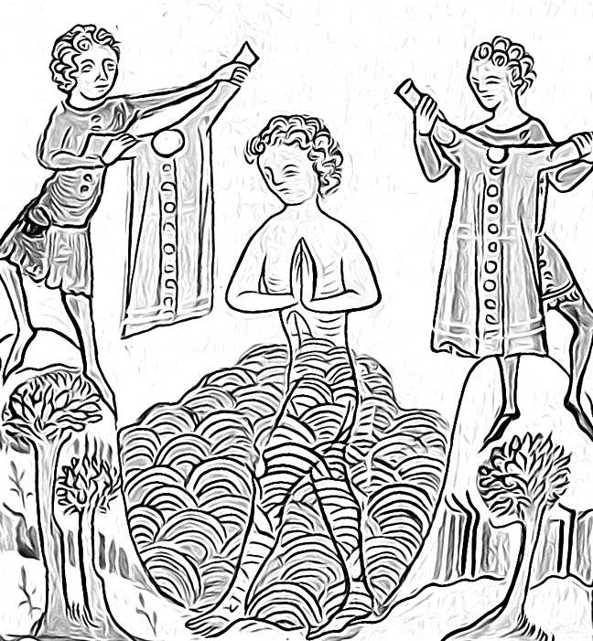
Naaman Bathes in the Jordan
Darmstadt, Germany
ca. 1360

Slide 4
O LORD my God, I cried to you for help, and you have healed me.
Psalm 30:2

Slide 5
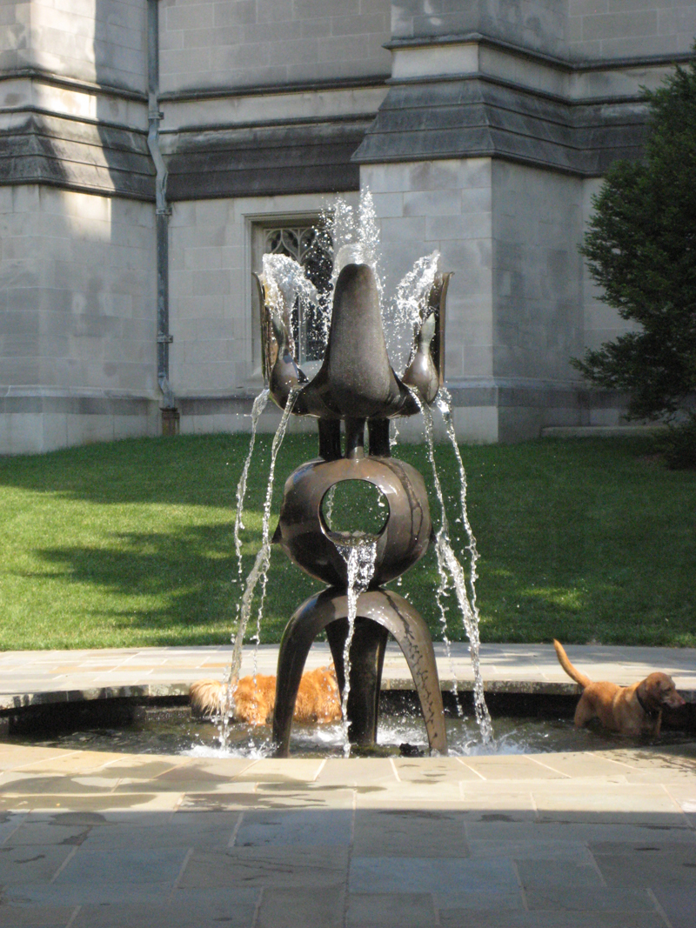
Joy in Water
Washington National Cathedral

Slide 6
Weeping may linger for the night, but joy comes with the morning.
Psalm 30:5b

Slide 7
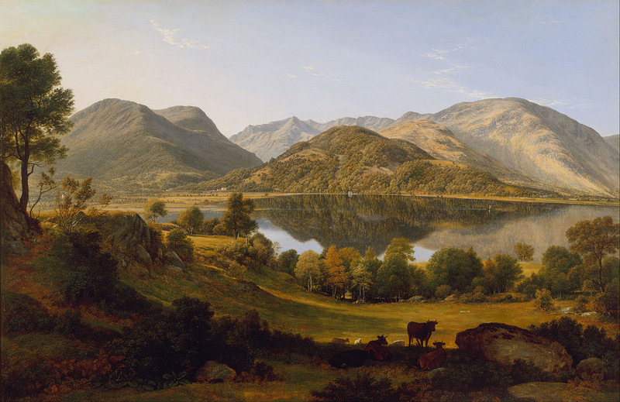
Ullswater, early morning, John Glover, ca. 1824

Slide 8
Athletes exercise self-control in all things; they do it to receive a perishable wreath, but we an imperishable one.
1 Corinthians 9:25

Slide 9
Self-Control
Wayne Stratz, Margaret Almon, Suzanne Halstead, 2011

Slide 10
So I do not run aimlessly, nor do I box as though beating the air;
1 Corinthians 9:24-27

Slide 11
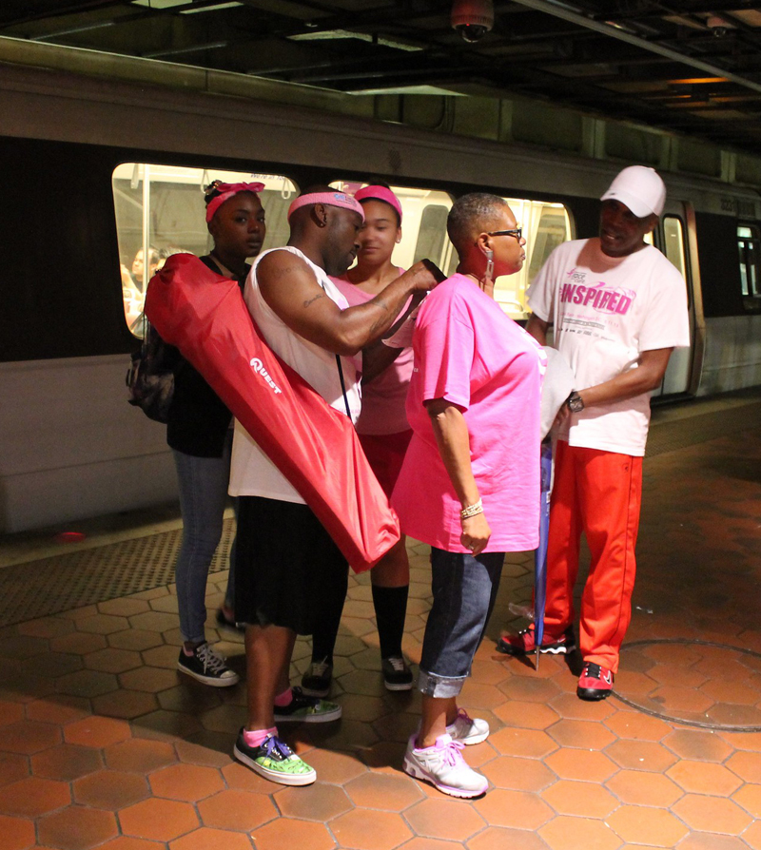
Getting Ready– Global Race for the Cure Participants
L’Enfant Plaza, 2014

Slide 12
A leper came to him begging him, and kneeling he said to him, “If you choose, you can make me clean.”
Mark 1:40

Slide 13
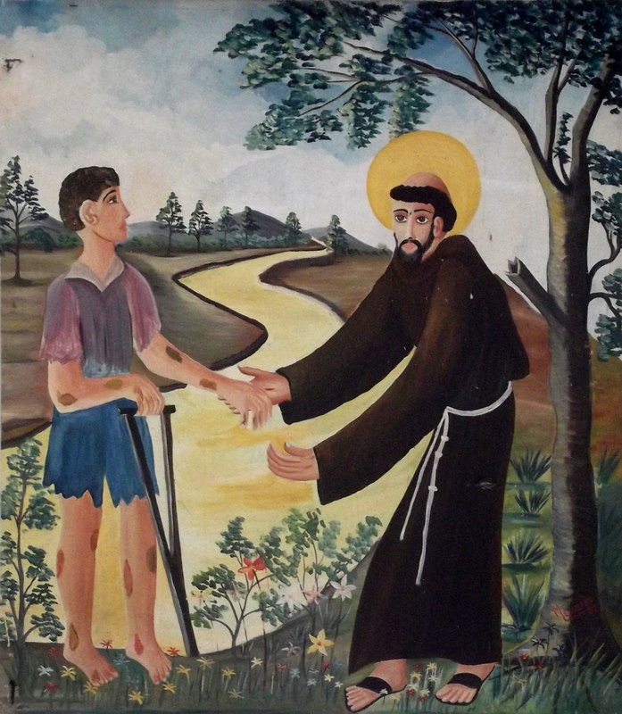
Priest reaching out to help a man with leprosy, Basílica de São Francisco das Chagas, 20th century

Slide 14
Moved with pity, Jesus stretched out his hand and touched him, and said to him, “I do choose. Be made clean!”
Mark 1:41

Slide 15
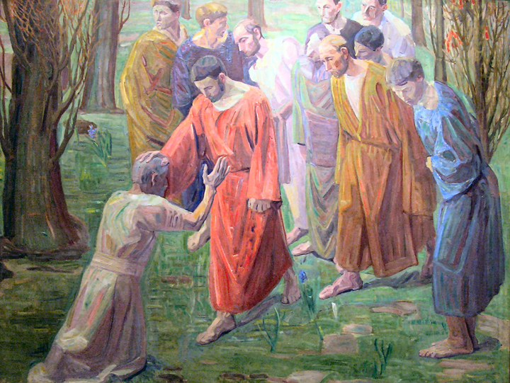
Healing of a Leper, Niels Larsen Stevns, 1913

Slide 16
Immediately the leprosy left him, and he was made clean.
Mark 1:42

Slide 17
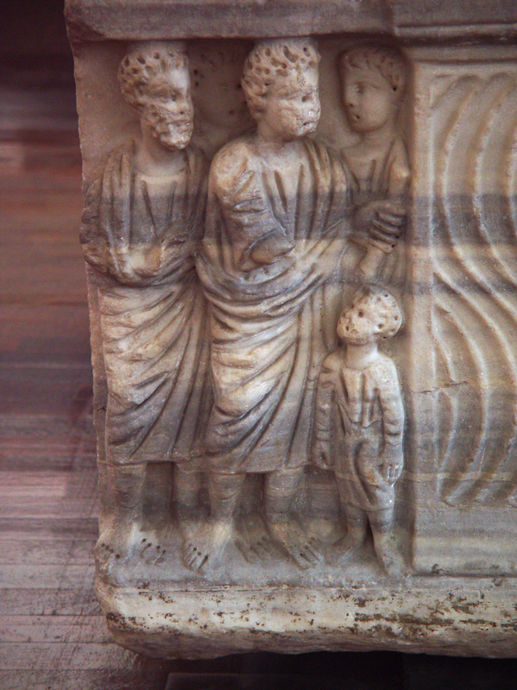
Christ in the Act of Healing
Vatican City, 3rd-4th centuries

Slide 18
After sternly warning him he sent him away at once,
Mark 1:43

Slide 19
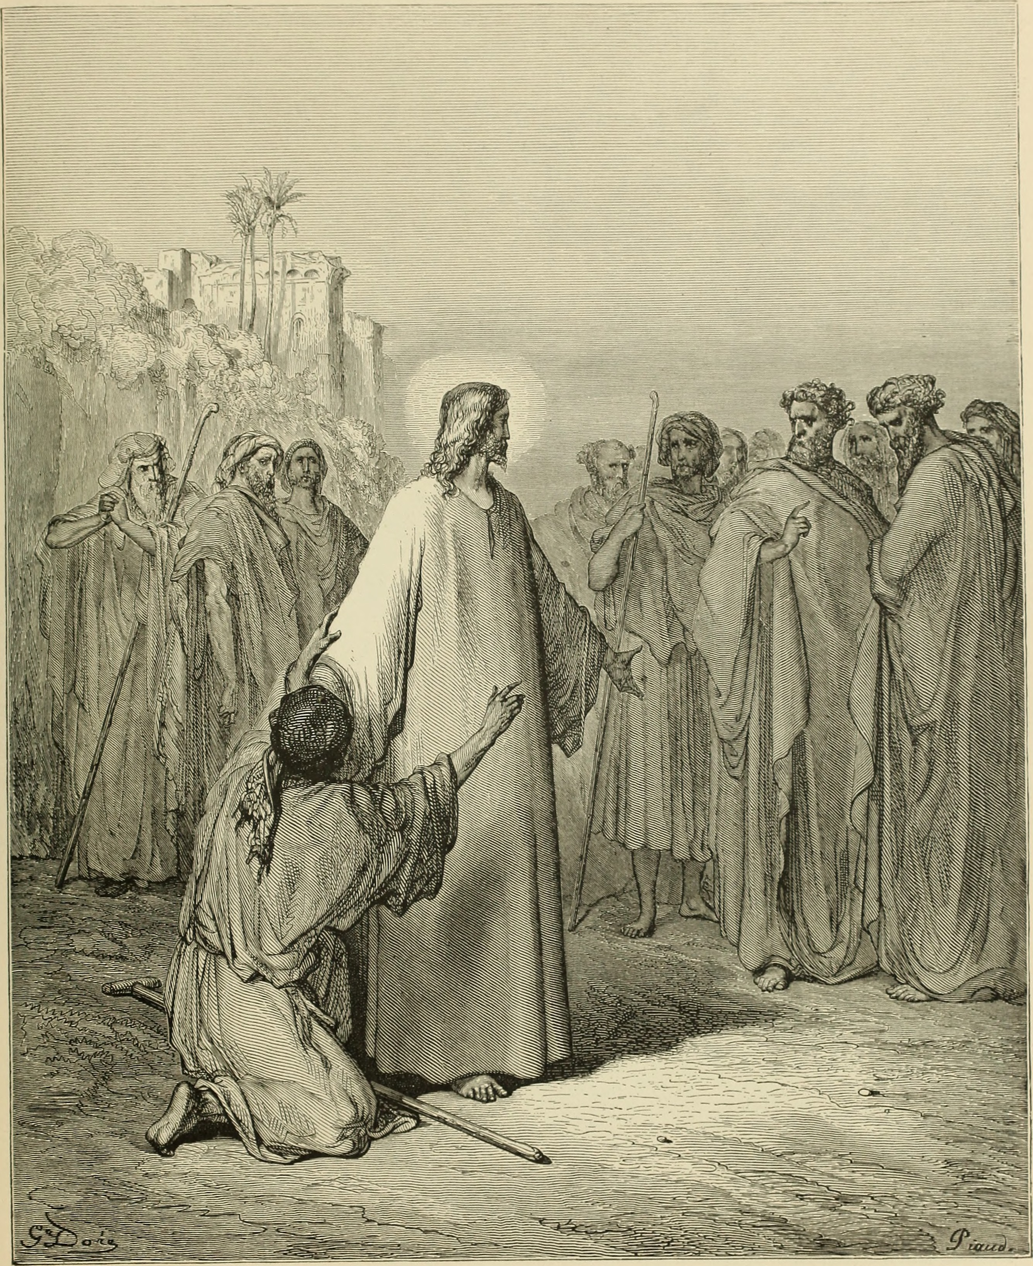
Jesus Cured the Leper
William A. Foster, 1891

Slide 20
Saying to him, “See that you say nothing to anyone; but go, show yourself to the priest, and offer for your cleansing what Moses commanded as a testimony to them.”
Mark 1:44

Slide 21
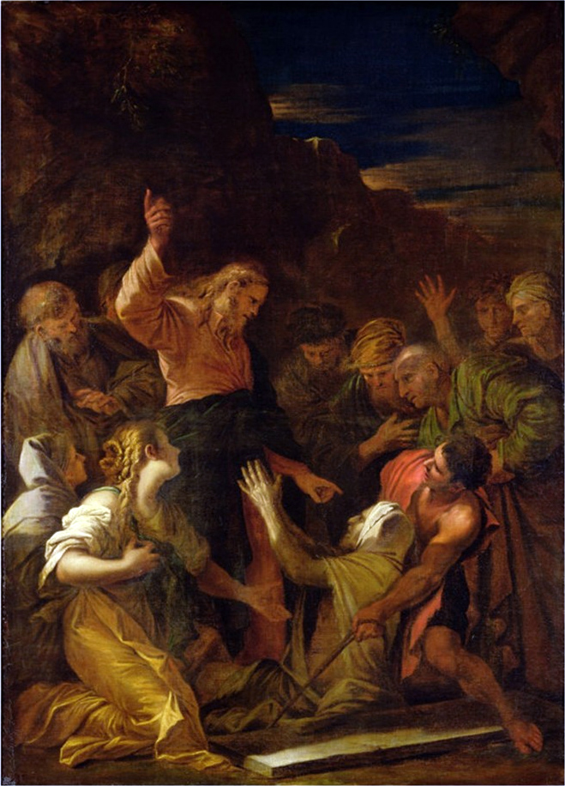
Jesus Cleansing a Leper
Melchior Jean-Marie Doze, 1864

Slide 22
But he went out and began to proclaim it freely, and to spread the word, so that Jesus could no longer go into a town openly, but stayed out in the country; and people came to him from every quarter.
Mark 1:45

Slide 23
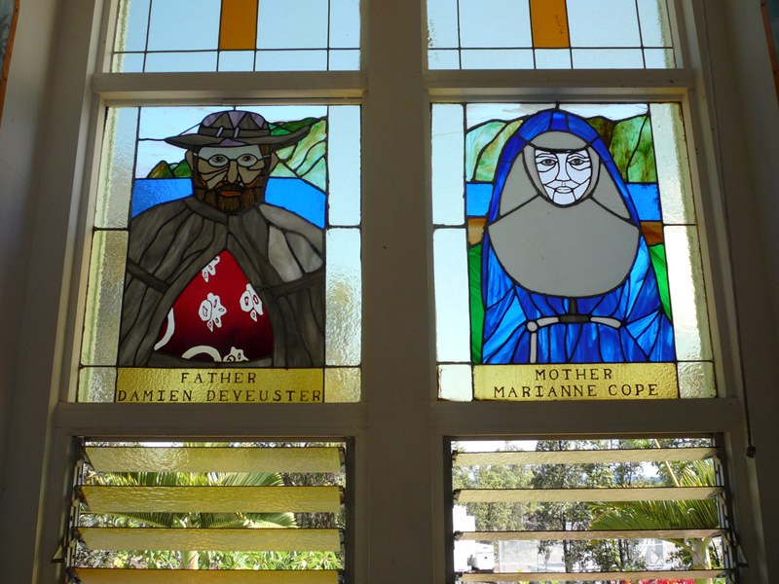
Father Damien and Mother Maryanne, Star of the Sea Painted Church, ca. 1980

Slide 24
Credits
New Revised Standard Version Bible, copyright 1989, Division of Christian Education of the National Council of the Churches of Christ in the United States of America. Used by permission. All rights reserved.
https://commons.m.wikimedia.org/wiki/File:Speculum_Darmstadt_2505_25r.jpg
http://www.flickr.com/photos/kmoliver/3677354616/
http://commons.wikimedia.org/wiki/File:John_Glover_-_Ullswater,_early_morning_-_Google_Art_Project.jpg
https://www.flickr.com/photos/nutmegdesigns/6209760844
https://www.flickr.com/photos/perspective/14152384141
http://commons.wikimedia.org/wiki/File:Bas%C3%ADlica_de_S%C3%A3o_Francisco_das_Chagas_(Canind%C3%A9)_-_Casa_dos_Milagres_008.JPG
https://commons.wikimedia.org/wiki/File:Niels_Larsen_Stevns-_Spedalske.jpg
https://diglib.library.vanderbilt.edu/diglib-fulldisplay.pl?SID=20211125298000197&code=act&RC=51207&Row=18
https://flickr.com/photos/internetarchivebookimages/14598352919/
https://commons.wikimedia.org/wiki/File:ChristCleansing.jpg
http://www.flickr.com/photos/waiferx/2675201073/
Additional descriptions can be found at the Art in the Christian Tradition image library, a service of the Vanderbilt Divinity Library, http://diglib.library.vanderbilt.edu/. All images available via Creative Commons 3.0 License.

