Slide 1
Third Sunday after Pentecost
Year B
1 Samuel 8:4-11, (12-15), 16-20, (11:14-15) and Psalm 138 Genesis 3:8-15 and Psalm 130 • 2 Corinthians 4:13-5:1 Mark 3:20-35

Slide 2
we are determined to have a king over us … So all the people went to Gilgal, and there they made Saul king …
1 Samuel 8:19b, 11:15a

Slide 3
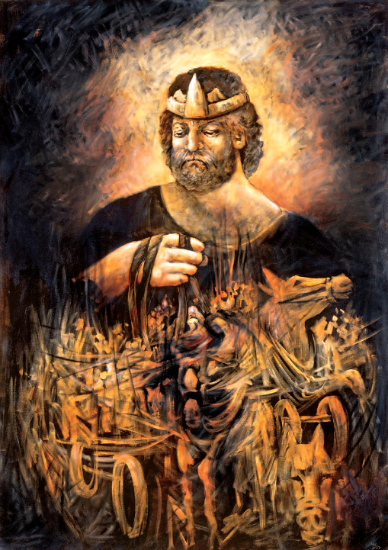
King Saul
Lidia Kozenitsky

Slide 4
Though I walk in the midst of trouble … you stretch out your hand, and your right hand delivers me.
Psalm 138:7

Slide 5
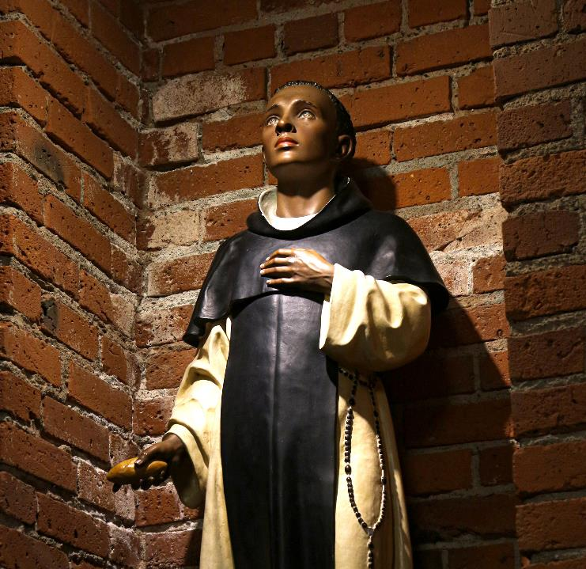
Martin of Porres, Patron Saint of the Poor and of Mixed Race People
Blessed Sacrament Church
Seattle, WA

Slide 6
the LORD God called to the man, and said to him, "Where are you?" He said, "I heard the sound of you in the garden, and I was afraid …
Genesis 3:9-10a

Slide 7
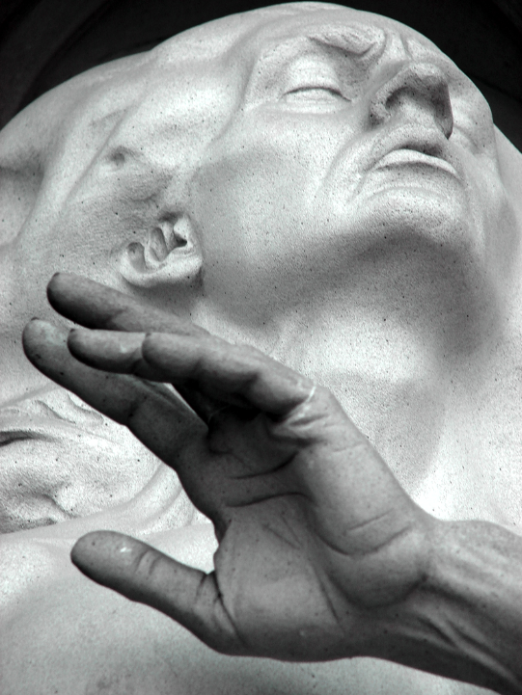
Adam
Frederick Hart
Washington National Cathedral
Washington, DC

Slide 8
Out of the depths I cry to you, O LORD … my soul waits for the Lord more than those who watch for the morning …
Psalm 130:1, 6a

Slide 9
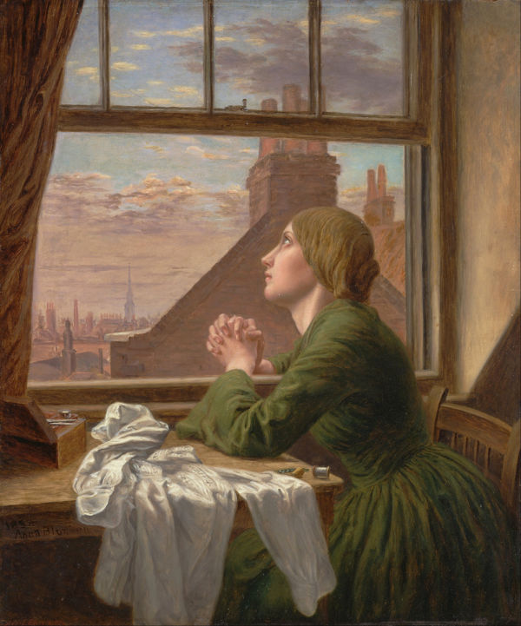
For Only One Short Hour
Anna Blunden
Yale Center for British Art
New Haven, CT

Slide 10
For we know that if the earthly tent we live in is destroyed, we have a building from God … eternal in the heavens.
2 Corinthians 5:1

Slide 11
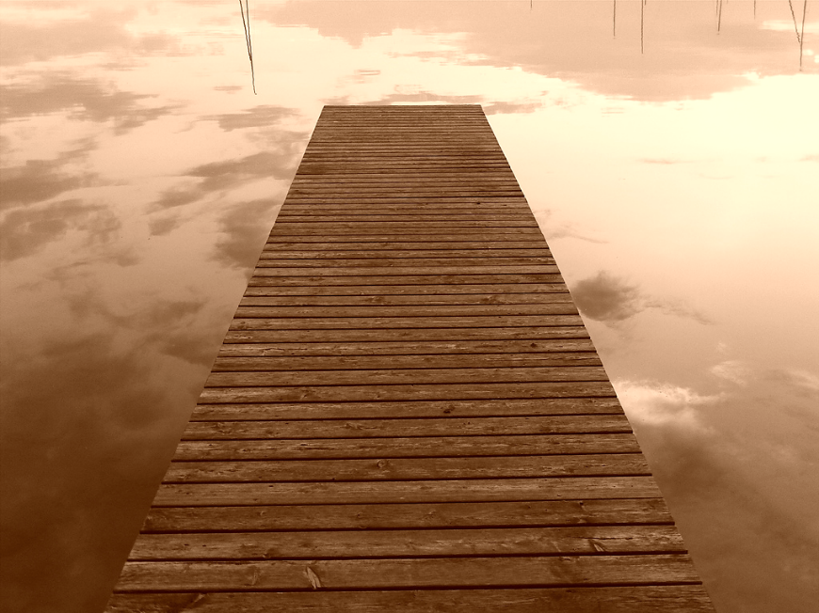
Walk into Heaven -- David McCracken, Bondi, Australia

Slide 12
If a kingdom is divided against itself, that kingdom cannot stand.
Mark 3:24

Slide 13
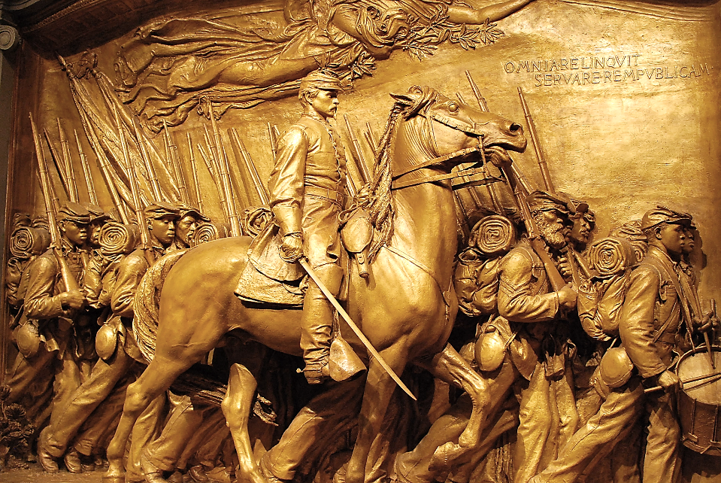
Shaw Civil War Memorial -- Augustus Saint-Gaudens, National Gallery of Art, Washington, DC

Slide 14
And if a house is divided against itself, that house will not be able to stand.
Mark 3:25

Slide 15
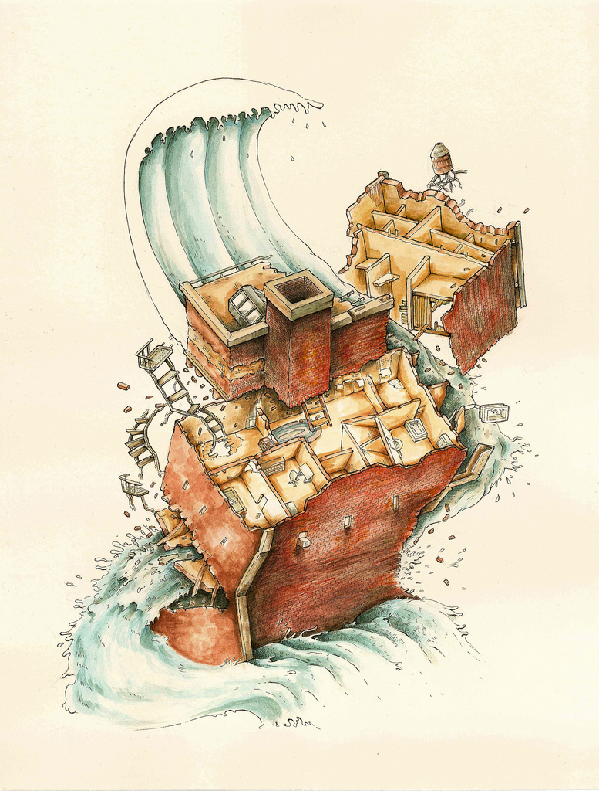
House Divided
Luke Siemans

Slide 16
A crowd was sitting around him; and they said to him, "Your mother and your brothers and sisters are outside, asking for you."
Mark 3:32

Slide 17
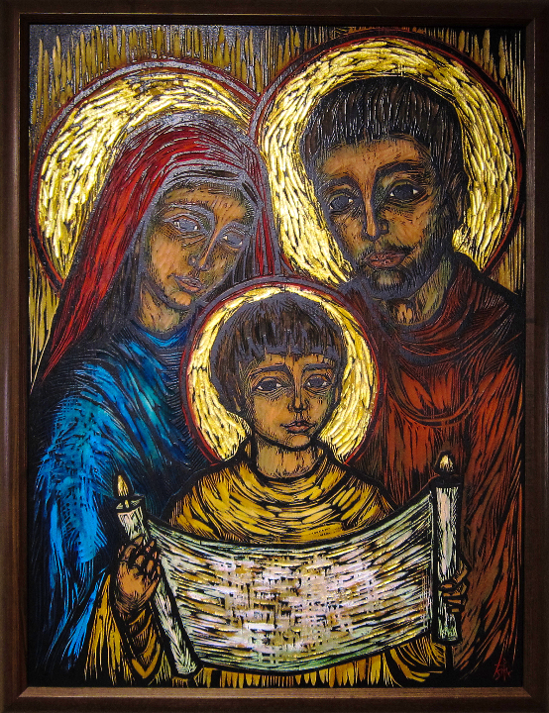
Holy Family
Sister Mary Charles
Holy Family Church
Duluth, MN

Slide 18
And he replied, "Who are my mother and my brothers?"
Mark 3:33

Slide 19
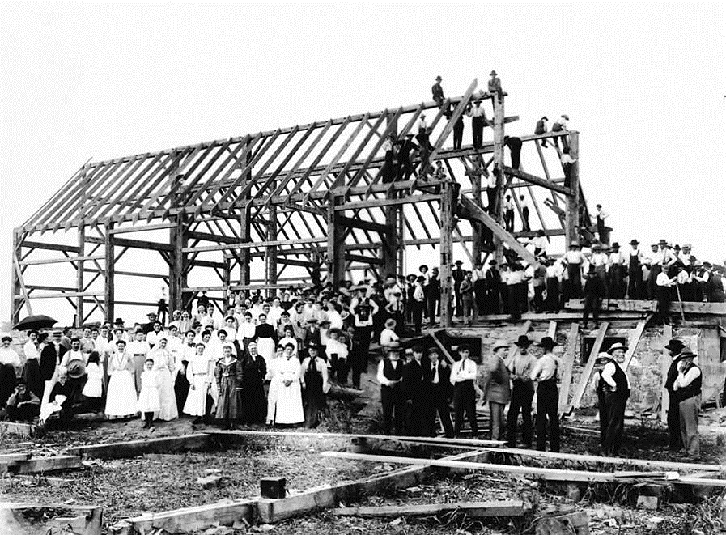
Barn Raising in Lansing -- early 20th c., Toronto, Canada

Slide 20
And looking at those who sat around him, he said, "Here are my mother and my brothers!
Mark 3:34

Slide 21
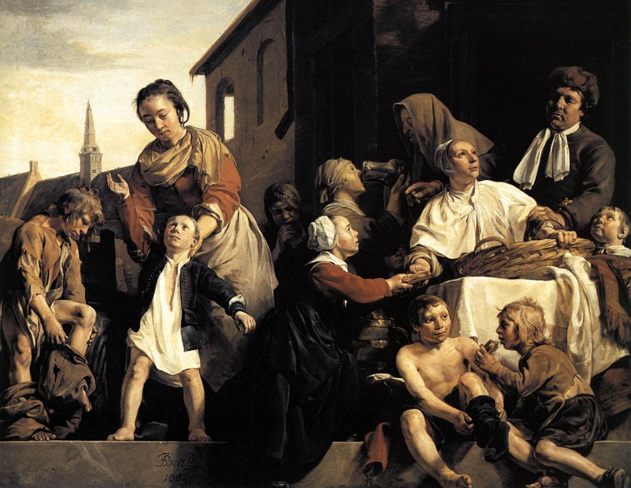
Tending Children at the Orphanage, Jan de Bray, Frans Hal Museum, Haarlem, Netherlands

Slide 22
Whoever does the will of God is my brother and sister and mother."
Mark 3:35

Slide 23
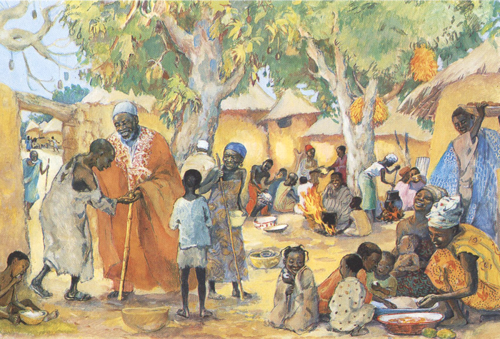
The Poor Invited to the Feast -- JESUS MAFA, Cameroon

Slide 24
Credits
New Revised Standard Version Bible, copyright 1989, Division of Christian Education of the National Council of the Churches of Christ in the United States of America. Used by permission. All rights reserved.
https://commons.wikimedia.org/wiki/File:TheKingSaul.jpg
http://commons.wikimedia.org/wiki/File:Guds_hand_2007.jpg
https://www.flickr.com/photos/locosteve/24999501748/
https://commons.wikimedia.org/wiki/File:Anna_Blunden_-_%22For_Only_One_Short_Hour%22_-_Google_Art_Project.jpg
https://www.flickr.com/photos/bbweb/4686133672/ - Bjorn Behrendt
https://www.flickr.com/photos/kneoh/11198982455/
http://www.flickr.com/photos/luccawithcheese/2799182537/
https://www.flickr.com/photos/cobalt/489916273
https://commons.wikimedia.org/wiki/File:Barn_raising_in_Lansing.jpg
https://commons.wikimedia.org/wiki/File:Jan_de_Bray_-_Tending_Children_at_the_Orphanage_in_Haarlem_-_WGA03131.jpg
http://diglib.library.vanderbilt.edu/act-imagelink.pl?RC=48397
Additional descriptions can be found at the Art in the Christian Tradition image library, a service of the Vanderbilt Divinity Library, http://diglib.library.vanderbilt.edu/. All images available via Creative Commons 3.0 License.

