Slide 1
Twenty-Second Sunday after Pentecost
Year B
Job 38:1-7, (34-41) and Psalm 104:1-9, 24, 35c
Isaiah 53:4-12 and Psalm 91:9-16 • Hebrews 5:1-10 Mark 10:35-45

Slide 2
Then the LORD answered Job …
Who has the wisdom to number the clouds? Or who can tilt the waterskins of the heavens …
Job 38:1a, 37a

Slide 3
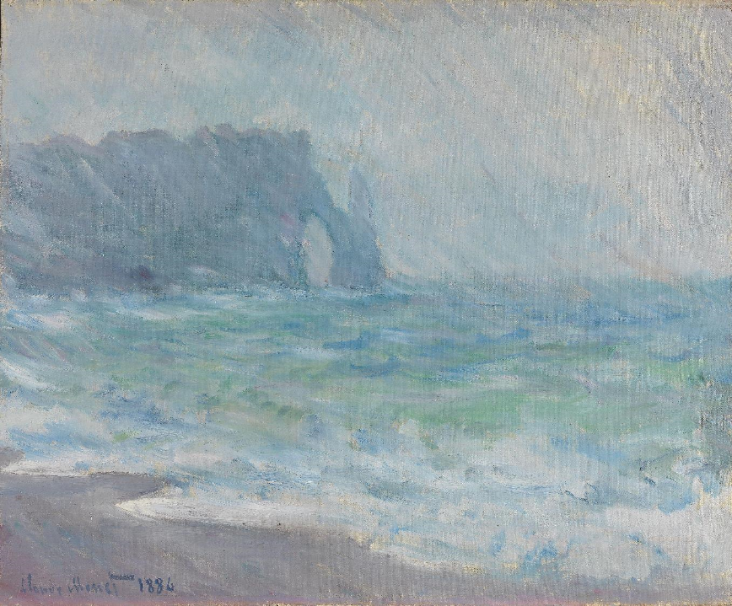
Rain, Étretat -- Claude Monet, National Gallery, Oslo Norway

Slide 4
He was oppressed … yet he did not open his mouth; like a lamb that is led to the slaughter, and like a sheep that before its shearers is silent,
Isaiah 53:7ac

Slide 5
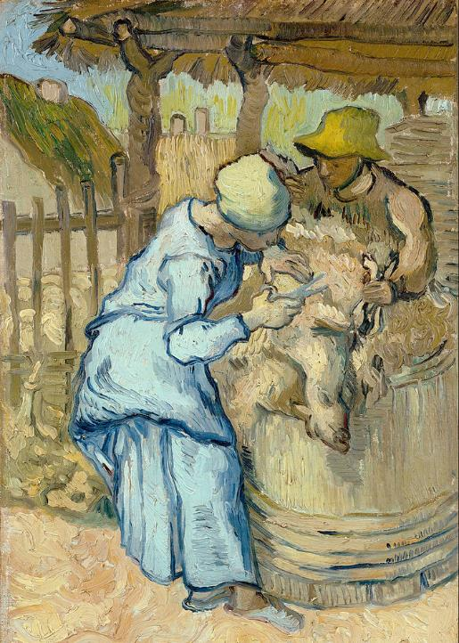
The Sheep-Shearer
Vincent van Gogh
Van Gogh Museum
Amsterdam, Netherlands

Slide 6
When they call to me,
I will answer them;
I will be with them in trouble …
Psalm 91:15a

Slide 7
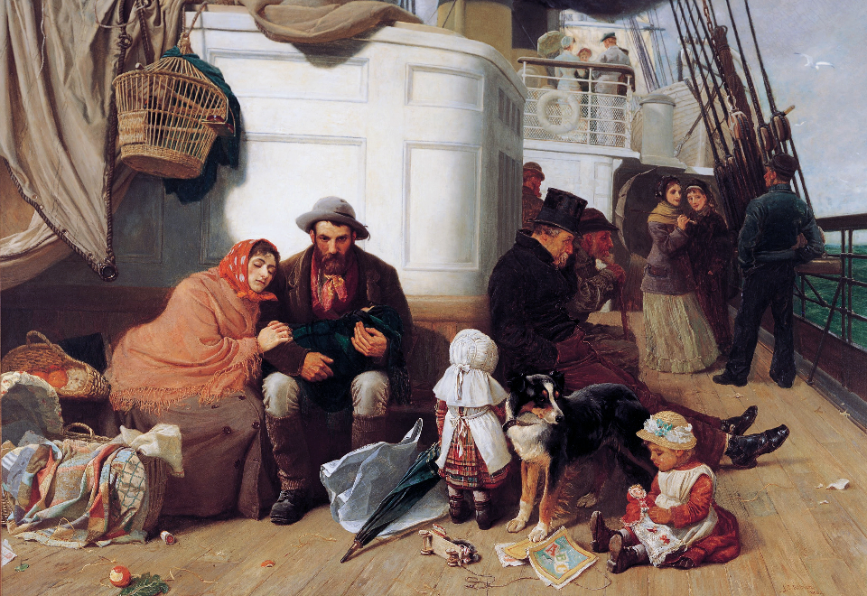
The Immigrant's Ship -- John C. Dollman, Art Gallery of South Australia, Adelaide, Australia

Slide 8
He is able to deal gently with the ignorant and wayward, since he himself is subject to weakness;
Hebrews 5:2

Slide 9
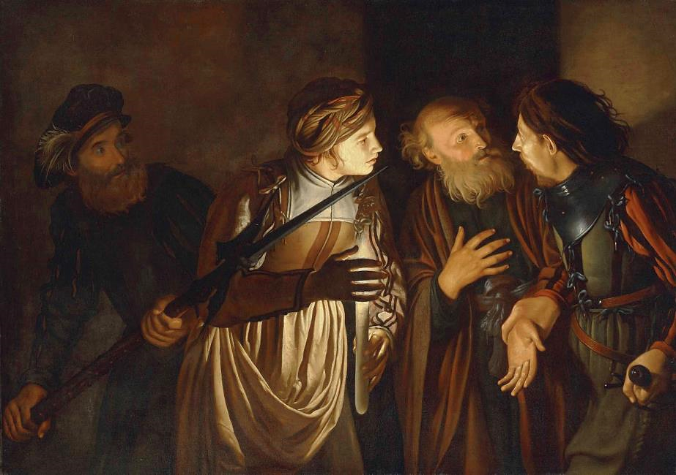
Peter's Denial -- Adam de Coster

Slide 10
But Jesus said to them, "You do not know what you are asking. Are you able to drink the cup that I drink …?
Mark 10:38a

Slide 11
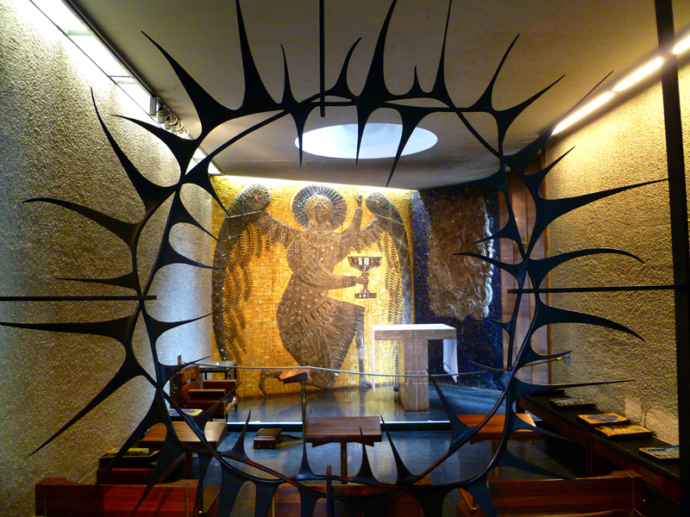
Gethsemane Chapel -- Coventry Cathedral, Coventry, England

Slide 12
They replied, "We are able." Then Jesus said to them, "… to sit at my right hand … is not mine to grant, but it is for those for whom it has been prepared.
Mark 10:39a, 40

Slide 13
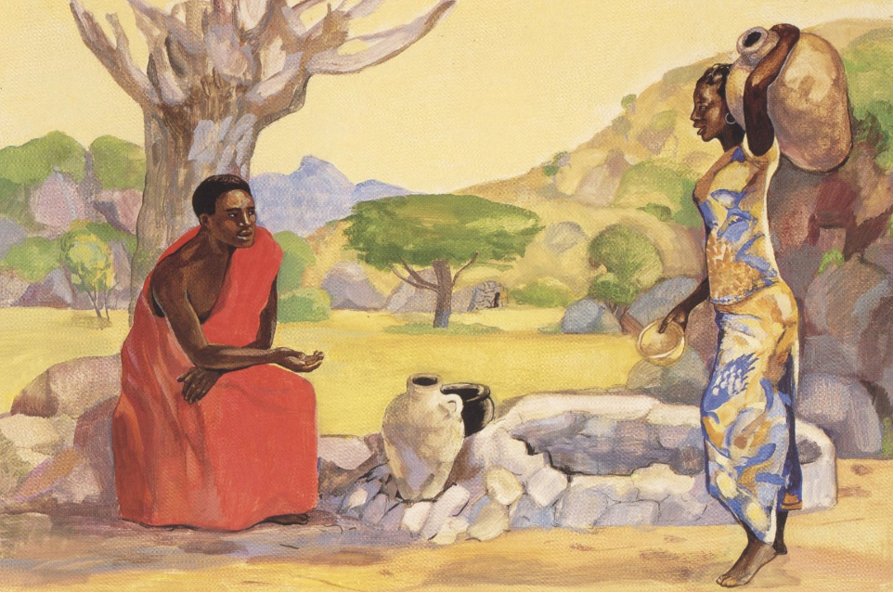
Christ and the Samaritan Woman -- JESUS MAFA, Cameroon

Slide 14
Jesus … said to them, "You know … the Gentiles … their rulers lord it over them, and their great ones are tyrants over them.
Mark 10:42ac

Slide 15
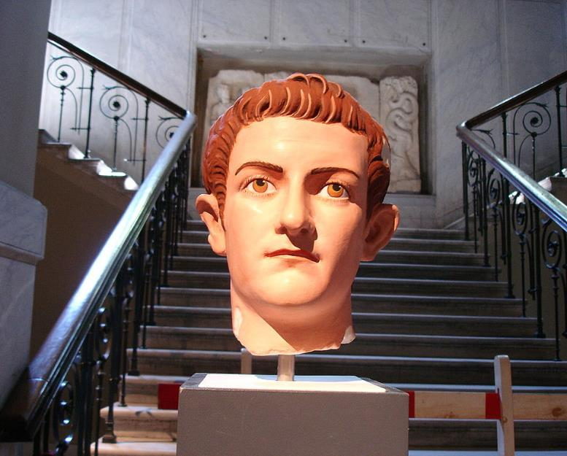
Caligula -- Reconstruction with original color, Istanbul Archaeological Museum, Istanbul, Turkey

Slide 16
But it is not so among you; but whoever wishes to become great among you must be your servant,
Mark 10:43

Slide 17
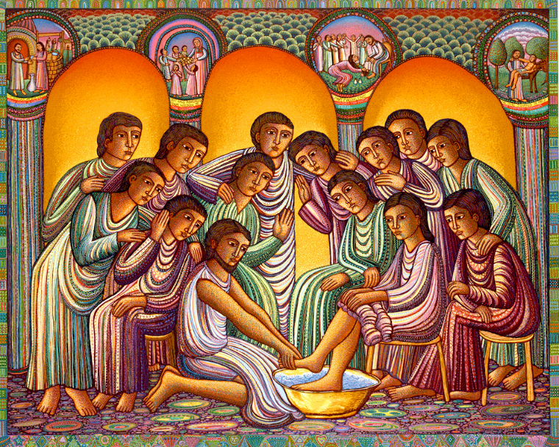
Christ Washing the Disciples' Feet -- John August Swanson, serigraph, 1999

Slide 18
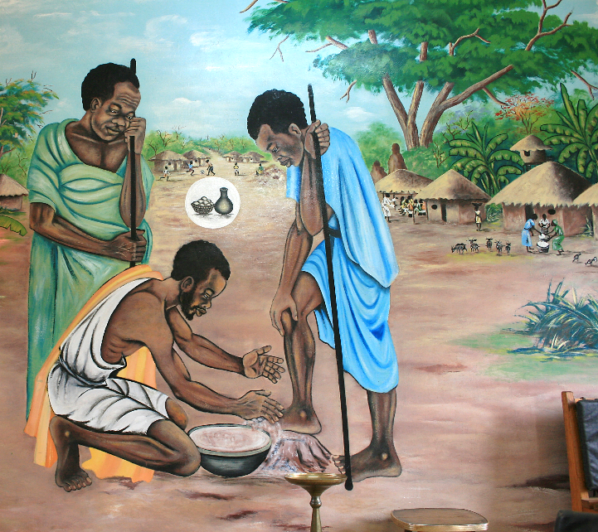
Jesus Washes His Disciples' Feet
Victoria Falls, Zambia

Slide 19
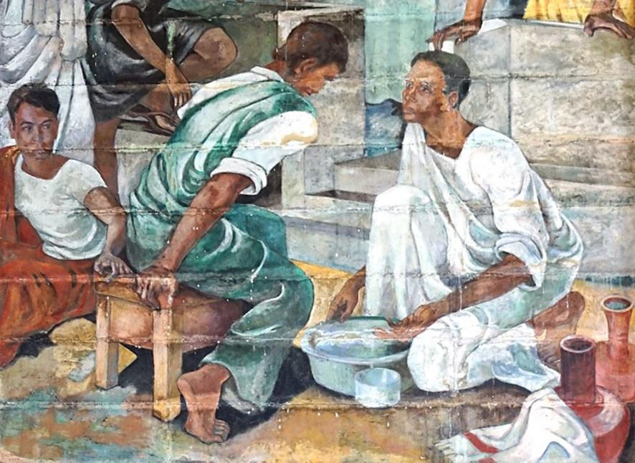
Christ Washing the Disciples' Feet -- David Paynter, Trinity College Chapel, Kandy, Sri Lanka

Slide 20
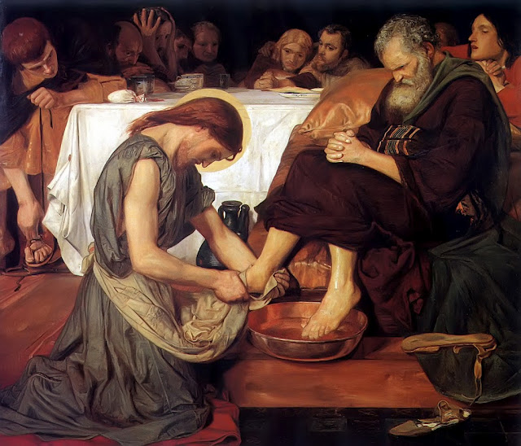
Christ Washes the Disciples' Feet -- Ford Madox Brown, Tate Britain, London, England

Slide 21
For the Son of Man came not to be served but to serve, and to give his life a ransom for many."
Mark 10:45

Slide 22
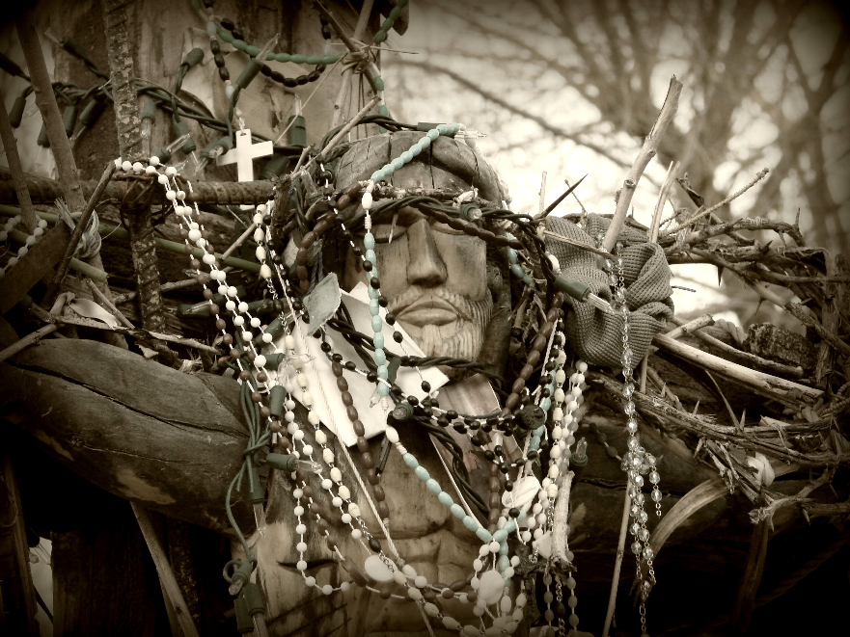
Crucifix -- before 1810, Sanctuario de Chimayo, Chimayo, NM

Slide 23
Credits
New Revised Standard Version Bible, copyright 1989, Division of Christian Education of the National Council of the Churches of Christ in the United States of America. Used by permission. All rights reserved.
https://commons.wikimedia.org/wiki/File:Claude_Monet_-_Rain,_%C3%89tretat_-_NG.M.00368_-_National_Museum_of_Art,_Architecture_and_Design.jpg
https://commons.wikimedia.org/wiki/File:Vincent_van_Gogh_-_The_sheep-shearer_(after_Millet)_-_Google_Art_Project.jpg
https://commons.wikimedia.org/wiki/File:John_C._Dollman_-_The_immigrants%27_ship_-_Google_Art_Project.jpg
http://diglib.library.vanderbilt.edu/act-imagelink.pl?RC=48282https://commons.wikimedia.org/wiki/File:Adam_de_Coster_-_The_Denial_of_Saint_Peter.jpg
http://www.flickr.com/photos/roel1943/6794790893
https://commons.wikimedia.org/wiki/File:Istanbul_-_Museo_archeologico_-_Mostra_sul_colore_nell%27antichit%C3%93_12_-_Foto_G._Dall%27Orto_28-5-2006.jpg
www.JohnAugustSwanson.com, Copyright 1999 by John August Swanson – with permission
http://www.flickr.com/photos/toddhiestand/2628057856/
https://commons.wikimedia.org/wiki/File:Trinity_College_Chapel_Mural_(2).jpg
https://www.flickr.com/photos/dora-alis/20804083349 - Dora Alis
http://www.flickr.com/photos/santafesweets/2386475728/
Additional descriptions can be found at the Art in the Christian Tradition image library, a service of the Vanderbilt Divinity Library, http://diglib.library.vanderbilt.edu/. All images available via Creative Commons 3.0 License.

