Slide 1
Twenty-First Sunday after Pentecost
Year B
Job 23:1-9, 16-17 and Psalm 22:1-15
Amos 5:6-7, 10-15 and Psalm 90:12-17
Hebrews 4:12-16 • Mark 10:17-31

Slide 2
Then Job answered … If only I could vanish in darkness, and thick darkness would cover my face!
Job 23:1a, 17

Slide 3
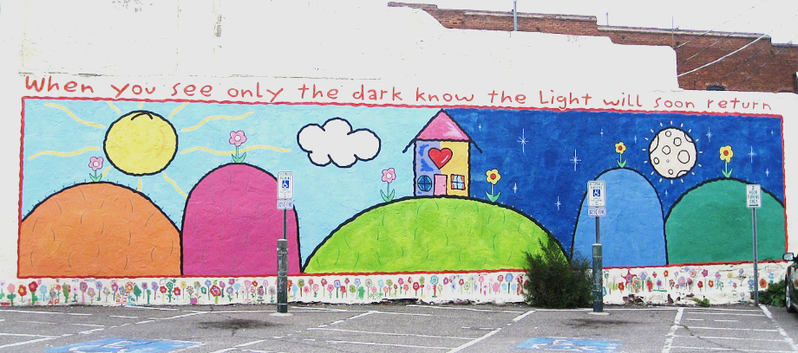
"When you see only the dark, know the Light will soon return." -- Building mural, Flagstaff, AZ

Slide 4
O my God … it was you who took me from the womb; you kept me safe on my mother's breast.
Psalm 22:2a, 9

Slide 5
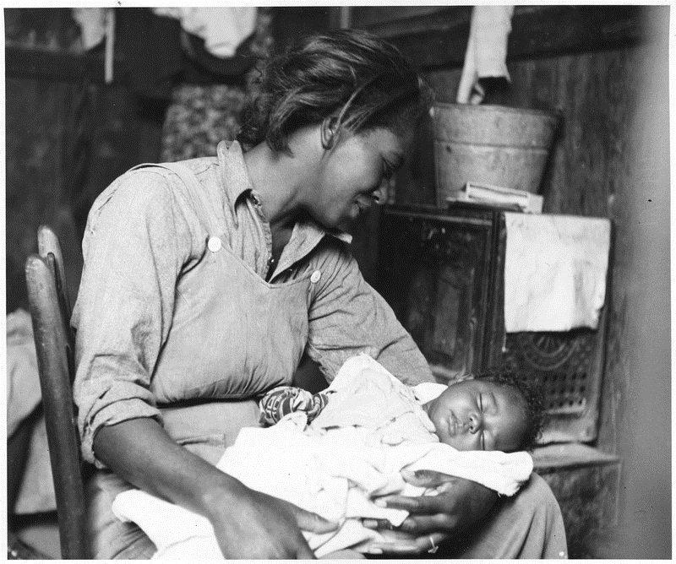
Migrant Cotton-picker and Her Baby -- Dorothea Lange, National Archives, Washington, DC

Slide 6
Hate evil and love good, and establish justice in the gate;
Amos 5:15a

Slide 7
Living Word -- Painting on wood, Manhattan, NY

Slide 8
Indeed, the word of God is living and active … it is able to judge the thoughts and intentions of the heart.
Hebrews 4:12

Slide 9
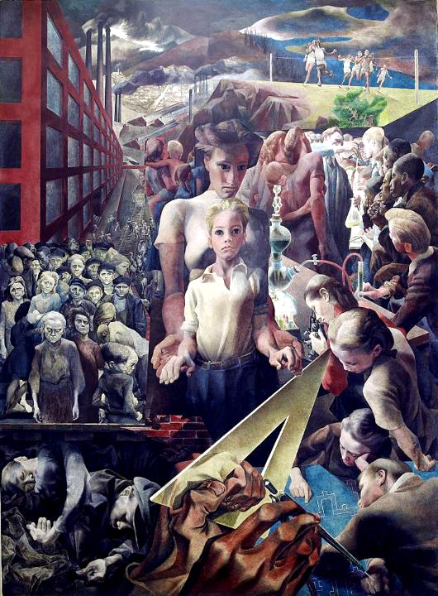
Justice and Child
Symeon Shimin
Department of Justice
Washington, DC

Slide 10
As he was setting out on a journey, a man ran up and knelt before him, and asked him, "Good Teacher, what must I do to inherit eternal life?"
Mark 10:17

Slide 11
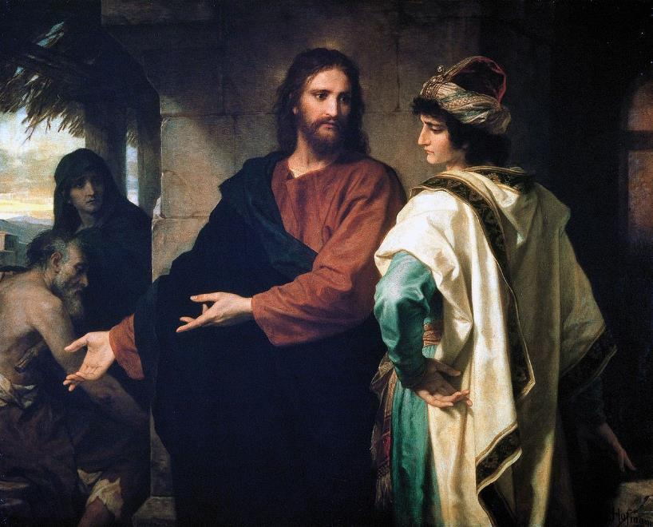
Christ and the Rich Young Ruler -- Heinrich Hofman, Riverside Church, New York, NY

Slide 12
Jesus said to him, "You know the commandments … "
He said to him, "Teacher, I have kept all these since my youth."
Mark 10:18a, 19a, 20

Slide 13
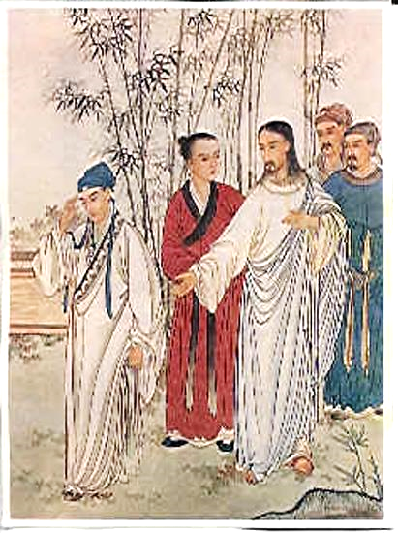
Jesus and the Rich Young Ruler -- Chinese illustration

Slide 14
Jesus, looking at him, loved him and said, "You lack one thing; go, sell what you own, and give the money to the poor …"
Mark 10:21a

Slide 15
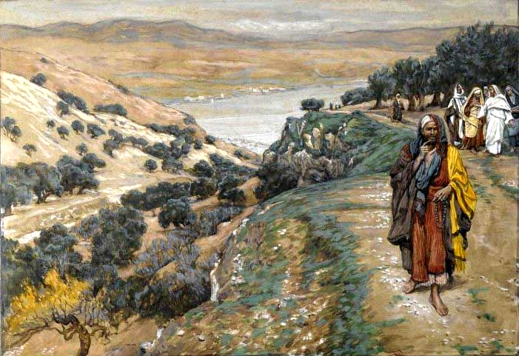
The Rich Young Man Went Away Sorrowful -- James Tissot, Brooklyn Museum, New York, NY

Slide 16
When he heard this, he was shocked and went away grieving, for he had many possessions.
Mark 10:22

Slide 17
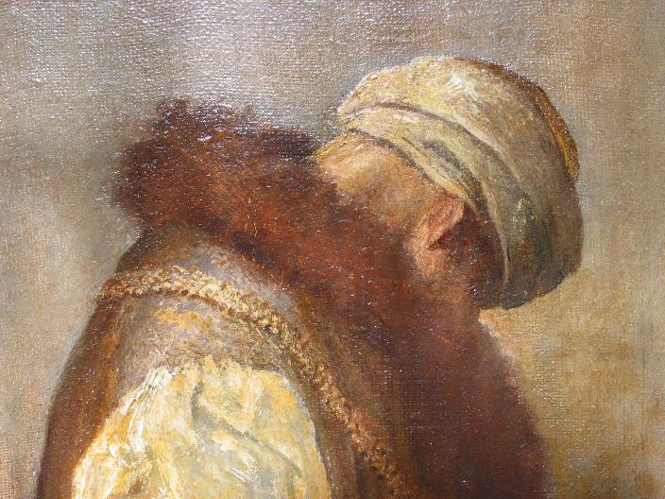
"For He Had Great Possessions" -- George Watts, Tate Britain, London, England

Slide 18
And the disciples were perplexed at these word … and said to one another, "Then who can be saved?"
Mark 10:24a, 26b

Slide 19
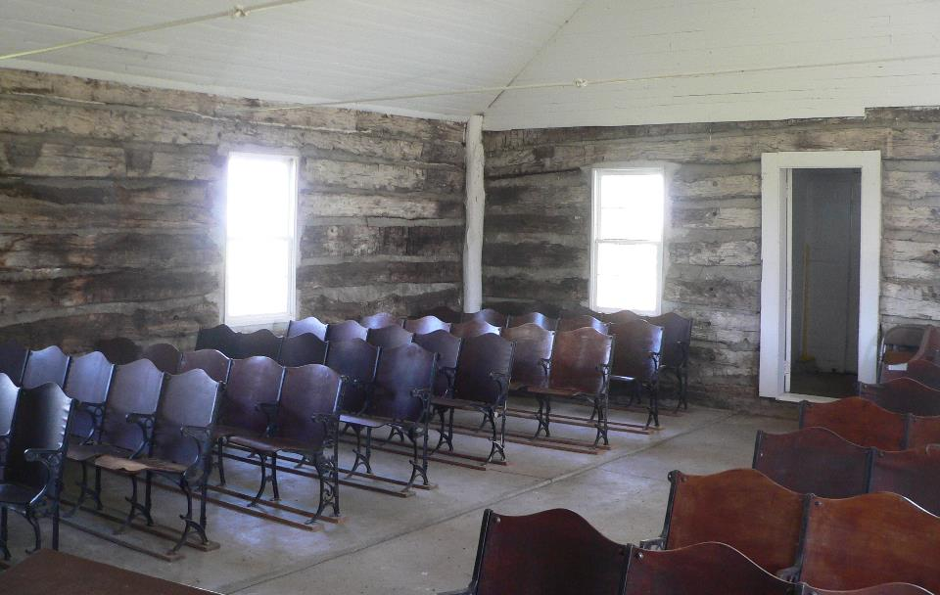
Brown Earth Presbyterian Church -- Grant County, South Dakota

Slide 20
Jesus looked at them and said, "For mortals it is impossible, but not for God; for God all things are possible."
Mark 10:27

Slide 21
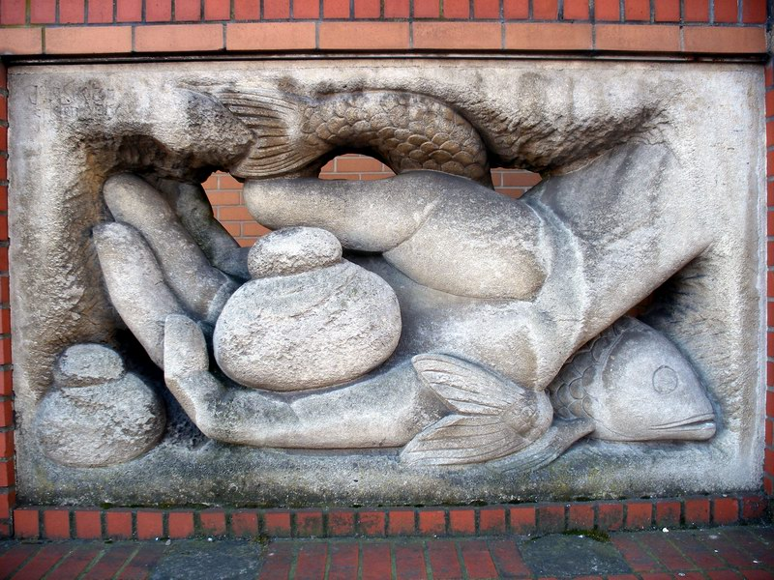
Hand of God with Loaves and Fish -- United Reformed Church, Brighton, England

Slide 22
" … many who are first will be last, and the last will be first."
Mark 10:31

Slide 23
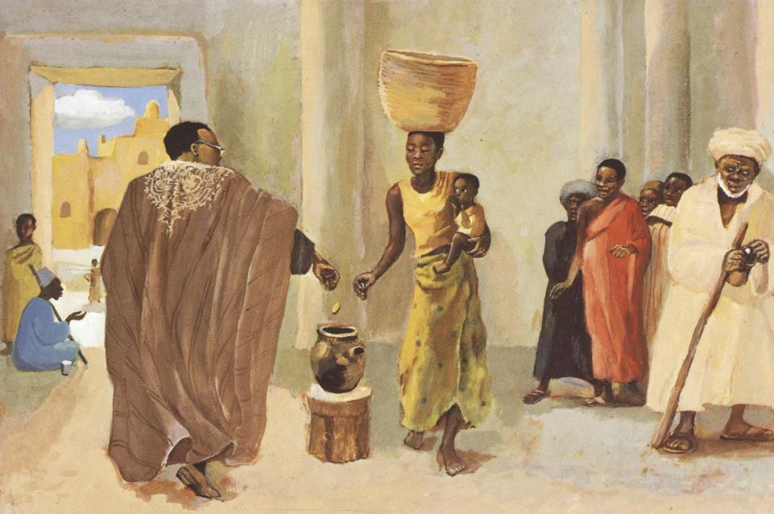
The Widow's Mite -- JESUS MAFA, Cameroon

Slide 24
Credits
New Revised Standard Version Bible, copyright 1989, Division of Christian Education of the National Council of the Churches of Christ in the United States of America. Used by permission. All rights reserved.
https://commons.wikimedia.org/wiki/File:When_you_see_only_the_dark_know_the_light_will_soon_return_-_Flickr_-_brewbooks.jpg
http://commons.wikimedia.org/wiki/File:Near_Buckeye,_Maricopa_County,_Arizona._Migrant_(African-American)_cotton_picker_and_her_baby._-_NARA_-_522540.jpg
http://lcweb2.loc.gov/service/pnp/highsm/02800/02898v.jpg
https://www.flickr.com/photos/denisecarbonell/2106528380/ - Denise Carbonell
https://commons.wikimedia.org/wiki/File:Hoffman-ChristAndTheRichYoungRuler.jpg
https://commons.wikimedia.org/wiki/File:ChineseJesus.jpg
https://commons.wikimedia.org/wiki/File:Brooklyn_Museum_-_The_Rich_Young_Man_Went_Away_Sorrowful_(Le_jeune_homme_riche_s%27en_alla_triste)_-_James_Tissot_-_overall.jpg
https://www.flickr.com/photos/oxfordshire_church_photos/413448324 - Martin Beek
https://commons.wikimedia.org/wiki/File:Frans_Hals_-_De_regentessen_van_het_oudemannenhuis.jpg
https://www.flickr.com/photos/arenamontanus/2313539134 - Anders Sandburg
http://diglib.library.vanderbilt.edu/act-imagelink.pl?RC=48392
Additional descriptions can be found at the Art in the Christian Tradition image library, a service of the Vanderbilt Divinity Library, http://diglib.library.vanderbilt.edu/. All images available via Creative Commons 3.0 License.

