Slide 1
Liturgy of the Passion
Year B
Isaiah 50:4-9a
Psalm 31:9-16
Philippians 2:5-11
Mark 14:1-15:47
or Mark 15:1-39, (40-47)

Slide 2
I gave my back to those who struck me, and my cheeks to those who pulled out the beard; I did not hide my face from insult and spitting.
Isaiah 50:6

Slide 3
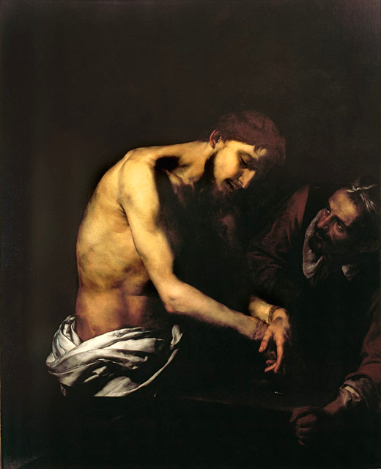
Flagellation of Christ
Jusepe de Ribera
Girolamini Gallery Naples, Italy

Slide 4
My times are in your hand; deliver me from the hand of my enemies and persecutors.
Psalm 31:15

Slide 5
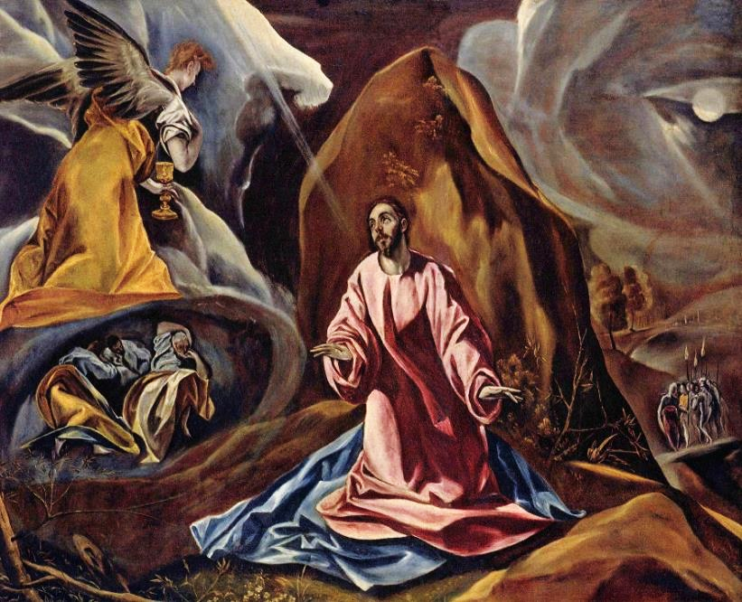
Christ on the Mount -- El Greco, National Gallery, London, England

Slide 6
he humbled himself and became obedient to the point of death-- even death on a cross.
Philippians 2:8

Slide 7
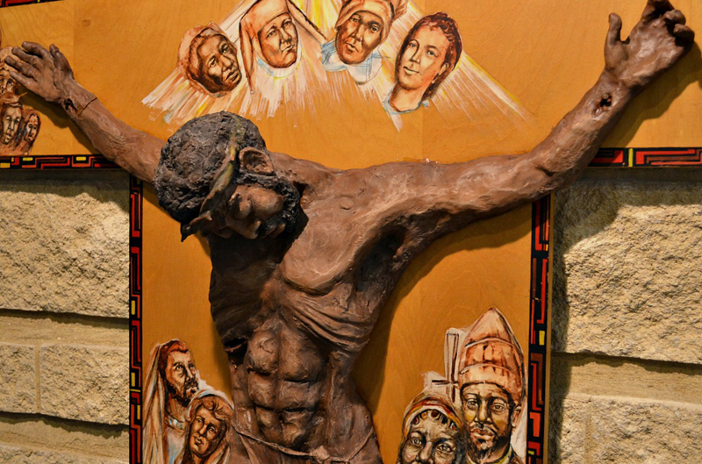
Jesus is Crucified -- St. Benedict the African in Chicago, IL

Slide 8
While they were eating, he took a loaf of bread, and after blessing it he broke it, gave it to them, and said, "Take; this is my body."
Mark 14:22

Slide 9
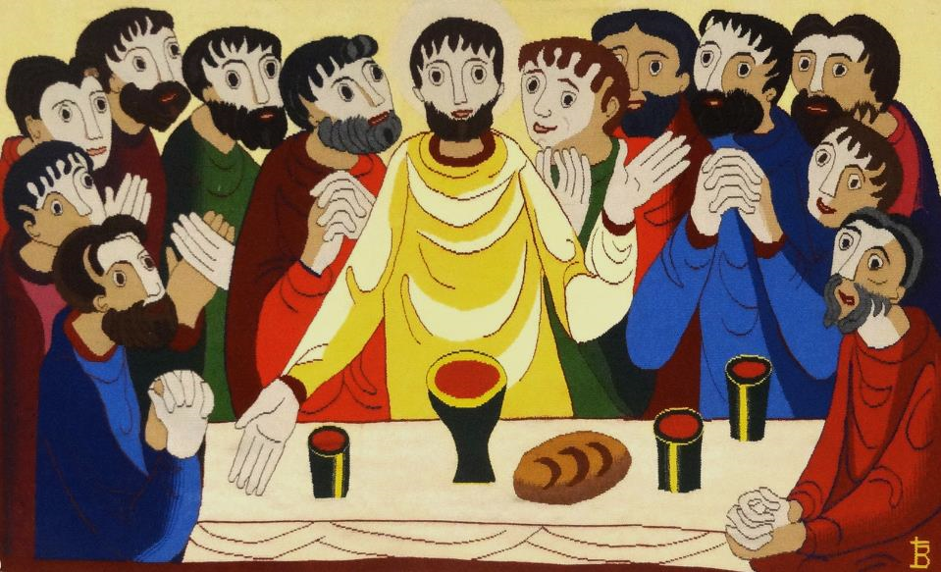
Last Supper -- Bose Monastic Community, Bose, Italy

Slide 10
"Abba, Father, for you all things are possible; remove this cup from me; yet, not what I want, but what you want."
Mark 14:36b

Slide 11
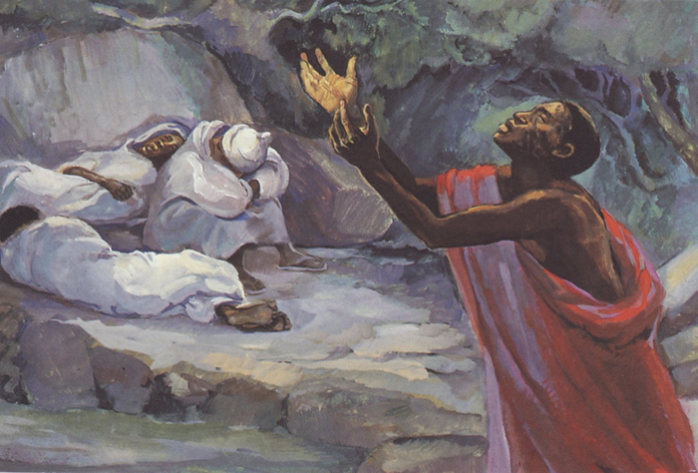
Christ on Gethsemane -- JESUS MAFA, Cameroon

Slide 12
Now the betrayer had given them a sign, saying, "The one I will kiss is the man; arrest him and lead him away under guard."
Mark 14:44

Slide 13
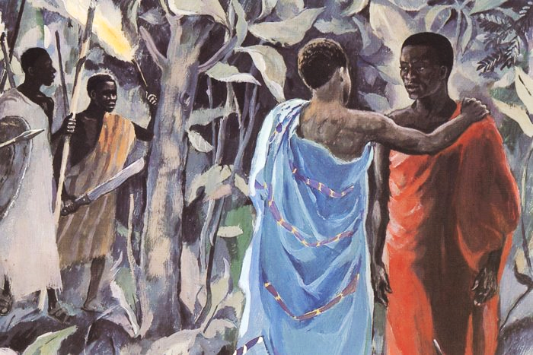
Kiss of Judas -- JESUS MAFA, Cameroon

Slide 14
Again the high priest asked him, "Are you the Messiah, the Son of the Blessed One?"
Mark 14:61b

Slide 15
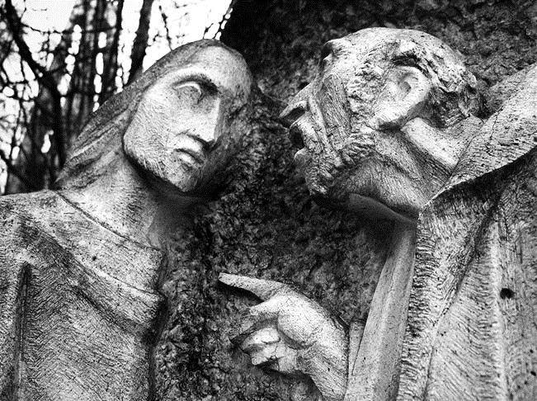
The Sanhedrin Examine Jesus -- Sanctuario di Lourdes Nevegal, Nevegal, Italy

Slide 16
When she saw Peter warming himself, she stared at him and said, "You also were with Jesus, the man from Nazareth." But he denied it …
Mark 14:67-68a

Slide 17
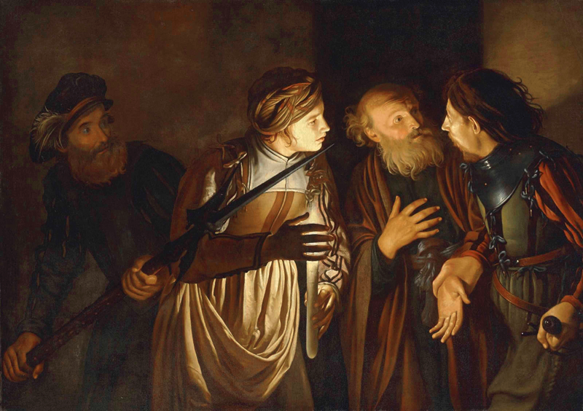
Peter’s Denial -- Adam de Coster, early 17th century

Slide 18
Pilate asked him again, "Have you no answer? See how many charges they bring against you." But Jesus made no further reply, so that Pilate was amazed.
Mark 15:4-5

Slide 19
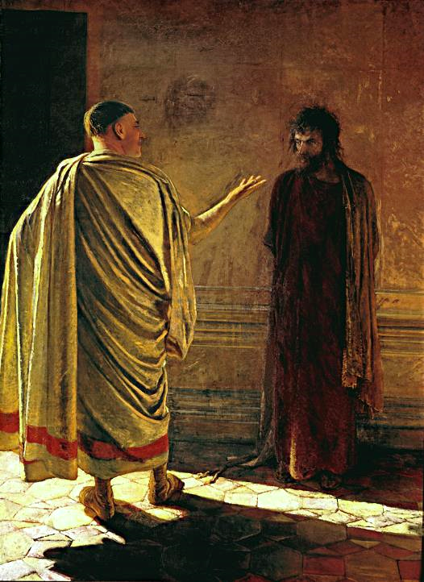
What is Truth?
Nicolai Ge
Tretyakov State Gallery
Moscow, Russia

Slide 20
… after twisting some thorns into a crown, they put it on him. And they began saluting him, "Hail, King of the Jews!"
Mark 15:17b, 18

Slide 21
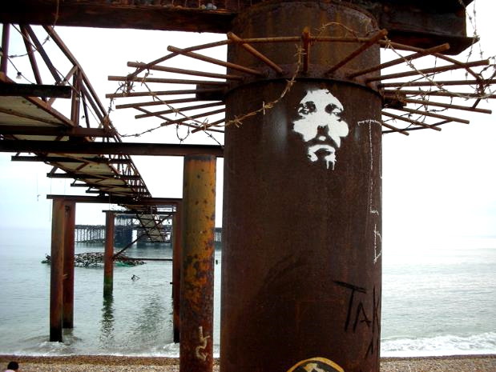
Crown of Thorns -- Easter 2007, West Pier, Brighton, England

Slide 22
In the same way the chief priests, along with the scribes, were also mocking him among themselves and saying, "He saved others; he cannot save himself…"
Mark 15:31

Slide 23
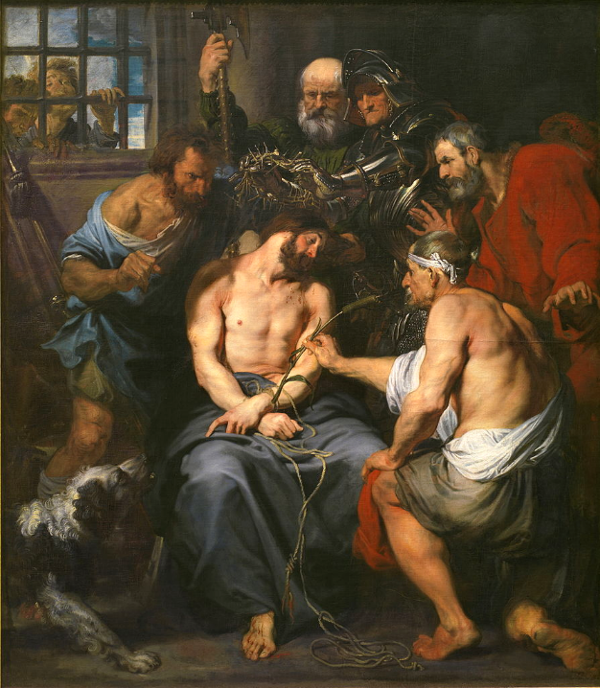
The Mocking of Christ
Anthony Van Dyck
Prado Museum
Madrid, Spain

Slide 24
At three o'clock Jesus cried with a loud voice, "Eloi, Eloi, lema sabachthani?" which means, "My God, my God, why have you forsaken me?"
Mark 15:34

Slide 25
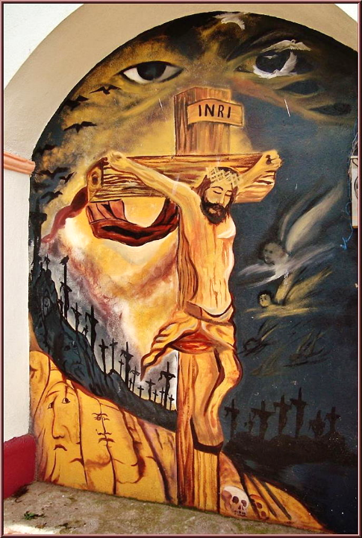
Crucifixion
Parish Church
Coatepec, Mexico

Slide 26
Then Jesus gave a loud cry and breathed his last.
Mark 15:37

Slide 27
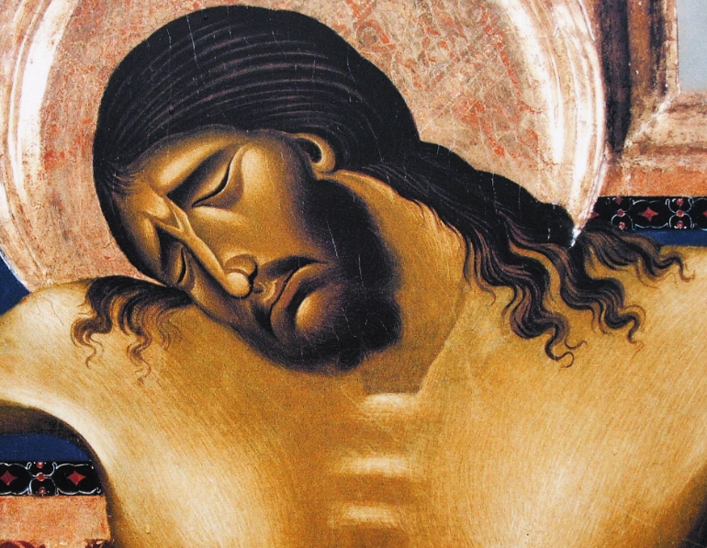
Crucifixion, detail -- Cimabue, Church of San Domenico, Arezzo, Italy

Slide 28
There were also women looking on from a distance … These used to follow him and provided for him when he was in Galilee …
Mark 15:40a, 41a

Slide 29
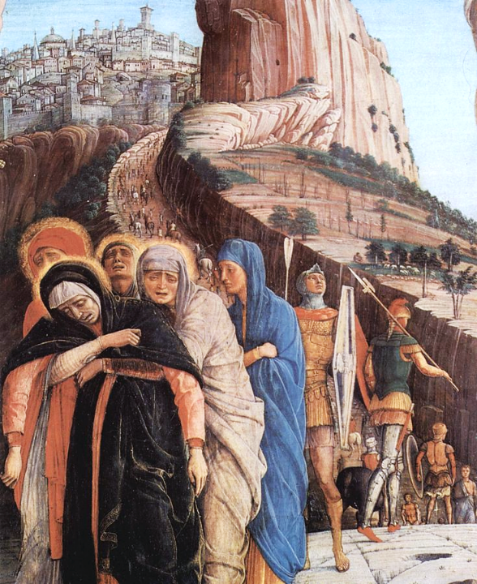
Crucifixion, detail
Andrea Mantegna
Basilica of San Zeno
Verona, Italy

Slide 30
Then Joseph … taking down the body, wrapped it in the linen cloth, and laid it in a tomb that had been hewn out of the rock.
Mark 15:46a

Slide 31
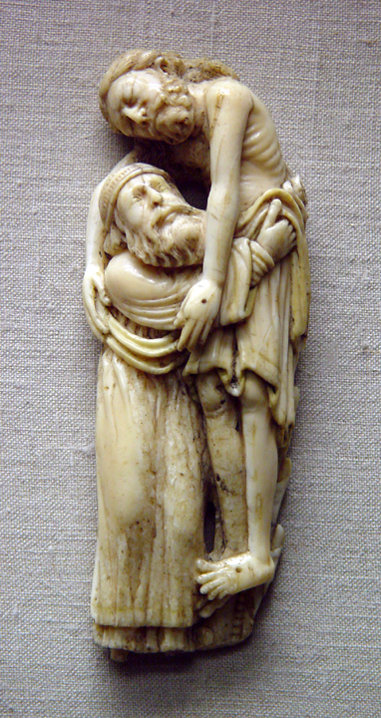
Joseph of Arimathea with the Body of Christ
Early 13th century
Victoria and Albert Museum, London, England

Slide 32
Credits
New Revised Standard Version Bible, copyright 1989, Division of Christian Education of the National Council of the Churches of Christ in the United States of America. Used by permission. All rights reserved.
https://commons.wikimedia.org/wiki/File:The_Flagellation_of_ChrisSpagnGirolamNaples.jpg
https://commons.wikimedia.org/wiki/File:El_Greco_019.jpg
https://www.flickr.com/photos/seanbirm/31589314255 - Sean Birmingham
https://https://www.flickr.com/photos/jimforest/15094200090/
http://diglib.library.vanderbilt.edu/act-imagelink.pl?RC=48391
http://diglib.library.vanderbilt.edu/act-imagelink.pl?RC=48300
http://www.flickr.com/photos/brtsergio/2338170327
https://commons.wikimedia.org/wiki/File:Adam_de_Coster_-_The_Denial_of_Saint_Peter.jpg
https://commons.wikimedia.org/wiki/File:What_is_truth.jpg
http://www.flickr.com/photos/barkaway/471544128/
https://commons.wikimedia.org/wiki/File:Anthonis_van_Dyck_004.jpg
https://commons.wikimedia.org/wiki/File:Andrea_Mantegna_031.jpg
https://commons.wikimedia.org/wiki/File:Parroquia_de_la_Asunci%C3%B3n_de_Mar%C3%ADa_(Coatepec_Harinas)_Estado_de_M%C3%A9xico,M%C3%A9xico.jpg
https://commons.wikimedia.org/wiki/File:Arezzo-Chiesa_di_san_Domenico-Crocifisso_di_Cimabue-closeup.jpg
Image courtesy of Patout Burns, Vanderbilt Divinity School
A service of the Vanderbilt Divinity Library, http://diglib.library.vanderbilt.edu/. All images available via Creative Commons 3.0 License.

