Slide 1
Liturgy of the Palms
Year B
Psalm 118:1-2, 19-29
Mark 11:1-11
or John 12:12-16

Slide 2
The LORD is God, and he has given us light. Bind the festal procession with branches …
Psalm 118:27a

Slide 3
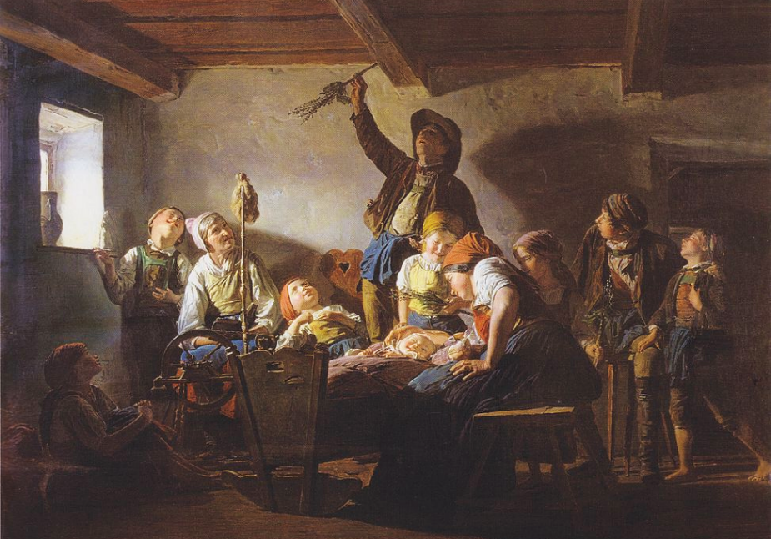
Palm Sunday -- Ferdinand Georg Waldmüller, Moravian Gallery, Brno, Czech Republic

Slide 4
"Go into the village ahead of you n … you will find tied there a colt that has never been ridden; untie it and bring it."
Mark 11:2b

Slide 5
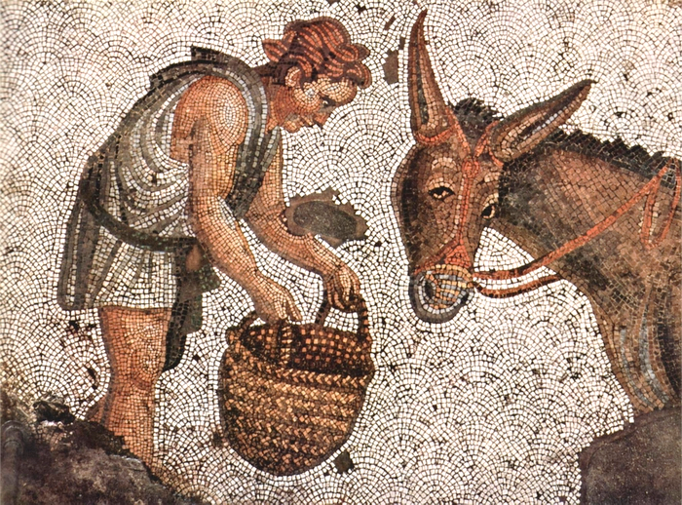
Child and Donkey -- Palace of Constantine the Great, Istanbul, Turkey

Slide 6
"Do not be afraid, daughter of Zion. Look …
John 12:14-15

Slide 7
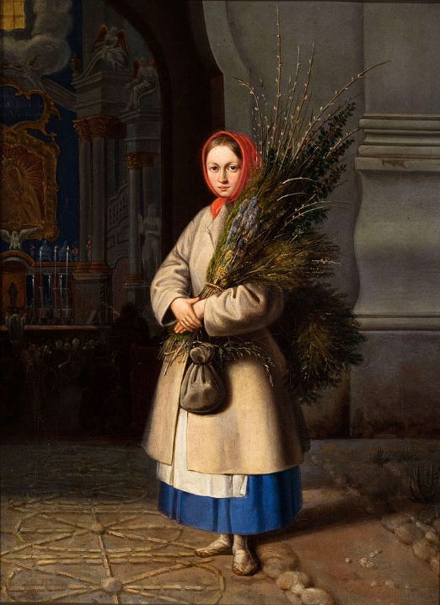
Girl with Palm Sunday Fronds
Kanutas Ruseckas
Lithuanian Art Museum
Vilnius, Lithuania

Slide 8
"… your king is coming, sitting on a donkey's colt!"
John 12:14-15

Slide 9
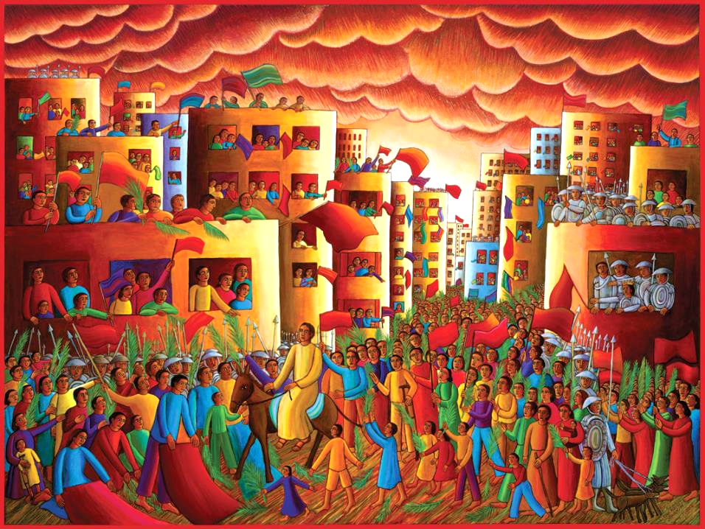
Christ's Entry into Jerusalem -- John August Swanson

Slide 10
Then they brought the colt to Jesus and threw their cloaks on it; and he sat on it.
Mark 11:7

Slide 11
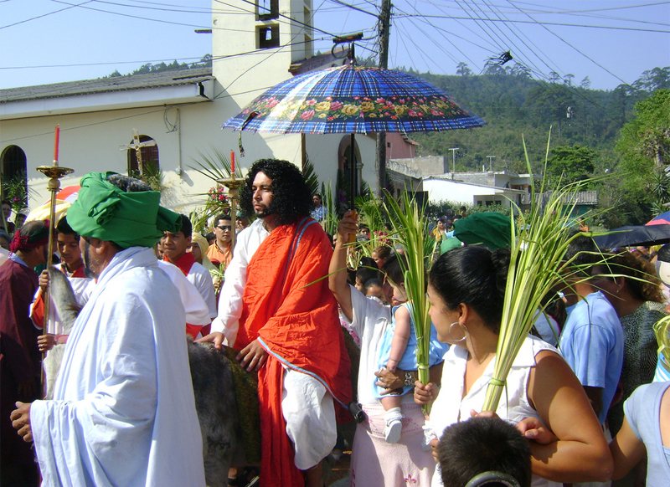
Palm Sunday Procession -- Honduras

Slide 12
Many people spread their cloaks on the road,
Mark 11:8a

Slide 13
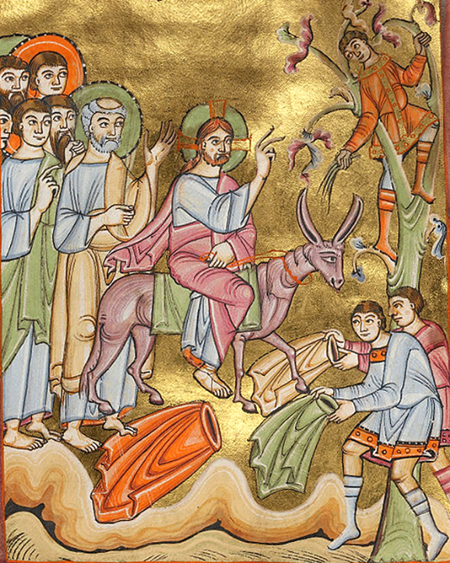
Entry into Jerusalem
c. 1030-1040
Getty Center
LosAngeles, CA

Slide 14
and others spread leafy branches that they had cut in the fields.
Mark 11:8

Slide 15
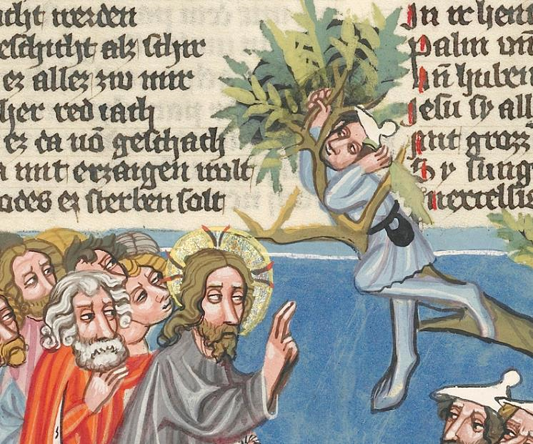
Gathering Leafy Branches -- World Chronicle, Getty Museum, Los Angeles, CA

Slide 16
Then those who went ahead and those who followed were shouting,
Mark 11:9a

Slide 17
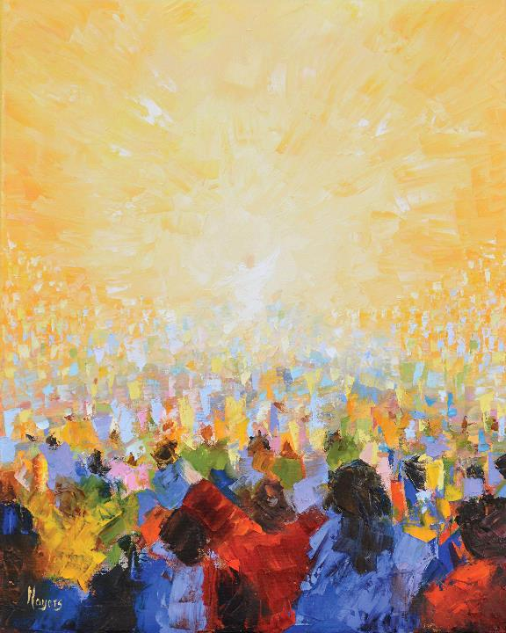
Hallelujah!
Mike Moyers

Slide 18
"Hosanna! Blessed is the one who comes in the name of the Lord!"
Mark 11:9

Slide 19
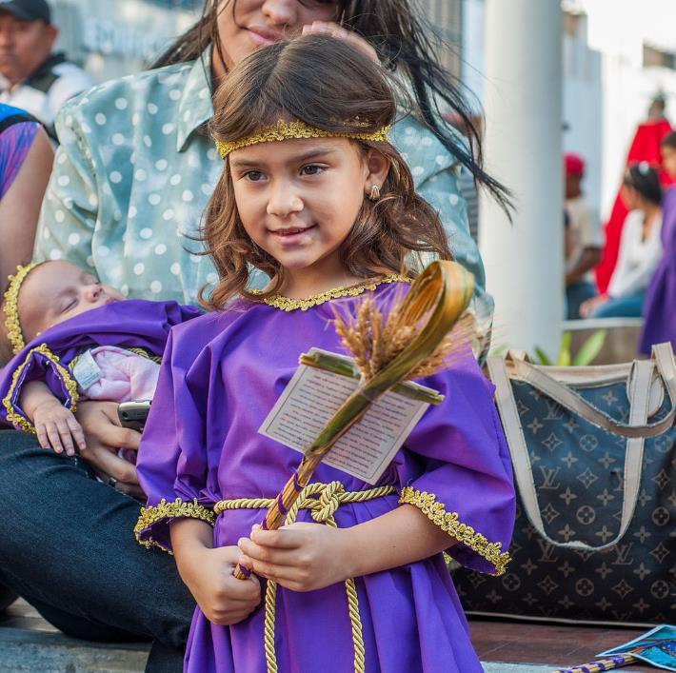
Palm Sunday
Maracaibo, Venezuela

Slide 20
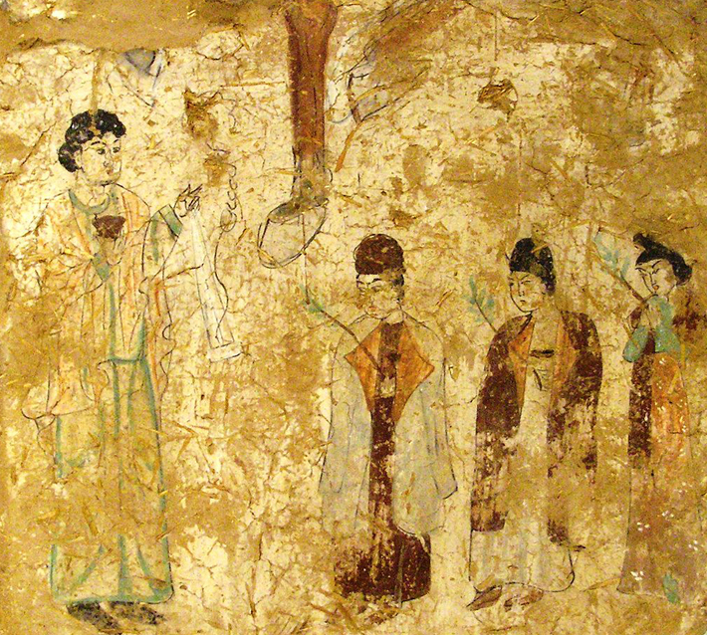
Chinese Nestorian Christian Palm Sunday Procession
Museum fur Indische Kunst Berlin, Germany

Slide 21
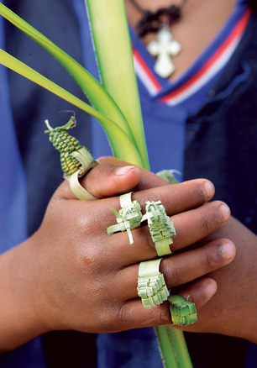
Palm Leaf Rings in Celebration of Hosanna
(Palm Sunday)
Ethiopia

Slide 22
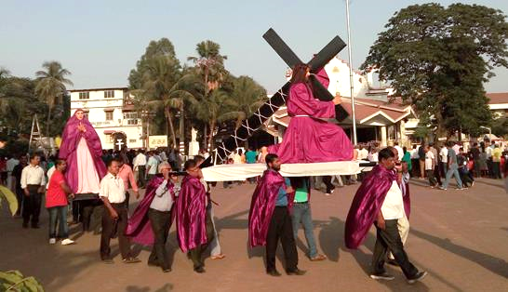
Palm Sunday Procession -- Kurla, India

Slide 23
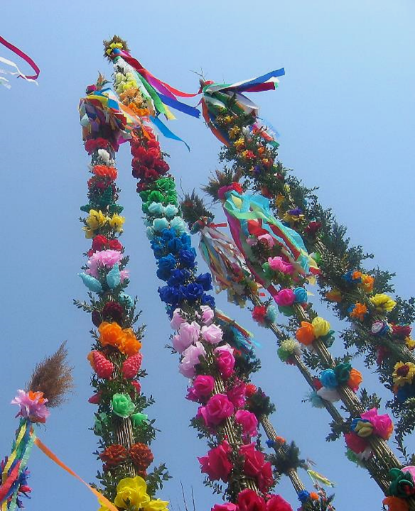
Traditional Paper Palm Trees in celebration of Palm Sunday
Lipnica Murowana, Poland

Slide 24
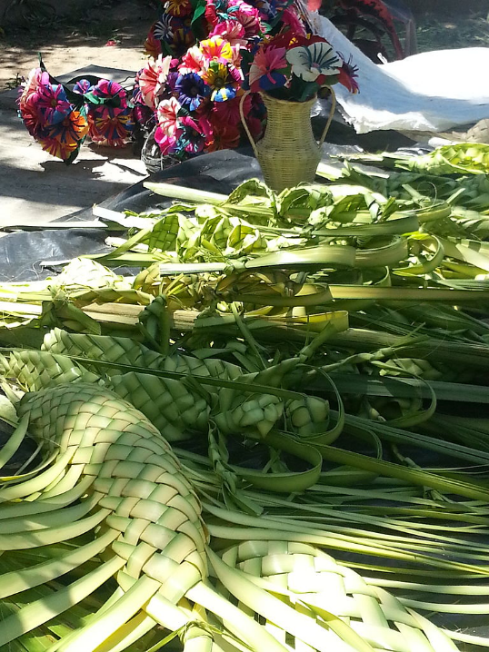
Palm Sunday Woven Fronds and Flowers
Nyarit, Mexico

Slide 25
Credits
New Revised Standard Version Bible, copyright 1989, Division of Christian Education of the National Council of the Churches of Christ in the United States of America. Used by permission. All rights reserved.
https://commons.wikimedia.org/wiki/File:Waldm%C3%BCller_-_Palmsonntag.jpeg
http://www.yorckproject.de
https://commons.wikimedia.org/wiki/File:Lithuanian_Girl_with_Palm_Sunday_Fronds.jpeg
www.JohnAugustSwanson.com - copyright 1990 by John August Swanson
http://www.flickr.com/photos/johndonaghy/3415402416/
http://commons.wikimedia.org/wiki/File:The_Entry_into_Jerusalem_-_Google_Art_Project_(6834070).jpg
https://commons.wikimedia.org/wiki/File:Vincent_van_Gogh_-_Olive_Trees_-_Google_Art_Project_(Minneapolis_Institute_of_Arts).jpg
Mike Moyers, https://www.mikemoyersfineart.com/
https://commons.wikimedia.org/wiki/File:Girl_disguised_Nazarene_2.jpg
http://commons.wikimedia.org/wiki/File:Museum_f%C3%BCr_Indische_Kunst_Dahlem_Berlin_Mai_2006_061.jpg
https://commons.wikimedia.org/wiki/File:Hosana_Rings.jpg
https://commons.wikimedia.org/wiki/File:Palm_Sunday_procession.jpg – Tiven Gonsalves
https://commons.wikimedia.org/wiki/File:Palm_Sunday_in_Poland.PNG - Maciej Szczepańczyk
https://commons.wikimedia.org/wiki/File:Palm_Sunday_in_Nayarit_Mexico.jpg – Fer Gutierrez
Additional descriptions can be found at the Art in the Christian Tradition image library, a service of the Vanderbilt Divinity Library, http://diglib.library.vanderbilt.edu/. All images available via Creative Commons 3.0 License.

