Slide 1
Eighth Sunday after the Epiphany
Year B
Hosea 2:14-20 • Psalm 103:1-13, 22
2 Corinthians 3:1-6 • Mark 2:13-22

Slide 2
I will make for you a covenant on that day with the wild animals, the birds of the air, and the creeping things of the ground; and I will abolish the bow, the sword, and war from the land; and I will make you lie down in safety.
Hosea 2:18

Slide 3
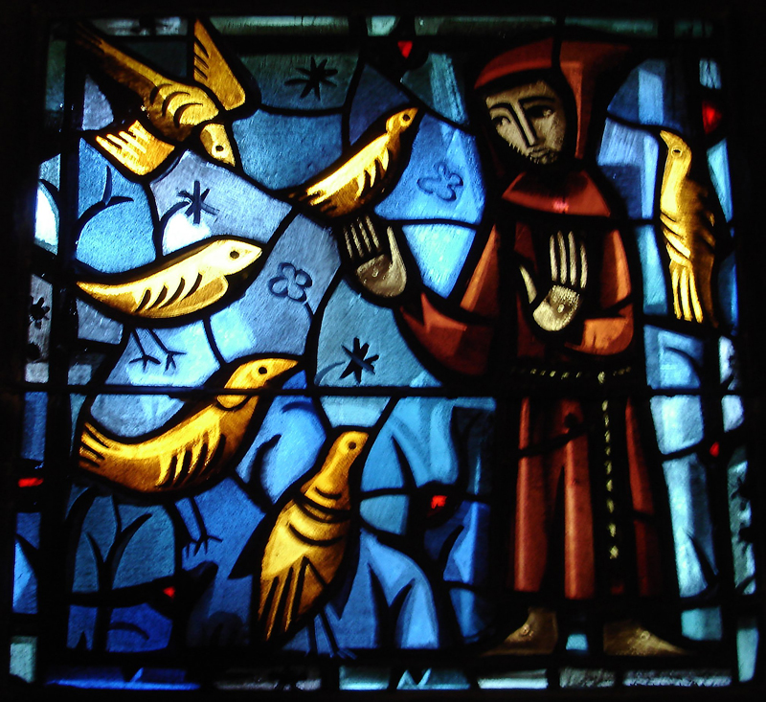
Prayer of St. Francis, Brother Eric, 20th century

Slide 4
And I will take you for my wife forever; I will take you for my wife in righteousness and in justice, in steadfast love, and in mercy.
Hosea 2:19

Slide 5
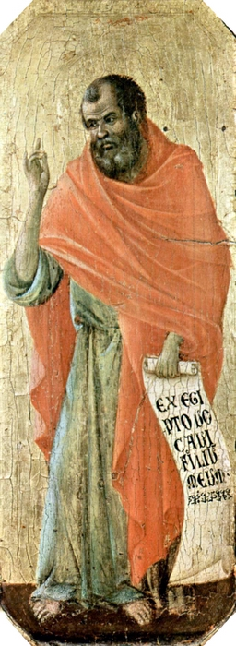
Prophet Hosea
Duccio di Buoninsegna, 1308-1311

Slide 6
Bless the LORD, O my soul, and all that is within me, bless his holy name.
Psalm 103:1

Slide 7
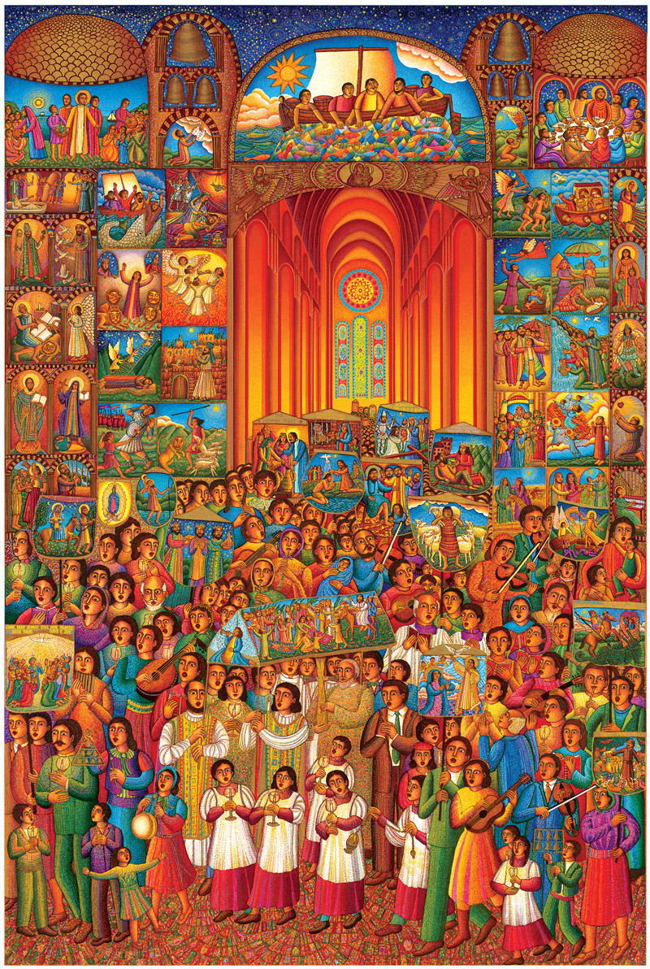
The Procession
John August Swanson, 2007

Slide 8
You yourselves are our letter, written on our hearts, to be known and read by all;
2 Corinthians 3:2

Slide 9
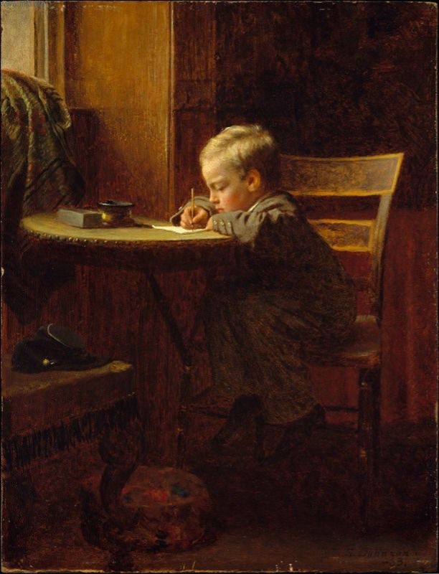
Writing to Father
Eastman Johnson, 1863

Slide 10
As he was walking along, he saw Levi son of Alphaeus sitting at the tax booth, and he said to him, “Follow me.” And he got up and followed him.
Mark 2:14

Slide 11
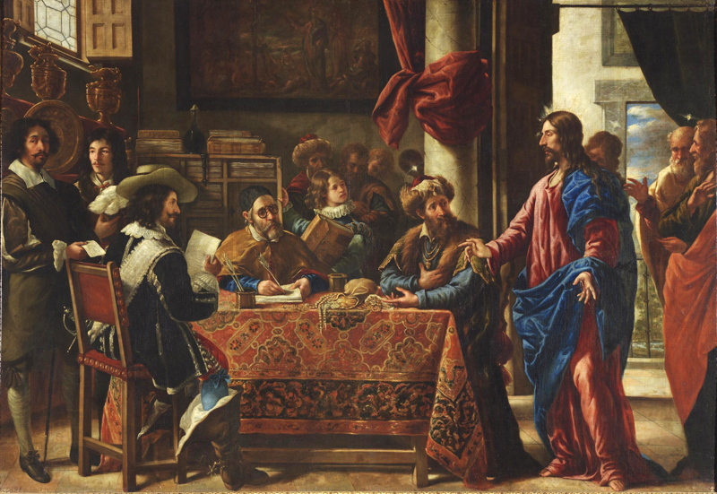
Vocation of Saint Matthew, Juan de Pareja, 1661

Slide 12
And as he sat at dinner in Levi’s house, many tax collectors and sinners were also sitting with Jesus and his disciples—for there were many who followed him.
Mark 2:15

Slide 13
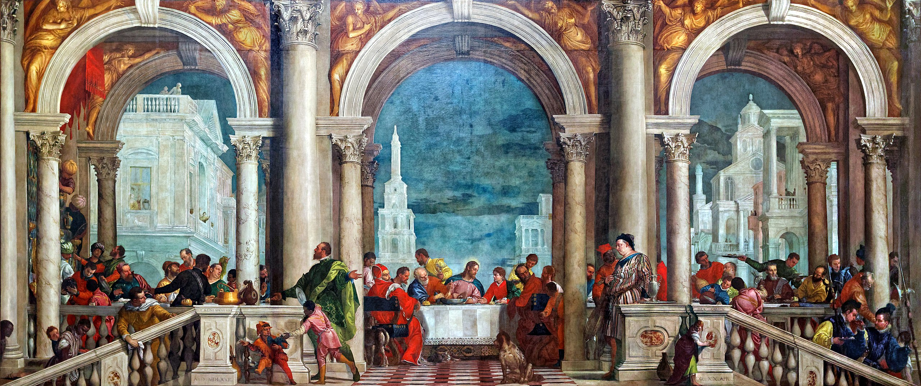
Feast in the House of Levi, Paolo Cagliari Veronese, 1573

Slide 14
When the scribes of the Pharisees saw that he was eating with sinners and tax collectors, they said to his disciples, “Why does he eat with tax collectors and sinners?”
Mark 2:16

Slide 15
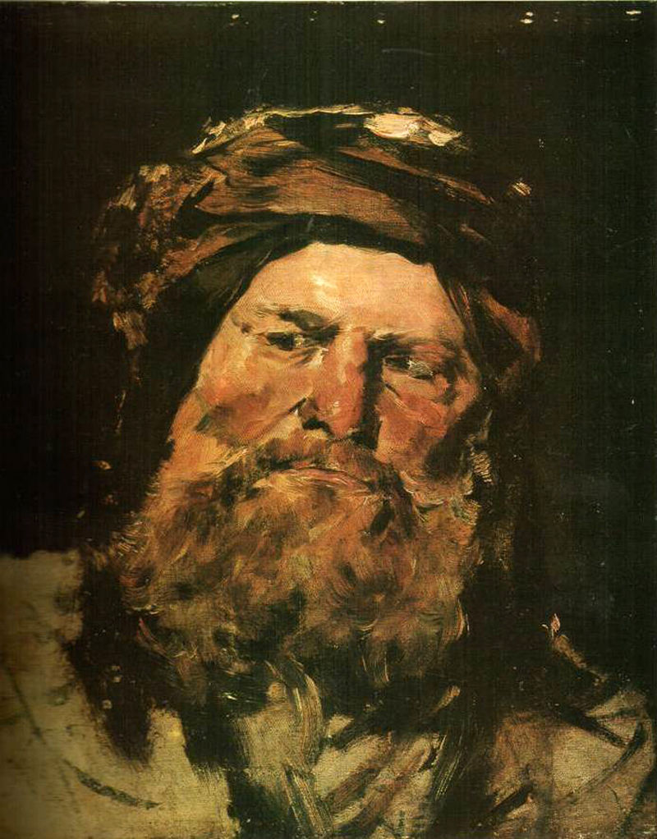
Head of a Pharisee
Mihály Munkácsy, 1881

Slide 16
When Jesus heard this, he said to them, “Those who are well have no need of a physician, but those who are sick; I have come to call not the righteous but sinners.”
Mark 2:17

Slide 17
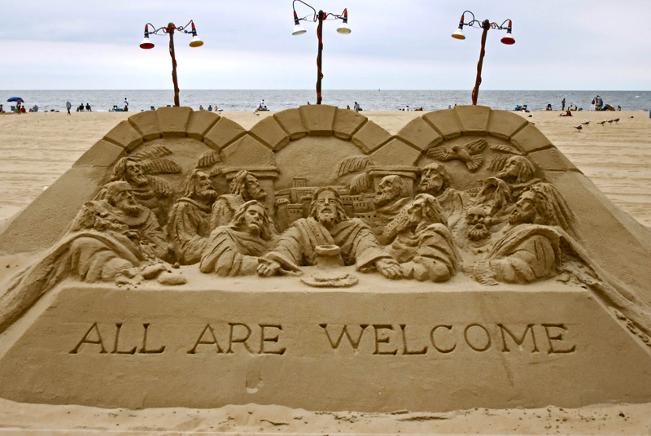
All Are Welcome in the Kingdom of God, Ocean City, Maryland, 2007

Slide 18
Now John’s disciples and the Pharisees were fasting; and people came and said to him, “Why do John’s disciples and the disciples of the Pharisees fast, but your disciples do not fast?”
Mark 2:18

Slide 19
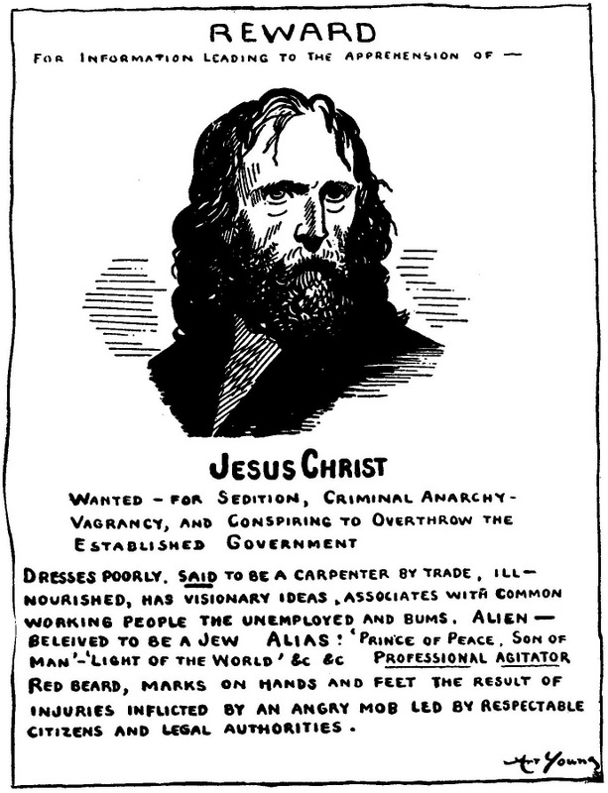
Jesus Wanted poster
Art Young, 1917

Slide 20
Jesus said to them, “The wedding guests cannot fast while the bridegroom is with them, can they? As long as they have the bridegroom with them, they cannot fast.”
Mark 2:19

Slide 21
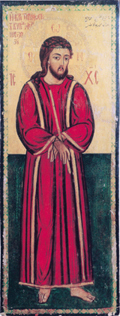
Jesus the Bridegroom
Anonymous, 19th century

Slide 22
Credits
New Revised Standard Version Bible, copyright 1989, Division of Christian Education of the National Council of the Churches of Christ in the United States of America. Used by permission. All rights reserved.
http://www.flickr.com/photos/swperman/221008978/
https://commons.wikimedia.org/wiki/File:Duccio_di_Buoninsegna_063.jpg
www.JohnAugustSwanson.com
https://commons.wikimedia.org/wiki/File:Eastman_Johnson_-_Writing_to_Father.jpg
https://commons.wikimedia.org/wiki/File:Pareja-vocacion_mateo.jpg
https://commons.wikimedia.org/wiki/File:The_Feast_in_the_House_of_Levi_(edited).jpg
https://commons.wikimedia.org/wiki/File:Mihaly_Munkacsy_Head_of_a_Pharisee.jpg
https://flickr.com/photos/jillianaphotography/1236022574/
https://commons.wikimedia.org/wiki/File:Jesus_wanted_poster.jpg
https://commons.wikimedia.org/wiki/File:Jesus_the_Bridegroom_(Syria).jpg
Additional descriptions can be found at the Art in the Christian Tradition image library, a service of the Vanderbilt Divinity Library, http://diglib.library.vanderbilt.edu/. All images available via Creative Commons 3.0 License.

