Slide 1
Ash Wednesday
Year B
Joel 2:1-2, 12-17
or Isaiah 58:1-12
Psalm 51:1-17
2 Corinthians 5:20b-6:10
Matthew 6:1-6, 16-21

Slide 2
Yet even now, says the LORD, return to me with all your heart, with fasting, with weeping, and with mourning;
Joel 2:12b

Slide 3
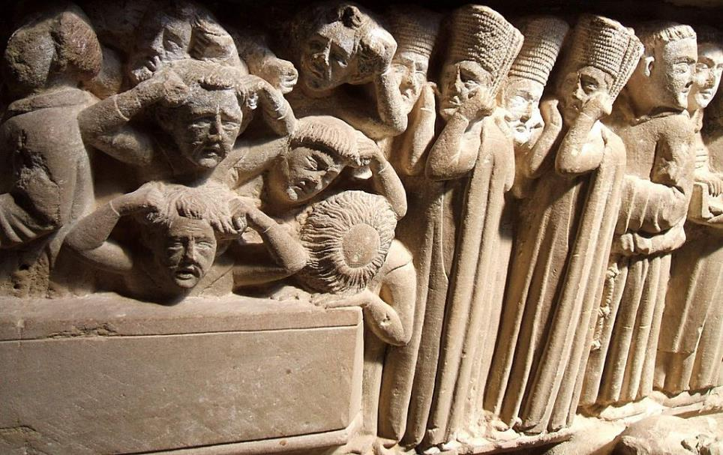
Sepulcher in Cistercian monastery -- Santa María del Salvador, Cañas, Spain

Slide 4
Is not this the fast that I choose:
to loose the bonds of injustice,
to undo the thongs of the yoke,
to let the oppressed go free,
and to break every yoke?
Isaiah 58:6

Slide 5
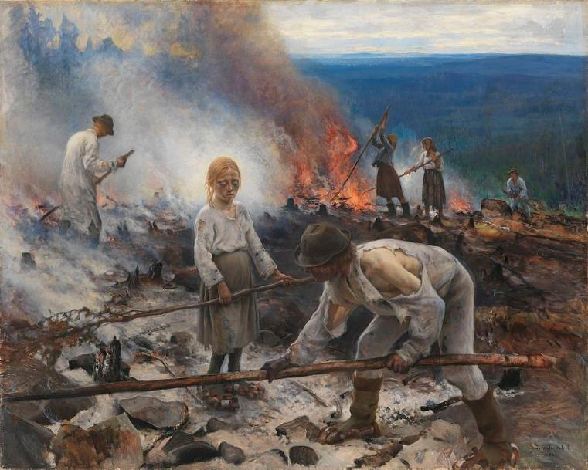
Under the Yoke -- Eero Jarnefelt, Finnish National Gallery, Helsinki, Finland

Slide 6
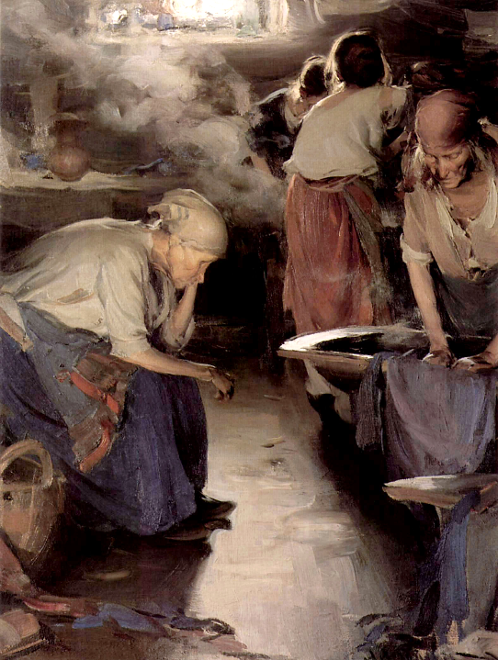
Washerwomen
Abram Archipov
Tretyakov Gallery
Moscow, Russia

Slide 7
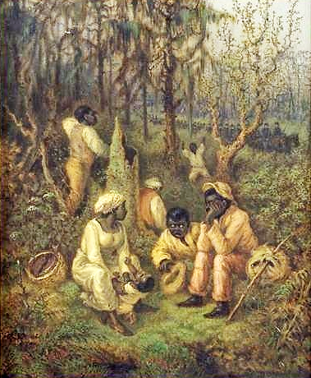
Fugitive Slaves in the Dismal Swamp
New York Historical Society

Slide 8
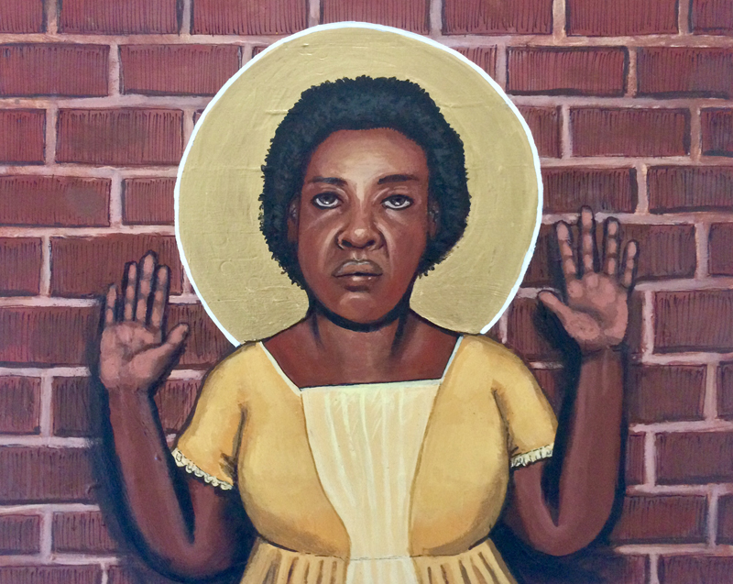
Fannie Lou Hamer, Civil Rights activist -- Kelly Latimore

Slide 9
Is it not to share your bread with the hungry,
and bring the homeless poor into your house;
when you see the naked,
to cover them,
and not to hide yourself from your own kin?
Isaiah 58:7

Slide 10
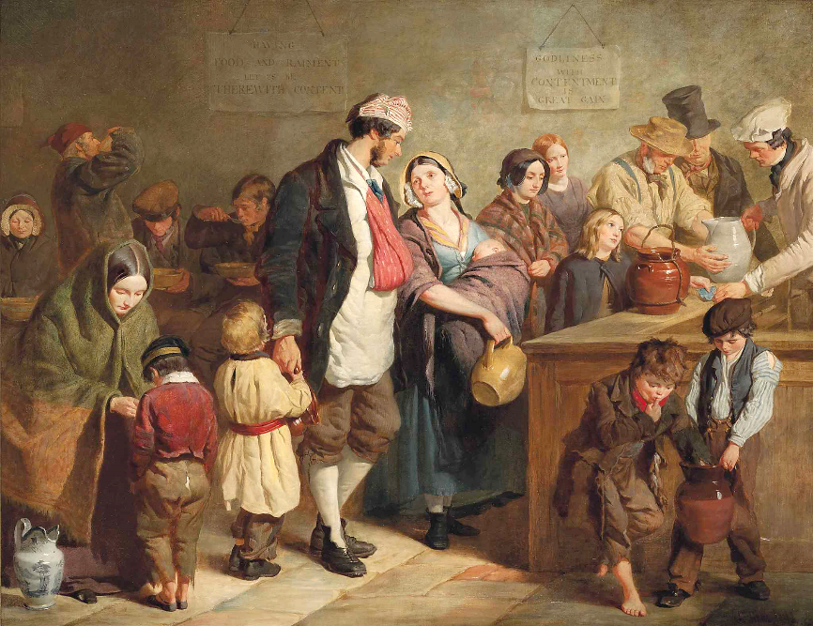
Parish Soup Kitchen -- George Hicks

Slide 11
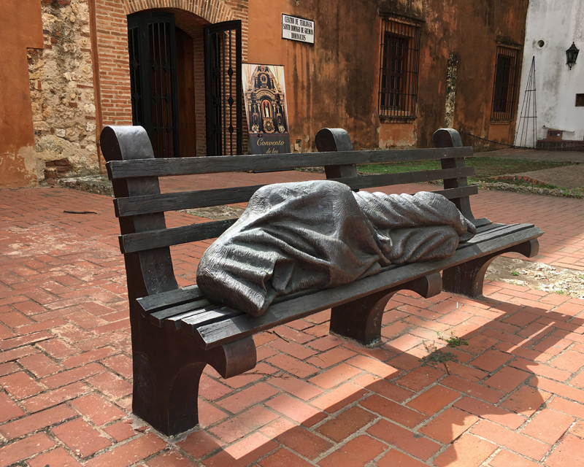
Homeless Jesus -- Timothy Schmalz, Dominican Convent, Santo Domingo, Dominican Republic

Slide 12
Thanks for Being a Helping Hand -- Ibrahim Ebi, graphic image using stylized Arabic script

Slide 13
Create in me a clean heart, O God, and put a new and right spirit within me.
Psalm 51:10

Slide 14
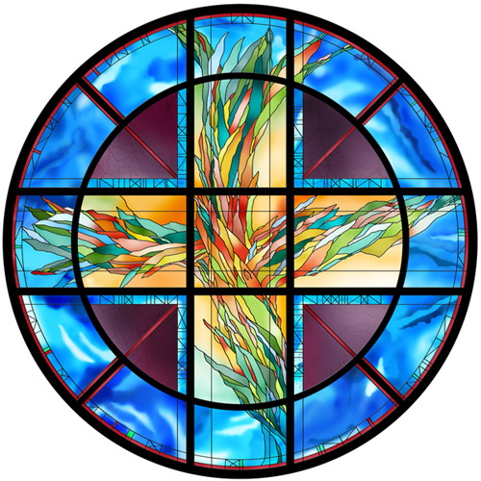
Living Cross
Sarah Hall, stained glass artist

Slide 15
... we have commended ourselves … by purity, knowledge, patience, kindness, holiness of spirit, genuine love, truthful speech, and the power of God;
2 Corinthians 6:4b, 6, 7a

Slide 16
Kindness, Compassion, Peace -- People's Climate March, 2017

Slide 17
"Beware of practicing your piety before others in order to be seen by them … "
Matthew 6:1a

Slide 18
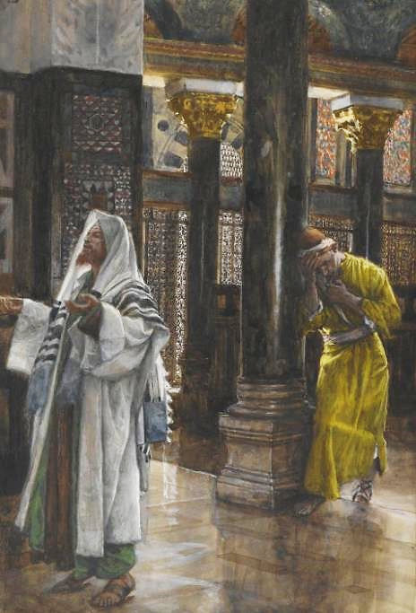
Pharisee and the Publican
James Tissot
Brooklyn Museum
New York, NY

Slide 19
"Do not store up for yourselves treasures on earth, where moth and rust consume … but store up for yourselves treasures in heaven … "
Matthew 6:19a, 20a

Slide 20
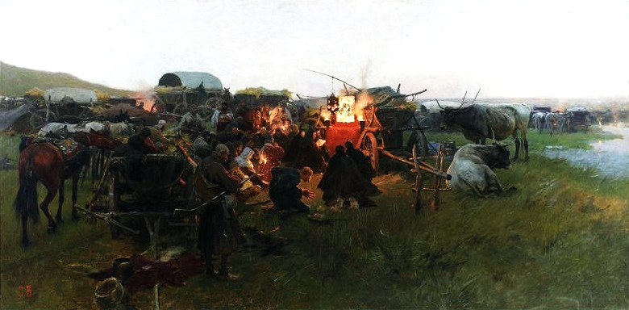
Prayer in the Steppe -- Jozef Brandt, National Museum, Warsaw, Poland

Slide 21
But when you give alms, do not let your left hand know what your right hand is doing, so that your alms may be done in secret;
Matthew 6:3-4a

Slide 22
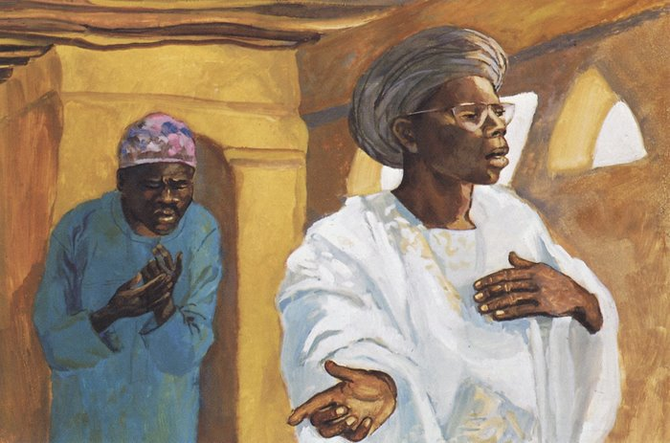
The Pharisee and the Publican -- JESUS MAFA, Cameroon

Slide 23
For where your treasure is, there your heart will be also.
Matthew 6:21

Slide 24
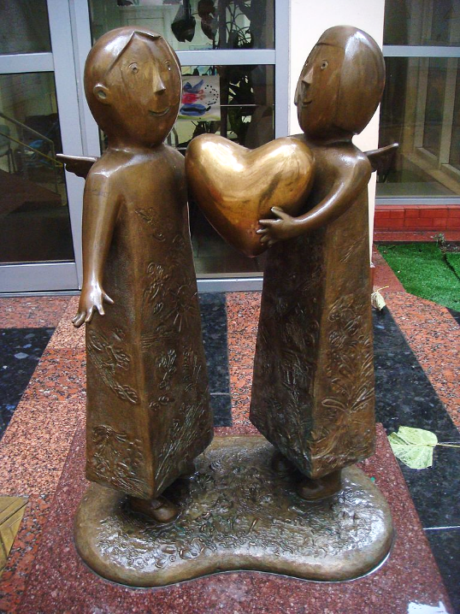
Heart of the World
Mikhail Reva
Odessa Children's Hospital
Odessa, Ukraine

Slide 25
Credits
New Revised Standard Version Bible, copyright 1989, Division of Christian Education of the National Council of the Churches of Christ in the United States of America. Used by permission. All rights reserved.
https://commons.wikimedia.org/wiki/File:Ca%C3%B1as_-_Monasterio_11_(Sepulcro_de_la_Beata_Urraca_D%C3%ADaz_de_Haro).jpg
https://commons.wikimedia.org/wiki/File:Eero_J%C3%A4rnefelt_(1863-1937)-_Under_the_Yoke_(Burning_the_Brushwood)_-_Raatajat_rahanalaiset_-_Kaski_-_Tr%C3%A4lar_under_penningen_-_Sved_(31948645643).jpg
http://www.yorckproject.de
http://commons.wikimedia.org/wiki/File:Great_Dismal_Swamp-Fugitive_Slaves.jpg
https://kellylatimoreicons.com/contact/
https://commons.wikimedia.org/wiki/File:George_Elgar_Hicks_-_The_Parish_Soup_Kitchen.jpg
https://commons.wikimedia.org/wiki/File:Homeless_Jesus_CCSD_07_2018_9749.jpg
https://commons.wikimedia.org/wiki/File:Helping_Hand.png - Ibrahim ebi
https://commons.wikimedia.org/wiki/File:Living_Cross_by_Sarah_Hall.jpg
https://commons.wikimedia.org/wiki/File:People%27s_Climate_March_2017_in_Washington_DC_35.jpg
https://commons.wikimedia.org/wiki/File:Tissot_The_Pharisee_and_the_publican_Brooklyn.jpg
https://commons.wikimedia.org/wiki/File:Brandt_Prayer_in_the_steppe.jpg
http://diglib.library.vanderbilt.edu/act-imagelink.pl?RC=48268
https://commons.wikimedia.org/wiki/File:Children_sculpture_by_Mikhail_Reva.jpg
Additional descriptions can be found at the Art in the Christian Tradition image library, a service of the Vanderbilt Divinity Library, http://diglib.library.vanderbilt.edu/. All images available via Creative Commons 3.0 License.

