Slide 1
Ascension of the Lord
Year B
Acts 1:1-11 • Psalm 47 or Psalm 93 • Ephesians 1:15-23 • Luke 24:44-53

Slide 2
When he had said this, as they were watching, he was lifted up, and a cloud took him out of their sight.
Acts 1:9

Slide 3
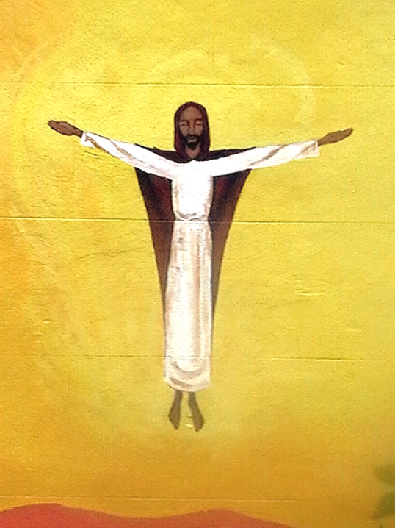
Ascension
Building Mural
Bristol, England

Slide 4
Clap your hands, all you peoples; shout to God with loud songs of joy.
Psalm 47:1

Slide 5
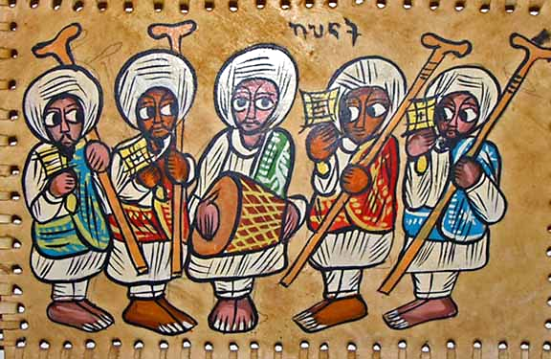
Ethiopian Orthodox Choir -- Paint on leather, 20th century

Slide 6
God put this power to work in Christ … far above all rule and authority …
Ephesians 1:20a, 21a

Slide 7
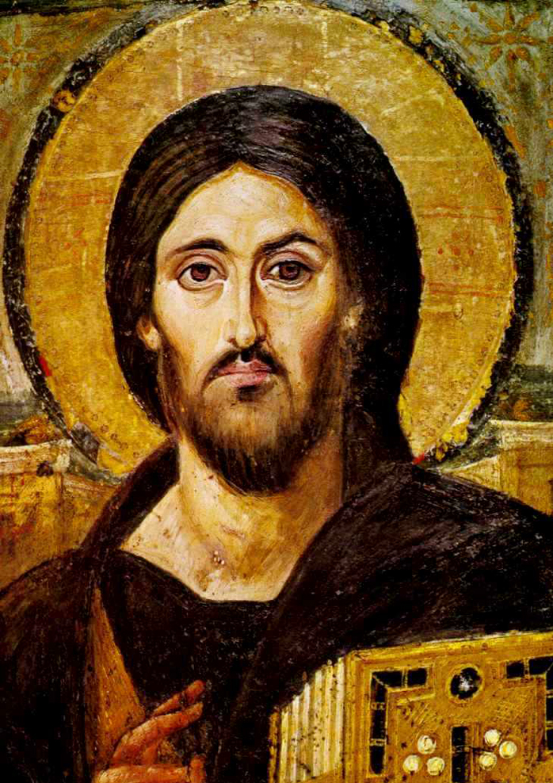
Christ Pantocratur
Encaustic Icon
St. Catherine's Monastery
Sinai, Egypt

Slide 8
… and he said to them, “Thus it is written, that the Messiah is to suffer and to rise from the dead on the third day…”
Luke 24:46

Slide 9
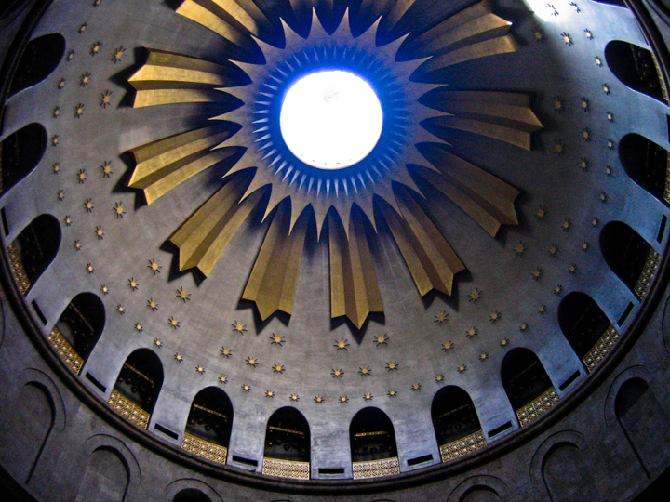
Church of the Holy Sepulchre -- Jerusalem

Slide 10
… repentance and forgiveness of sins is to be proclaimed in his name to all nations,
Luke 24:47

Slide 11
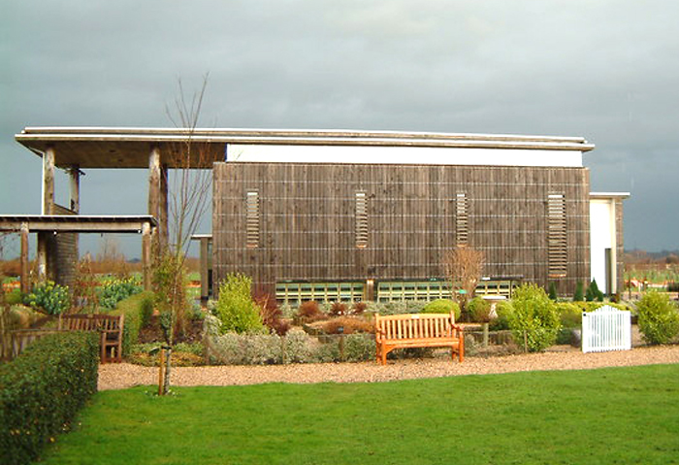
Millennium Chapel of Peace and Forgiveness, Alrewas, England

Slide 12
Then he led them out as far as Bethany, and, lifting up his hands, he blessed them.
Luke 24:50

Slide 13
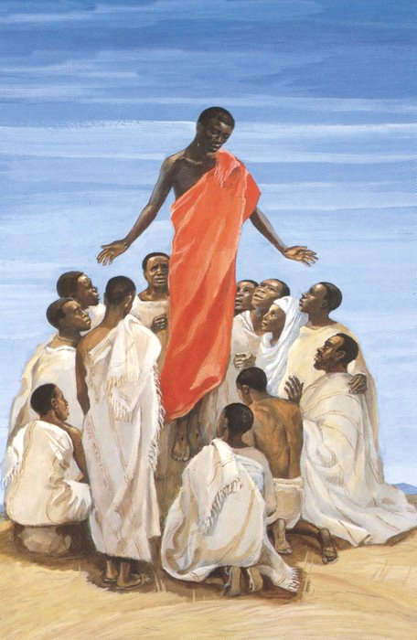
Ascension of Christ
JESUS MAFA, Cameroon

Slide 14
While he was blessing them, he withdrew from them and was carried up into heaven.
Luke 24:51

Slide 15
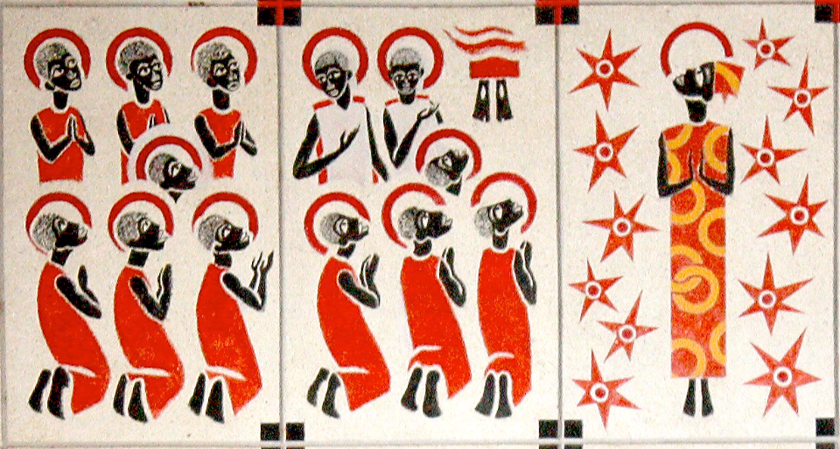
Ascension -- Keur Moussa Abbey, Keur Moussa, Senegal

Slide 16
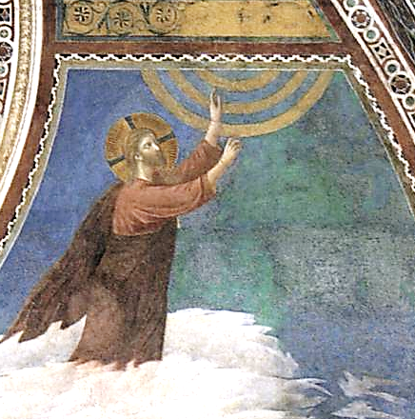
Ascension -- Giotto, Basilica of St. Francis, Assisi, Italy

Slide 17
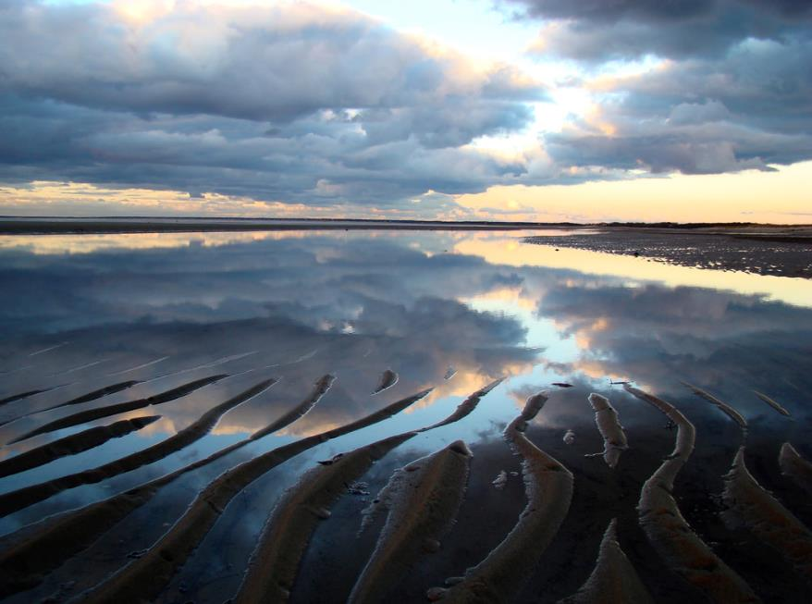
Ascension -- Joanna Vaughn, Cape Cod Bay

Slide 18
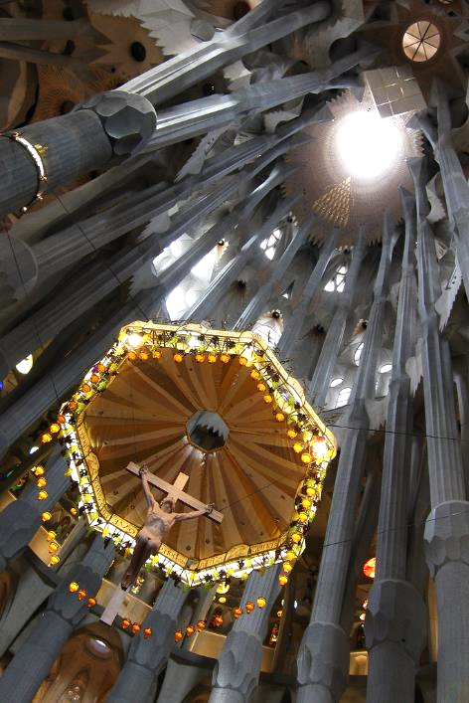
Ascension
Bousure
Sagrada Familia
Barcelona, Spain

Slide 19
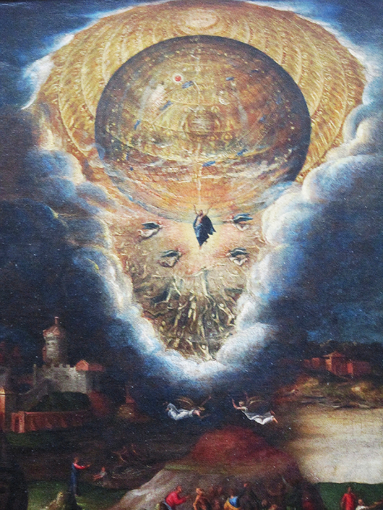
Mysteries of the Passion, Resurrection, and Ascension of Christ (detail)
Antonio Campi
Louvre Museum, Paris

Slide 20
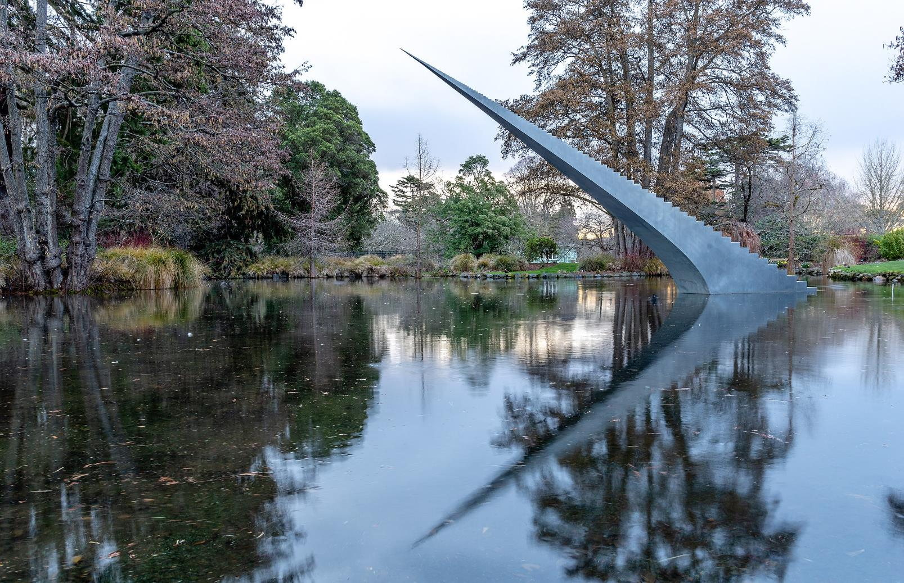
Diminish and Ascend -- David McCracken, Christchurch, New Zealand

Slide 21
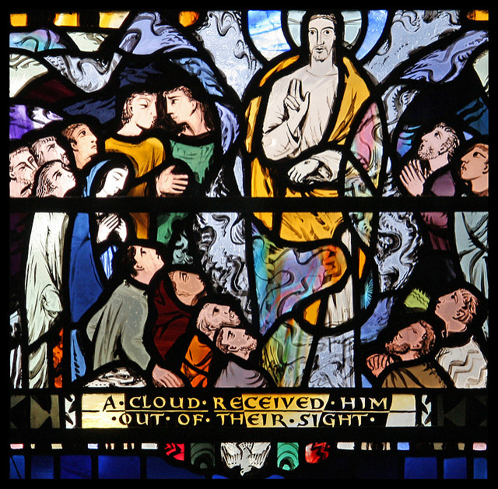
Ascension
Church of St Ethelreda London, England

Slide 22
And they worshiped him, and returned to Jerusalem with great joy.
Luke 24:52

Slide 23
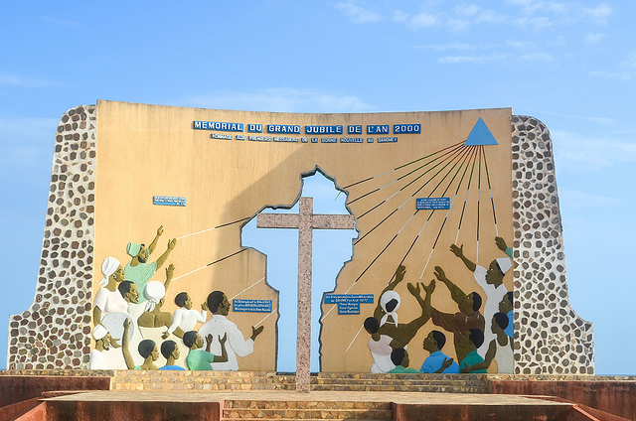
Jubilee Monument -- Ouidah, Benin

Slide 24
Credits
New Revised Standard Version Bible, copyright 1989, Division of Christian Education of the National Council of the Churches of Christ in the United States of America. Used by permission. All rights reserved.
http://www.flickr.com/photos/skip/111045024/
http://commons.wikimedia.org/wiki/File:Ethiopian_painting_of_Ethiopian_Orthodox_choir.png
http://en.wikipedia.org/wiki/File:Spas_vsederzhitel_sinay.jpg
http://commons.wikimedia.org/wiki/File:The_Millennium_Chapel_of_Peace_and_Forgiveness,_at_the_National_Memorial_Arboretum,_Alrewas,_Staffordshire._-_geograph.org.uk_-_814782.jpg
http://diglib.library.vanderbilt.edu/act-imagelink.pl?RC=48398
https://commons.wikimedia.org/wiki/File:KeurMoussaAutel.jpg
https://commons.wikimedia.org/wiki/File:Giotto_di_Bondone_-_Ascension_of_Christ_-_WGA09156.jpg
https://www.flickr.com/photos/joannavaughanphotography/1909248290/ - Joanna Vaughn
https://www.flickr.com/photos/30430801@N06/5871511887/
https://www.flickr.com/photos/mhbishop/7061390583/
https://commons.wikimedia.org/wiki/File:Diminish_and_Ascend,_Christchurch_Botanic_Gardens,_Christchurch.jpg
https://www.flickr.com/photos/paullew/3558979922/ - Fr Lawrence Lew, O.P.
https://www.flickr.com/photos/jbdodane/10310585524/
Additional descriptions can be found at the Art in the Christian Tradition image library, a service of the Vanderbilt Divinity Library, http://diglib.library.vanderbilt.edu/. All images available via Creative Commons 3.0 License.

