Slide 1
Sixth Sunday after Epiphany
Year A
Deuteronomy 30:15-20 or Sirach 15:15-20 • Psalm 119:1-8
1 Corinthians 3:1-9 • Matthew 5:21-37

Slide 2
Choose…loving the LORD your God, obeying him, and holding fast to him;
Deuteronomy 30:19b, 20a

Slide 3
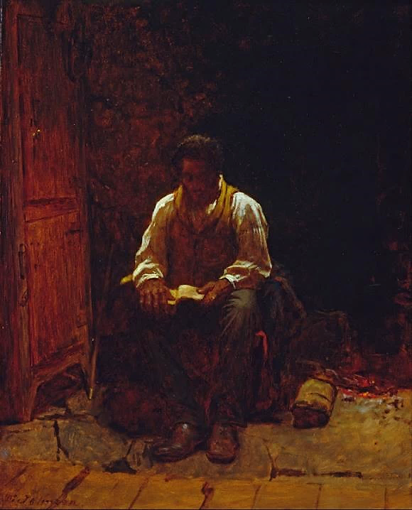
The Lord is My Shepherd
Eastman Johnson Smithsonian American Art Museum
Washington, DC

Slide 4
Happy are those who keep his decrees, who seek him with their whole heart;
Psalm 119:1-8

Slide 5
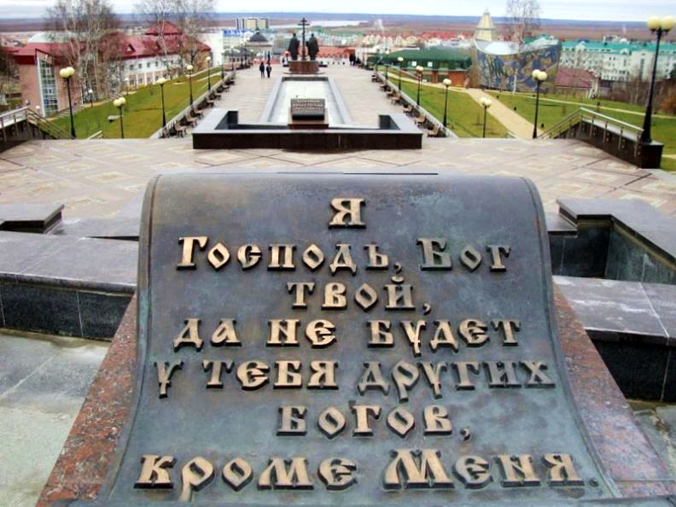
“I am the Lord Your God, You Shall Have No Other Gods Before Me.” Khanty-Mansiysk, Russia

Slide 6
I planted, Apollos watered, but God gave the growth.
1 Corinthians 3:6

Slide 7
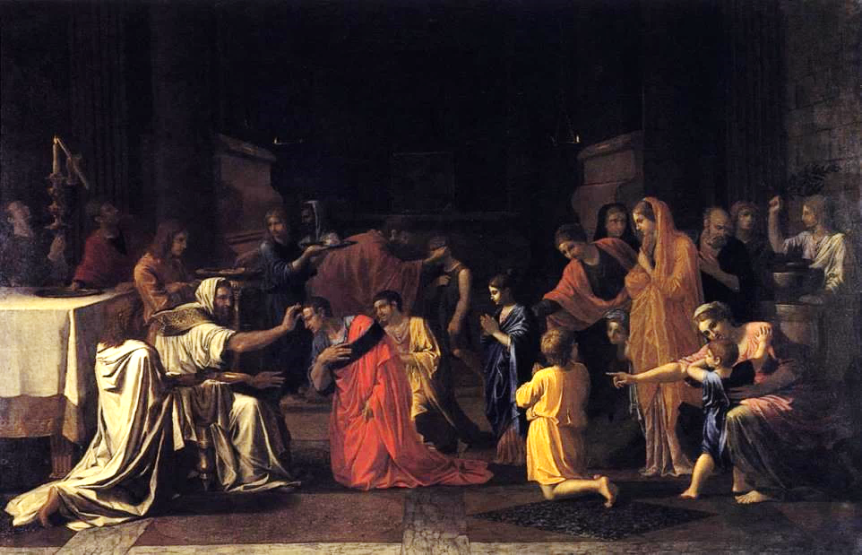
Confirmation -- Nicolas Poussin, Scottish National Gallery, Edinburgh, Scotland

Slide 8
The one who plants and the one who waters have a common purpose…
1 Corinthians 3:8a

Slide 9
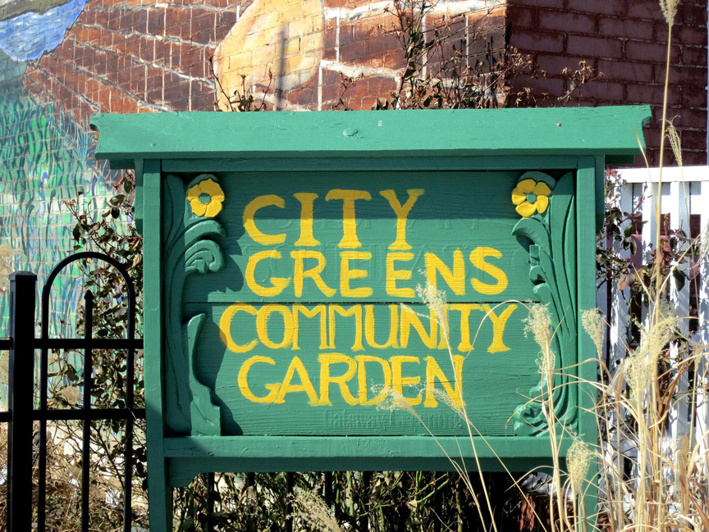
City Greens Community Garden -- City Greens, St. Louis, MO

Slide 10
We are God's servants, working together; you are God's field, God's building.
1 Corinthians 3:9

Slide 11
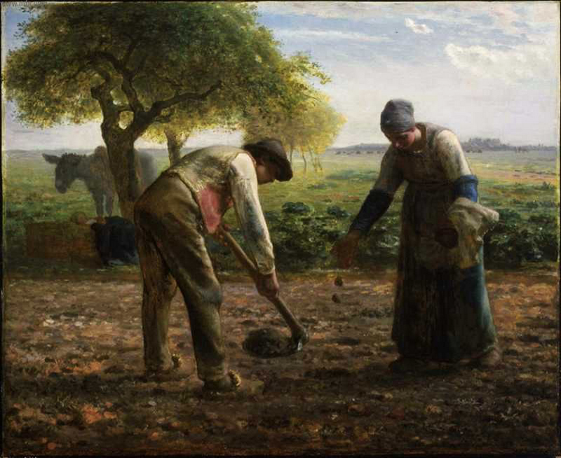
Potato Planters -- Jean Francois Millet, Museum of Fine Arts, Boston

Slide 12
“… when you are offering your gift at the altar, if you remember that your brother or sister has something against you,
Matthew 5:23

Slide 13
…first be reconciled to your brother or sister, and then come and offer your gift.”
Matthew 5:24b

Slide 14
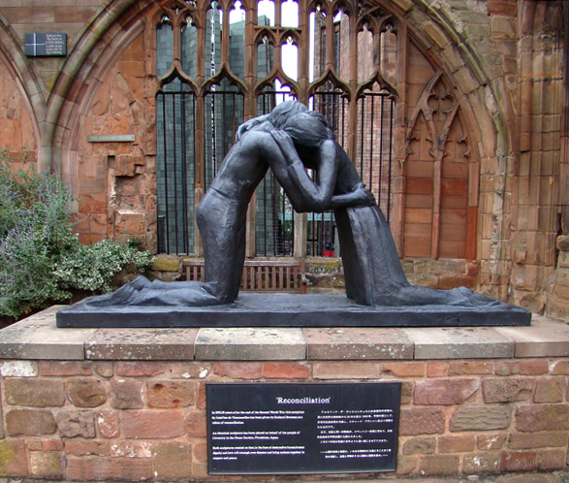
Reconciliation -- Josephina de Vasconcellos, Coventry Cathedral, Coventry, UK

Slide 15
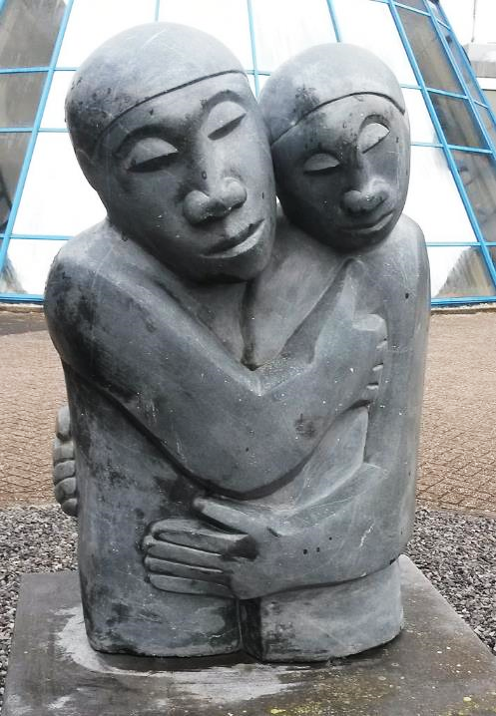
Reconciliation
Amos Supuni Woerden, Netherlands

Slide 16
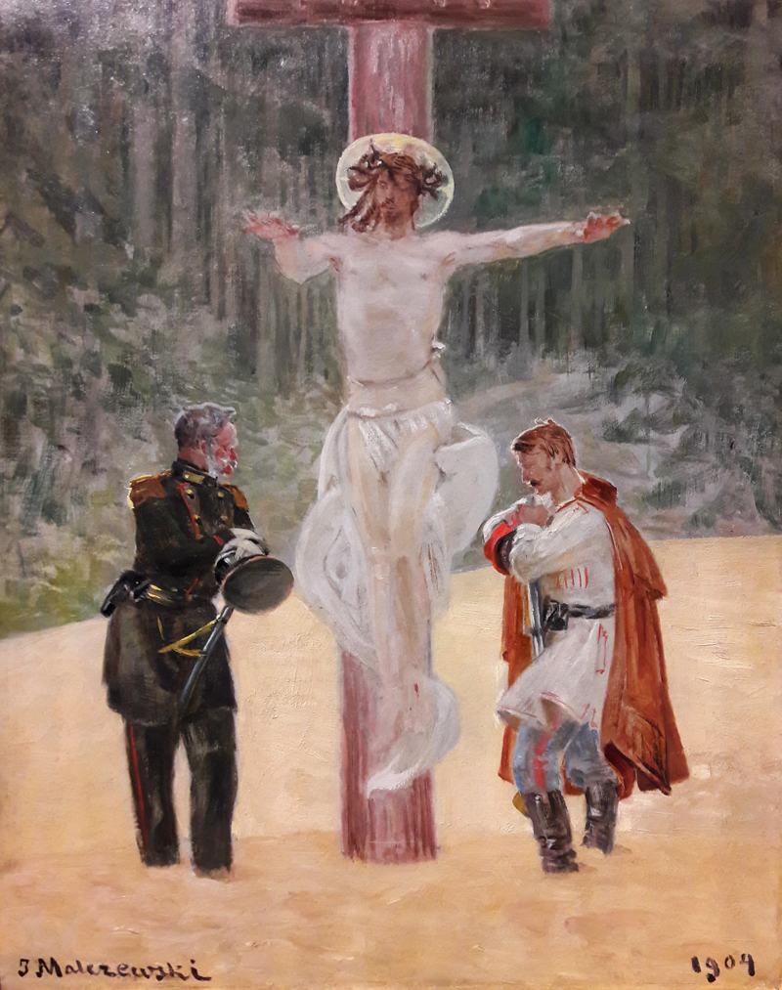
Reconciliation
Jacek Malczewski
National Museum
Warsaw, Poland

Slide 17
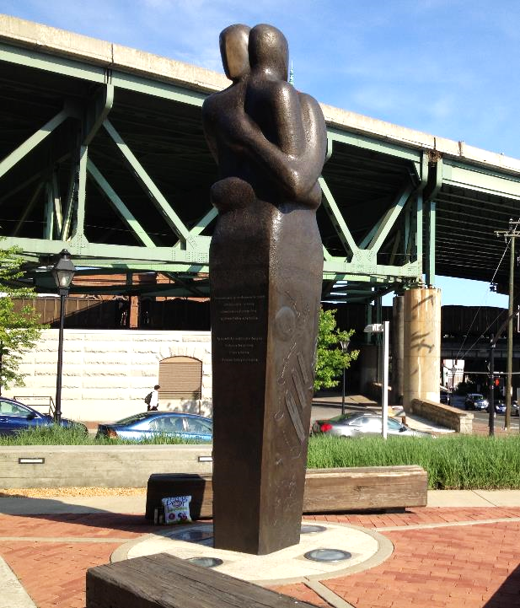
Slavery Reconciliation Statue
Stephen Broadbent
Richmond, VA

Slide 18
Credits
New Revised Standard Version Bible, copyright 1989, Division of Christian Education of the National Council of the Churches of Christ in the United States of America. Used by permission. All rights reserved.
http://diglib.library.vanderbilt.edu/act-imagelink.pl?RC=55852
http://commons.wikimedia.org/wiki/File:The_1st_Commandment_of_God._I_am_the_Lord_thy_God._You_shall_have_no_other_gods_before_Me..jpg
https://commons.wikimedia.org/wiki/File:Seven_Sacraments_-_Confirmation_II_(1645)_Nicolas_Poussin.jpg
https://www.flickr.com/photos/pasa/8508822920
http://www.mfa.org/
http://www.flickr.com/photos/52325611@N05/4947065261/
https://commons.wikimedia.org/wiki/File:Reconciliation_Amos_Supuni_Woerden.jpg
https://www.flickr.com/photos/wolfnowl/3893602036/
http://commons.wikimedia.org/wiki/File:Hands_Across_the_Divide_-_geograph.org.uk_-_478600.jpg
https://www.flickr.com/photos/emeryjl/511012098
https://commons.wikimedia.org/wiki/File:Malczewski_Reconciliation.jpg
https://commons.wikimedia.org/wiki/File:Reconciliation_Triangle.jpg
Additional descriptions can be found at the Art in the Christian Tradition image library, a service of the Vanderbilt Divinity Library, http://diglib.library.vanderbilt.edu/. All images available via Creative Commons 3.0 License.

