Slide 1
Second Sunday after Epiphany
Year A
Isaiah 49:1-7
Psalm 40:1-11
1 Corinthians 1:1-9
John 1:29-42

Slide 2
The LORD called me before I was born, while I was in my mother's womb he named me.
Isaiah 49:1b

Slide 3
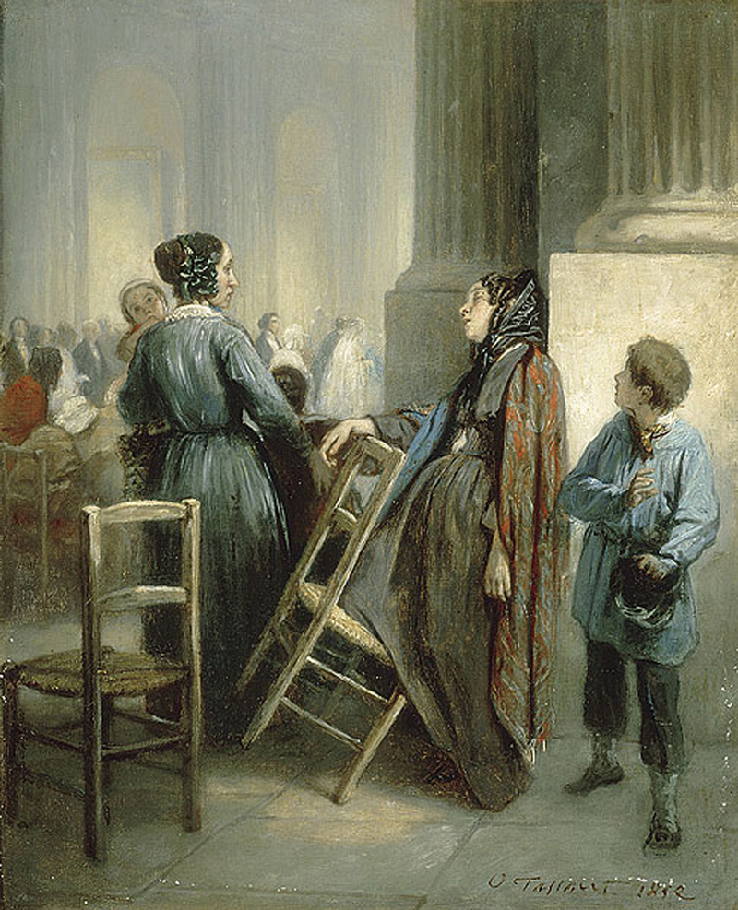
Abandoned
Octave Tasseart
Musee Fabre
Montpellier, France

Slide 4
He says, … “I will give you as a light to the nations…”
Isaiah 49:6b

Slide 5
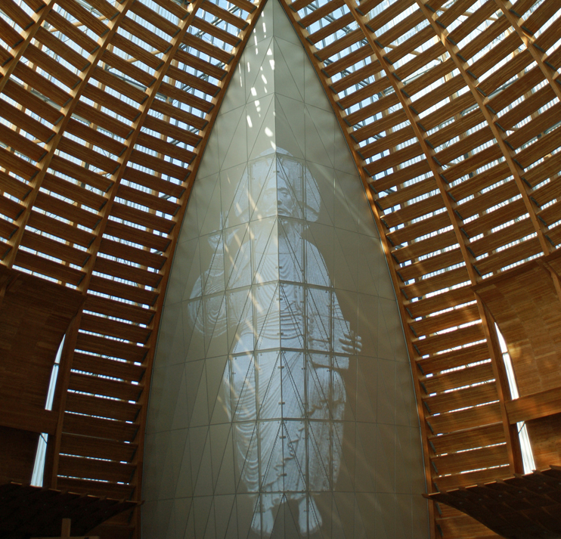
Cathedral of Christ the Light
Oakland, CA

Slide 6
I waited patiently for the LORD;
he inclined to me and heard my cry.
Psalm 40:1

Slide 7
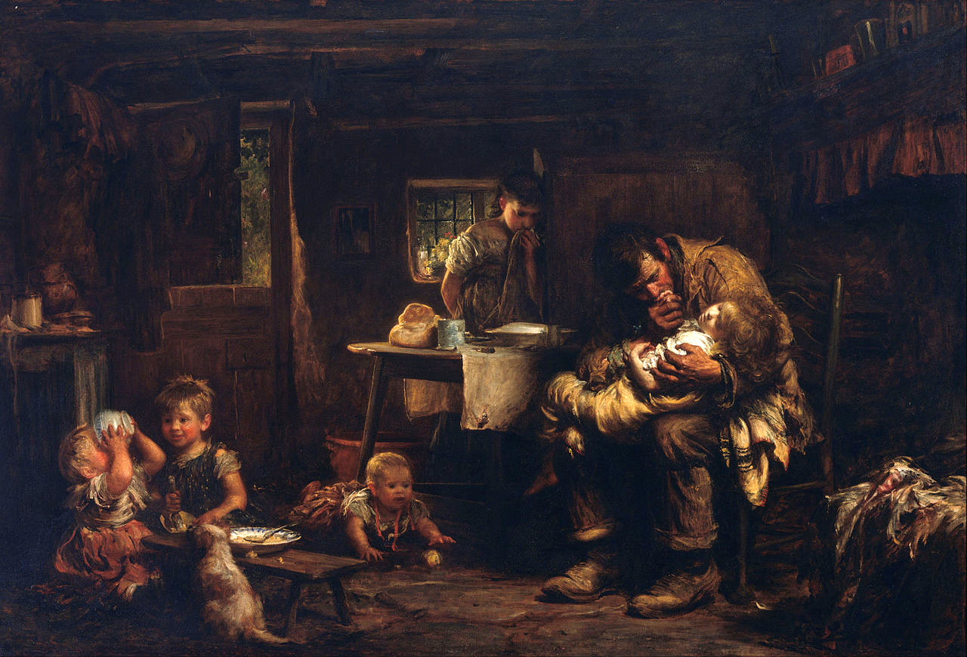
The Widower -- Luke Fildes, Art Gallery of New South Wales, Sydney, Australia

Slide 8
He drew me up from the desolate pit, out of the miry bog, and set my feet upon a rock, making my steps secure.
Psalm 40:2

Slide 9
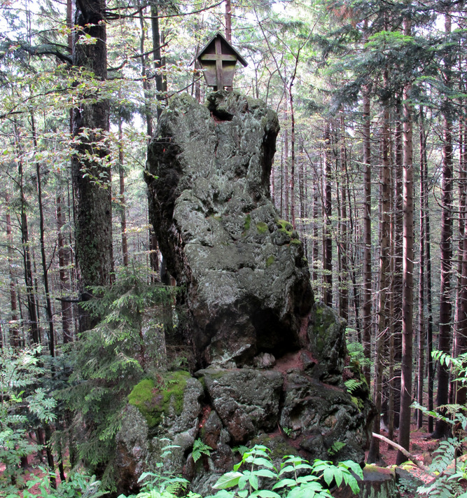
Rock with Cross
Sumava Park
Spicak
Czech Republic

Slide 10
Happy are those who make the LORD their trust…
Psalm 40:4a

Slide 11
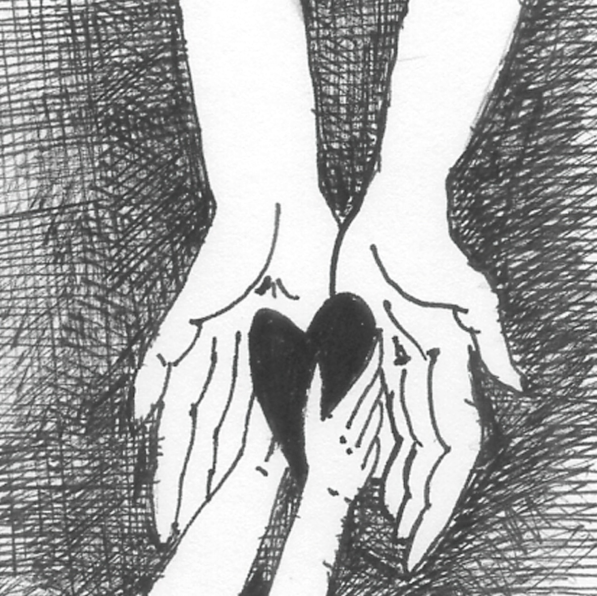
My Heart for the Lord -- Liz Valente

Slide 12
Grace to you and peace from God our Father and the Lord Jesus Christ.
1 Corinthians 1:3

Slide 13
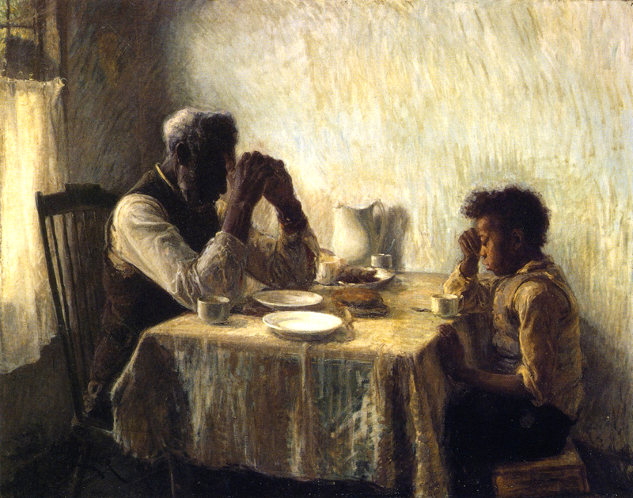
Thankful -- Henry Ossawa Tanner

Slide 14
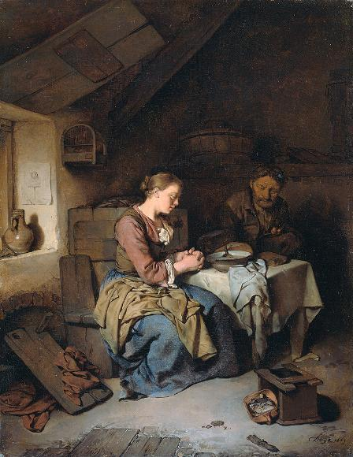
Saying Grace
Cornelis Bega
Rijksmuseum
Amsterdam, Netherlands

Slide 15
I give thanks … because of the grace of God that has been given you in Christ Jesus …
1 Corinthians 1:4

Slide 16
Wedding at Cana
John August Swanson

Slide 17
The next day he saw Jesus coming toward him and declared, "Here is the Lamb of God who takes away the sin of the world!
John 1:29

Slide 18
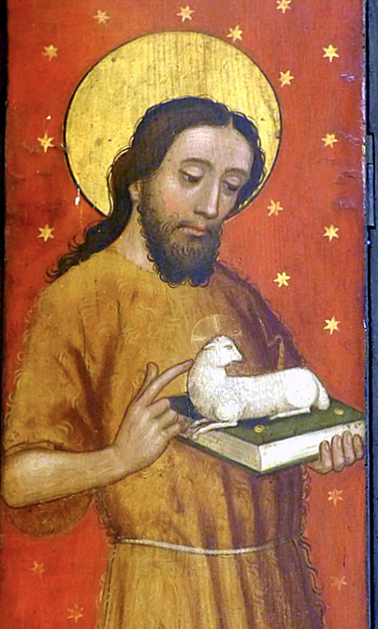
John the Baptist
Altar wing
Stadtkirche
Schwabach, Germany

Slide 19
One of the two who heard John speak and followed him was Andrew, Simon Peter's brother.
John 1:40

Slide 20
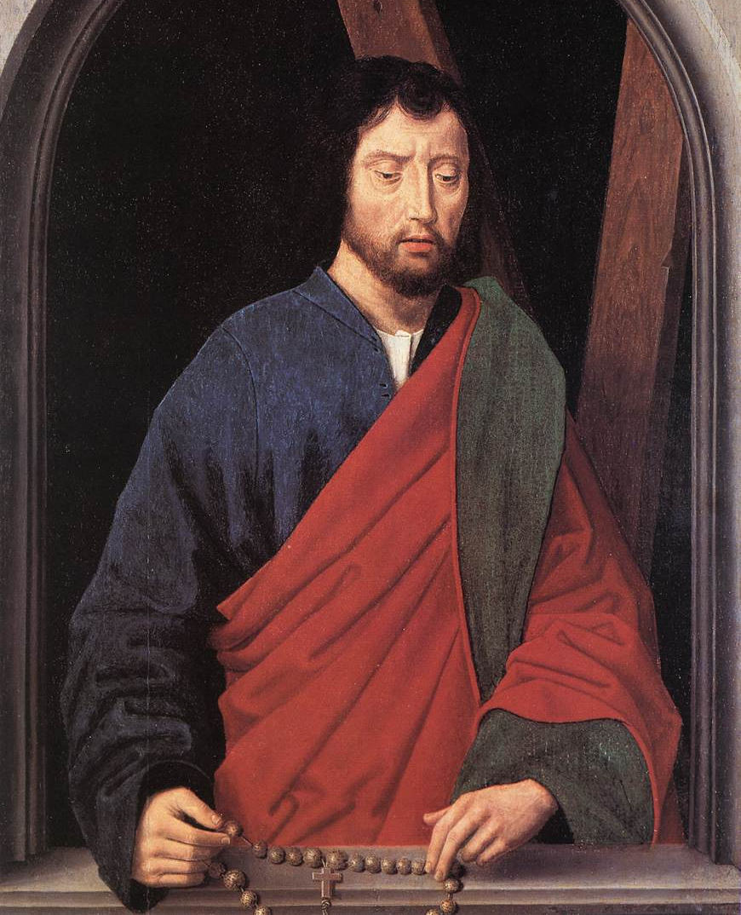
St. Andrew
Hans Memling Groeningemuseum
Bruges, Belgium

Slide 21
He first found his brother Simon and said to him, “We have found the Messiah.”
John 1:41

Slide 22
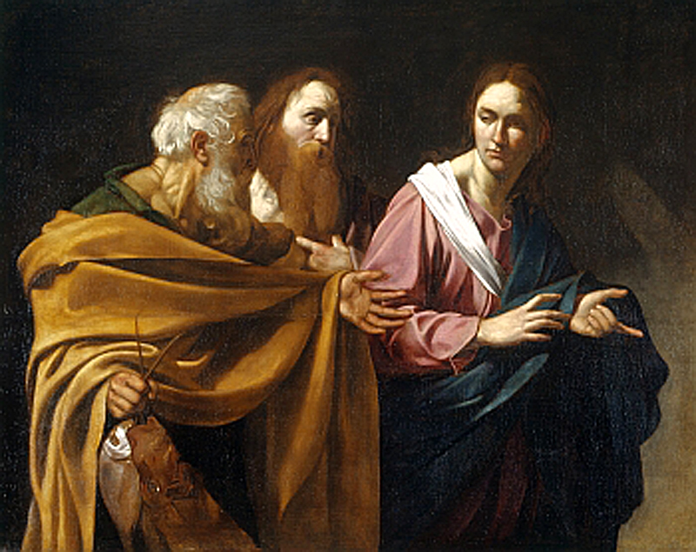
The Calling of Andrew and Simon Peter -- follower of Caravaggio, Buckingham Palace, London

Slide 23
"You are Simon son of John. You are to be called Cephas" (which is translated Peter).
John 1:42b

Slide 24
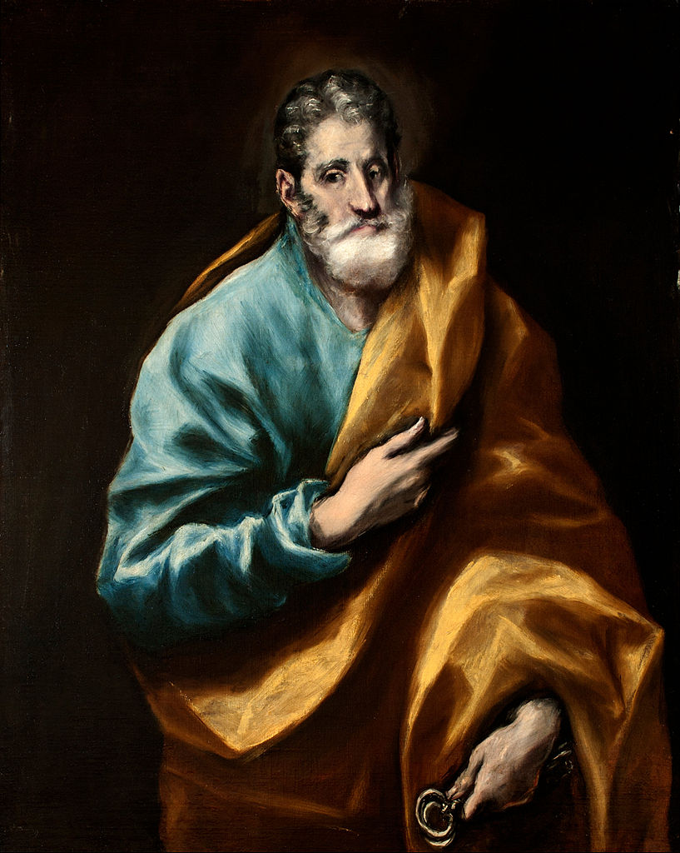
Peter
El Greco
El Greco Museum
Toledo, Spain

Slide 25
Credits
New Revised Standard Version Bible, copyright 1989, Division of Christian Education of the National Council of the Churches of Christ in the United States of America. Used by permission. All rights reserved.
http://commons.wikimedia.org/wiki/File:Octave_TASSAERT_The_Waif_-L%27abandonn%C3%A9e.jpg
http://www.flickr.com/photos/sicarr/3251258111/
http://commons.wikimedia.org/wiki/File:Sir_Luke_Fildes_-_The_widower_-_Google_Art_Project.jpg
http://commons.wikimedia.org/wiki/File:Rock_with_cross_in_%C5%A0umava_region.jpg
Liz Valente, https://www.instagram.com/donalizvalente/
https://commons.wikimedia.org/wiki/File:The_Thankful_Poor,_1894._Henry_Ossawa_Tanner.jpg
http://commons.wikimedia.org/wiki/File:BegaPrayer.jpg
Estate of John August Swanson, https://www.johnaugustswanson.com/
https://commons.wikimedia.org/wiki/File:Schwabach_Stadtkirche_-_Katharinenaltar_Fl%C3%BCgel_4a.jpg – Wolfgang Sauber
https://commons.wikimedia.org/wiki/File:Hans_Memling_-_St_Andrew_(left_wing_of_a_diptych,_reverse)_-_WGA15004.jpg
https://commons.wikimedia.org/wiki/File:Uqueen3.jpg
https://commons.wikimedia.org/wiki/File:El_Greco_-_St._Peter_-_Google_Art_Project.jpg
Additional descriptions can be found at the Art in the Christian Tradition image library, a service of the Vanderbilt Divinity Library, http://diglib.library.vanderbilt.edu/. All images available via Creative Commons 3.0 License.

