Slide 1
Second Sunday after Christmas Day
Year A
Jeremiah 31:7-4 or Sirach 4:1-12
Psalm 147:12-20 or Wisdom of Solomon 10:15-21
Ephesians 1:3-14
John 1:(1-9), 10-18

Slide 2
For thus says the Lord:… I am going to…gather…the blind and the lame, those with child and those in labor…
Jeremiah 31:7a, 8

Slide 3
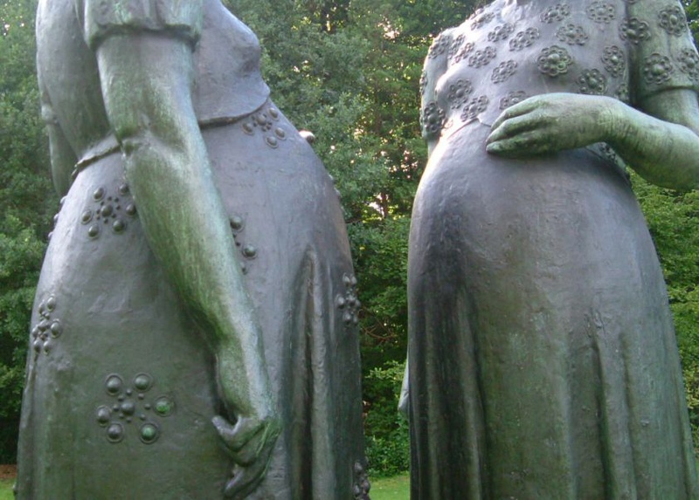
Two Women -- Charles LePlae, Openluchtmuseum, Antwerp, Belgium

Slide 4
I will turn their mourning into joy, I will comfort them, and give them gladness for sorrow.
Jeremiah 31:13b

Slide 5
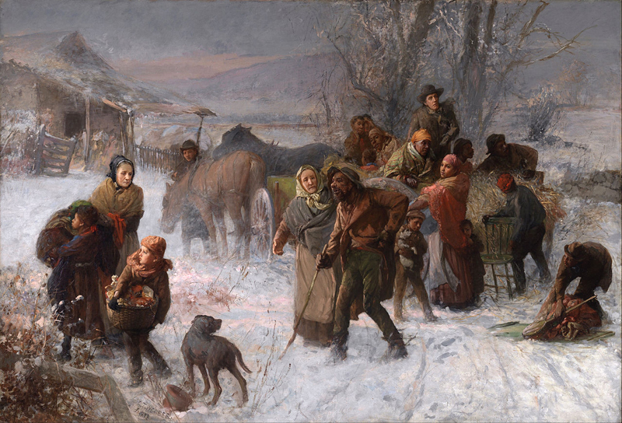
Underground Railroad -- Charles Webber, Cincinnati Art Museum, Cincinnati, OH

Slide 6
Praise the LORD, O Jerusalem! … He grants peace within your borders; he fills you with the finest of wheat.
Psalm 147: 12a, 14

Slide 7
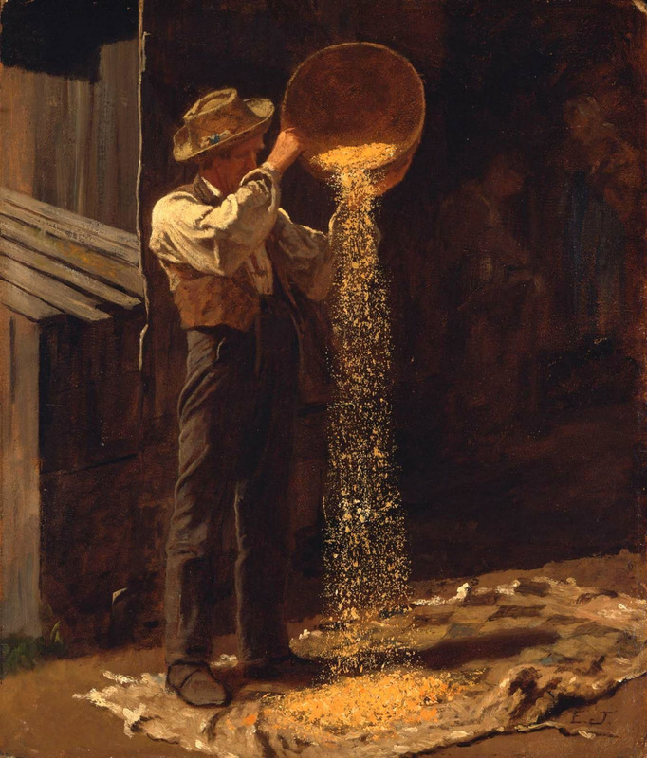
Winnowing Grain
Eastman Johnson Museum of Fine Arts, Boston, MA

Slide 8
She brought them over the Red Sea, and led them through deep waters;
Wisdom of Solomon 10:18

Slide 9
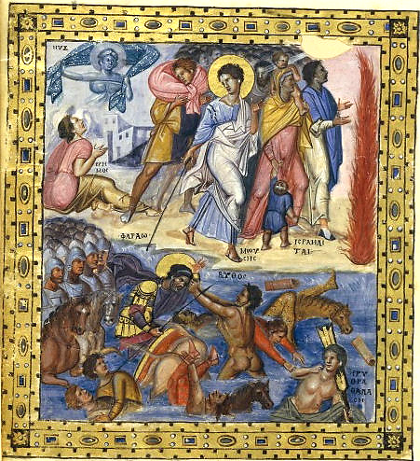
Crossing the Red Sea
Bibliotheque National Paris, France

Slide 10
He destined us for adoption as his children through Jesus Christ, according to the good pleasure of his will …
Ephesians 1:5

Slide 11
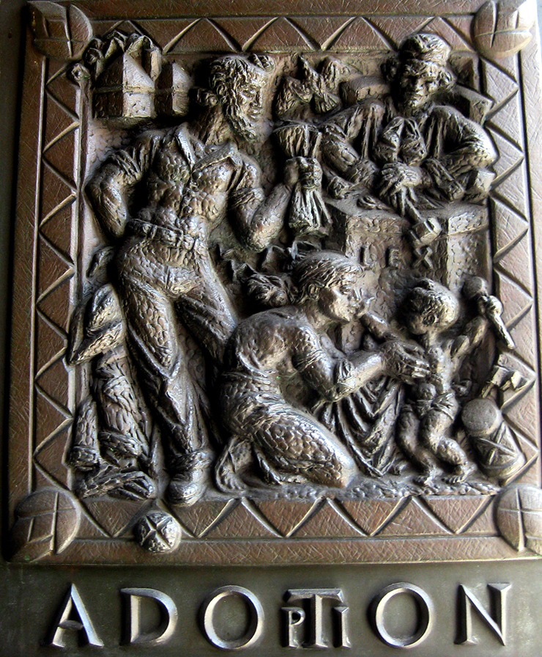
Adoption
Bronze Doors panel Grace Cathedral
San Francisco, CA

Slide 12
In the beginning was the Word, and the Word was with God, and the Word was God.
John 1:1

Slide 13
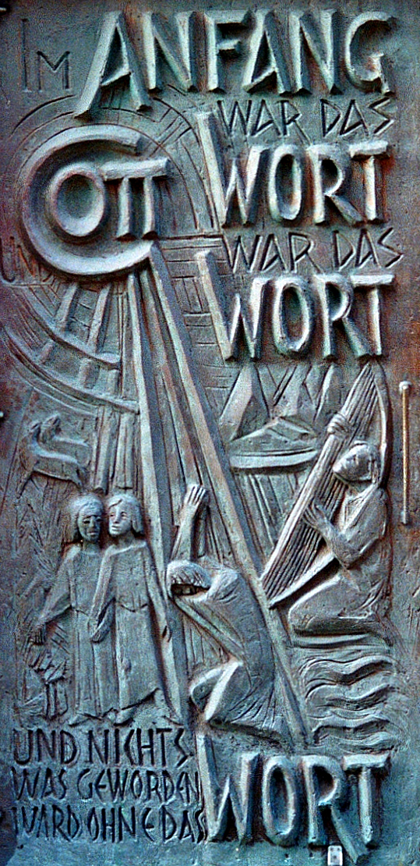
In the Beginning Was the Word
Josef Krautwald
St. Dionysius Church Recht, Germany

Slide 14
In him was life, and the life was the light of all people.
John 1:4

Slide 15
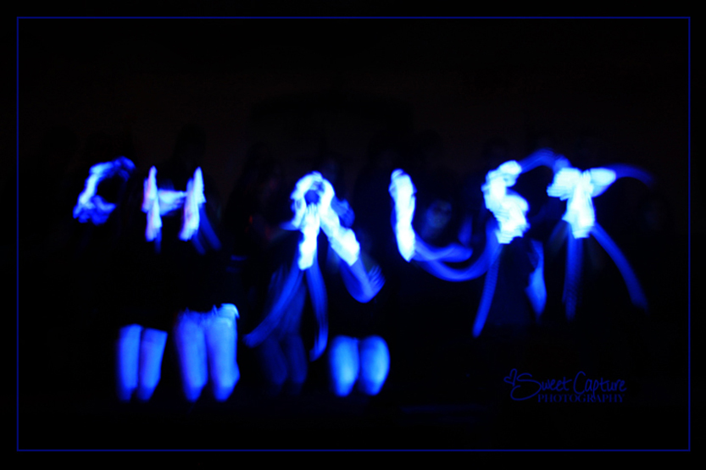
Light of the World -- Presentation by youth with gloves in dark space

Slide 16
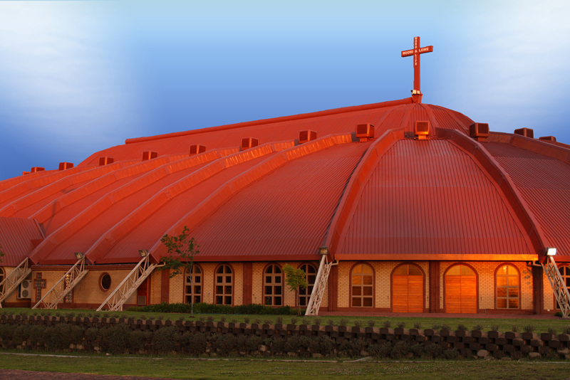
Apostolic Faith Mission Word and Life Church -- Boksburg, South Africa

Slide 17
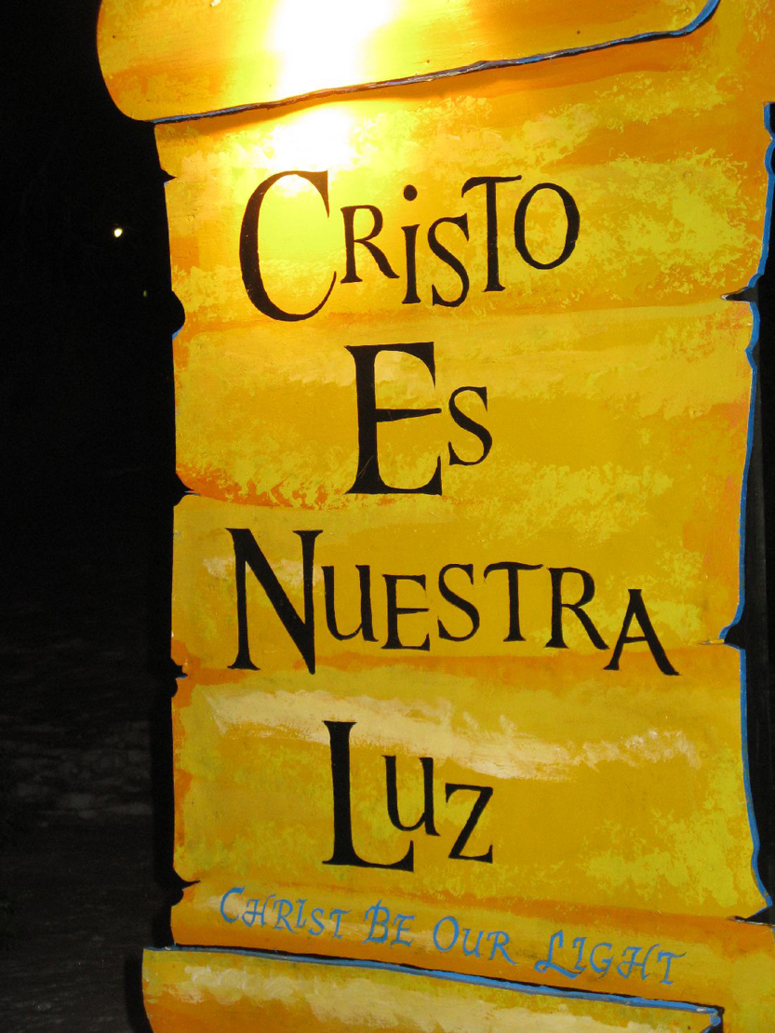
Cristo Es Nuestra Luz
LaSalette Festival of Light
Attleboro, MA

Slide 18
Credits
New Revised Standard Version Bible, copyright 1989, Division of Christian Education of the National Council of the Churches of Christ in the United States of America. Used by permission. All rights reserved.
http://diglib.library.vanderbilt.edu/act-imagelink.pl?RC=54235, jikimajoja, Flickr Creative Commons
https://commons.wikimedia.org/wiki/File:Charles_T._Webber_-_The_Underground_Railroad_-_Google_Art_Project.jpg
http://commons.wikimedia.org/wiki/File:Eastman_Johnson_-_Winnowing_Grain.jpg
http://commons.wikimedia.org/wiki/File:Paris_psaulter_gr139_fol419v.jpg
http://www.flickr.com/photos/wallyg/3972631077/
https://commons.wikimedia.org/wiki/File:St_Dionysius_Hauptportal_Tuer_1.jpg – J. H. Jansen
http://www.flickr.com/photos/cuonhigh/3398636812/
https://commons.wikimedia.org/wiki/File:AFM_Word_And_Life.jpg – ShiningWolf
http://www.flickr.com/photos/heartlover1717/4141462290/
Additional descriptions can be found at the Art in the Christian Tradition image library, a service of the Vanderbilt Divinity Library, http://diglib.library.vanderbilt.edu/. All images available via Creative Commons 3.0 License.

