Slide 1
Fifth Sunday after Pentecost
Year A
Genesis 22:1-14 and Psalm 13
Jeremiah 28:5-9 and Psalm 89:1-4, 15-18 Romans 6:12-23
Matthew 10:40-42

Slide 2
God tested Abraham. He said, "Take … your only son Isaac, whom you love, … and offer him … as a burnt offering …
Genesis 22:1b, 2a

Slide 3
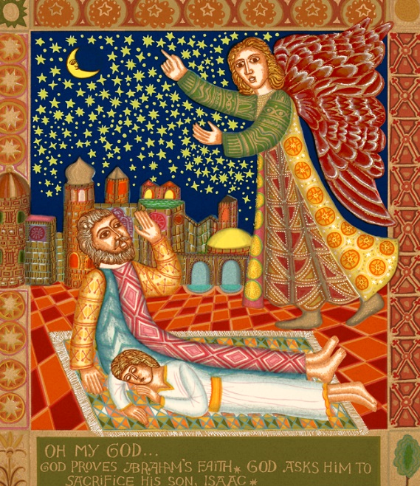
God Tests Abraham
John August Swanson
Print, 1976

Slide 4
Abraham took the wood of the burnt offering and laid it on his son Isaac … So the two of them walked on together.
Genesis 22:6

Slide 5
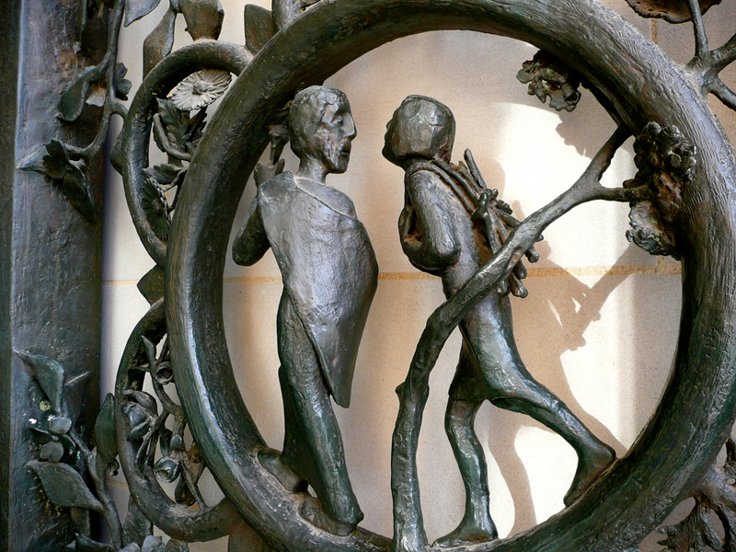
Sacrifice of Isaac -- Washington Cathedral, Washington DC

Slide 6
Isaac said to his father Abraham, "Father! … The fire and the wood are here, but where is the lamb for a burnt offering?"
Genesis 22:7

Slide 7
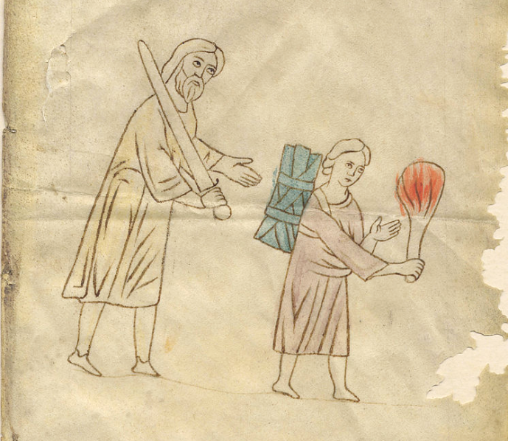
Sacrifice of Isaac -- Manuscript fragment, 14th century

Slide 8
Abraham built an altar … and laid the wood in order. He bound his son Isaac, and laid him on the altar, on top of the wood.
Genesis 22:9b

Slide 9
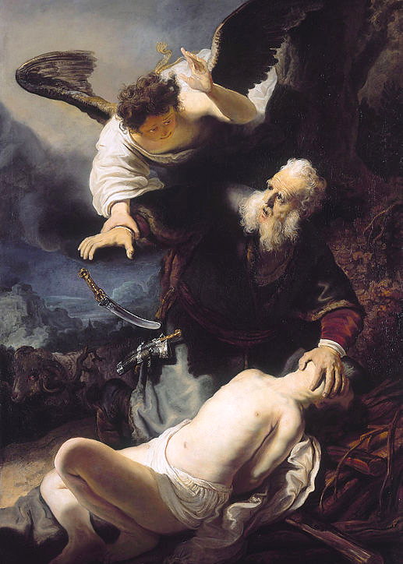
Sacrifice of Isaac
Workshop of Rembrandt
Alte Pinakothek
Munich, Germany

Slide 10
Then Abraham reached out his hand and took the knife to kill his son.
Genesis 22:10

Slide 11
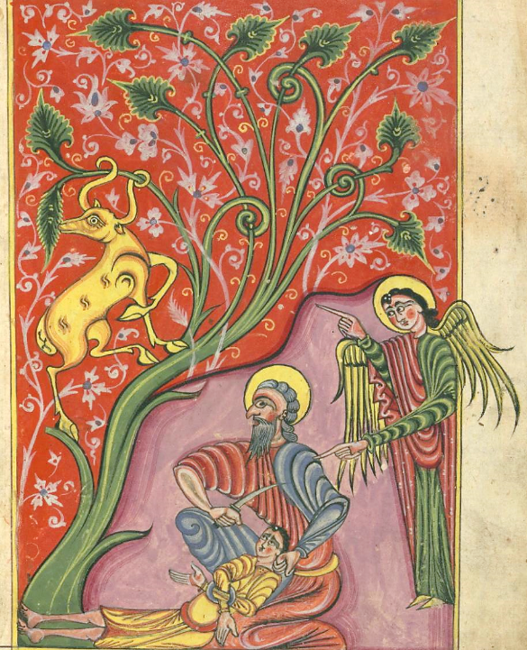
Sacrifice of Isaac
Follow Gospels
Walters Art Museum
Baltimore, MD
?

Slide 12
But the angel of the LORD called to him and said,
"Do not lay your hand on the boy,
… for now I know that you fear God…"
Genesis 22:11a,12a

Slide 13
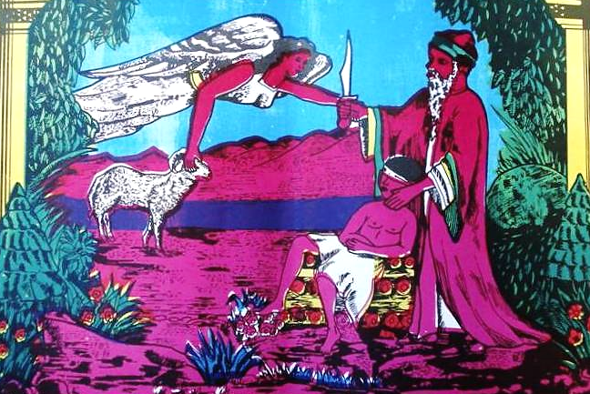
Attempted Sacrifice of Ishmael/Isaac, Chromolithograph, Kano, Nigeria

Slide 14
And Abraham looked up and saw a ram … and offered it up as a burnt offering instead of his son.
Genesis 2:13a,c

Slide 15
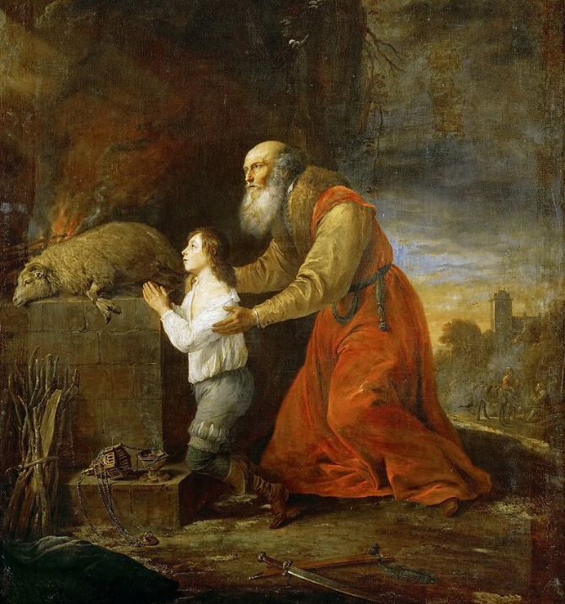
Sacrifice of Isaac
Kunsthistorisches Museum
Vienna, Austria
?

Slide 16
But I trusted in your steadfast love; my heart shall rejoice in your salvation.
Psalm 13:5

Slide 17
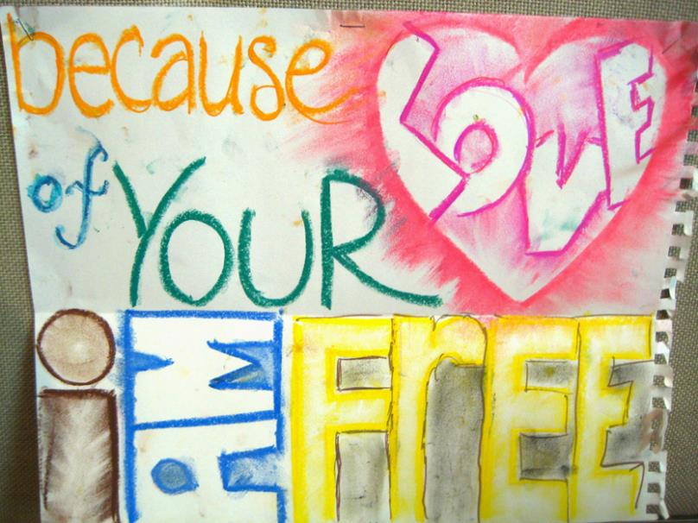
Because of Your Love -- Gateway Mission Camp, Lingnan University, Hong Kong, China

Slide 18
"As for the prophet who prophesies peace, when the word of that prophet comes true, then it will be known that the LORD has truly sent the prophet."
Jeremiah 28:5-9

Slide 19
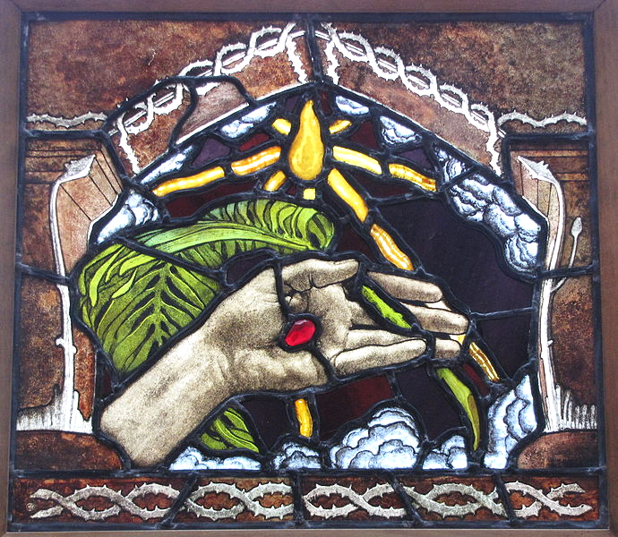
The Hand of Christ, The Palm of Peace -- Akseli Gallen-Kallela Museum, Espoo, Finland

Slide 20
Happy are the people who know the festal shout, who walk, O LORD, in the light of your countenance;
Psalm 89:15

Slide 21
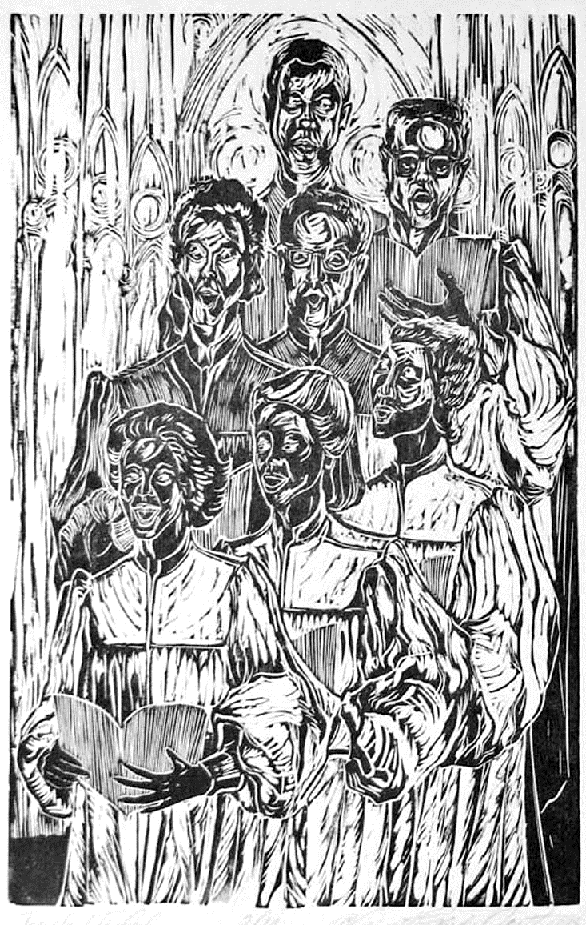
Choir
Annette Gandy
Silver Spring, MD

Slide 22
For sin will have no dominion over you, since you are not under law but under grace.
Romans 6:14

Slide 23
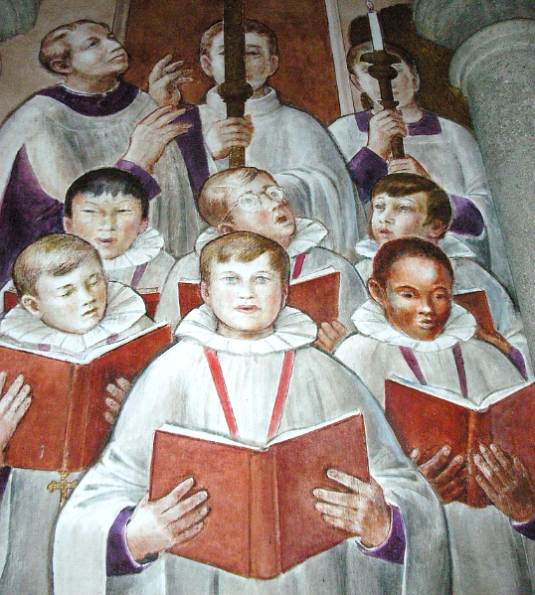
Choir
Grace Cathedral
San Francisco, CA

Slide 24
"Whoever welcomes you welcomes me,
and whoever welcomes me welcomes the one who sent me."
Matthew 10:40

Slide 25
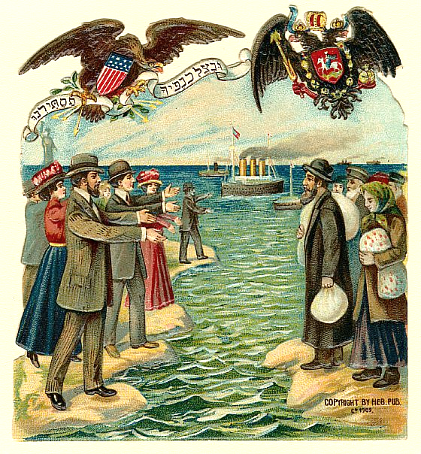
Welcoming Jewish Immigrants
Jewish Holiday Card 1901

Slide 26
Credits
New Revised Standard Version Bible, copyright 1989, Division of Christian Education of the National Council of the Churches of Christ in the United States of America. Used by permission. All rights reserved.
www.JohnAugustSwanson.com - copyright 1976 by John August Swanson
http://www.flickr.com/photos/sshb/2253871778/
https://commons.wikimedia.org/wiki/File:Sacrifice_d._Abraham;_Loue_don_de_Dieu_(Sacrifice_of_Abraham,_Praise_the_gift_of_God)_-_Recto_(16099058663).jpg
https://commons.wikimedia.org/wiki/File:Ofiara_Abrahama1.jpg
https://www.flickr.com/photos/medmss/8613677273
https://www.flickr.com/photos/32909549@N08/3472859255/
https://www.flickr.com/photos/jimforest/8586411462/ - Jim Forest
http://www.flickr.com/photos/mckln/4814377195/ - David Woo
http://commons.wikimedia.org/wiki/File:Kristuksen_k%C3%A4si_Gallen-Kallela.JPG
annettefortt.com
https://www.flickr.com/photos/brandi666/201477278
https://commons.wikimedia.org/wiki/File:Jewish_immigration_Russia_United_States_1901.jpg
Additional descriptions can be found at the Art in the Christian Tradition image library, a service of the Vanderbilt Divinity Library, http://diglib.library.vanderbilt.edu/. All images available via Creative Commons 3.0 License.

