Slide 1
Second Sunday after Pentecost
Genesis 6:9-22; 7:24 8:14-19 and Psalm 46 or Deuteronomy 11:18-21 and Psalm 31:1-5, 19-24
Romans 1:16-17; 3:22b-28, (29-31) Matthew 7:21-29
Year A

Slide 2
For my part, I am going to bring a flood of waters on the earth, to destroy from under heaven all flesh in which is the breath of life; everything that is on the earth shall die.
Genesis 6:17

Slide 3
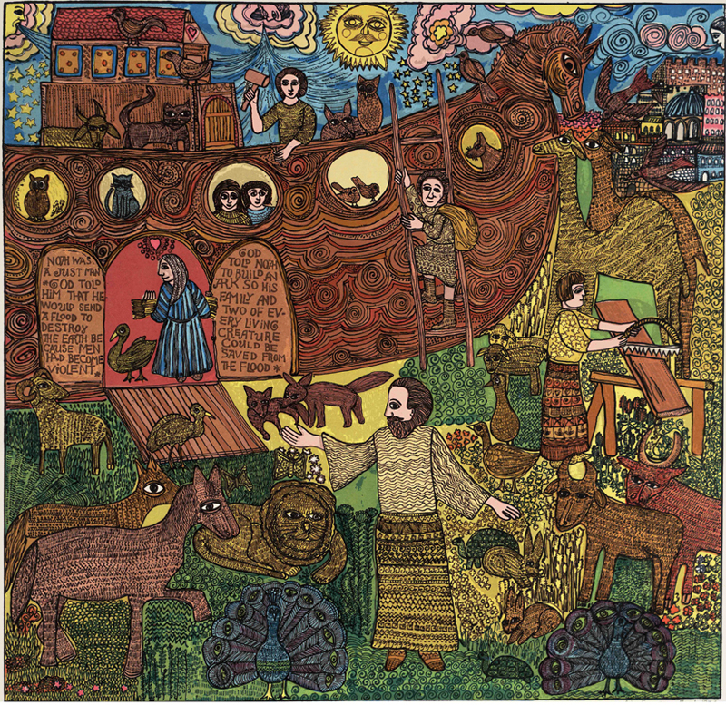
The Flood, John August Swanson, 1974

Slide 4
And the waters swelled on the earth for one hundred fifty days.
Genesis 7:24

Slide 5
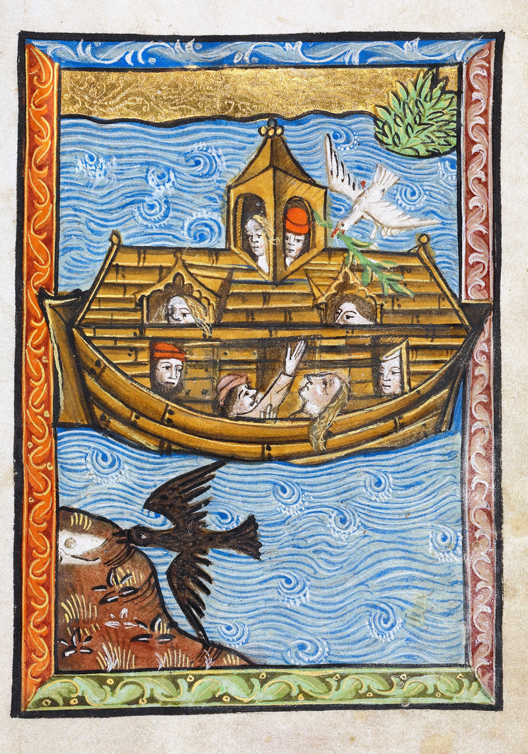
Noah’s Ark
Getty Center
15th century

Slide 6
Then God said to Noah, “Go out of the ark, you and your wife, and your sons and your sons’ wives with you.
Genesis 8:15-16

Slide 7
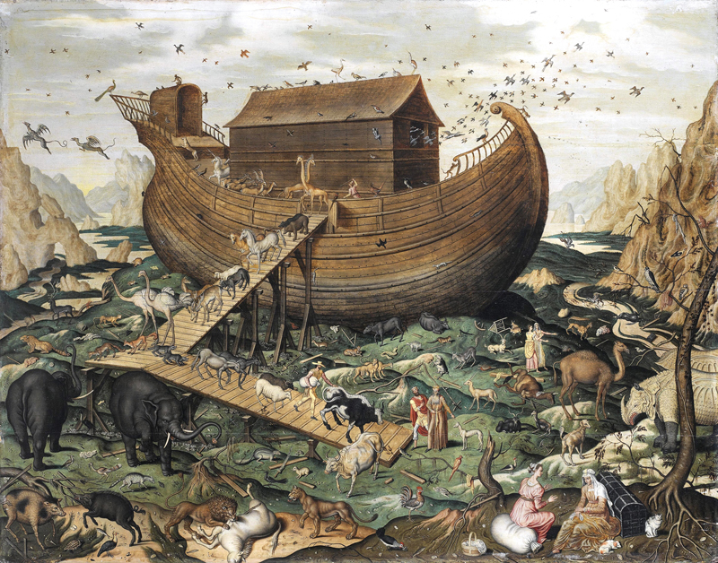
Noah’s Ark on the Mount Ararat, Simon de Myle, 1570

Slide 8
“Be still, and know that I am God! I am exalted among the nations, I am exalted in the earth.”
Psalm 46:10

Slide 9
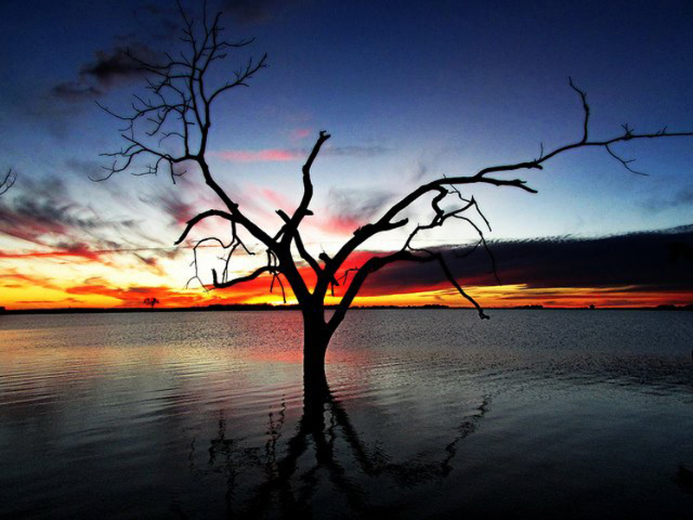
Sunset sets the sky ablaze at South Dakota’s Waubay National Wildlife Refuge, Spencer Neuharth

Slide 10
For in it the righteousness of God is revealed through faith for faith; as it is written, “The one who is righteous will live by faith.”
Romans 1:17

Slide 11
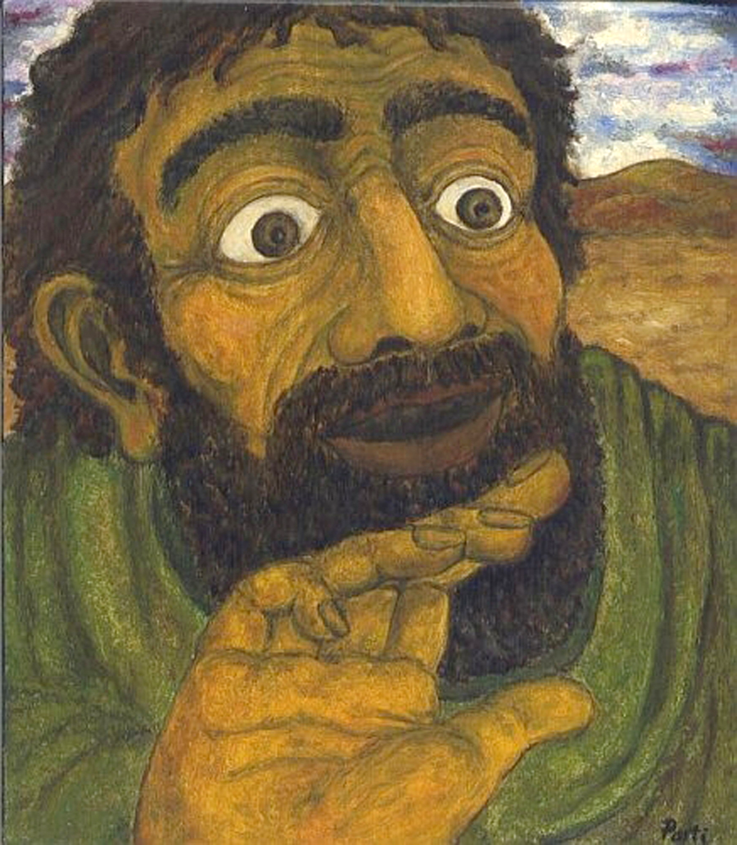
Doubting Thomas -- Zoltan Joo

Slide 12
“Not everyone who says to me, ‘Lord, Lord,’ will enter the kingdom of heaven, but only the one who does the will of my father in heaven.
Matthew 7:21

Slide 13
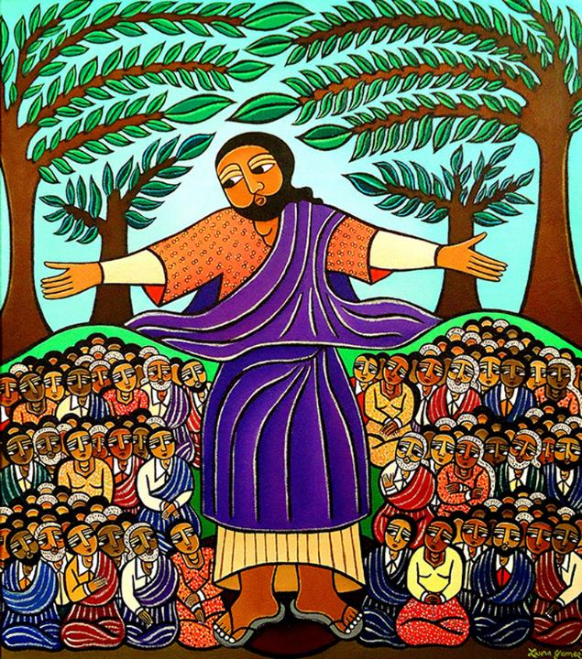
Sermon on the Mount, Laura James, New York

Slide 14
“Everyone then who hears these words of mine and acts on them will be like a wise man who built his house on rock.”
Matthew 7:24

Slide 15
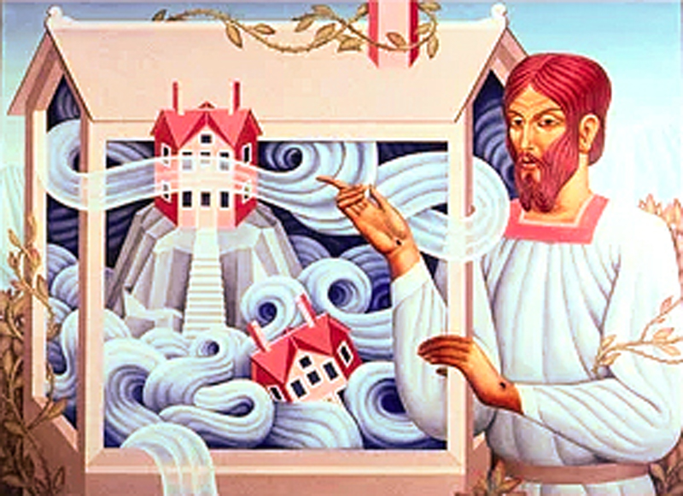
A House Built on Rock (2), Peter Koenig, 2018

Slide 16
“The rain fell, the floods came, and the winds blew and beat on that house, but it did not fall, because it had been founded on rock.”
Matthew 7:25

Slide 17
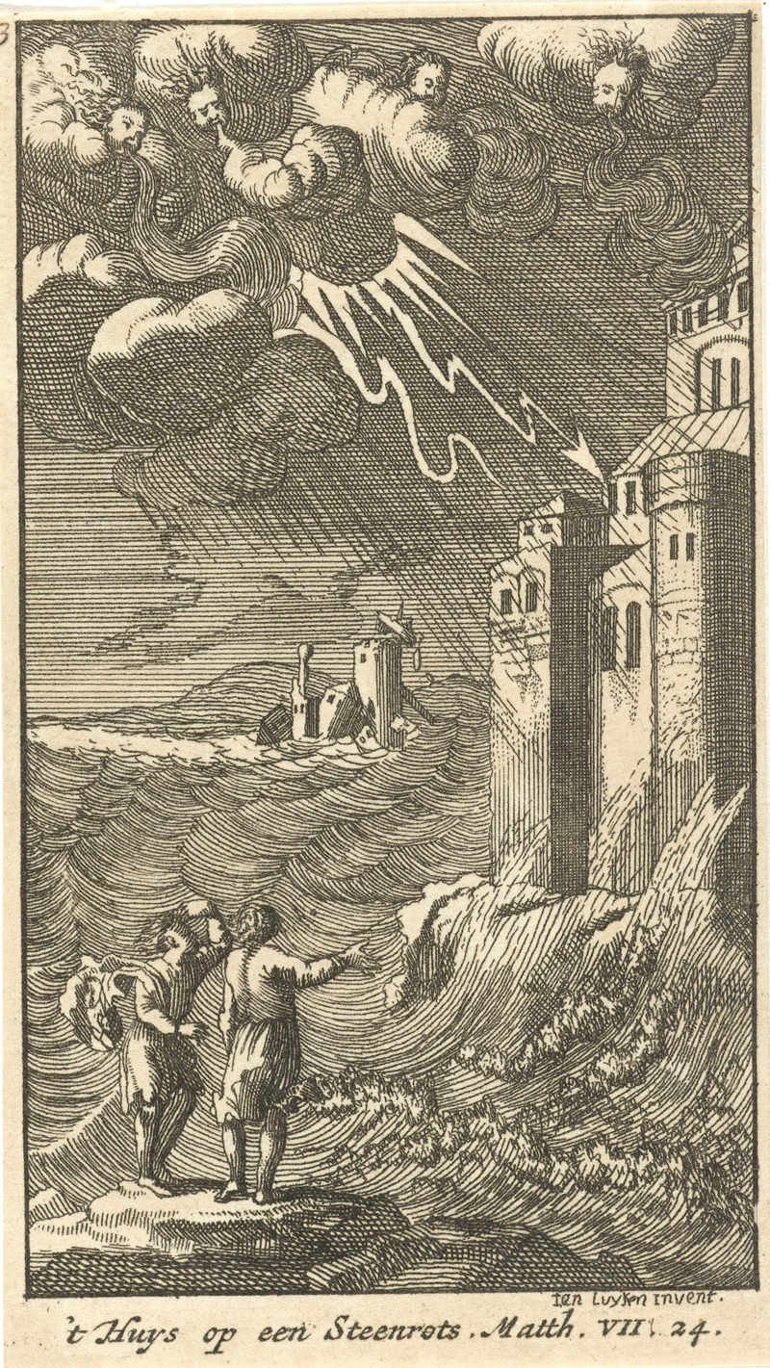
The House on the Rock
Rijksmuseum
1720

Slide 18
“And everyone who hears these words of mine and does not act on them will be like a foolish man who built his house on sand.”
Matthew 7:26

Slide 19
A House Built on Rock
Peter Koenig,
2018

Slide 20
Now when Jesus had finished saying these things, the crowds were astounded at his teaching,
Matthew 7:28

Slide 21
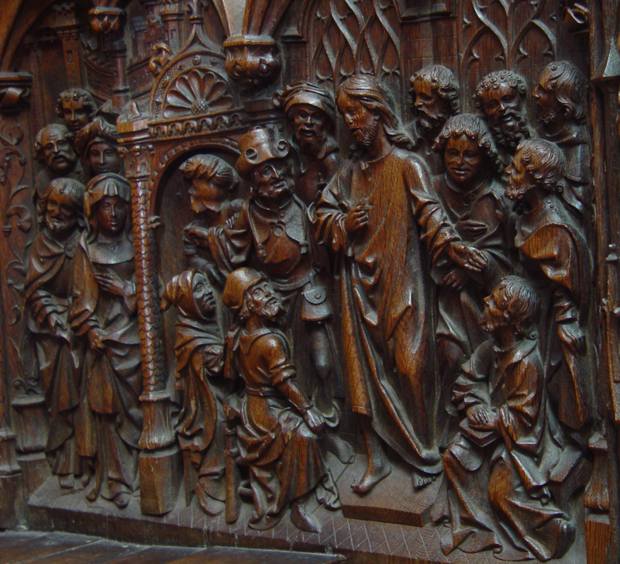
Jesus Teaching the Disciples
Cathédrale d’Amiens
1508-1519

Slide 22
Credits
New Revised Standard Version Bible, copyright 1989, Division of Christian Education of the National Council of the Churches of Christ in the United States of America. Used by permission. All rights reserved.
www.johnaugustswanson.com
https://commons.wikimedia.org/wiki/File:Noah’s_Ark_-_Google_Art_Project.jpg
https://commons.wikimedia.org/wiki/File:Noah%27s_Ark_on_Mount_Ararat_by_Simon_de_Myle.jpg
https://commons.wikimedia.org/wiki/File:Waubay_NWR_Sunset_(9737733990).jpg
https://commons.wikimedia.org/wiki/File:Hitetlen_Tam%C3%A1s.jpg
https://www.flickr.com/photos/jsprig/6859476674
https://www.laurajamesart.com/collections/religious/
https://www.pwkoenig.co.uk/
https://commons.wikimedia.org/wiki/File:Het_huis_op_de_rots_%27t_Huijs_op_een_Steenrots_Vierentwintig_sc%C3%A8nes_uit_het_Nieuwe_Testament_(serietitel),_RP-P-1896-A-19368-159.jpg
https://www.pwkoenig.co.uk/
https://diglib.library.vanderbilt.edu/diglib-fulldisplay.pl?SID=20211201175783351&code=act&RC=51542&Row=1
Additional descriptions can be found at the Art in the Christian Tradition image library, a service of the Vanderbilt Divinity Library, http://diglib.library.vanderbilt.edu/. All images available via Creative Commons 3.0 License.

