Slide 1
Twenty-Third Sunday after Pentecost
Year A
Joshua 3:7-17 and Psalm 107:1-7, 33-37 • Micah 3:5-12 and Psalm 43 • 1 Thessalonians 2:9-13 • Matthew 23:1-12

Slide 2
… the priests who bore the ark of the covenant of the LORD … stood on dry ground in the middle of the Jordan, until the entire nation finished crossing …
Joshua 3:17b

Slide 3
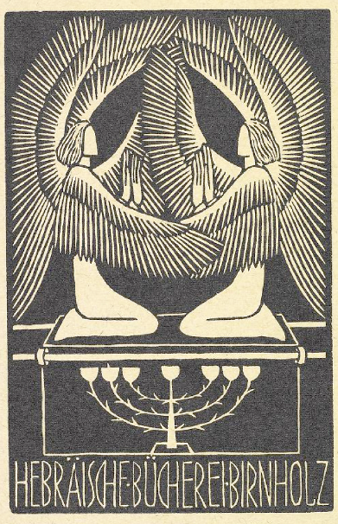
Ark of the Covenant Bookplate
Birnholz Collection,
Jewish Theological Seminary
New York, NY

Slide 4
And there he lets the hungry live, and they establish a town to live in …
Psalm 107:36

Slide 5
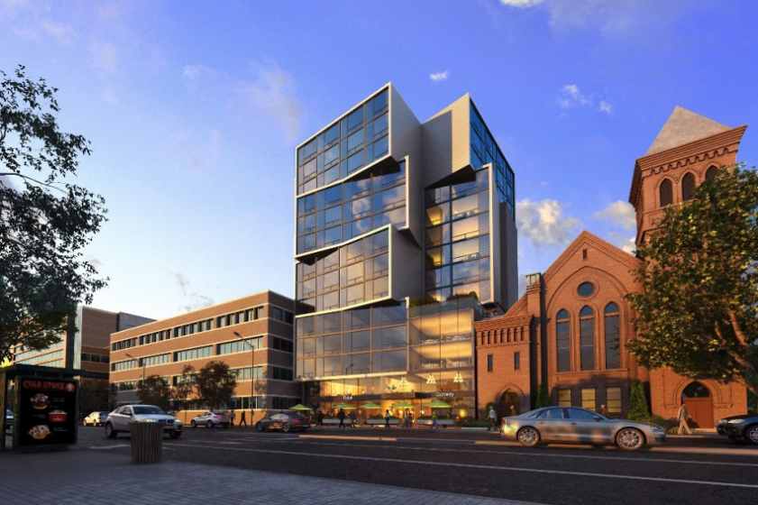
Ker Family Affordable Micro Homes for Veterans -- Sorg Architects, Washington, DC

Slide 6
… they sow fields, and plant vineyards, and get a fruitful yield.
Psalm 107:37

Slide 7
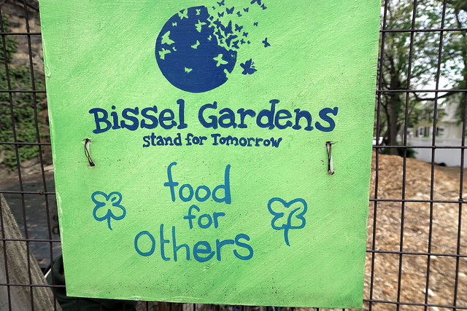
Bissel Community Gardens -- Bronx, New York, NY

Slide 8
Its rulers give judgment for a bribe, its priests teach for a price, its prophets give oracles for money …
Micah 3:11a

Slide 9
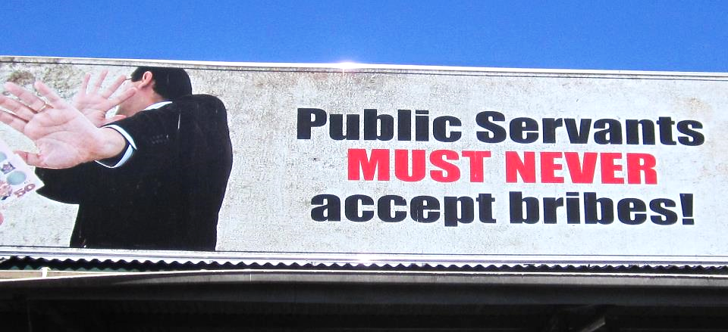
Billboard -- Sigatoka, Fiji

Slide 10
Then I will go to the altar of God, to God my exceeding joy; and I will praise you with the harp, O God, my God.
Psalm 43:4

Slide 11
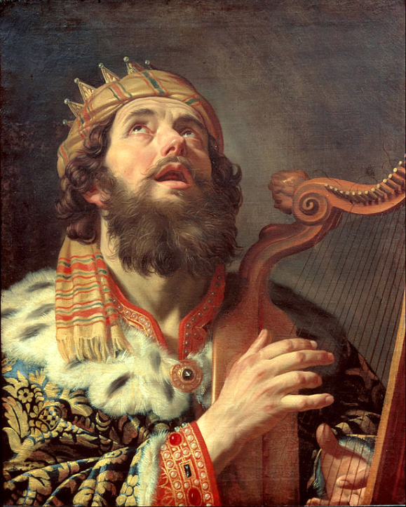
King David Plays the Harp
Gerard van Honthorst
Centraal Museum
Utrecht, Netherlands

Slide 12
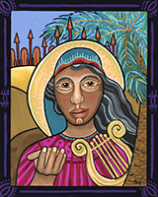
Deborah – In Tune
Lauren Wright Pittman, Sanctified Art

Slide 13
… we dealt with each one of you like a father with his children, urging and encouraging you and pleading that you lead a life worthy of God …
1 Thessalonians 2:11-12a

Slide 14
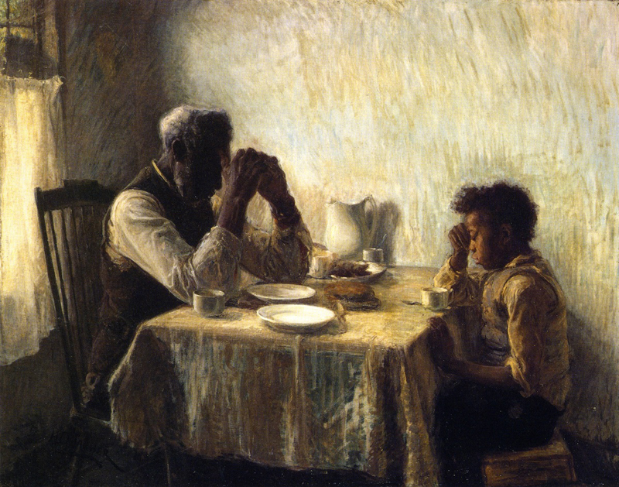
Thankful -- Henry Ossawa Tanner

Slide 15
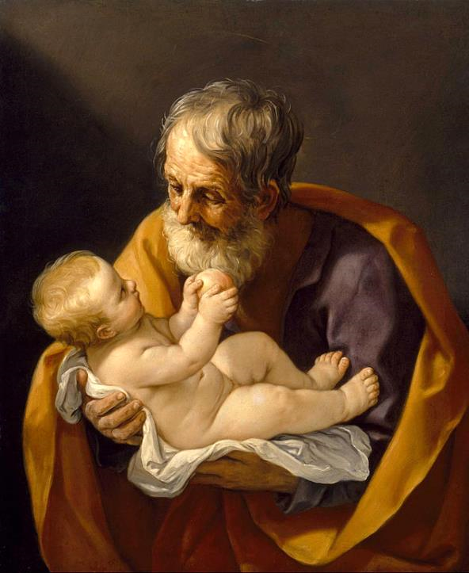
Joseph and the Christ Child
Guido Reni
Museum of Fine Arts
Houston, TX

Slide 16
They tie up heavy burdens, hard to bear, and lay them on the shoulders of others; but they themselves are unwilling to lift a finger to move them.
Matthew 23:4

Slide 17
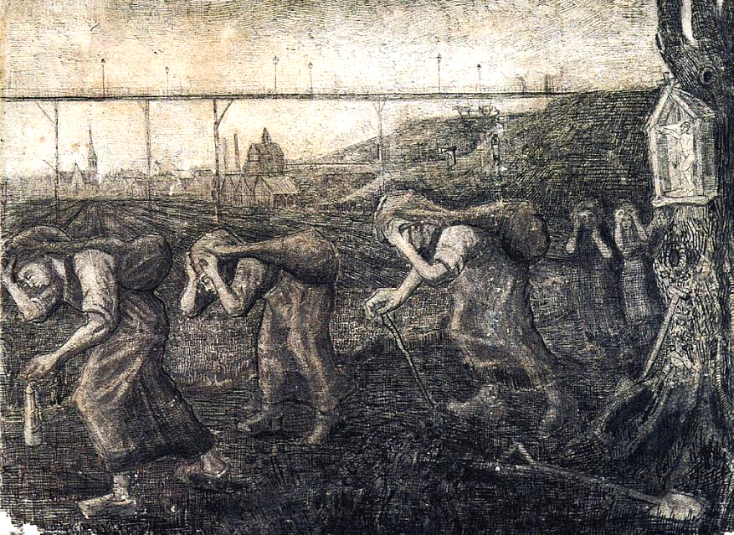
Miners and Women Carrying Sacks -- Bearers of the Burden
Vincent van Gogh, Kroller-Muller Museum, Otterlo, Netherlands

Slide 18
They do all their deeds to be seen by others …
Matthew 23:5a

Slide 19
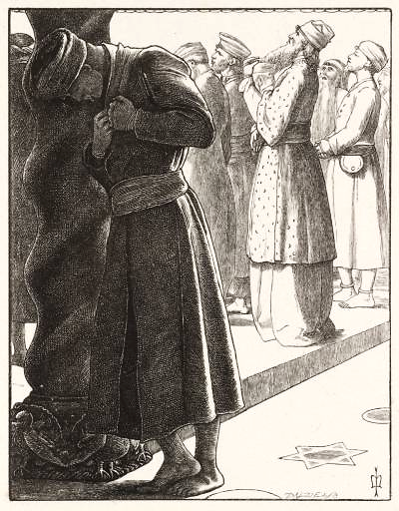
The Pharisee and the Publican
John Everett Millais Tate Britain, London, England

Slide 20
The greatest among you will be your servant.
Matthew 23:11

Slide 21
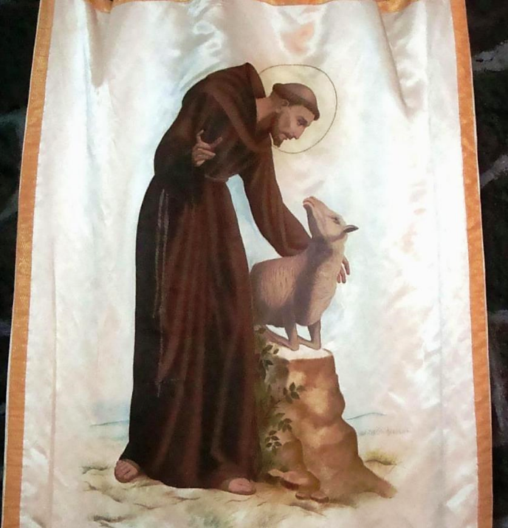
Saint Francis of Assisi Church
Coyoacan, Federal District, Mexico

Slide 22
All who exalt themselves will be humbled, and all who humble themselves will be exalted.
Matthew 23:12

Slide 23
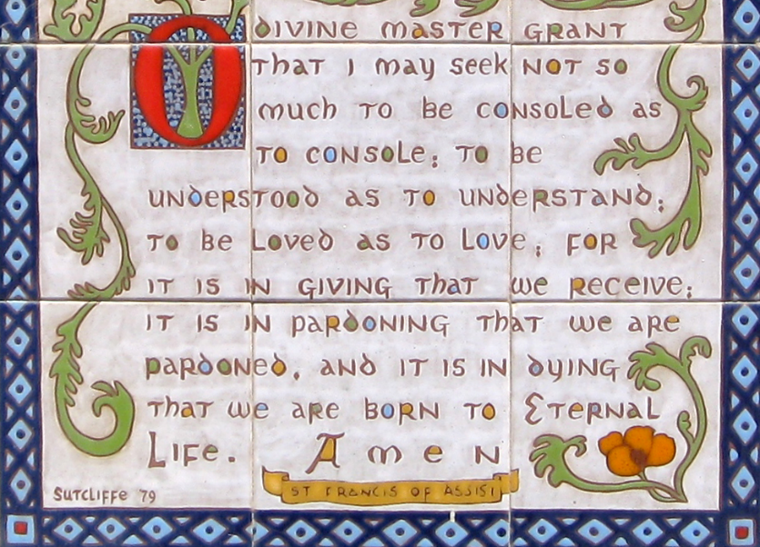
Plaque on Wall, Convent of the Poor Clares, Santa Barbara, CA

Slide 24
Credits
New Revised Standard Version Bible, copyright 1989, Division of Christian Education of the National Council of the Churches of Christ in the United States of America. Used by permission. All rights reserved.
https://www.flickr.com/photos/jewishtheologicalseminary/6796950913/ - Jewish Theological Seminary
http://www.lewpstudio.com - copyright by Lauren Wright Pittman
https://www.flickr.com/photos/taedc/22255563780/
https://www.flickr.com/photos/kpaulus/33504990674 - Kristine Paulus
https://www.flickr.com/photos/49576736@N08/9211994207 - jonesytheteacher
https://commons.wikimedia.org/wiki/File:Gerard_van_Honthorst_-_King_David_Playing_the_Harp_-_Google_Art_Project.jpg
http://www.lewpstudio.com - copyright by Lauren Wright Pittman
https://commons.wikimedia.org/wiki/File:The_Thankful_Poor,_1894._Henry_Ossawa_Tanner.jpg
https://commons.wikimedia.org/wiki/File:Guido_Reni_-_Saint_Joseph_and_the_Christ_Child_-_Google_Art_Project.jpg
https://commons.wikimedia.org/wiki/File:Miners-women-carrying-sacks-the-bearers-of-the-burden-1881-_Brussels.jpg
https://commons.wikimedia.org/wiki/File:MillaisThe_Pharisee_and_the_publican_Tate.jpg
https://commons.wikimedia.org/wiki/File:Saint_Francis_of_Assisi_Church,_Coyoacan,_Federal_District,_Mexico009.jpg - Enrique López-Tamayo _{Biosca}
https://commons.wikimedia.org/wiki/File:Prayer_for_Peace_-_Flickr_-_brewbooks.jpg
Additional descriptions can be found at the Art in the Christian Tradition image library, a service of the Vanderbilt Divinity Library, http://diglib.library.vanderbilt.edu/. All images available via Creative Commons 3.0 License.

