Slide 1
Ninth Sunday after Epiphany
Year A
Deuteronomy 11:18-21, 26-28 • Psalm 31:1-5, 19-24 • Romans 1:16-17, 3:22b-28, (29-31) Matthew 7:21-29

Slide 2
You shall put these words of mine in your heart and soul.
Deuteronomy 11:18

Slide 3
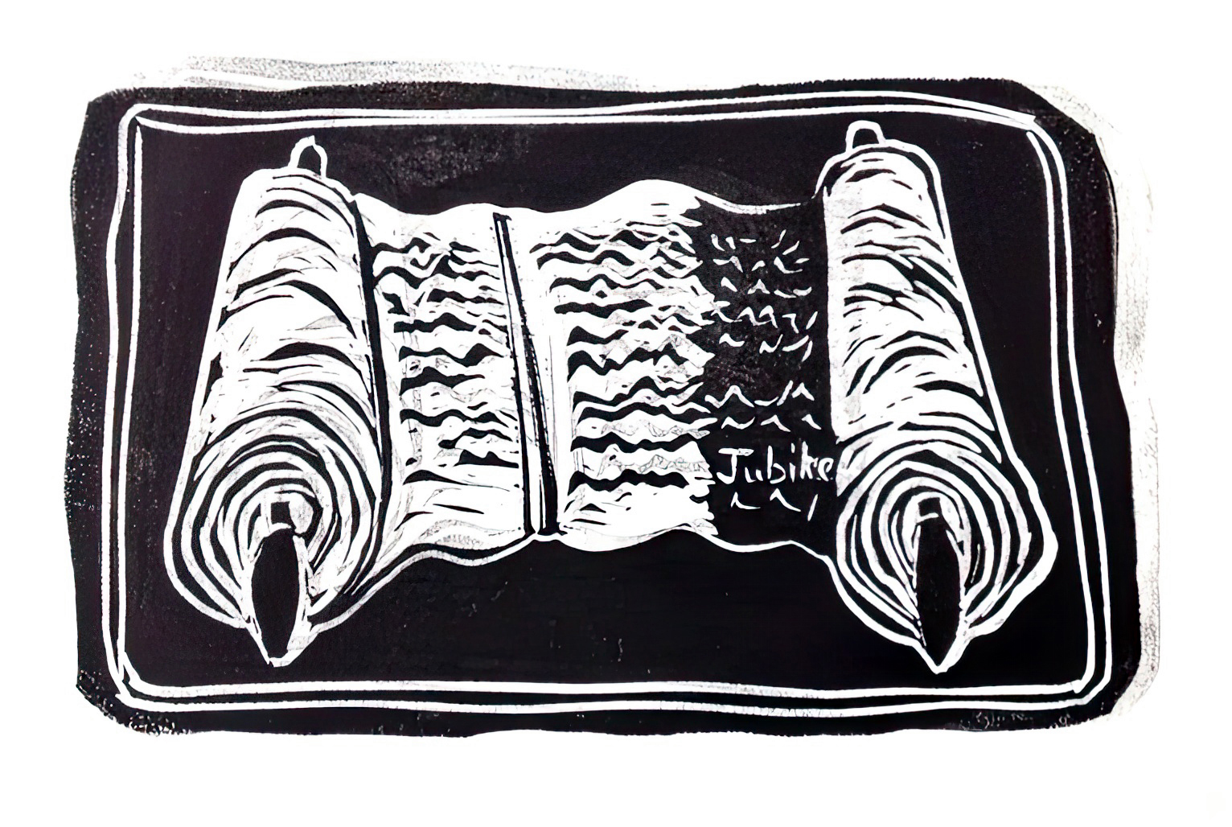
Reading from the Torah -- Cara Hochhalter

Slide 4
Teach them to your children, talking about them when you are at home and when you are away…
Deuteronomy 11:19a

Slide 5
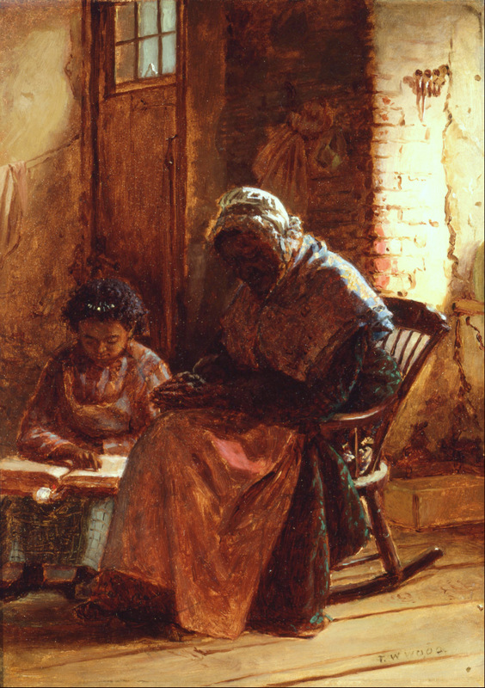
Sunday Morning
Thomas Waterman Wood
Smithsonian American Art Museum Washington, DC

Slide 6
…when you lie down and when you rise.
Deuteronomy 11:19b

Slide 7
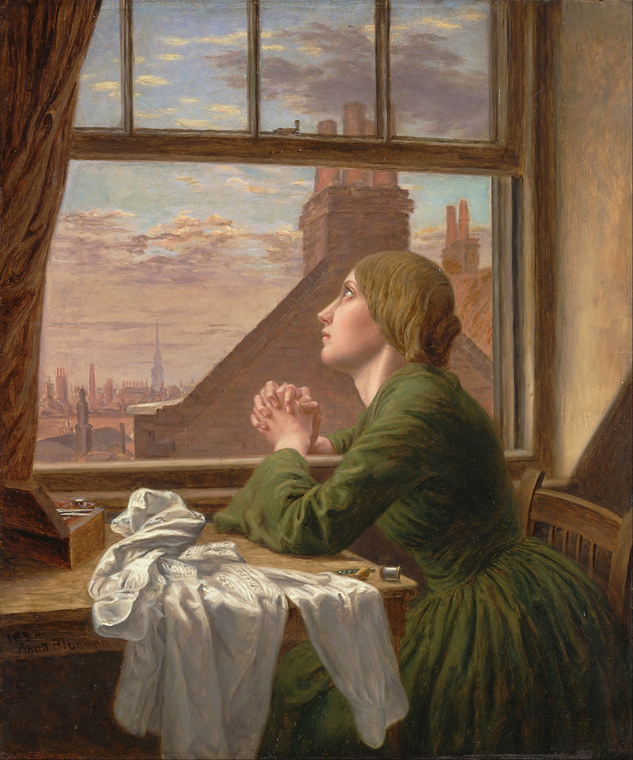
For Only One Short Hour –
The Seamstress
Anna Blunden
Yale Center for British Art

Slide 8
You are indeed my rock and my fortress; for your name's sake lead me and guide me,
Psalm 31:3

Slide 9
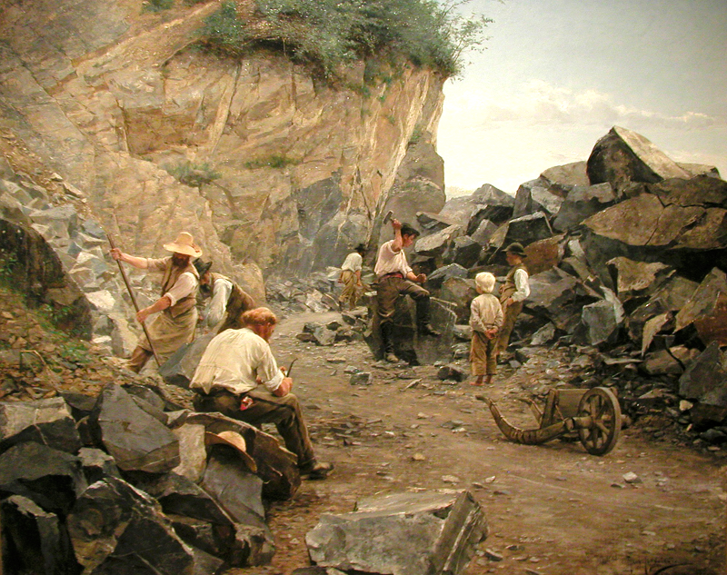
In the Quarry -- Axel Jungstedt, Nationalmuseum, Stockholm, Sweden

Slide 10
…they are now justified by his grace as a gift.
Romans 3:24a

Slide 11
“and grace came down…”
Grace Building, New York, NY

Slide 12
The rain fell, the floods came, and the winds blew and beat on that house, but it did not fall, because it had been founded on rock.
Matthew 7:25

Slide 13
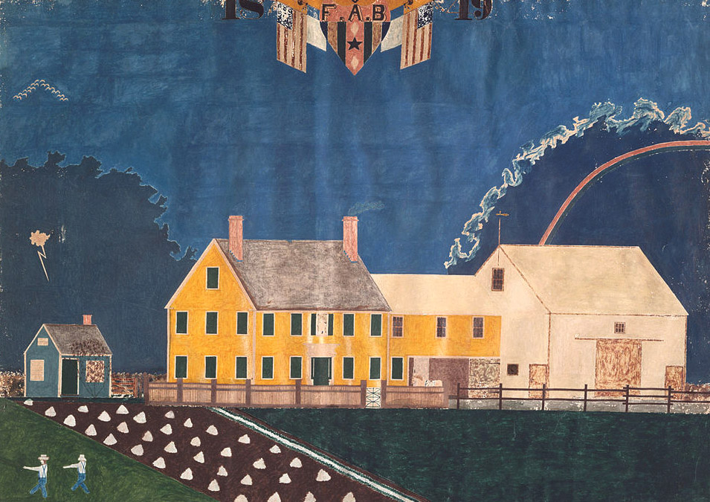
Farmstead in a Passing Storm -- unidentified artist, Museum of Fine Arts, Boston

Slide 14
Credits
New Revised Standard Version Bible, copyright 1989, Division of Christian Education of the National Council of the Churches of Christ in the United States of America. Used by permission. All rights reserved.
Cara Hochhalter - The artist has granted permission for the non-commercial use of this image with attribution. The artist must be contacted for other uses.
http://commons.wikimedia.org/wiki/File:Thomas_Waterman_Wood_-_Sunday_Morning_-_Google_Art_Project.jpg
https://commons.wikimedia.org/wiki/File:Anna_Blunden_-_%22For_Only_One_Short_Hour%22_-_Google_Art_Project.jpg
http://commons.wikimedia.org/wiki/File:Axel_Jungstedt.-_I_stenbrottet..jpg
http://www.flickr.com/photos/sarowen/2626992252/
https://commons.wikimedia.org/wiki/File:Unidentified_artist_-_Farmstead_in_Passing_Storm_-_Google_Art_Project.jpg
Additional descriptions can be found at the Art in the Christian Tradition image library, a service of the Vanderbilt Divinity Library, http://diglib.library.vanderbilt.edu/. All images available via Creative Commons 3.0 License.

